Slide 1
Image Processing Studio
Diagnose, fix and verify: making real-world images fit for analysis
Image & Video Processing (702EX0E020) | Mini Project
Team Members
E221 Chinmay Soni
E226 Atharva Khandelwal
E272 Akshat Katiyar
Notes:
Presenter: Chinmay Soni
Introduce the team. One line: most vision projects ask what is in an image; we built the system that first checks whether the image is fit to be analysed, fixes only what is wrong, and proves the fix helped.

Slide 2
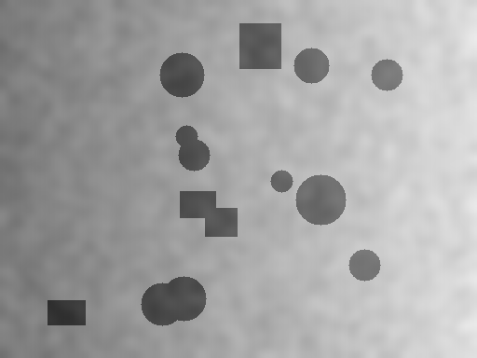

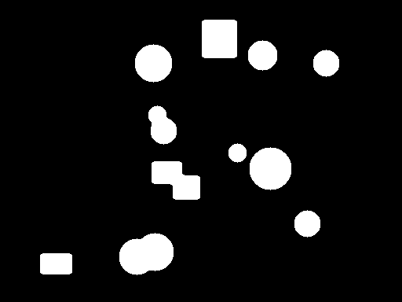
Classical Image Processing Fails Silently
Same Otsu threshold, same settings: one input works, the other fails, and nothing warns you.
Input: uneven lighting
Otsu directly: wrong, no warning
Fix lighting first: correct
Noise breaks operators
Lighting breaks Otsu
Nobody verifies
Specks riddle masks with holes; edge detectors fire on grain
One global threshold splits light from shade, not object from background
Fixes are trial and error: which defect, which fix, did it help?
Notes:
Presenter: Chinmay Soni
Left: the input has a lighting ramp. Middle: Otsu run directly separates the bright half from the dark half, a completely wrong mask, yet the algorithm reports no error. Right: after flattening the background, every object is found. Separability eta rises from 0.70 to 0.97. Then the three cards: noise, lighting and the fact that nobody measures whether a fix helped. Real photos (field, phone, scans, screenshots) have exactly these defects.

Slide 3
Where We Fit
Other vision projects ask what is in the image. We ask whether the image is fit to analyse, and make it fit.
Raw photo
Our system
Classifier
Decision
field · phone · scan
diagnose · fix · verify
disease, currency, …
more reliable
OBJECTIVES
Diagnose every image
Measure noise, specks, exposure, contrast and lighting
Fix only what is needed
Calibrated rules, safe order, every step explained
1
2
Prove it with numbers
Same operation run directly and after fixing, then scored
Compare compression fairly
DCT vs Hadamard vs JPEG-style at equal quality
3
4
Notes:
Presenter: Chinmay Soni
Disease detection or currency detection models are trained and tested on images. If the photo is dark, noisy or unevenly lit, the model inherits that problem. Our system sits before the model: it measures the defects, fixes only those, and shows the evidence. It is complementary to those projects, not a replacement. Then read the four objectives.

Slide 4
Our Approach in Four Steps
Diagnose → Prescribe → Apply → Verify: one loop behind every feature, and the order of this talk.
Diagnose
Prescribe
Apply
Verify
10 measurements: noise σ, specks, exposure, contrast, lighting, Otsu η
Calibrated rules choose the fix and its parameter, in a safe order
Enhance, denoise, find edges, segment or compress
Run directly and after fixing; numbers decide the verdict
SYSTEM
React UI
FastAPI
ivp_pipeline
Vercel
Tools · Auto Fix · Compare
JSON + previews
OpenCV + own NumPy
public web app
Notes:
Presenter: Chinmay Soni
Explain the loop with the uneven-lighting example: Diagnose finds U = 0.33; Prescribe picks flattening; Apply runs Otsu; Verify compares with the direct run and gives the verdict. Then the system row: React dashboard, FastAPI, our pipeline (OpenCV plus our own NumPy version of every algorithm, tested to give the same results), deployed on Vercel. Hand over to Atharva.

Slide 5
Key Contributions
What we designed and measured, beyond calling library functions.
Contribution | Evidence
Image Health: 10 measurements with thresholds calibrated on data | 391 labelled images, recall 100 %
Auto Fix: rule-based prescription, re-diagnosed after every step | Explains each step and its reason
Guided vs Direct: every result checked against a baseline | Otsu η 0.70 → 0.97; false edges 6.7 % → 0.11 %
Found and fixed a failure: noise in screenshots | Caught 0 / 170 before → 170 / 170 after
Compression compared at equal quality, not equal settings | JPEG-style 6.3× smaller than DCT
Every algorithm also written from scratch in NumPy | Tested equal to OpenCV; 294 + 60 automated tests
Notes:
Presenter: Chinmay Soni
This is the slide that answers 'what is new here'. Each row is something we designed, with the number that proves it. The next slides explain how each one works.

Slide 6
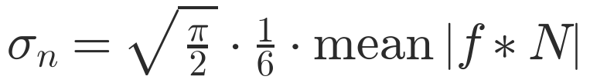
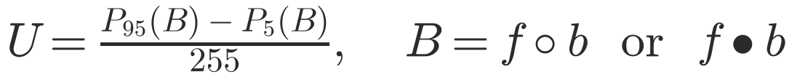
Diagnose: Image Health
Ten measurements, each compared with a calibrated threshold.
Measurement | Finding when | Fix
Mean brightness | < 0.30 / > 0.70 | Auto gamma
Range P1–P99 | < 100 levels | Stretch
Noise σ (Immerkær) | > 5 (warn > 8) | Gaussian
Salt & pepper ρ | > 0.75 % | Median
Lighting U | > 0.15 | Flatten
Otsu η | < 0.70 | info
Clipped pixels | > 5 % | cannot fix
Enlarged noise (½ scale) | ρ½ > 2.3 % · σ½ > 3.5 σ | 5×5 median / σ 1.5
Noise σ (Immerkær)
1 -2 1
-2 4 -2
1 -2 1
Salt & pepper density
Share of pixels with f ≤ 5 or f ≥ 250
AND |f − median3×3(f)| > 50
Lighting unevenness
Notes:
Presenter: Atharva Khandelwal
Explain the table row by row. For noise, the Immerkaer mask is zero on flat and sloped areas, so only noise remains. For specks, a pixel must be extreme AND differ from its 3x3 median by more than 50. Thresholds were tested on 391 labelled images (backup slide).

Slide 7
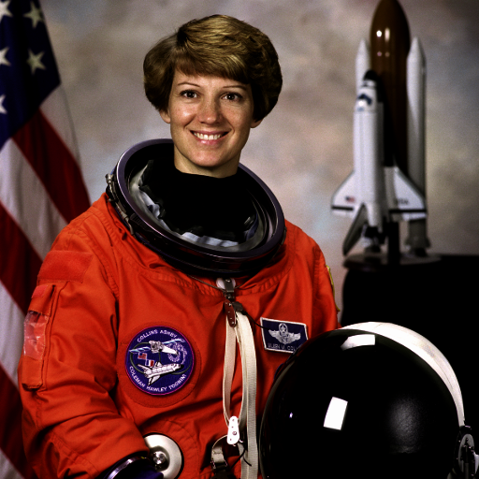
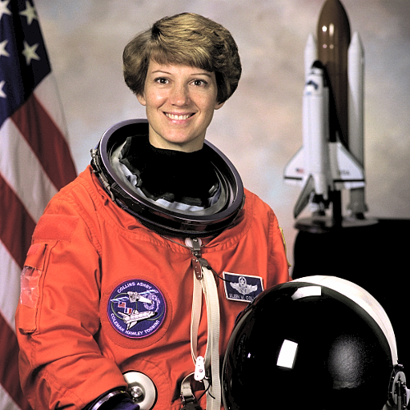

Prescribe: Auto Fix
Five rules in a fixed order; the image is diagnosed again after every fix.
1
Specks?
ρ > 0.75 % → median 3×3 (5×5 if heavy)
2
Grain?
σ > 8 → Gaussian σ 1.0; 5–8 → σ 0.6
Before
Auto Fixed
3
Exposure?
mean < 0.30 or > 0.70 → auto gamma
Auto gamma
4
Flat?
P1–P99 < 100 → contrast stretch
Chosen so the mean moves to mid-grey: here γ = 0.52, mean 0.27 → 0.42
5
Sharpen?
only if no noise at any scale → unsharp k 0.6
Notes:
Presenter: Atharva Khandelwal
Order matters: specks before grain (specks inflate sigma), noise before brightness, sharpening last and never when noise was found. Example: the dark astronaut gets gamma (mean 0.27 -> 0.42) and a mild sharpen.

Slide 8
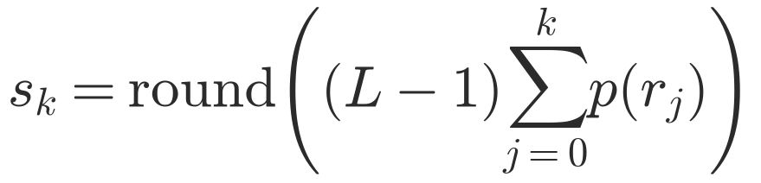

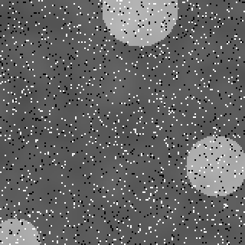
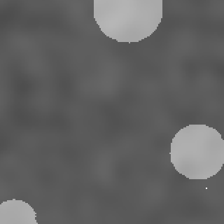
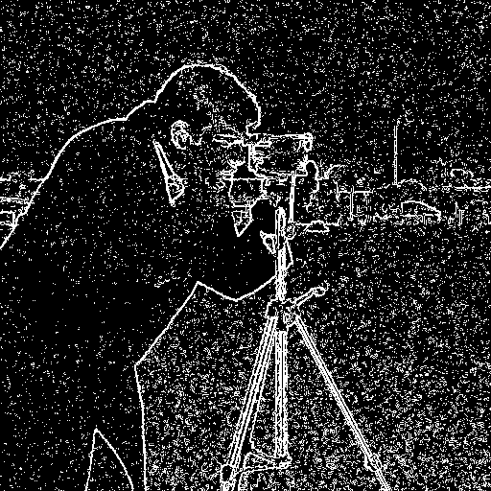
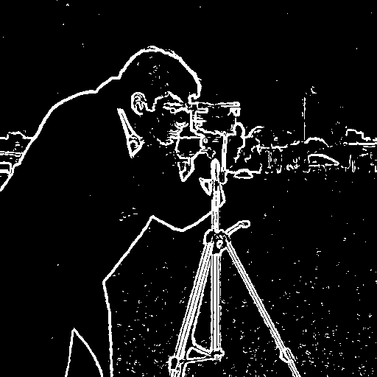
Apply: Enhancement, Noise & Edges
Point operations change brightness, neighbourhood filters remove noise, gradients find edges.
Histogram equalisation
Unsharp masking
SOBEL MASKS GX AND GY
-1 0 1 -1 -2 -1
-2 0 2 0 0 0
-1 0 1 1 2 1
On brightness Y only, so colours never shift
Add back k × (image − blur)
Salt & pepper
3×3 median
Sobel directly: 6.7 % false
Smooth first: 0.11 % false
Notes:
Presenter: Atharva Khandelwal
Median vs mean on the window 12,10,255,11,13,9,0,12,11: sorted, the middle value is 11, the mean is 37, so the median removes specks while averaging smears them. Edges: Sobel's 1-2-1 weights smooth across the edge; on a noisy image it still fires on grain (6.7 % false edges), after smoothing first only 0.11 %.

Slide 9
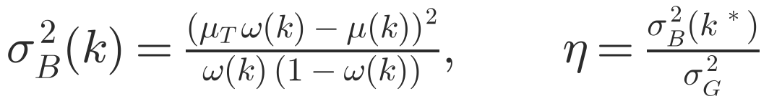

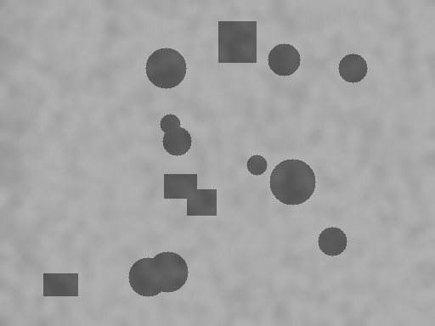
Apply: Otsu & Morphology
Choose the threshold that best separates two classes; morphology removes the lighting first.
Otsu threshold and separability
Background flattening (top-hat)
Mask clean-up
Opening removes specks, closing fills holes
Disk radius 3; opening first
B = opening / closing with disk R = max(H, W)/10
Input
Flattened
Mask: η 0.70 → 0.97
Notes:
Presenter: Atharva Khandelwal
Otsu tries every threshold k and keeps the one with the largest between-class variance. Eta says how separable the histogram is. Flattening: a big disk opening/closing erases the objects, leaving the background B, which is subtracted.

Slide 10
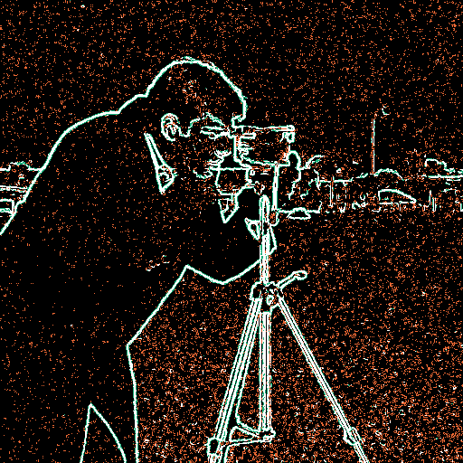

Verify: Guided vs Direct
Run the same operation twice and let the numbers decide.
GUIDED BRANCH: PREREQUISITE CHAIN
Specks?
Grain?
Lighting?
Operate
median
Gaussian
flatten
Otsu / edges
Fix that ran | Measured by | Guided wins if
Median / Gaussian (segment) | Fragmentation = islands + holes | lower
Flattening (segment) | Otsu separability η | η rises by ≥ 0.02
Median / Gaussian (edges) | False-edge density in flat regions | lower
Verdict shown to the user
Fixing first clearly helps
Partly better
Did not help here
Image is ready (no fix needed)
Difference maps: orange = only direct, green = only guided
Notes:
Presenter: Atharva Khandelwal
The guided branch applies only the fixes the diagnosis asks for, then runs the SAME operation with the SAME settings. One measurement per fix decides the verdict. The difference maps show where the two routes disagree: orange = only direct (false edges, wrong regions), green = only guided. Hand over to Akshat.

Slide 11
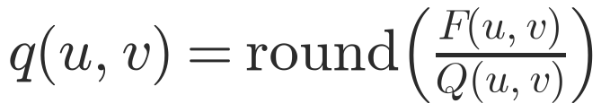

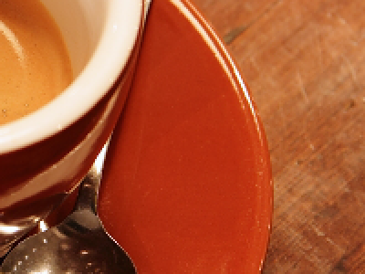



Compression: Same Quality, 6.3× Smaller File
Keeping fewer coefficients does not shrink a file; quantisation does.
JPEG-STYLE PIPELINE
YCbCr 4:2:0
8×8 DCT
Quantise
Entropy code
Quality 1–100 scales the IJG tables Q
Orthonormal: inverse = transpose, energy preserved
Original
DCT 10 %: 30.0 dB · 148 KB
Hadamard 10 %: 27.7 dB · 166 KB
JPEG q41: 30.0 dB · 24 KB
Quantisation + entropy coding is what really compresses.
Notes:
Presenter: Akshat Katiyar
DCT and Walsh-Hadamard keep the same 10 % of coefficients: DCT wins because smooth cosines fit natural images better. But both still store a full image. JPEG-style divides each 8x8 block's DCT coefficients by a step Q and rounds, so most become 0: at the same quality (q41) the file is 6.3x smaller. Comparing at equal quality is what makes this fair.

Slide 12
Results: Fixing First Wins
Benchmark on images with known ground truth: wherever a defect exists, the guided route wins.
0.14 → 0.99
IoU, segmentation with a lighting ramp
0.51 → 0.91
edge F1 with 5 % salt & pepper
6.3×
smaller file than DCT at equal quality
Notes:
Presenter: Akshat Katiyar
Segmentation uses IoU against the exact mask of synthetic scenes; edges use edge F1 with 1-pixel tolerance. At 20 % salt & pepper direct Otsu collapses to 0.26; guided stays at 0.97. With a lighting ramp direct Otsu gets 0.14, guided 0.99.

Slide 13
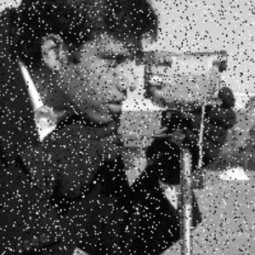
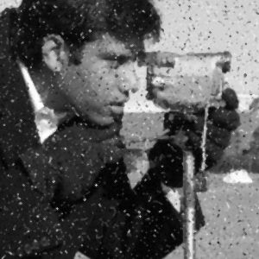

Case Study: Noise in Screenshots
A real failure we found in testing, measured and fixed.
1
Observed
2
Hypothesis
3
Experiment
4
Fix
Screenshot of a noisy image: Image Health said “no issues”
Enlarging smears noise over 2–3 px; at half scale it is pixel-sized again
204 screenshot-like images: saved as JPEG, shown 1.5× / 2× larger
Half-scale tests added; enlarged specks get a 5×5 median
0 → 170 / 170
noisy screenshots detected, before → after
Enlarged specks
3×3 median: specks remain
5×5 median: removed
Notes:
Presenter: Akshat Katiyar
Tell it as a story. We took a screenshot of a noisy image from Google; Image Health said 'no issues'. Why? The browser enlarges the image, so each speck becomes a 2-3 pixel grey blob and grain becomes smooth between neighbouring pixels; our pixel-scale tests were blind to it. Hypothesis: at half scale the noise is pixel-sized again. We built 204 screenshot-like test images: the old rules caught 0 of 170 noisy ones, the new half-scale rules catch all 170, with one false alarm each. Enlarged specks also need a 5x5 median instead of 3x3.

Slide 14
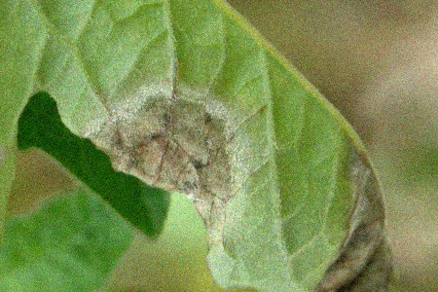

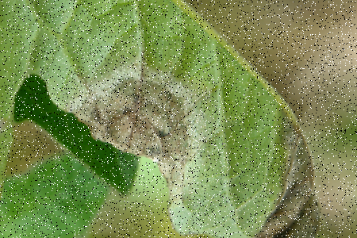

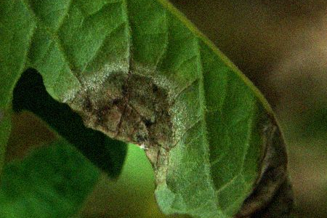
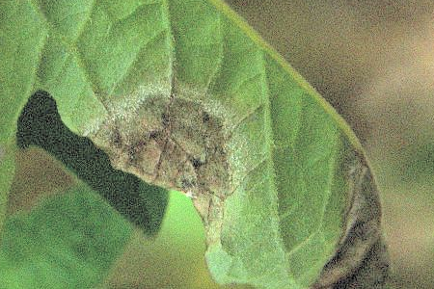
Application: Making Field Photos ML-Ready
A real tomato leaf with late blight, under three field conditions: diagnosed, fixed and scored.
FIELD CONDITION (SIMULATED)
AUTO FIXED
FOUND → FIX APPLIED
SSIM VS CLEAN
MASK IOU VS CLEAN
Low light: sensor grain
Noise σ 10.7 → Gaussian σ 1.0
0.46 → 0.86
0.65 → 0.93
Dust / dead pixels: 8 % specks
Specks 7.9 % → 3×3 median
0.14 → 0.96
0.55 → 0.96
Shade: dark + noise
Mean 0.21 → auto gamma
0.38 → 0.38
0.43 → 0.73
Limitation found: brightening the shaded photo reveals noise hidden in the shadows; Auto Fix does not yet denoise after brightening (next step).
Photo: “Tomato late blight leaf sporulating lesions 1”, Scot Nelson, CC0, Wikimedia Commons. Degradations simulated so the clean original can score each result.
Notes:
Presenter: Akshat Katiyar
This is the link to disease-detection projects. The photo is a real CC0 photo of late blight. We simulated three conditions a farmer's phone photo suffers, so the clean original can score the result. SSIM measures how close the image is to the clean photo; mask IoU measures whether a downstream step (Otsu segmentation) gives the same answer as on the clean photo. Grain and dust: the system finds the right defect and nearly restores the photo. Shade: brightening recovers the segmentation, but noise hidden in the shadows becomes visible and is not removed yet; we found this limitation with this experiment and it is our next fix. We do not claim a classifier accuracy number, because we did not train one.

Slide 15
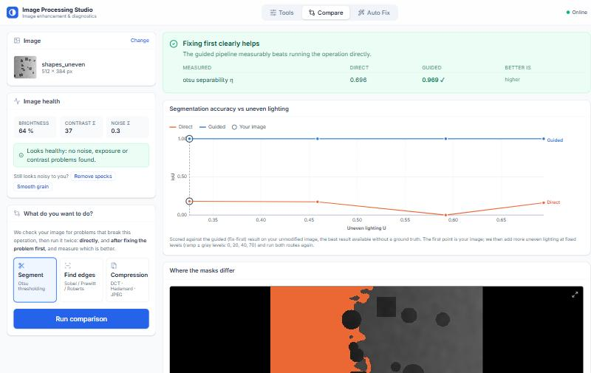
Live Demo: The Dashboard
Tools · Auto Fix · Compare (Segment, Find edges, Compression).
Compare → Segment on the uneven-lighting sample: verdict, accuracy chart and difference map
Notes:
Presenter: Akshat Katiyar
Switch to the live app. Best: ask the evaluator for any image (or use a phone photo), show the Image Health findings, run Auto Fix, then Compare -> Segment to show the verdict and the difference map. Keep the slide as a fallback if the network fails.

Slide 16
Conclusion, Applications & Future Scope
A transparent pre-processing step that tells you what is wrong with an image, fixes it and proves it.
No training data, every decision explained with a formula, runs on an ordinary CPU: a step that makes images fit for analysis, and the evidence that it did.
Where it applies
Next steps
ML dataset quality check
Plant / leaf disease photos
Re-check noise after brightening (leaf case study)
Measure classifier accuracy before / after with a disease model
Direct-to-storage uploads for photos over 4.5 MB
CLAHE, bilateral denoising, adaptive thresholds
Document scanning
Microscopy & cell counting
Industrial inspection
Screenshot & forwarded images
GitHub: github.com/AkshatKatiyar081/IVP_2026
Live app: [paste Vercel link]
Notes:
Presenter: Akshat Katiyar
Read the takeaway. Mention two or three applications, then the next steps, then invite questions. Backup slides (hidden) follow for questions about masks, JPEG tables, metrics, calibration and references.

Slide 17
Backup: All Filter Masks
Every mask used, applied as correlation (no flip), like OpenCV.
SMOOTHING / LAPLACIAN
SHARPEN / NOISE
Box 3×3 (×1/9) Laplacian (4-nbr)
1 1 1 0 1 0
1 1 1 1 -4 1
1 1 1 0 1 0
High-boost (A) Immerkær N
-1 -1 -1 1 -2 1
-1 A+8 -1 -2 4 -2
-1 -1 -1 1 -2 1
Conventions
Borders: reflect-101 for linear filters, replicate for the median
Gaussian: K = 2⌈3σ⌉ + 1, separable (rows then columns)
Morphology: disk structuring element, erosion pads 255, dilation pads 0
High-boost: A = 1 sharpen, A = 0 edges only, A > 1 also brightens
Notes:
Presenter: Akshat Katiyar
Backup slide: show only if asked.

Slide 18
Backup: JPEG Quantisation
Quality scales the standard Annex K tables; rounding is the only lossy step.
LUMINANCE TABLE, QUALITY 50
Quality scaling
16 11 10 16 24 40 51 61
12 12 14 19 26 58 60 55
14 13 16 24 40 57 69 56
14 17 22 29 51 87 80 62
18 22 37 56 68 109 103 77
24 35 55 64 81 104 113 92
49 64 78 87 103 121 120 101
72 92 95 98 112 100 103 99
S = 5000 / q (q < 50)
S = 200 − 2q (q ≥ 50)
Q = ⌊(Q₅₀ · S + 50) / 100⌋, clipped to 1…255
q 75 → first row 8 6 5 8 12 20 26 31
q 90 → 3 2 2 3 5 8 10 12
q 20 → 40 28 25 40 60 100 128 153
Worked example
DC F = −415, Q = 16 → q = round(−25.9) = −26 → F′ = −416 (error 1)
Fine detail F = 5, Q = 99 → q = 0: dropped, costs almost nothing in the file
Notes:
Presenter: Akshat Katiyar
Backup slide: worked example F = -415, Q = 16 gives q = -26; F = 5, Q = 99 gives 0.

Slide 19
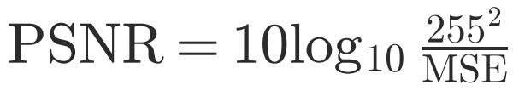
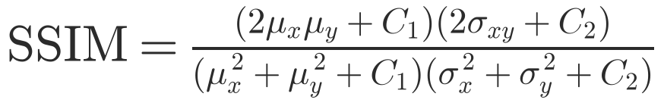
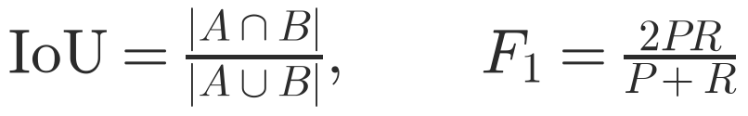
Backup: Quality Metrics
How every result in the project is scored.
PSNR
Pixel error in dB; > 40 dB invisible, < 25 dB clearly degraded
SSIM
Local brightness, contrast and structure in 7×7 windows; 1 = identical
IoU and edge F1
Masks overlap / edges matched within 1 pixel (BSDS-style)
Notes:
Presenter: Akshat Katiyar
Backup slide.

Slide 20
Backup: Threshold Calibration
Thresholds tested on labelled images, not guessed.
Rule | Images | Precision | Recall | F1
Noise σ > 5 | normal (119) | 0.944 | 1.000 | 0.971
Salt & pepper > 0.75 % | normal (187) | 0.986 | 1.000 | 0.993
Lighting U > 0.15 | normal (187) | 0.370 | 1.000 | 0.540
Grain, any scale | screenshots (102) | 0.986 | 1.000 | 0.993
Specks, any scale | screenshots (204) | 0.990 | 1.000 | 0.995
Why lighting U is kept low
Its best-F1 value is 0.25, but a false alarm only costs an extra guided run that reports “did not help”, while a miss would hide the biggest improvement (IoU 0.14 → 0.99). So recall is kept at 100 %.
Notes:
Presenter: Akshat Katiyar
Backup slide: 187 labelled images, plus 204 screenshot-like images for the half-scale rules.

Slide 21
Backup: References
Sources behind the algorithms and the case-study photo.
Gonzalez, R. C., Woods, R. E. Digital Image Processing, 4th ed. Pearson, 2018.
Otsu, N. A threshold selection method from gray-level histograms. IEEE Trans. SMC, 9(1), 62–66, 1979.
Immerkær, J. Fast noise variance estimation. Computer Vision and Image Understanding, 64(2), 300–302, 1996.
Wallace, G. K. The JPEG still picture compression standard. IEEE Trans. Consumer Electronics, 38(1), 1992.
Wang, Z. et al. Image quality assessment: from error visibility to structural similarity. IEEE TIP, 13(4), 2004.
Nelson, S. Tomato late blight leaf sporulating lesions 1. Wikimedia Commons, CC0 (case-study photo).
Notes:
Presenter: Akshat Katiyar
Backup slide.

