Slide 1
Music, Mind and Technology: Project—Lyrics and Personality
Team Opus
Chinmay Deshpande (2020102069)
Atharva Gogate (2020112001)
Amal Sunny (2021121011)

Slide 2

Personality: “the enduring characteristics and behaviour that comprise a person’s unique adjustment to life”.
Musical taste: “the overall patterning of an individual’s preferences for music over “longer” time periods”.
Can one explain the other?
Problem Definition
Notes:
BFI, preference for acoustic and psychological features, lyrics extraction: correlations between each other

Slide 3
Data Collection
Data collection was done through a form consisting of questions on the user’s musical preference, acoustic and psychological preferences, and personality traits.
5 liked, 5 disliked songs–a more well-rounded perspective on the link between music preference and personality.

Slide 4
Data Collection (Continued)
Acoustic features: 14 questions (loud, percussive, synthesiser, etc.)
Psychological features: 7 questions (aggressive, relaxing, romantic, etc.)
Big Five Inventory (BFI): 20-question version–scores for Openness, Conscientiousness, Neuroticism, Agreeableness, Extraversion are obtained.

Slide 5
Feature Reduction

Slide 6
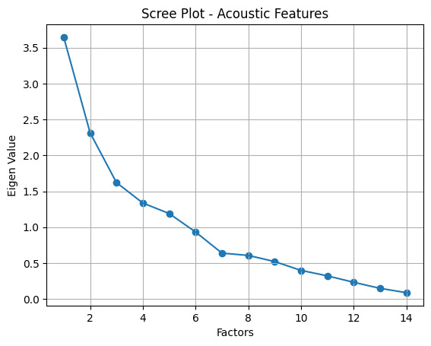
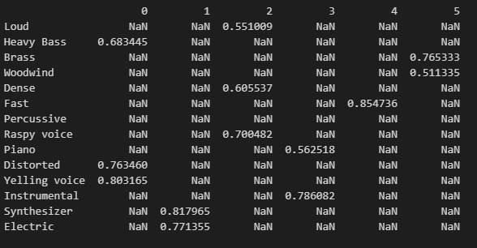
Acoustic Attributes
Scree plot: Number of features
6 factors selected
Loadings per factor are shown (>0.5)

Slide 7
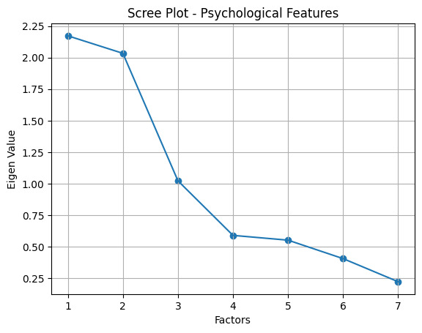
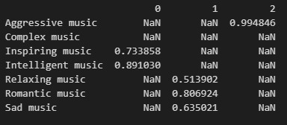
Psychological Attributes
3 factors selected

Slide 8
Big Five Inventory, Acoustic and Psychological

Slide 9
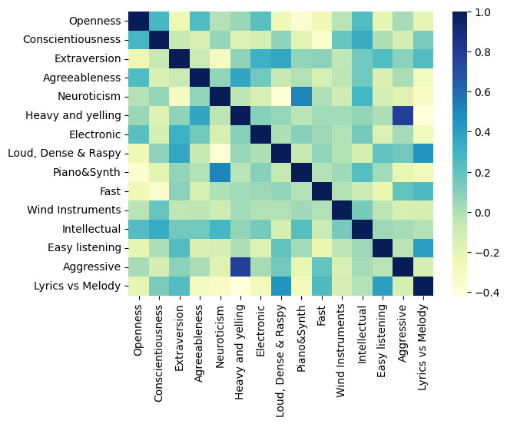
Correlation Matrix

Slide 10
Significant Correlations
Positive Correlations:
Heavy & Yelling vs Agreeableness: 0.37*
Piano & Synth vs Neuroticism: 0.51**
Aggressive vs Heavy & Yelling: 0.77**
Lyrics Melody vs Loud, Dense, Raspy: 0.44* (Lyrics)
Lyrics Melody vs Easy Listening: 0.4* (Lyrics)
Negative Correlations:
Loud, Dense, Raspy vs Neuroticism: -0.39*
Piano & Synth vs Openness : -0.36*
Lyrics Melody vs Heavy & Yelling: -0.42* (Melody)

Slide 11
LIWC and Psychological Features

Slide 12
Lyrics and Personality - Any Link?
We can gauge people’s responses to music by obtaining data regarding the likes and dislikes of people in terms of songs.
By examining recurrent themes in a subject’s likes or dislikes, we can obtain a generalized correlation between their musical preference and their personality traits.

Slide 13
Chosen Approach
LIWC is used to obtain lyrical features of the songs. The name and LIWC features of each song are stored in a lookup table.
Likes and dislikes for each user are stored separately, with 5 songs per user.
Feature-wise average of the data rows is calculated–gives a single vector that is taken to be the representation of the user’s likes or dislikes.
We can use this setup for various correlations, as will be shown in subsequent slides.

Slide 14
Correlations Drawn
Pearson correlation: word frequencies from LIWC vs BFI scores of all users.
We did this separately for liked and disliked songs, as we felt it would give us a better picture of how lyrical features influence likes and dislikes.
We also drew partial correlations for statistically related values in lyrical features and personality, with acoustic and psychological features as the covariates.

Slide 15
Observed Correlations
For liked songs, agreeableness appeared to be linked with moralization in the lyrics. Correlation coefficient: 0.47.
For disliked songs, conscientiousness appeared to be linked to self-referential words (I-words) and authenticity of lyrics. The correlation coefficients are 0.41 and 0.41, respectively

Slide 16
Partial Correlations
Covariates: Acoustic features
Agreeableness, Moralization (liked) r = 0.477, p = 0.021
Conscientiousness, I-word (disliked) r = 0.476, p = 0.026
Conscientiousness, Authenticity (disliked) r = 0.419, p = 0.066
Covariates: Psychological features
Agreeableness, Moralization (liked) r = 0.522, p = 0.006
Conscientiousness, I-words (disliked) r = 0.516, p = 0.02
Conscientiousness, Authenticity (disliked) r = 0.445, p = 0.033

Slide 17
Difference Test

Slide 18
T-test (Liked and Disliked songs)
Measure | t-Statistic | p-value
I Words, (I, me, my) | 2.28 | 0.031*
Positive tone | 2.78 | 0.009**
Negative Tone | 2.37 | 0.025*
Social Words | 2.27 | 0.031*
Cognitive Processes | 7.90 | <0.001***
Allure | 6.02 | <0.001***
Moralization | 0.35 | 0.728
Analytical | 1.03 | 0.312
Authentic | 6.61 | <0.001***
Mean | 6.18 | <0.001***

Slide 19
Caveats
Our analysis results are not exactly consistent with the research paper results, since we used a different set of psychological features for music. Moreover, the LIWC output for the research paper has 42 word frequency categories, while we only had access to 8.
The sample size we had (n=30) is much smaller than what the original paper had (n=124) making it harder to get significant results as per the original paper.

Slide 20
Thank You

