Slide 1
Solution to Ciphense Summer Internship 2019 Coding Test
Submitted By:
Chinmay Ranjan Behera

Slide 2
Question #2 Write a program -- Take the map of India, and find all cities that has more than five lakhs population.

Slide 3
Solution:-
Approach:
Data Extraction: Collecting population of each city of India using web scraping
Data Analysis: Finding cities having population more than 5 lakhs

Slide 4
Data Extraction
Url: https://en.wikipedia.org/wiki/List_of_cities_in_India_by_population
Programming language: Python
Libraries used:
bs4
urllib
pandas

Slide 5
Steps:
A csv file named “census.csv” was created
A pandas data frame was created. Four attributes namely:
“ID”
“CITY”
“POPULATION”
“STATE”
were created.
Url was fetched and contents stored in “soup” variable using urllib and bs4 libraries.
Respective data were fetched from “soup” and stored in the “census.csv” file.

Slide 6
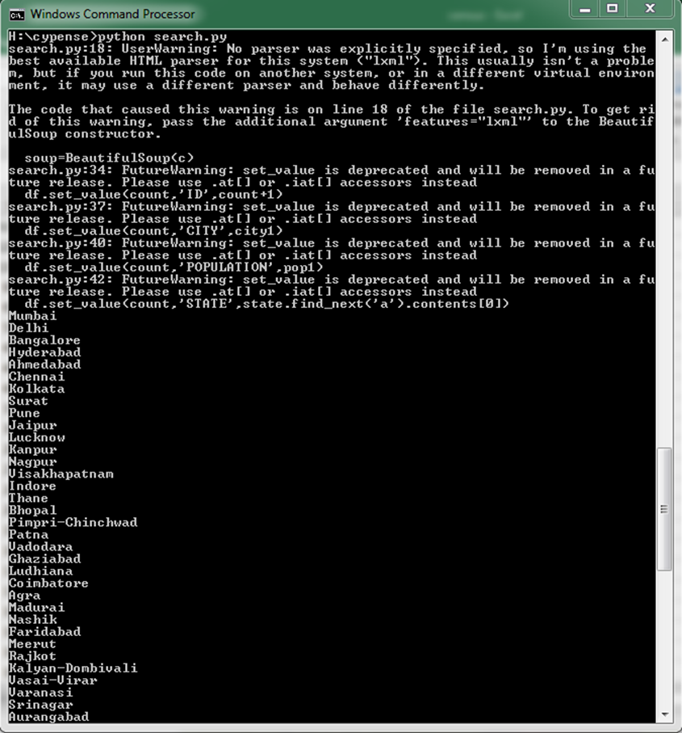
Data Analysis
Steps:
“census.csv” file was read.
Cities having population more than 500000 were stored in a list.
Fig1. Output

