Slide 1




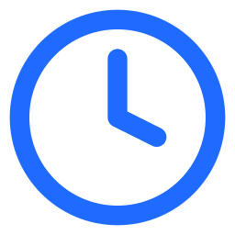
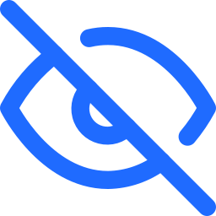
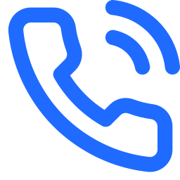

CATARACT CARE · INDIA
What DrishtiSaathi does
See your lens
before you choose it.
Talks with the patient
in Kannada, Hindi, Tamil or English
Turns their day into a lens plan
that the surgeon reviews and approves
A voice-first companion for cataract patients, plus a surgeon dashboard. Built for the ZEISS Hackathon, AI-Powered Digital Experiences.
Shows their own world
through each lens, before surgery
The gap today
Stays through recovery
drops, home eye test, red-flag alerts
A 10-minute choice
Can't picture it
Recovery overload
A lifelong lens picked from an English brochure
No way to see what each lens does to their day
Warning signs wait behind routine calls
Notes:
Imagine you're sixty-two, a tailor in Mysuru, and your doctor says you need cataract surgery. You have to choose a lens that stays in your eye for life, from an English brochure, in a ten-minute slot. Most people pick on price, and some regret it for years.
Three gaps: the choice is made without knowing how the patient lives; patients can't picture what each lens will do; and after surgery, clinics are flooded with routine calls while real warning signs wait.
DrishtiSaathi talks to the patient in their language, turns their day into a lens plan the surgeon approves, shows them their own world through each lens, and stays with them through recovery.

Slide 2
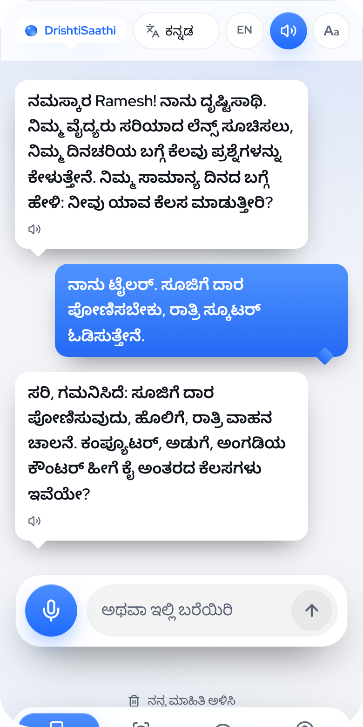
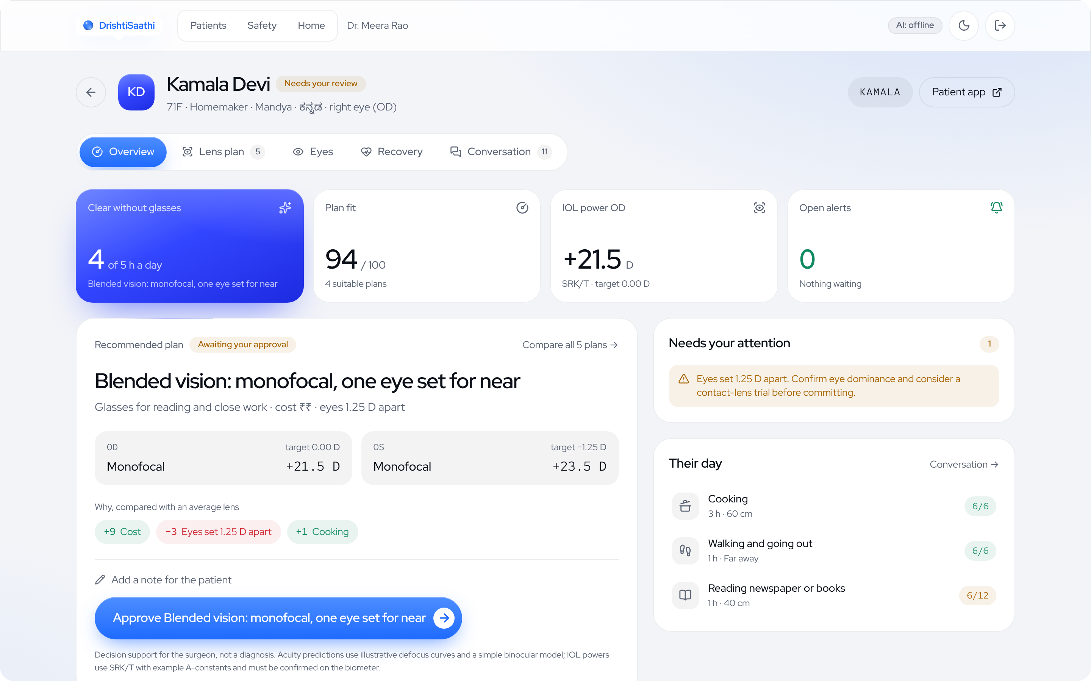
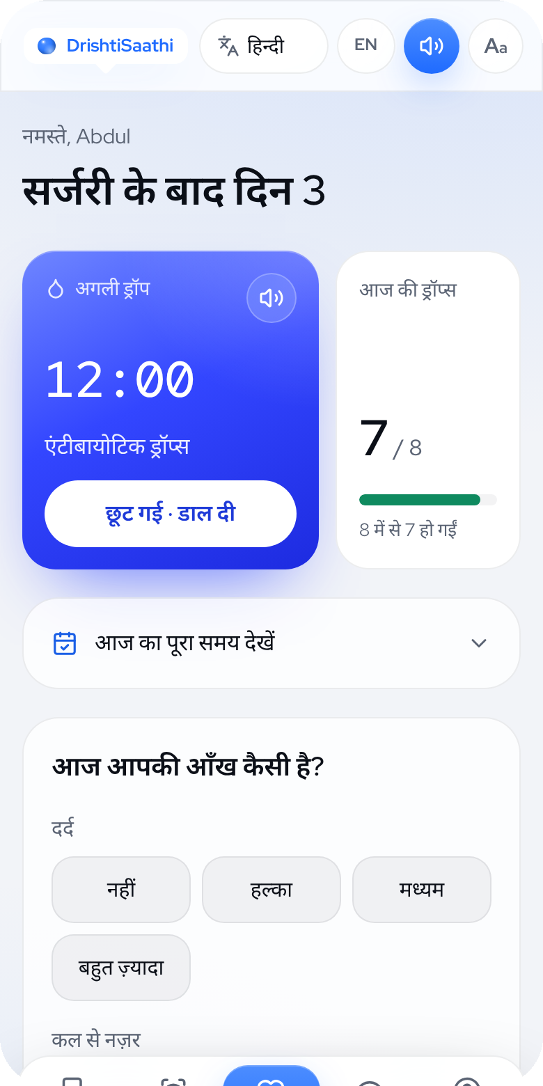




What works today
The full patient and surgeon journey runs end to end, in four languages
Patient talks, in Kannada
Surgeon sees the plan, the reasons, and approves
Recovery, in Hindi
Talk
Voice intake that skips what's already said
Match
Both-eye plans, lens powers, exact reasons
See
Own photo, depth measured on the phone
Recover
Drops, home eye test, alerts in seconds
Notes:
Ramesh, a tailor, tells the assistant in Kannada that he threads needles and rides his scooter at night. It understands both and skips the questions he's already answered; every answer becomes an activity with a distance and hours.
The surgeon sees a summary first. Kamala has macular disease and is cost-sensitive, so the trifocal is excluded and blended vision ranks first: one eye set slightly for near, reading vision at monofocal cost. Every score breaks down into exact reasons, with per-eye SRK/T lens powers. Nothing reaches the patient until the surgeon approves.
Patients photograph their own world and see it through each lens; the depth is measured on the phone and the photo never leaves it. After surgery: the next drop, a daily check-in, a calibrated home eye test, and red-flag alerts to the doctor.

Slide 3

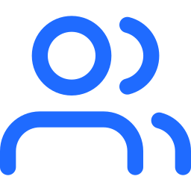

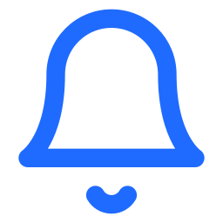
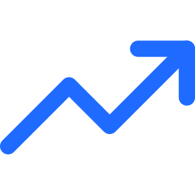

Measured, and what's next
We publish how well it works, and what still needs checking
97%
0%
Next, before the final round
Native-speaker and clinician review of every Kannada, Hindi and Tamil line
of emergencies caught on our first held-out test (85 messages)
false alarms on that same test
A fresh held-out safety set written by people outside our team
Drop reminders on WhatsApp
74
235
Clinic outcomes page: predicted vs. real vision after surgery
Runs offline, no AI key
Photos stay on the phone
automated tests, plus a browser test of the whole journey
labelled safety and Q&A cases in four languages
Surgeon approves every plan
Consent first, delete anytime
Notes:
Every patient message passes a red-flag check that works without AI, in four languages including romanised and mixed typing. On its first held-out test of 85 messages, written before tuning, it caught 97% of emergencies with no false alarms. The AI can raise an alert but never clear one.
At mid-point: the full journey works end to end, with 74 automated tests, a scorecard on 235 labelled cases and a browser test of the whole journey. It runs offline without any AI key.
Next: a native-speaker and clinician review of every Indic line and safety case, a fresh held-out set written outside our team, WhatsApp drop reminders, and an outcomes page comparing predicted and real vision.
Close: DrishtiSaathi, so every patient sees the choice clearly, before they see the world clearly again.

