Slide 1
ARCHIVUM
PDF Content Management System
CRUD app deployed on docker and kubernetes
Chinmay Ajmera

Slide 2
What Is Archivum?
A self-contained PDF library — upload, organise, search, and manage documents from a single browser tab. No external services, no cloud storage, no complexity.
Or use a separate storage to act as a centralized database of documents with option of multiple concurrent access.
Upload PDFs
Search & Filter
Full CRUD
Drag & drop or browse.
Metadata stored in SQLite.
Real-time search across
titles, tags, descriptions.
Create, read, update
and delete documents.

Slide 3
Tech Stack
FRONTEND
Single-file template served by FastAPI. Jinja2 rendering. No build step.
HTML + CSS + JavaScript
BACKEND
7 REST endpoints — upload, list, view, download, edit, delete, search.
FastAPI (Python 3.11)
DATABASE
Stores document metadata. Lives at /app/data/cms.db inside the container.
SQLite
FILES
PDFs stored at /app/uploads/ with UUID filenames. Seed files pre-loaded.
Local Filesystem

Slide 4
API Endpoints
POST
/documents
Upload a PDF with title, description & tags
GET
/documents
List all documents (supports ?search= query)
GET
/documents/{id}
Fetch metadata for a single document
GET
/documents/{id}/file
Stream / download the PDF file
PUT
/documents/{id}
Update title, description, or tags
DELETE
/documents/{id}
Delete document and remove file from disk

Slide 5
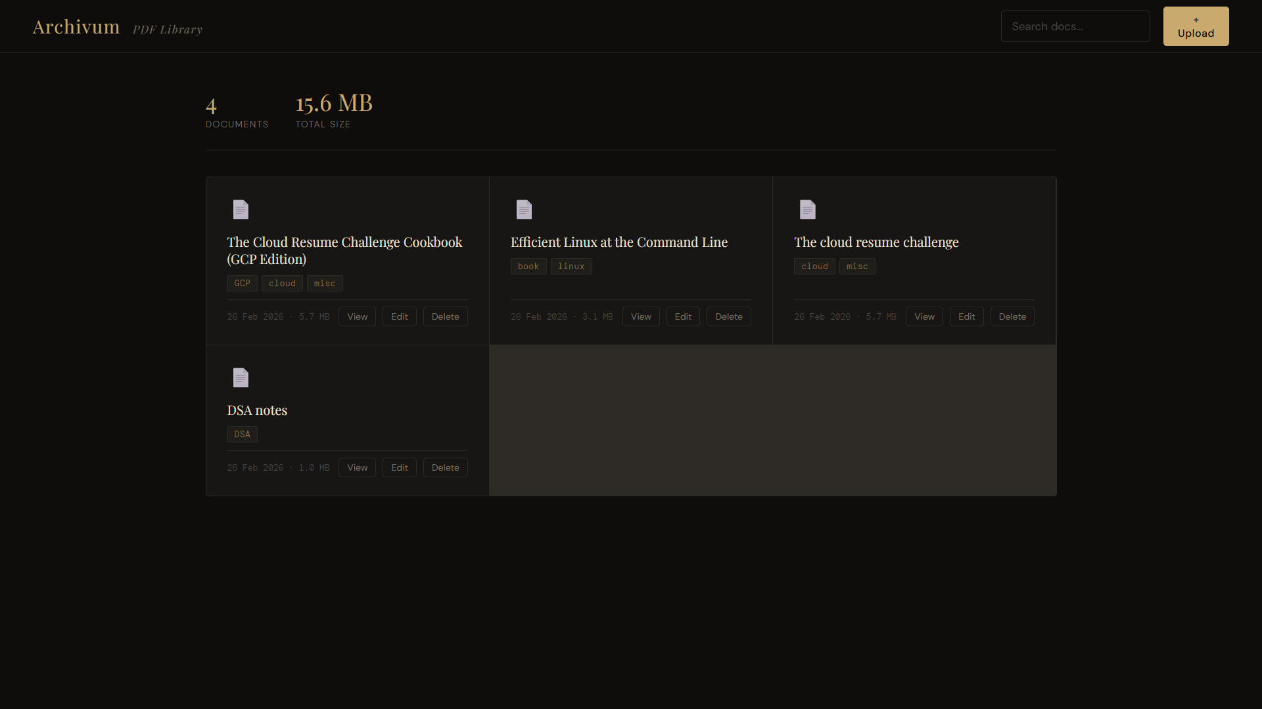
Home

Slide 6
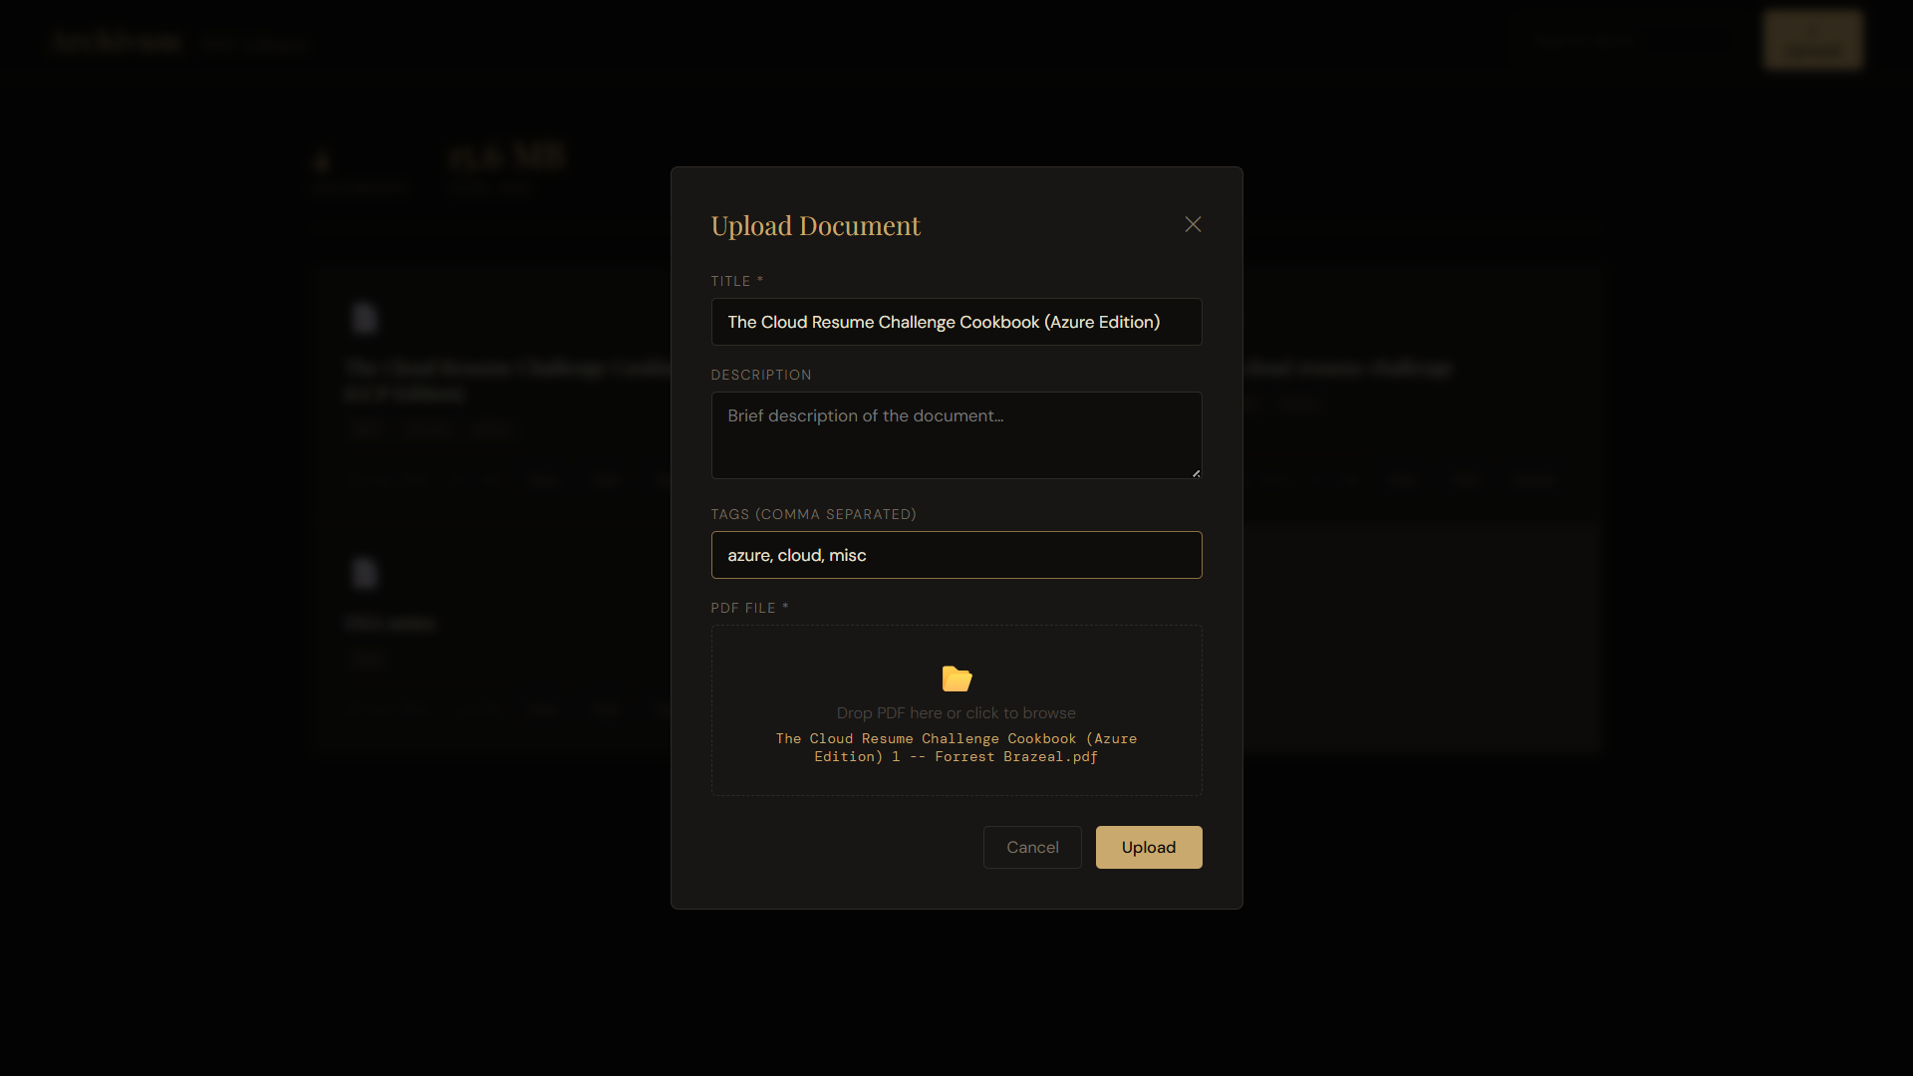
Upload

Slide 7
Docker — Single Container
Build & Run
BUILD IMAGE
docker build -t pdf-cms .
RUN CONTAINER
docker run -p 8000:8000 pdf-cms
OPEN BROWSER
http://localhost:8000

Slide 8
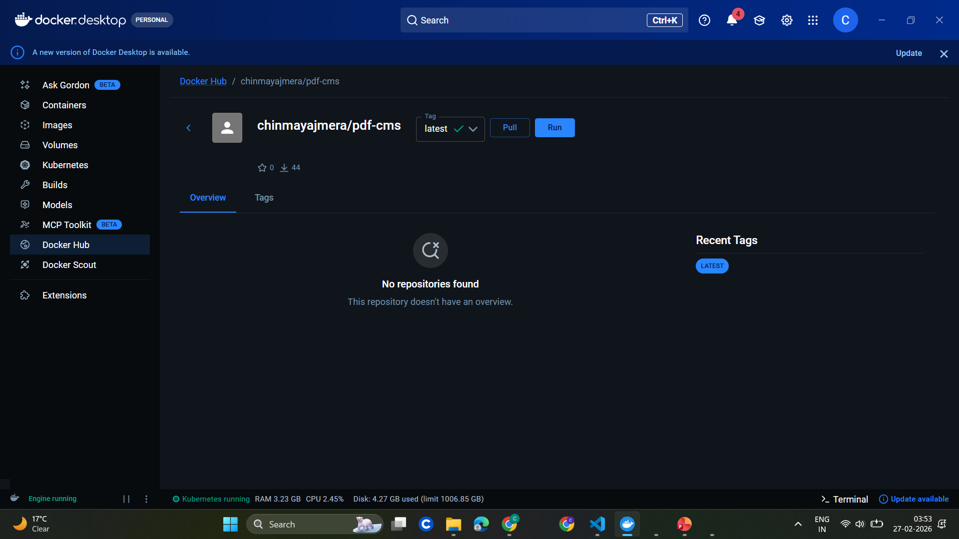
Docker Hub

Slide 9
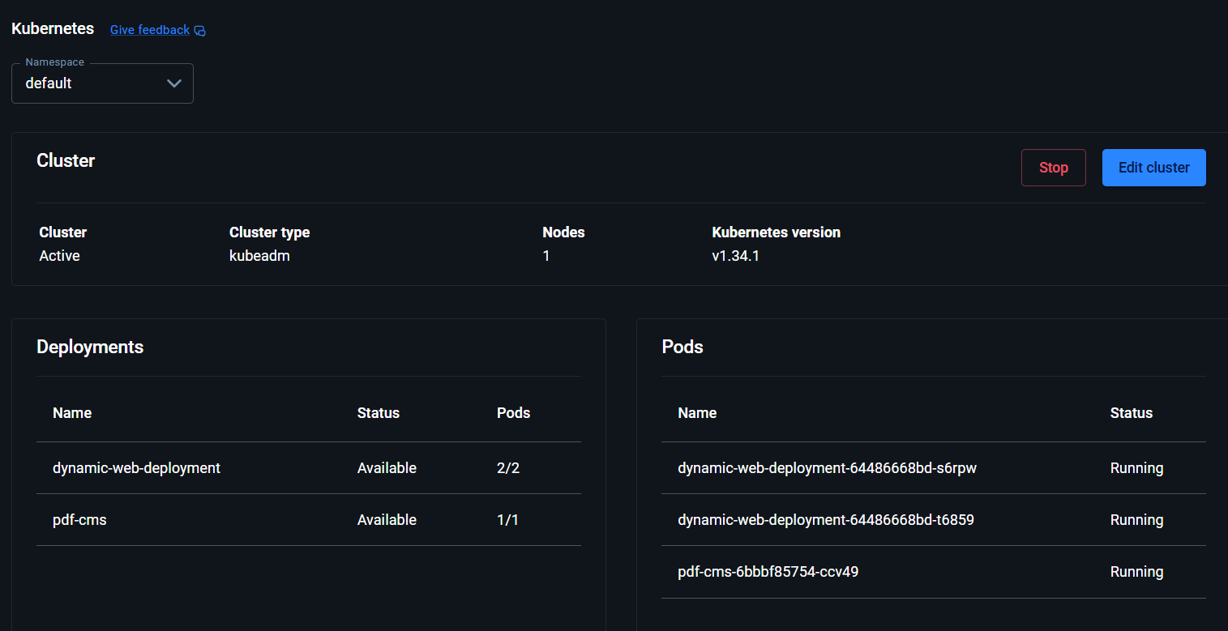
Kubernetes

Slide 10
Project Structure
main.py
pdf-cms/
├── app/
│ ├── main.py
│ ├── database.py
│ ├── seed.py
│ └── templates/
│ └── index.html
├── demo-files/
│ └── *.pdf
├── k8s/
│ ├── deployment.yaml
│ └── service.yaml
├── Dockerfile
├── entrypoint.sh
└── requirements.txt
All 7 FastAPI routes — the entire backend logic in one file.
database.py
SQLite connection + schema creation. Auto-runs on startup.
seed.py
Populates demo PDFs on first boot. Skips if data exists.
index.html
Complete frontend — JS, CSS, and HTML in one Jinja2 template.
entrypoint.sh
Runs seed.py then starts Uvicorn. Docker entry point.
Dockerfile
Builds the single image: code + deps + demo files + scripts.

Slide 11
Thank you
A complete, production-ready PDF CMS — in a single Docker container.
FastAPI
SQLite
Docker
K8s

