Slide 1
Big Data Architecture and Governance
Metadata Project

Slide 2
Group-1
Database Creation & Design

Slide 3
Database Design
Created database schema design in SQL Server to load Business and Technical metadata
Different tables created for Business metadata
Domain
DomainRelationship
DomainTermsRelationship
BusinessTerms
Different tables created for Technical metadata
TechnicalTerms
Bridge table to connect Business and Technical metadata
TechBusBridge

Slide 4
Database Schema Structure
DOMAIN
DomainRelationship
DomainTermsRelationship
BusinessTerms
TechnicalTerms
TechBusBridge

Slide 5
SQL Server code to create Database schema
Create Database Metadata;
CREATE TABLE BusinessTerms
(
BusTermId VARCHAR(15) NOT NULL,
Business_Term VARCHAR(55),
Term_Desciption VARCHAR(255),
CONSTRAINT PK_BusinessTerm_id PRIMARY KEY (BusTermId)
);
CREATE TABLE DomainRelationship
(
ParentId INT NOT NULL,
ChildId INT NOT NULL
);
Create table Domain
(
DomainId INT NOT NULL,
Description VARCHAR(55),
CONSTRAINT PK_domain_id PRIMARY KEY (DomainId)
);
CREATE TABLE TechBusBridge
(
Bridge_Id INT NOT NULL IDENTITY(1,1),
TechTermId VARCHAR(15) NOT NULL,
BusTermId VARCHAR(15) NOT NULL,
CONSTRAINT FK_TechTermId FOREIGN KEY(TechTermId) REFERENCES TechnicalTerms(TechTermId),
CONSTRAINT FK_BusTermId FOREIGN KEY(BusTermId) REFERENCES BusinessTerms(BusTermId),
);
CREATE TABLE DomainTermsRelationship
(
ChildId INT NOT NULL,
BusTermId VARCHAR(15) NOT NULL,
CONSTRAINT FK_DomainTermsRelationship_TermID FOREIGN KEY (BusTermId) REFERENCES BusinessTerms(BusTermId)
);
CREATE TABLE TechnicalTerms
(
TechTermId VARCHAR(15) NOT NULL,
Database_Name VARCHAR(55) NOT NULL,
Label VARCHAR(55) NOT NULL,
Property VARCHAR(55),
Type VARCHAR(55),
isIndexed VARCHAR(55),
uniqueConstraint VARCHAR(55),
existenceConstraint VARCHAR(55)
CONSTRAINT PK_TechTermId PRIMARY KEY (TechTermId)
);

Slide 6
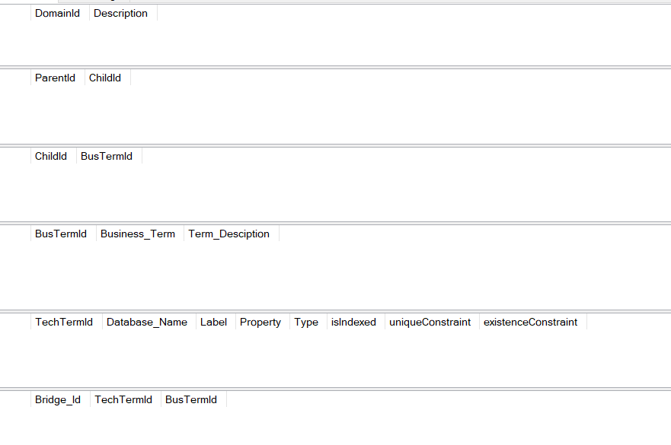
Database Schema in SQL Server

Slide 7
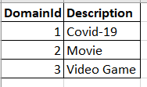
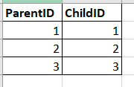
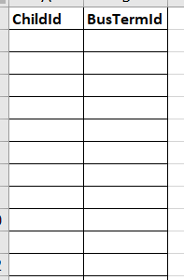
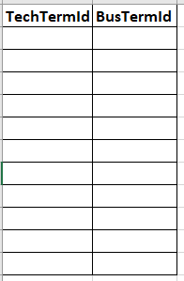
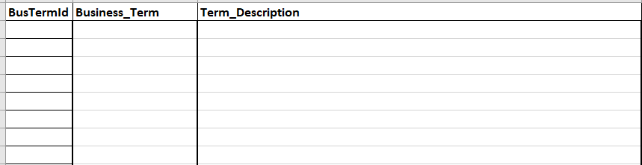
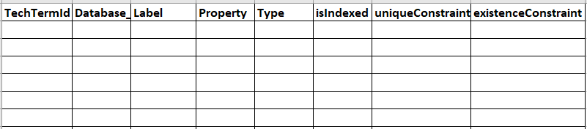
CSV structure of the metadata schema

Slide 8
Script to Extract Technical Metadata in Neo4j
CALL apoc.meta.schema() YIELD value as schemaMap
UNWIND keys(schemaMap) as label
WITH label, schemaMap[label] as data
WHERE data.type = "node"
UNWIND keys(data.properties) as property
WITH label, property, data.properties[property] as propData
RETURN label,
property,
propData.type as type,
propData.indexed as isIndexed,
propData.unique as uniqueConstraint,
propData.existence as existenceConstraint;
MATCH (n)
WHERE NOT n:Metagraph AND size(labels(n))>0
WITH labels(n) as LABELS, keys(n) as KEYS
MERGE (m:Metagraph:NodeType {labels: LABELS})
SET m.properties =
CASE m.properties
WHEN NULL THEN KEYS
ELSE apoc.coll.union(m.properties, KEYS)
END
MATCH (n)-[r]->(m)
WHERE NOT n:Metagraph AND NOT m:Metagraph
WITH labels(n) as start_labels, type(r) as rel_type, keys(r) as rel_keys, labels(m) as end_labels
MERGE (a:Metagraph:NodeType {labels: start_labels})
MERGE (b:Metagraph:NodeType {labels: end_labels})
MERGE (rel:Metagraph:RelType {type:rel_type})
MERGE (a)<-[:StartNodeType]-(rel)-[:EndNodeType]->(b)
SET rel.properties =
CASE
WHEN rel.properties IS NULL AND rel_keys IS NULL THEN []
WHEN rel.properties IS NULL AND rel_keys IS NOT NULL THEN rel_keys
WHEN rel.properties IS NOT NULL AND rel_keys IS NULL THEN rel.properties
WHEN rel.properties IS NOT NULL AND rel_keys IS NOT NULL THEN apoc.coll.union(rel.properties, rel_keys)
END

Slide 9
Group-2
Database Extraction and Integration

Slide 10
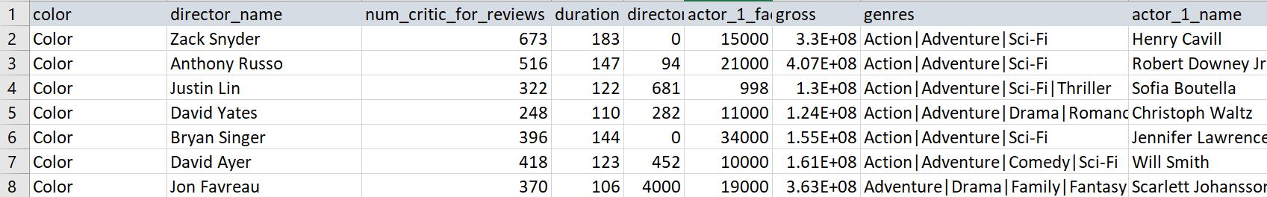
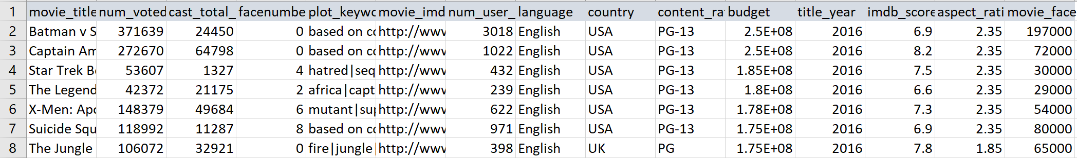
The Dataset
The IMDB movie dataset contains a list of over 5000 movie titles with production, cast and release information across 24 fields
The aim of this project is to extract metadata from multiple sources for data analysis and visualization and to document the entire process

Slide 11
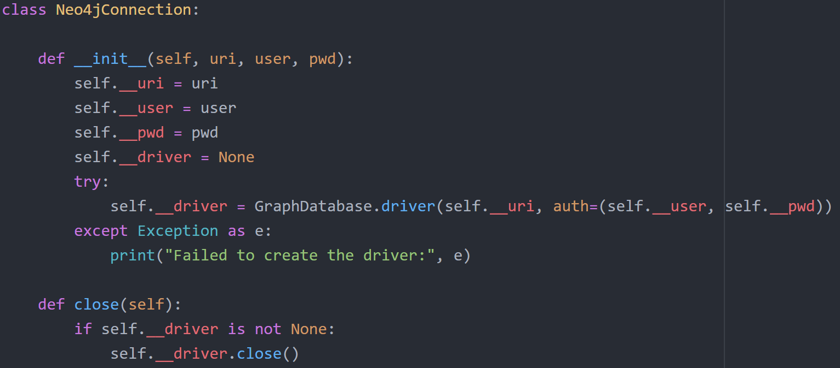
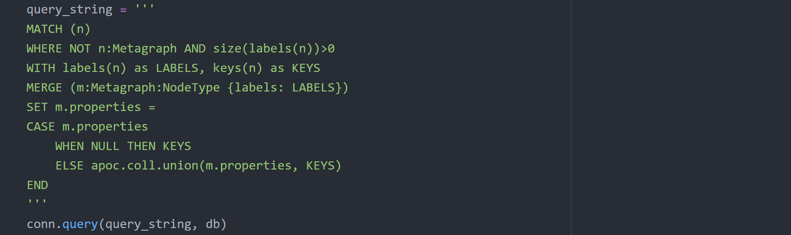
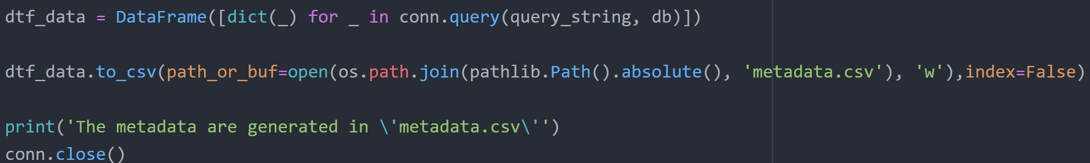
Metadata Extraction from Neo4j
Establish connection with Neo4j database
Execute queries in the Neo4j database to create and extract the metadata.
Export metadata as CSV file.

Slide 12
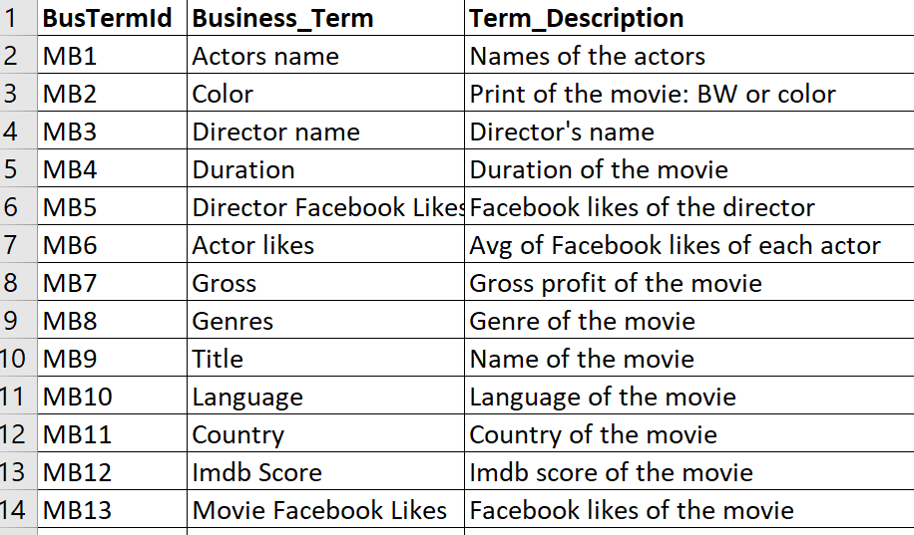
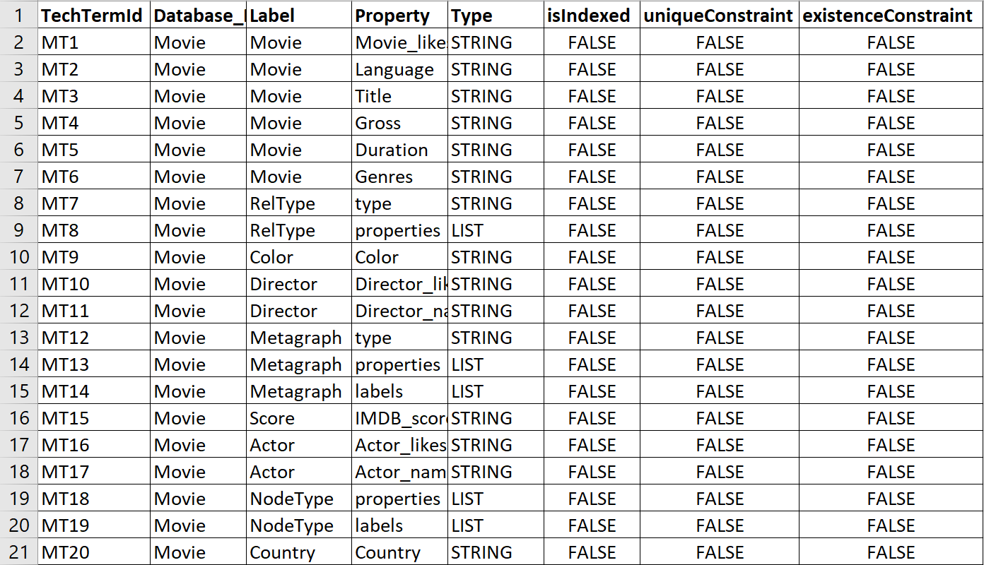
Metadata
Business | Technical

Slide 13
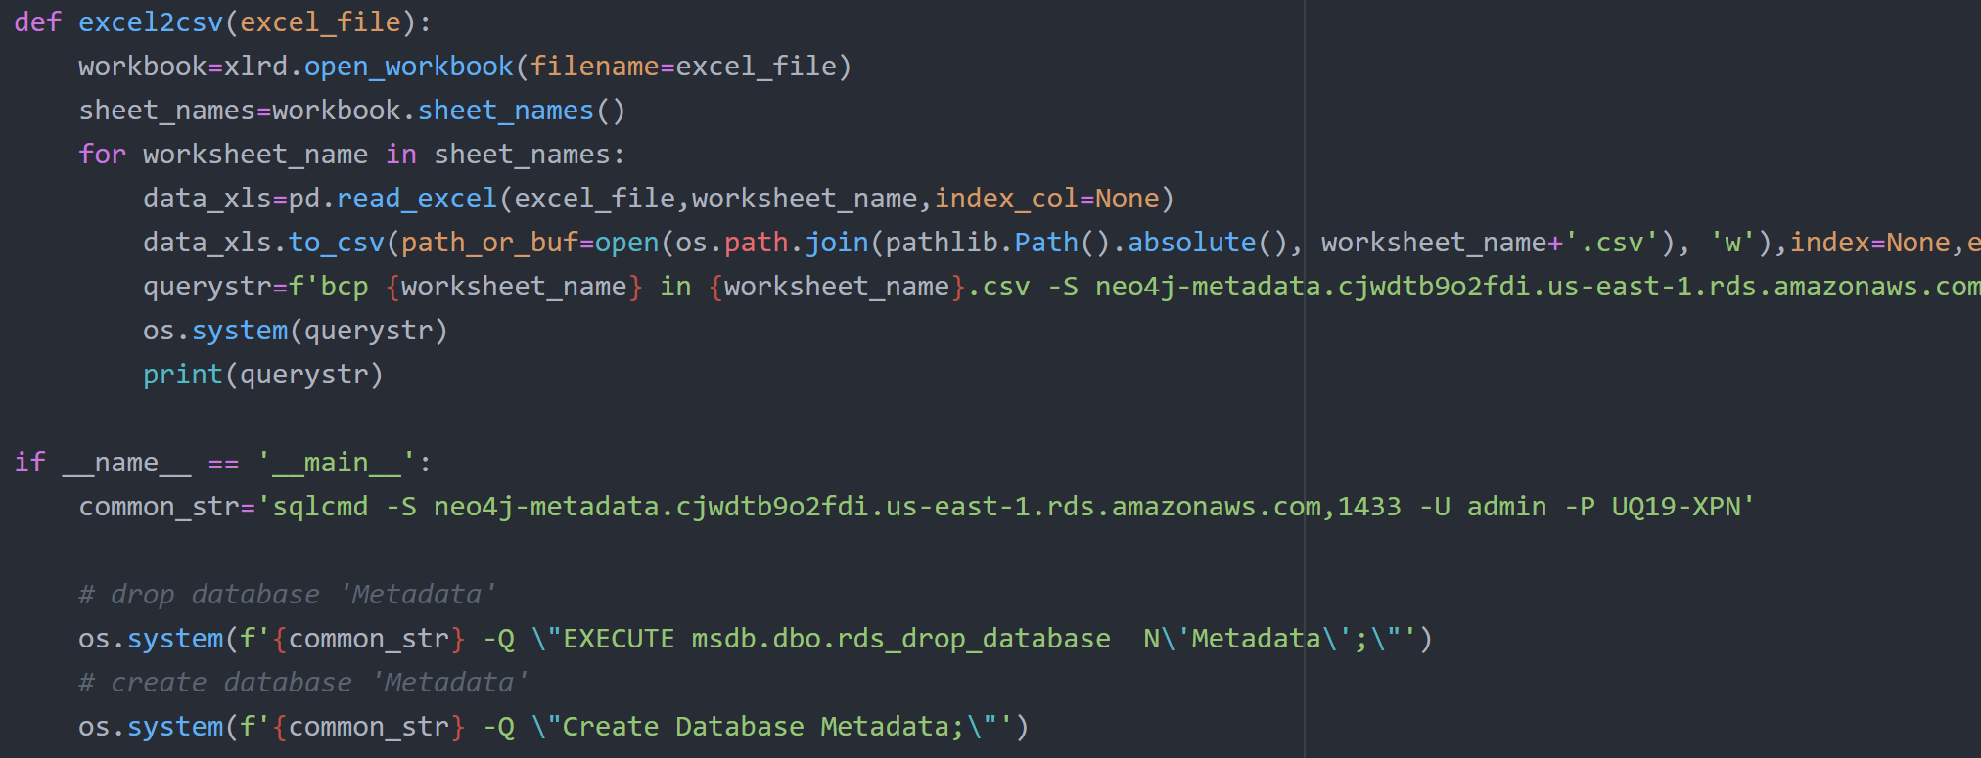
Load Metadata into SQL Database
The metadata was then loaded on to a SQL database hosted on AWS

Slide 14
Group-3
User Interface

Slide 15
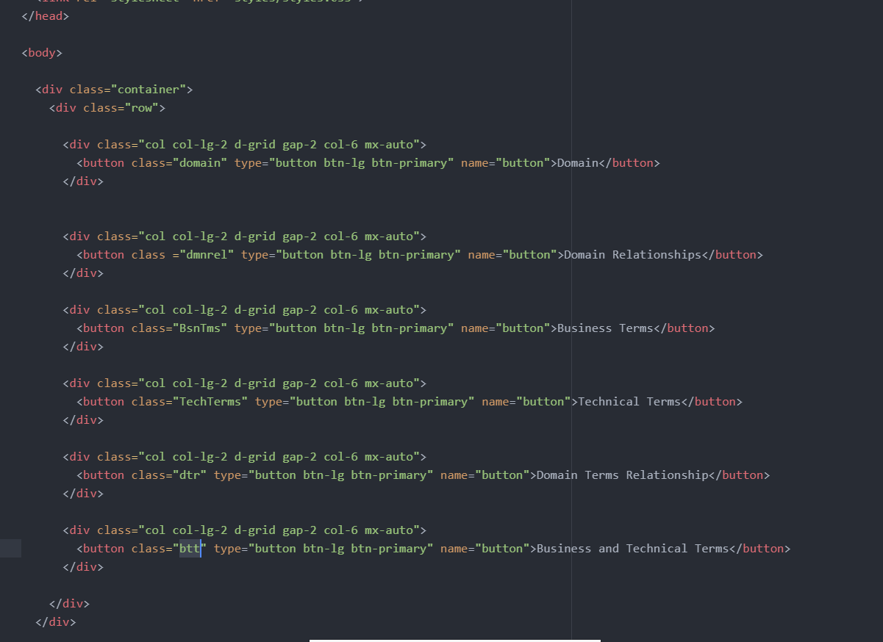
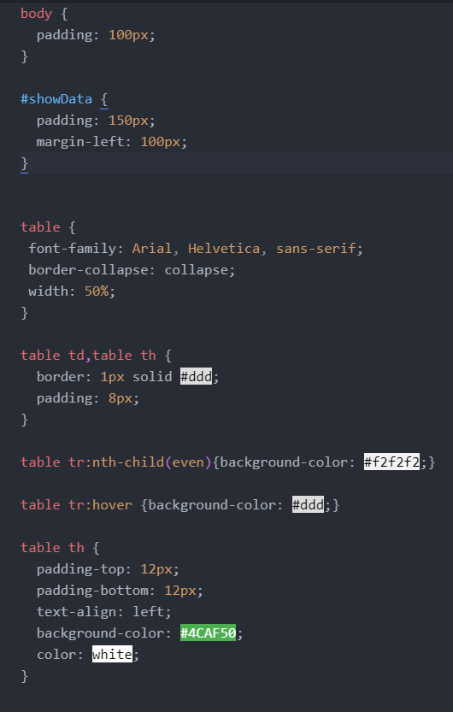
Web Application
HTML
Step1: Developed a HTML body page with buttons and additional functionality, also added CSS to the page for styling
CSS

Slide 16
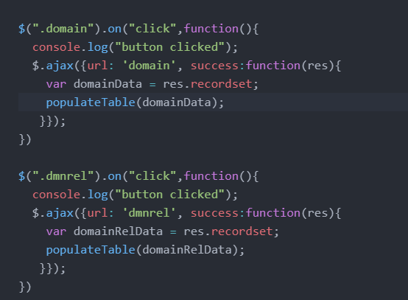
JavaScript file
Step2: Adding JavaScript functionality such that when clicked on a button, sends a request to node.js which provides the data and populates in the table on the HTML page.

Slide 17
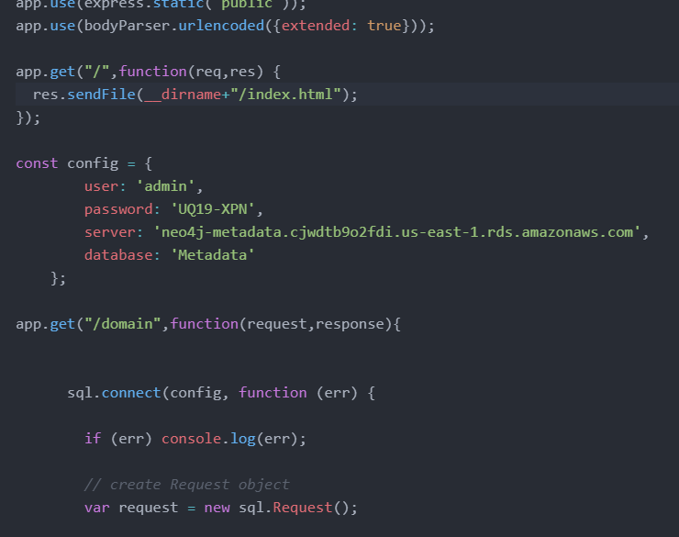
Node js file
Step3: Connection between the frontend and backend. Node.js runs on backend and responds to the requests sent from frontend such as providing the data from database(AWS RDS) to the html table for which the request was sent.

Slide 18
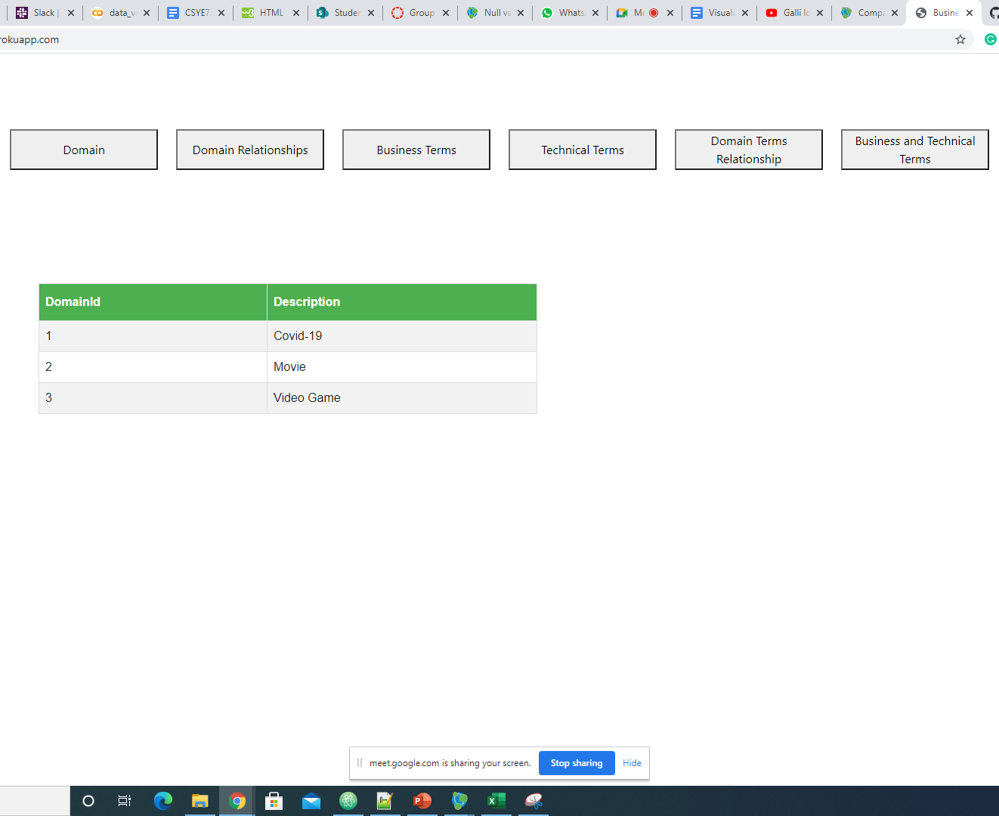
Deployment on Heroku
Home Page
Step1: Create an account on Heroku
Step2: Create a Procfile
Step3: Add Procfile to the project
Step4: Run the following commands
heroku login
Git add .
Git commit –m “comments”
Git push Heroku master
Now the app has been deployed.
Link: https://nameless-spire-63573.herokuapp.com/

Slide 19
DEMO
https://nameless-spire-63573.herokuapp.com/

Slide 20
Thank you

