Slide 1











SQL FINAL PROJECT
IPL AUCTION
Submitted by
Chinmay Golegaonkar
Batch- Jan 01

Slide 2
Table of content
Create Table deliveries and matches
Aggressive batsman
Anchor batsman
High hitting batsman
Economical bowler
Wicket taking bowler
All rounder
Wicketkeeper
Additional question for final assessment

Slide 3
create table deliveries (
match_id int,
inning int,
over_n int,
ball_n int,
batsman varchar(50),
non_strike_batsman varchar(50),
bolwer varchar(50),
run_per_ball int,
extra_run int,
total_runs int,
is_wicket bit,
dismissal_kind varchar(50),
player_dismissed varchar(50),
fielder varchar(50),
extras_type varchar(50),
batting_team varchar(50),
bowling_team varchar(50)
)
copy deliveries from 'C:\Program Files\PostgreSQL\16\data\SQL_Course\IPL_auction\IPL_Dataset\IPL_Ball.csv'
delimiter ',' csv header;

Slide 4
create table matches(
id int,
city varchar(100),
date varchar(50),
player_of_the_match varchar(50),
venue varchar(100),
neutral_venue varchar(50),
team1 varchar(50),
team2 varchar(50),
toss_win varchar(50),
toss_decison varchar(50),
winner varchar(50),
result varchar(50),
result_margin int,
eliminator varchar(50),
method varchar(50),
umpire1 varchar(50),
umpire2 varchar(50)
);
copy matches from 'C:\Program Files\PostgreSQL\16\data\SQL_Course\IPL_auction\IPL_Dataset\IPL_matches.csv'
delimiter ',' csv header;

Slide 5

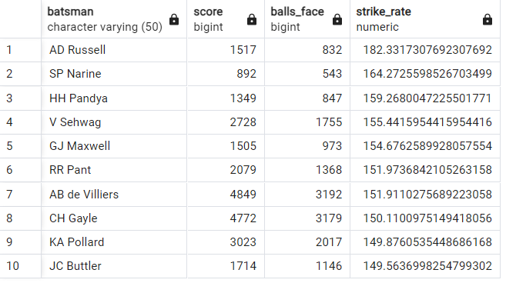
Aggressive batters
QUERY
OUTPUT
select
d.batsman,
sum(d.run_per_ball) as score,
count(d.ball_n) as balls_face,
sum(d.run_per_ball)*100./count(ball_n) as strike_rate
from deliveries as d
where extras_type not in('wides')
group by batsman
having count(d.ball_n)>=500
order by strike_rate desc
limit 10;

Slide 6
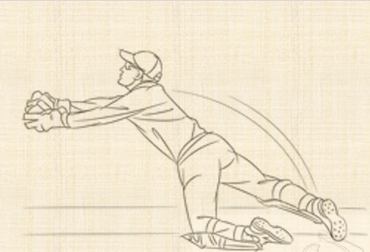


Slide 7
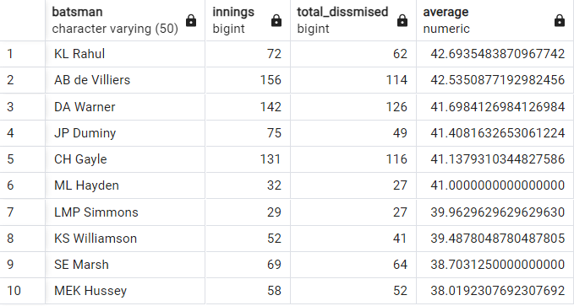
Anchor batsmen
QUERY
OUTPUT
select
batsman,
count(distinct match_id) as innings,
sum(cast(is_wicket as int)) as total_dissmised,
sum(run_per_ball)*1./sum(cast(is_wicket as int)) as average
from deliveries
group by batsman
having count(distinct match_id)>=28 and sum(cast(is_wicket as int))>=1
order by average desc
limit 10;

Slide 9
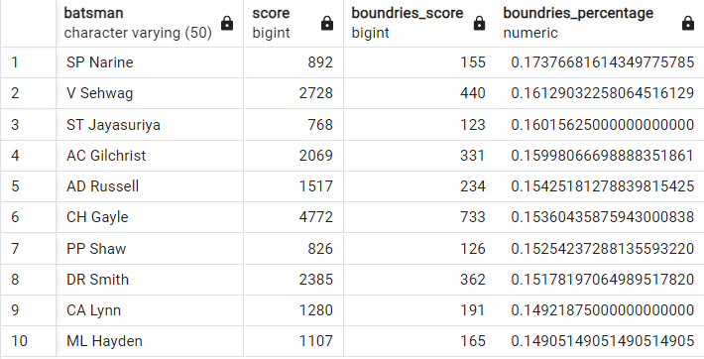
Hard hitters
QUERY
select
d.batsman,
sum(d.run_per_ball) as score,
a.boundries_score,
a.boundries_score*1./sum(d.run_per_ball) as boundries_percentage
from deliveries as d
left join
(select
batsman,
count(run_per_ball) as boundries_score
from deliveries
where run_per_ball in (6,4)
group by batsman
) as a
on a.batsman = d.batsman
where d.extras_type not in('wides')
group by d.batsman, a.boundries_score
having count(distinct match_id)>=28
order by boundries_percentage desc
limit 10;
OUTPUT

Slide 11
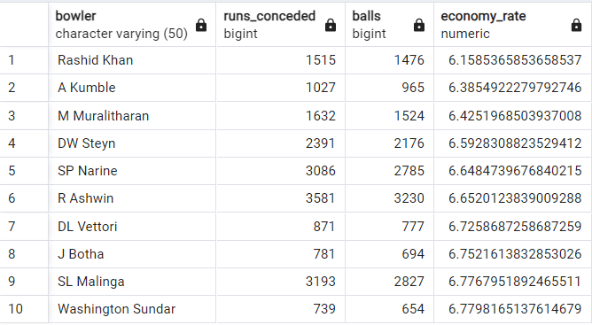
Economical bowlers
OUTPUT
QUERY
select
a.bowler,
a.runs_conceded,
b.balls,
a.runs_conceded*6./balls as economy_rate
from (select bowler,
sum(run_per_ball) as runs_conceded
from deliveries
where not extras_type='legbyes' and not extras_type='byes' and not extras_type='penalty'
group by bowler) as a
left join
( select bowler,
count(ball_n) as balls
from deliveries
where not extras_type='wides' and not extras_type='noballs' and not extras_type='penalty'
group by bowler) as b
on a.bowler = b.bowler
where b.balls>500
order by economy_rate
limit 10;

Slide 13
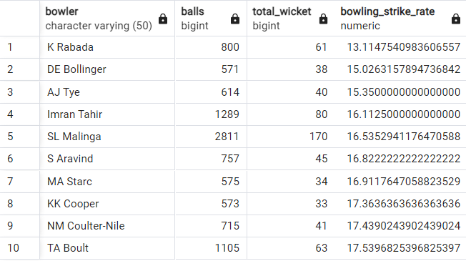
Wicket-taking bowlers
QUERY
OUTPUT
select
bowler,
count(ball_n) as balls,
sum(cast(is_wicket as int)) as total_wicket,
count(ball_n)*1./sum(cast(is_wicket as int)) as bowling_strike_rate
from deliveries
where
extras_type not in ('wides','noballs','penalty') and not dismissal_kind = 'run out'
group by bowler
having sum(cast(is_wicket as int))>0 and count(ball_n)>500
order by bowling_strike_rate
limit 10

Slide 15
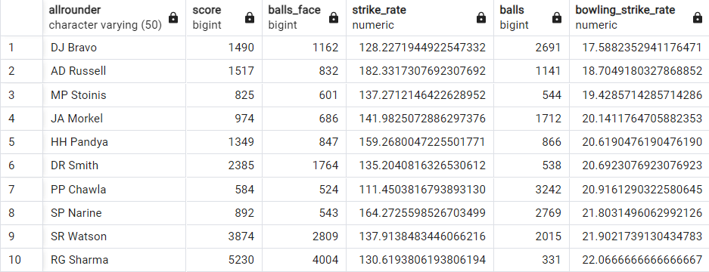
All-Rounders
QUERY
OUTPUT
select
a.allrounder,
a.score,
a.balls_face,
a.strike_rate,
b.balls,
b.bowling_strike_rate
from
(select
batsman as allrounder,
sum(run_per_ball) as score,
count(ball_n) as balls_face,
sum(run_per_ball)*100./count(ball_n) as strike_rate
from deliveries
where extras_type not in('wides')
group by batsman
having count(ball_n)>=500 ) as a
left join
(select
bowler as allrounder,
count(ball_n) as balls,
sum(cast(is_wicket as int)) as total_wicket,
count(ball_n)*1./sum(cast(is_wicket as int)) as bowling_strike_rate
from deliveries
where
extras_type not in ('wides','noballs','penalty') and not dismissal_kind = 'run out’ group by bowler
having sum(cast(is_wicket as int))>0 and count(ball_n)>300) as b
on a.allrounder = b.allrounder
order by b.bowling_strike_rate,a.strike_rate
limit 10;

Slide 17
Wicketkeeper
OUTPUT
Criteria for wicketkeeper
Consideration of wicketkeeper ability due to the limited time and overs in T20 matches.
Batting Ability:
Must possess aggressive batting skills.
Fielding:
Quick reflexes for catching and stumping.
Bowling:
Ability to contribute with the ball, though less emphasized compared to batting and fielding.
QUERY

Slide 18
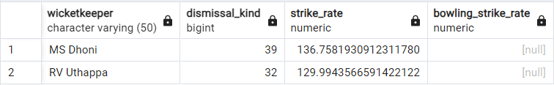
Wicketkeeper
QUERY
select w.player as wicketkeeper,
w.dismissal_kind,
b.strike_rate,
b.bowling_strike_rate
from (select fielder as player,
count(dismissal_kind) as dismissal_kind
from deliveries
where dismissal_kind in ('stumped')
group by fielder) as w
left join (select a.player as player,
a.strike_rate as strike_rate,
c.bowling_strike_rate as bowling_strike_rate
from (select batsman as player,
sum(run_per_ball) as score,
count(ball_n) as balls_face,
sum(run_per_ball)*100./count(ball_n) as strike_rate
from deliveries
where extras_type not in('wides')
group by batsman
having count(ball_n)>=500 ) as a
left join
(select bowler as player,
count(ball_n)*1./sum(cast(is_wicket as int)) as bowling_strike_rate
from deliveries
where extras_type not in ('wides','noballs','penalty') and not dismissal_kind = 'run out'
group by bowler
having sum(cast(is_wicket as int))>0 and count(ball_n)>6) as c
on a.player = c.player
) as b
on w.player = b.player
order by w.dismissal_kind desc
limit 2
OUTPUT

Slide 19
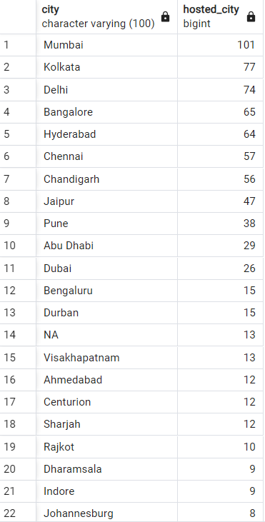
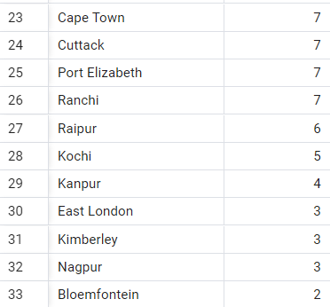
Additional Questions for Final Assessment
1. Get the count of cities that have hosted an IPL match
select
distinct city,
count(city) as hosted_city
from matches
group by city
order by hosted_city desc

Slide 21
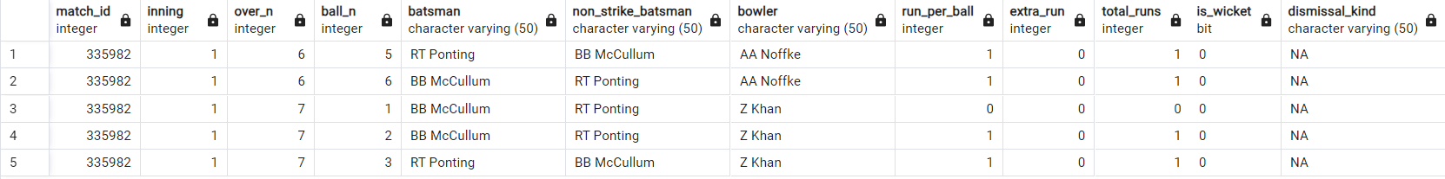
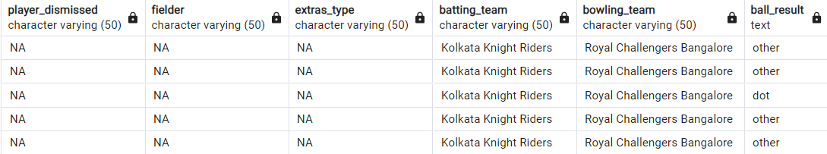
Additional Questions for Final Assessment
Create table deliveries_v02 with all the columns of the table ‘deliveries’ and an additional
column ball_result containing values boundary, dot or other depending on the total_run
create table deliveries_v02 as
(select *,
case
when run_per_ball >=4 then 'boundary'
when run_per_ball = 0 then 'dot'
else 'other'
end as ball_result
from deliveries)
select * from deliveries_v02 limit 5

Slide 22

Additional Questions for Final Assessment
Write a query to fetch the total number of boundaries and dot balls from the
deliveries_v02 table
select
(select count(ball_result) from deliveries_v02 where ball_result = 'boundary' ) as total_boundary,
(select count(ball_result) from deliveries_v02 where ball_result = 'dot' ) as total_dots
from deliveries_v02 limit 1;

Slide 23
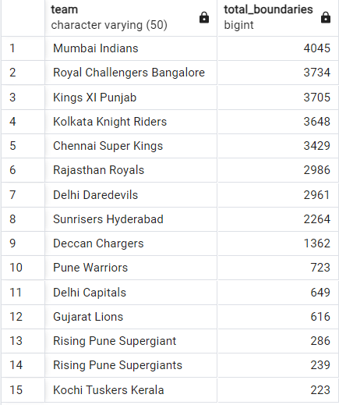
Additional Questions for Final Assessment
Write a query to fetch the total number of boundaries scored by each team from the
deliveries_v02 table and order it in descending order of the number of boundaries
scored.
select
distinct batting_team as team,
count(ball_result) as total_boundaries
from deliveries_v02
where ball_result = 'boundary'
group by batting_team
order by total_boundaries desc

Slide 25
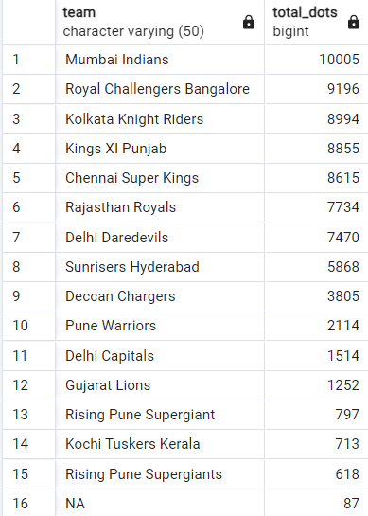
Additional Questions for Final Assessment
Write a query to fetch the total number of dot balls bowled by each team and order it in
descending order of the total number of dot balls bowled.
select
distinct bowling_team as team,
count(ball_result) as total_dots
from deliveries_v02
where ball_result = 'dot'
group by bowling_team
order by total_dots desc

Slide 27
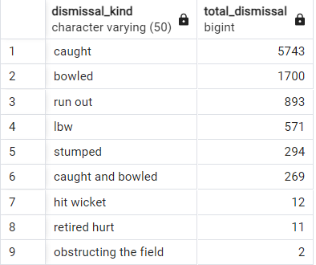
Additional Questions for Final Assessment
Write a query to fetch the total number of dismissals by dismissal kinds where dismissal
kind is not NA
select
dismissal_kind,
count(dismissal_kind) as total_dismissal
from deliveries_v02
where not dismissal_kind ='NA'
group by dismissal_kind
order by total_dismissal desc

Slide 29
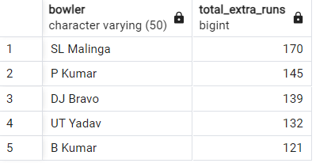
Additional Questions for Final Assessment
Write a query to get the top 5 bowlers who conceded maximum extra runs from the
deliveries table
select
bowler,
sum(extra_run) as total_extra_runs
from deliveries
where extras_type in ('wides','noballs')
group by bowler
order by total_extra_runs desc
limit 5

Slide 31
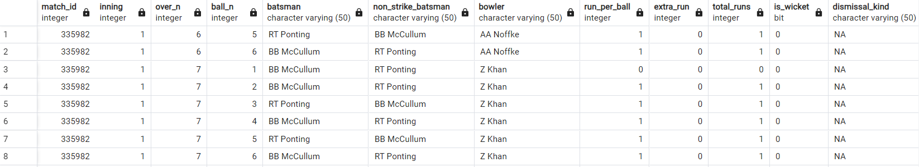
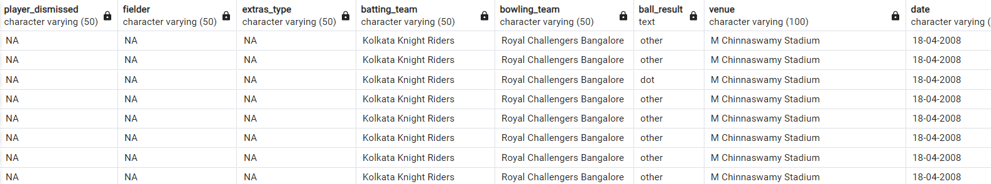
Additional Questions for Final Assessment
Write a query to create a table named deliveries_v03 with all the columns of
deliveries_v02 table and two additional column (named venue and match_date) of venue
and date from table matches
create table deliveries_v03 as
(select d.*,
m.venue,
m.date
from deliveries_v02 as d left join matches as m
on d.match_id = m.id)
select * from deliveries_v03

Slide 32
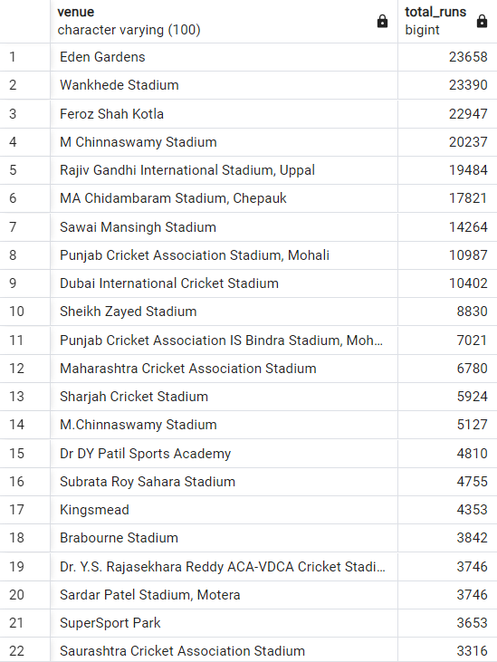
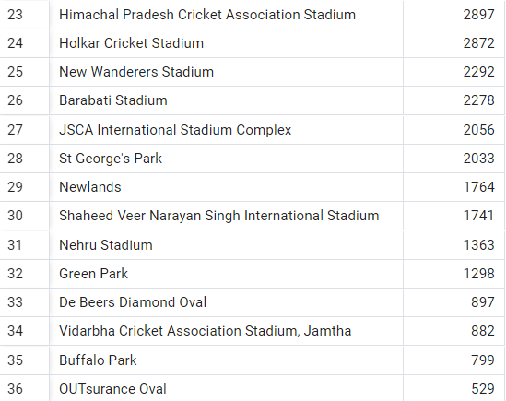
Additional Questions for Final Assessment
Write a query to fetch the total runs scored for each venue and order it in the descending
order of total runs scored.
select
venue,
sum(total_runs) as total_runs
from deliveries_v03
group by venue
order by total_runs desc

Slide 34
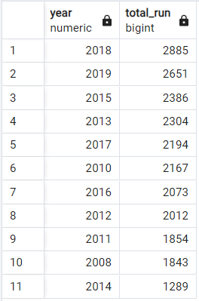
Additional Questions for Final Assessment
Write a query to fetch the year-wise total runs scored at Eden Gardens and order it in the
descending order of total runs scored
select
extract(year from to_date(date,'DD-MM-YYYY')) as year,
SUM(total_runs) AS total_run
from deliveries_v03
where venue = 'Eden Gardens'
group by extract(year from to_date(date,'DD-MM-YYYY'))
order by total_run desc

