Slide 1

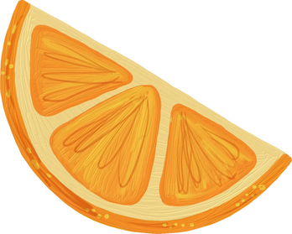



BITEWISE
Smart Food Recognition and Nutrition Tracking
Mentor: Mohammed Wasid Sir
Sudeepti Gupta E23CSEU1202
Prakhar Kedia E23CSEU1218
Nitesh E23CSEU1222
Chinmay Pal E23CSEU1204

Slide 2


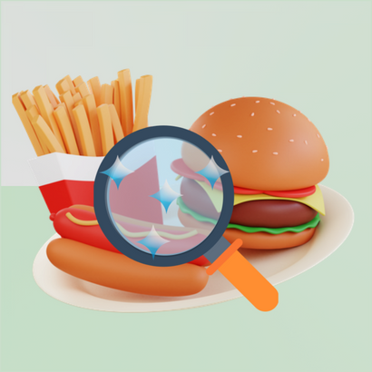
BiteWise

Slide 3
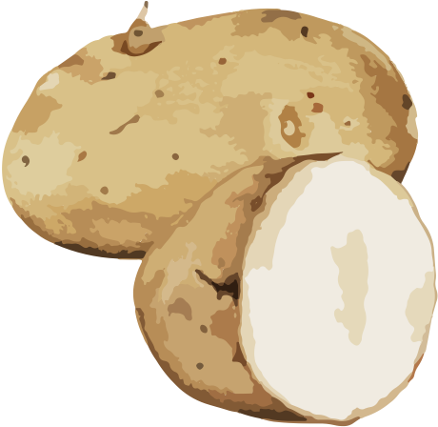

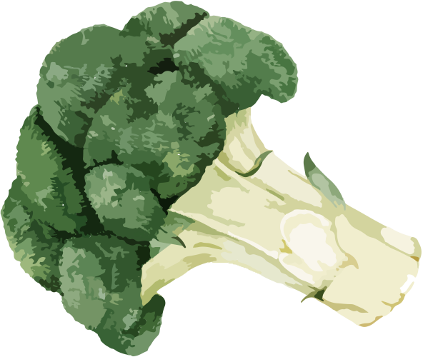
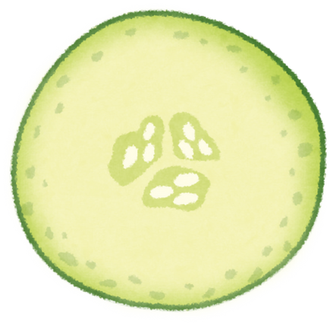
Encourages smart
eating
Displays nutrients instantly
AI-powered nutrition app
WHAT DOES BITEWISE DO ?
Detects food via images
Analyzes calorie content
Designed for all age groups

Slide 4

PROBLEMS
Most people forget or avoid logging their meals daily
Hidden calories in food go completely unnoticed
Poor eating habits develop from lack of awareness
Manual food tracking is time-consuming and boring
Users don’t receive immediate nutritional feedback
Existing tools are complex and hard to stick with

Slide 5

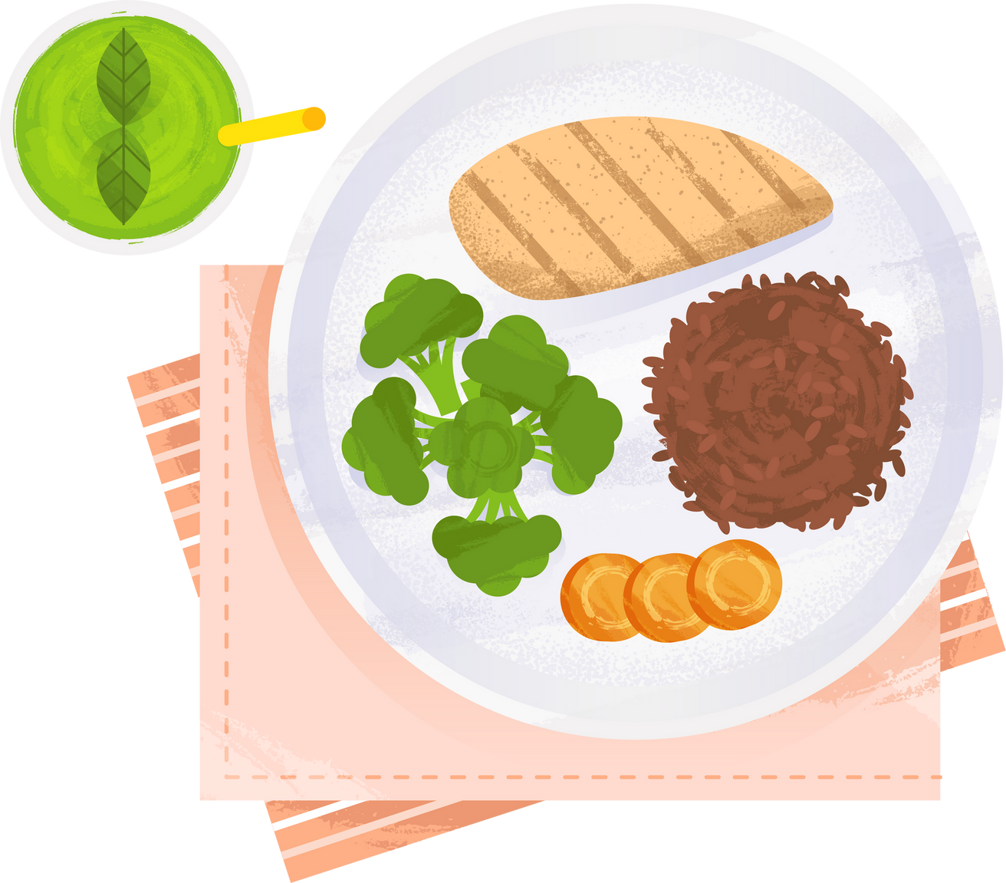

Identify food from images
Analyze nutritional data
OBJECTIVE
´ Display info visually
´ Educate and guide users

Slide 6
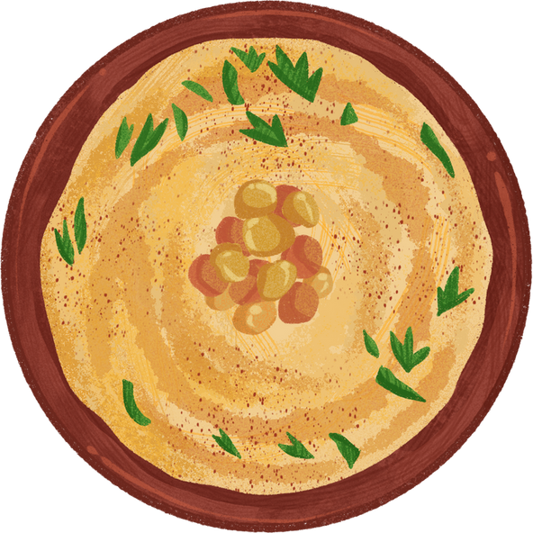


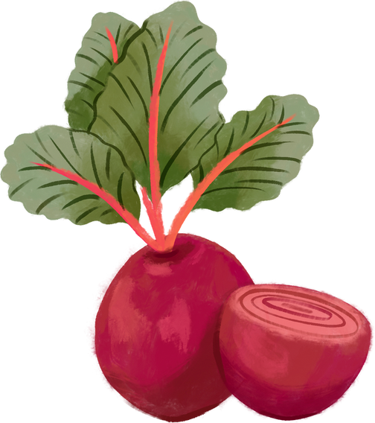

TECH STACK
Frontend: | Flutter toolkit by Google for building cross-platform apps with a single codebase.
Backend: | Dart providing a fast and responsive UI for users to interact with the nutritional analysis features.
Model: | Gemini API Key and Custom AI to authenticate and securely access Google’s AI and machine learning services

Slide 7
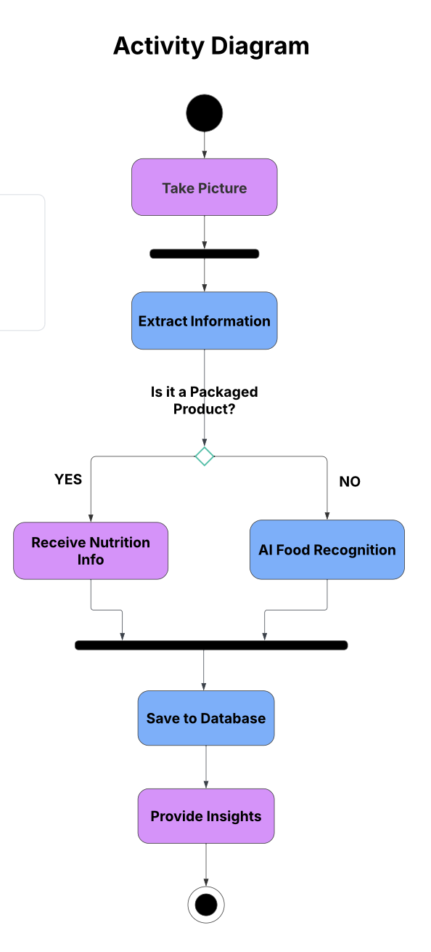
HOW IT WORKS
Workflow of Nutrify
User starts by taking a photo of their food
App checks if the item is a packaged product
If yes:
- Extracts label/nutrition info using OCR
- Saves the data to the database
- Retrieves complete nutritional details
If no:
- Performs AI-based food recognition
Based on the result, the app provides nutritional insights
Ends the process after displaying the information

Slide 8
Scan Food Widget -
Detects food items using AI image recognition
Scan Label Widget –
Extracts nutrition data from food packaging
Daily Intake Widget –
Tracks and visualizes daily nutrient consumption
APP SCREENS

Slide 9
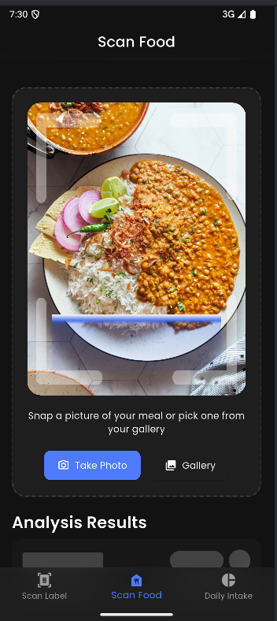
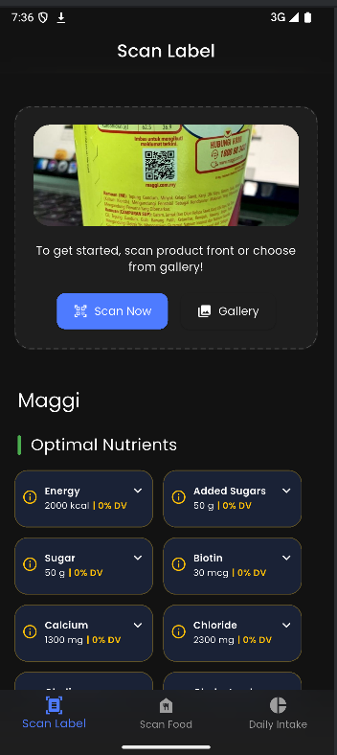
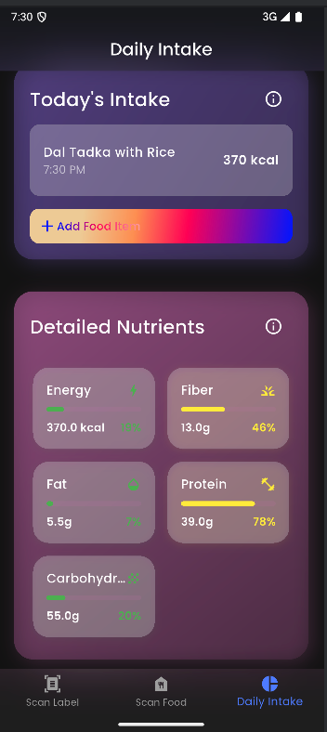

SCREENS
Scan Food Widget
Scan label Widget
Daily Intake Widget

Slide 10

CHALLENGES
Food Image Recognition Challenges
Ambiguous Food Appearance – Visually similar dishes can confuse the model.
Data & Maintenance
Model Needs Continuous Updating – New foods and edge cases require ongoing training.
Nutrition Estimation Issues
Inaccurate Portion Size Estimation – The app can’t reliably measure quantity from a photo.
Privacy Concerns Over Image Use
– Users may be wary about sharing personal food photos.
Technical Challenges
Poor Model Generalization – Trained models might underperform on real-world images.

Slide 11
FUTURE ENHANCEMENTS
CONCLUSION
Voice Recognition: Enable hands-free food analysis via voice commands.
Personalized Diet Plans: AI-driven custom meal plans based on health goals and preferences.
Recipe Suggestions: Recommend meals based on scanned foods and dietary needs.
Global Food Database Expansion: Include food items from diverse cultures and regions.
AI-based app promoting healthy eating.
Real-time food recognition & nutrition info.
Simple and user-friendly interface.
Continuous improvement through data updates.
Future-ready with API integration like Gemini.

Slide 12


SUDEEPTI GUPTA
E23CSEU1202BENNETT.EDU.IN
PRAKHAR KEDIA E23CSEU1218@BENNETT.EDU.IN
NITESH
E23CSEU1222@BENNETT.EDU.IN
CHINMAY PAL
E23CSEU1204@BENNETT.EDU.IN
THANK YOU

