Slide 1
BTP-I Final Presentation
“Autonomous Crack Detection using Deep Learning on Synthetic Thermogram Datasets”
Name of Presenter: Chinmay Makarand Pimpalkhare
Roll Number: 200100115
Department: 4th Year UG, Mechanical Engineering
Institute: Indian Institute of Technology Bombay
Name of Guide : Prof. Dnyanesh Pawaskar, Dept. of Mechanical Engineering, IIT Bombay

Slide 2
PROBLEM STATEMENT
Detection of Cracks
Failure due to Crack Propagation
1. Local cracks can propagate and cause failure in different parts of the material
Corrosion
Cracks make a material more susceptible to corrosion
The global cost of failure due to corrosion is estimated to be US$2.5 trillion, which is equivalent to 2.5% of the global GDP. Reference: http://impact.nace.org/economic-impact.aspx
Example Case: Toyota Recalled 44,000 of its cars for potential engine cracks in 2020
- Manufacturing error leading to cracks in engine
- Better detection could have facilitated prevention of such a situation
Reference: https://www.yourlemonlawrights.com/news/2020/05/04/44000-toyota-vehicles-recalled-for-potential-engine-cracks

Slide 3
CURRENT METHODS
Perform some kind of Non-Destructive Testing (eg. Thermography)
Human Expert looks at thermography report for detecting cracks
Issues with Current Methods of Crack Detection
- Manual inspection is very time-consuming and also prone to human error
- It also requires skilled and experienced specialists
Solution: Develop an algorithm which can replace the need for expert operators
Challenges for Algorithm/Model Development
- These models need huge amounts of data for training
- Experimental data is extremely costly to obtain in terms of time, energy and money
Idea: Develop a model which can be trained on synthetic data and aim to make it work on real-life data

Slide 4
SOLUTION OVERVIEW
Autonomous Crack Detection using Deep Learning on Synthetic Thermal Profile Datasets
Data Generation
MATLAB Thermal simulations being used to generate synthetic data
Deep Learning
Training an object detection framework to locate cracks given the temperature profile images
Why Deep Learning?
- Autonomous and accurate method
- Reduces human intervention
- Ability to generalize well
Image Augmentation
Introducing variations in the dataset on the basis of the model`s performance
Why Synthetic Data?
- Collecting Experimental data is difficult
- Synthetic data easy to generate
- Offers more chances of experimentation
WHAT?
WHY?

Slide 5
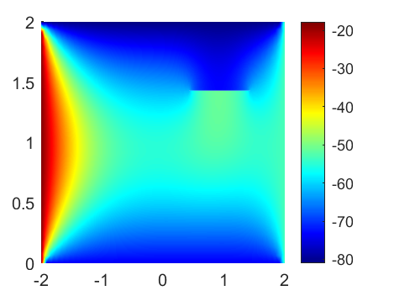
SOLUTION OVERVIEW
Data Generation Pipeline
Define Geometry
Generate Mesh
Define Boundary Conditions
Obtain temperature profile using finite element methods using PDE toolbox in MATLAB
An example of a generated temperature profile
Image is annotated to provide
a label telling the position of
crack inside the image*
Annotations are being performed using the CVAT.io annotation tool
The location of the crack is stored in a text file which is passed to the algorithm during training
We are also storing the boundary conditions provided to improve the model in later stages of the project

Slide 6
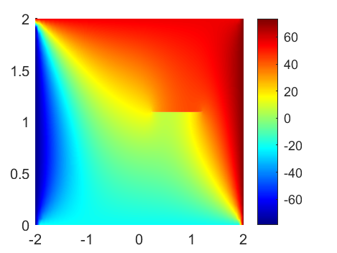
SOLUTION OVERVIEW
Deep Learning Pipeline
Processing
New Data
Raw Image
Location of Crack
Label
Deep Learning Model
Boundary Condition
Boundary Condition*
Model is Trained
TRAINING DATA
INFERENCE
*Current implementation only focuses on outputting the crack location and not the boundary condition

Slide 7
SOLUTION FLOWCHART
Deep Learning Pipeline
Processing
New Data
Raw Image
Location of Crack
Label
Deep Learning Model
Model is Trained
TRAINING DATA
INFERENCE

Slide 8
EXISTING LITERATURE
SURVEY PAPERS
- Mohan, Poobal ``Crack detection using image processing: A critical review and analysis”(2018)
USING EXPERIMENTAL DATASETS
- Yang, Wang et al.“Infrared Thermal Imaging-Based Crack Detection Using Deep Learning (2019)
- Jaeger, Schmid et al. ``Infrared Thermal Imaging-Based Turbine Blade Crack Classification Using Deep Learning (2022)
- Chandra, AlMansoor et al. ``Deep learning based Infrared Thermal Image Analysis of Complex Pavement Defect Conditions considering Seasonal Effect (2022)”
DATA AUGMENTATION / DATA FUSION
- Alexander, Hoskere et al. “Fusion of RGB and Thermal Images for automated deep learning crack detection in civil architecture” (2022)
- Tian, Wang et al. ``A New GAN-based approach to Data Augmentation and Image Segmentation for Crack Detection in Thermal Imaging Datasets (2021)”
PARTIALLY SYNTHETIC DATASETS
- Fang et al. ``Automatic Defects Segmentation and Identification by Deep Learning Algorithm with Pulsed Thermography: Synthetic and Experimental Data (2021)”
- Kovacs et al. “Deep Learning approaches for Thermographic Imaging (2020)”

Slide 9
SUMMARY OF EXISTING LITERATURE
Practical Challenges:
- Difficult to access Non-Destructive Testing datasets (due to agreements and protocols etc)
Type of Datasets:
- Mostly experimental datasets are being used, with a little bit of synthetic samples
- No datasets with large fraction of synthetic data available
Algorithmic Insights:
- Mostly CNN-based algorithms such Faster R-CNN being used for detection
- GANs also being used for synthetic data generation
Possible Improvements:
- Lack of diverse synthetic data
- New model architectures can be tried out, with experimentation in loss functions etc

Slide 10




DATA GENERATION
Design Decision
- Decided to use Matlab due to flatter learning curve, ease of resource availability and elaborate features
$$T_{4}$$
$$T_{3}$$
$$T_{1}$$
$$T_{2}$$
Simulation Geometry: Plate with crack (shown in black). Temperature BCs on all 4 edges

Slide 11
DATA GENERATION
Data Features
Plate dimensions and crack dimensions kept constant for now
- Define f = (crack length)/(plate length)
- At f = 0.1, crack is easily visible to human eye
- At f = 0.001, crack is not very easily visible, a human can observe the thermal profile and make a good guess
- At f = 0.0001, even a human eye cannot easily see the location of the crack
- Thus f = 0.001, was finalized for further usage
Crack location is varied along the x-axis
Cracks at an angle can be handled by data augmentation automatically
Edge temperatures being initialized randomly to provide more variety in the data
Steady state temperature profiles being considered finally
Plate material modelled as Steel and corresponding parameters used
Definition of Crack: NO presence of material

Slide 12
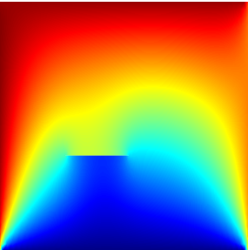
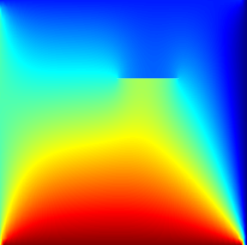
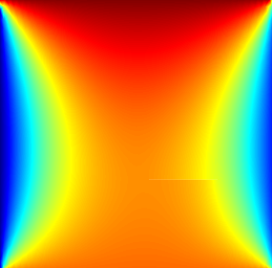
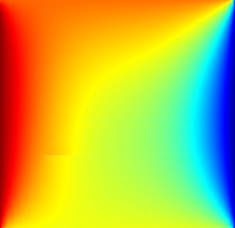
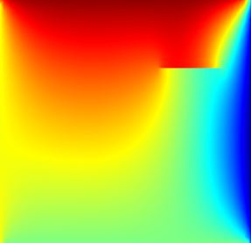
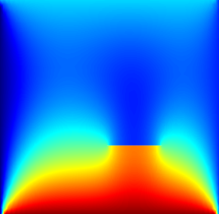
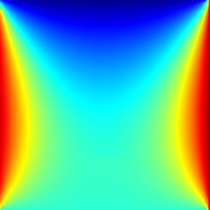
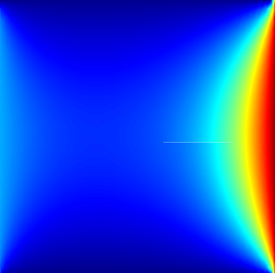
DATA GENERATION
Data Examples
Easier Examples
Variations in the thermal profile
because of crack are conspicuous
Harder Examples
Much harder to spot the cracks, even for the human eye

Slide 13
DATA GENERATION
Data Examples
Easier Examples
Variations in the thermal profile
because of crack are conspicuous
Harder Examples
Much harder to spot the cracks, even for the human eye

Slide 14
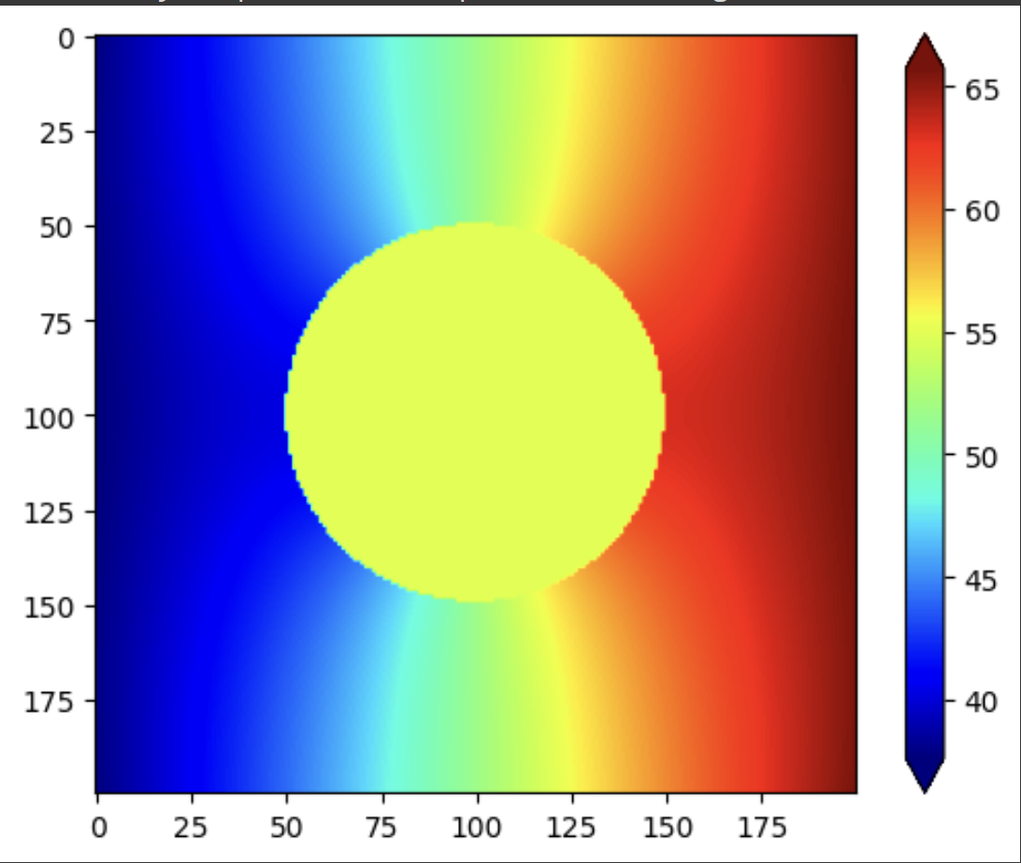
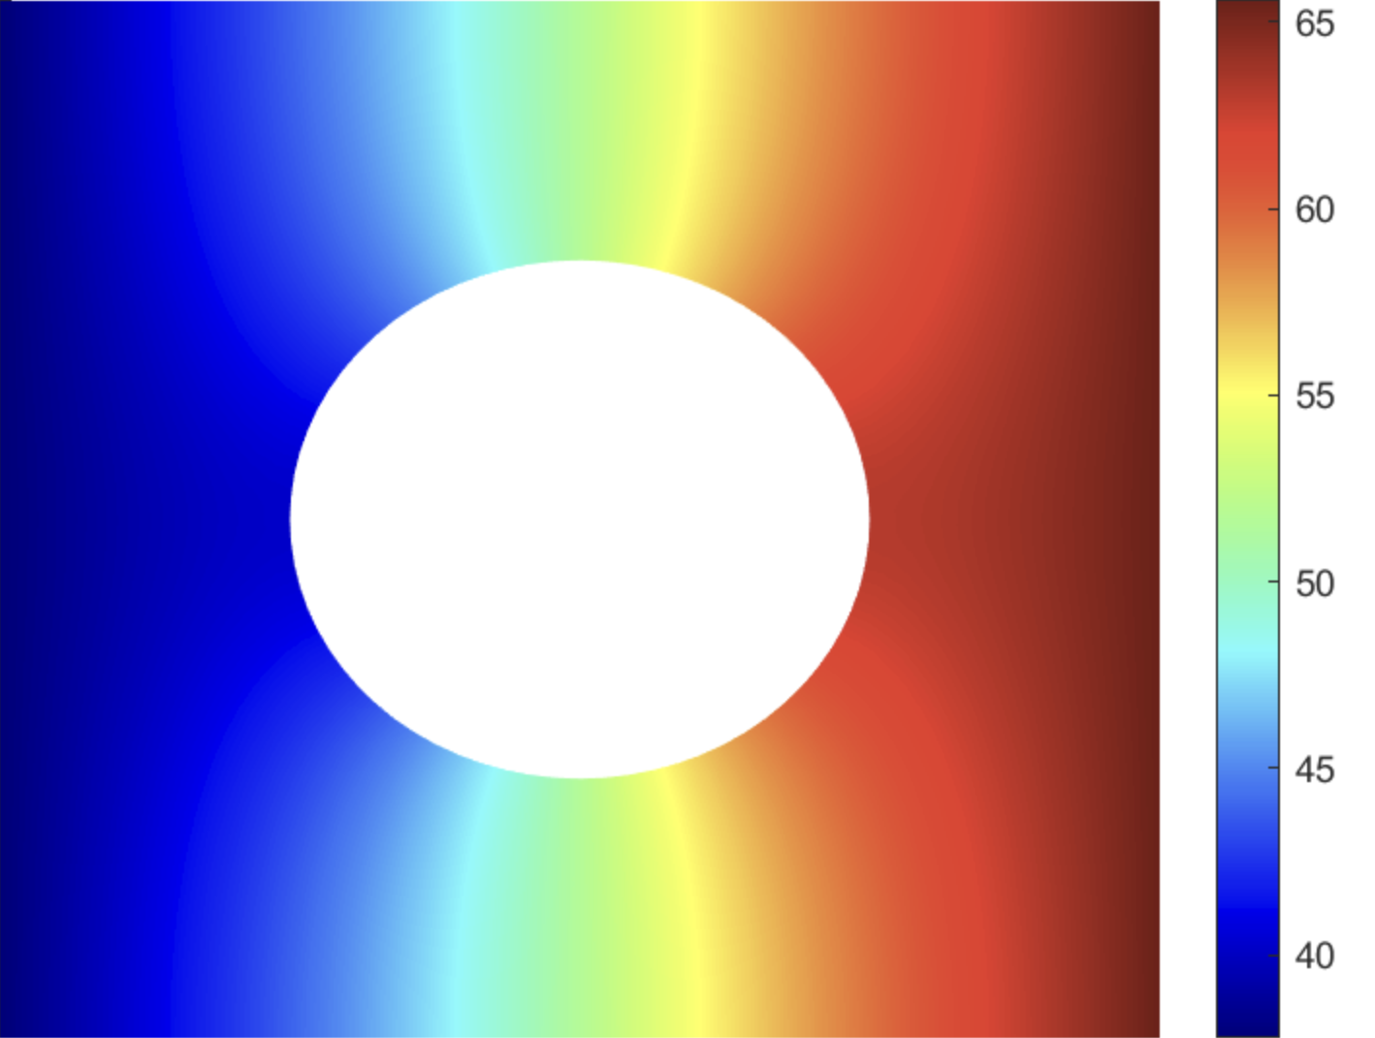
DATA GENERATION
Benchmarking
- To ensure the validity of the solutions, we compared them with an analytical solution obtained from the paper: “Thermal Stresses In Plates with Circular Holes, K.S.Rao et al., Nuclear Engineering and Design, 1971``.
- Since this paper solves considering a circular hole, we compared our simulation methodology for the same geometry.
- Simulations on the crack geometry were continued once the benchmarking ensured validity of our method
Analytical Solution
Numerical Solution
Comparison for a Circular Hole Geometry
As we can see, the analytical and numerical solutions are matching and the magnitudes are also very similar.
Note that the green circle in the analytical solution is a mask since the values were not computed in the region.

Slide 15
DEEP LEARNING
What is it that we want our neural network to detect?
- Majorly detect low level features first
- These are combined to detect higher level features
Effect is much more pronounced if the crack is perpendicular to the direction of maximum opposite edge temperature difference
Temperatures, and hence, pixel values change very fast in the vicinity of the crack
Abrupt changes in the direction of thermal contour lines as they become perpendicular to the crack
The neural network tries to detect these features at a smaller scale and their combines them through weighted operations to calculate the probability of a crack existing in a range of pixels and thus locating the crack.

Slide 16
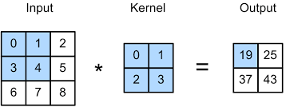
IMAGE PROCESSING
Convolution
This is how the process of convolution is used for detecting specific features in an image. In the above example, the kernel values are randomly initialized
For us,
- Input: Temperature profile image in terms of RGB pixel values
- Kernel: Trained inside the Convolutional Neural Network to obtain the weights
- Output: Feature map, or a simpler representation of the image (generally in grayscale due to channel superimposition)
Image Reference: https://courses.cs.washington.edu/courses/cse446/22wi/sections/08/convolutional_networks.html

Slide 17
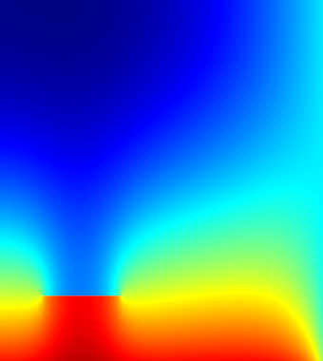
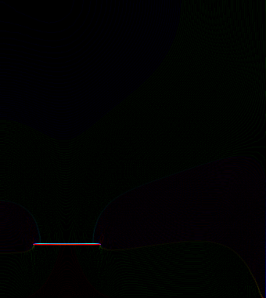
IMAGE PROCESSING
Convolution to obtain Feature Maps: Crack
-1
-1
-1
-1
8
-1
-1
-1
-1
Input Image
Kernel
Output Feature Map
Edge Detection Kernel
- As we can see, the output feature map is almost completely black, except for the region where the hole is
- This feature map is then later processed to obtain the location of the hole

Slide 18
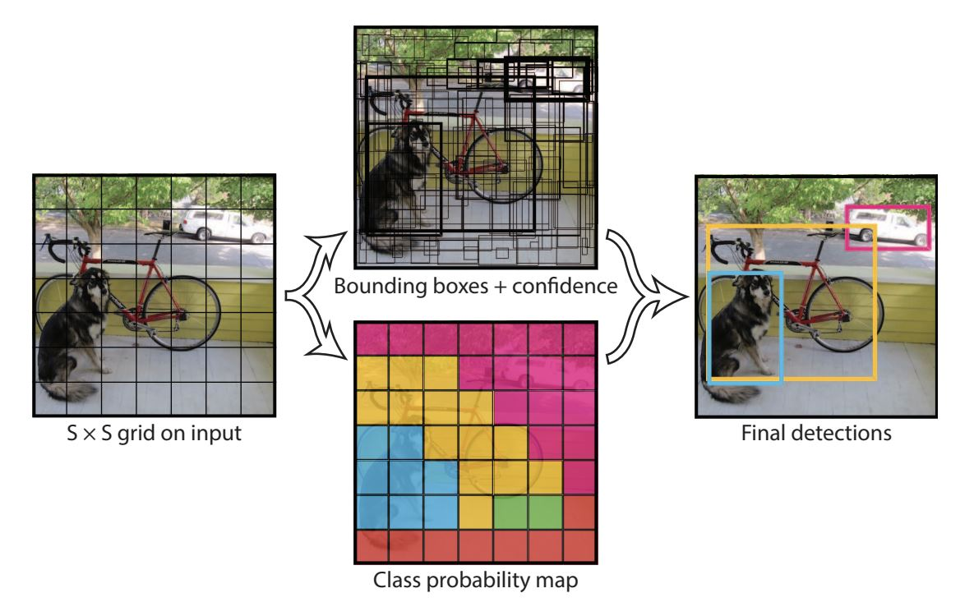
DEEP LEARNING
YOLO Algorithm, Image from Original YOLO Paper
Reference: Redmon, Divvala et al. ``You Only Look Once: Unified, Real-time Object Detection
- Divides image into a grid and predicts bounding boxes and class probabilities for each grid cell
- Uses a CNN to simultaneously predict multiple objects
- Outputs bounding box coordinates and class probabilities directly, to improve speed and accuracy

Slide 19
DEEP LEARNING
Our Current Model Pipeline
Data Generation
Annotation
Data Augmentation
Model Weight Initialization
Training
Inference
MATLAB
CVAT.io
PyTorch*
YOLOv5
Our Dataset
Test images**
* I have not yet implemented Data Augmentation methods, but in further iterations will employ them as they will significantly improve model robustness
** Test images used right now are also from our dataset. When the model is fully perfected, it should be able to learn from the synthetic dataset and perform well on experimental images also. This is a difficult task called Domain Adaptation in Machine Learning

Slide 20
DEEP LEARNING
Implementation Details
Entity | Details
Size of training dataset | 80 images (280 x 280 px)*
Size of testing dataset | 20 images (280 x 280 px)*
Optimizer | Stochastic Gradient Descent (SGD)
Metrics | Precision, Recall, mAP50, mAP50-95
Number of Epochs | 250
Training Image Resize | 512 px
Batch size | 8
Training Time per Epoch | 2.22 seconds (for dataset with size 80)
Inference Time | 0.154 seconds (for 20 images)
*The reason why we have used such a small number of data points is that the model was able to perform well even with a small dataset. In further experiments, we shall use augmentation to increase the dataset size.

Slide 21
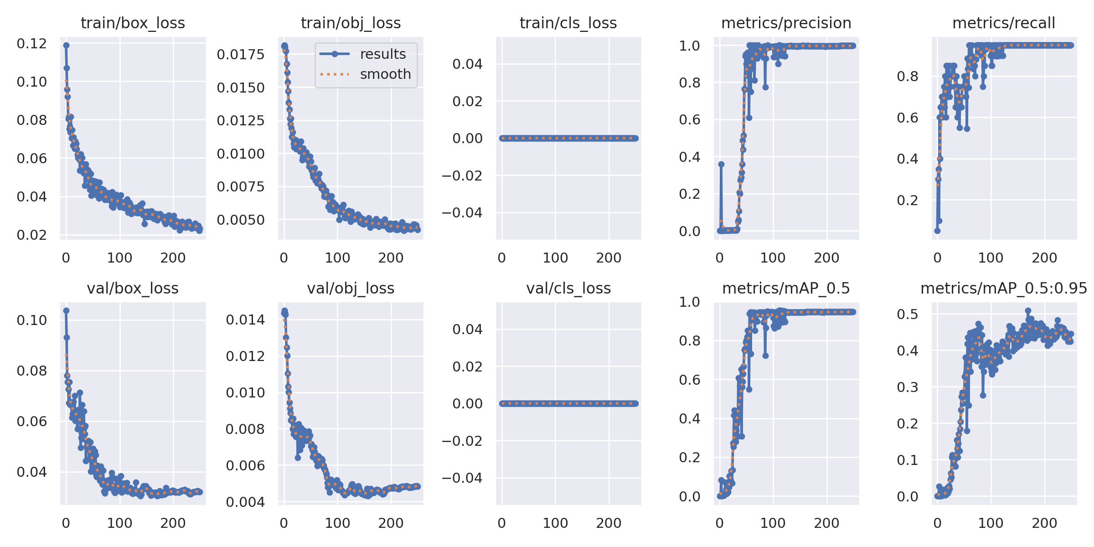
RESULTS
Metrics v/s Epochs

Slide 22
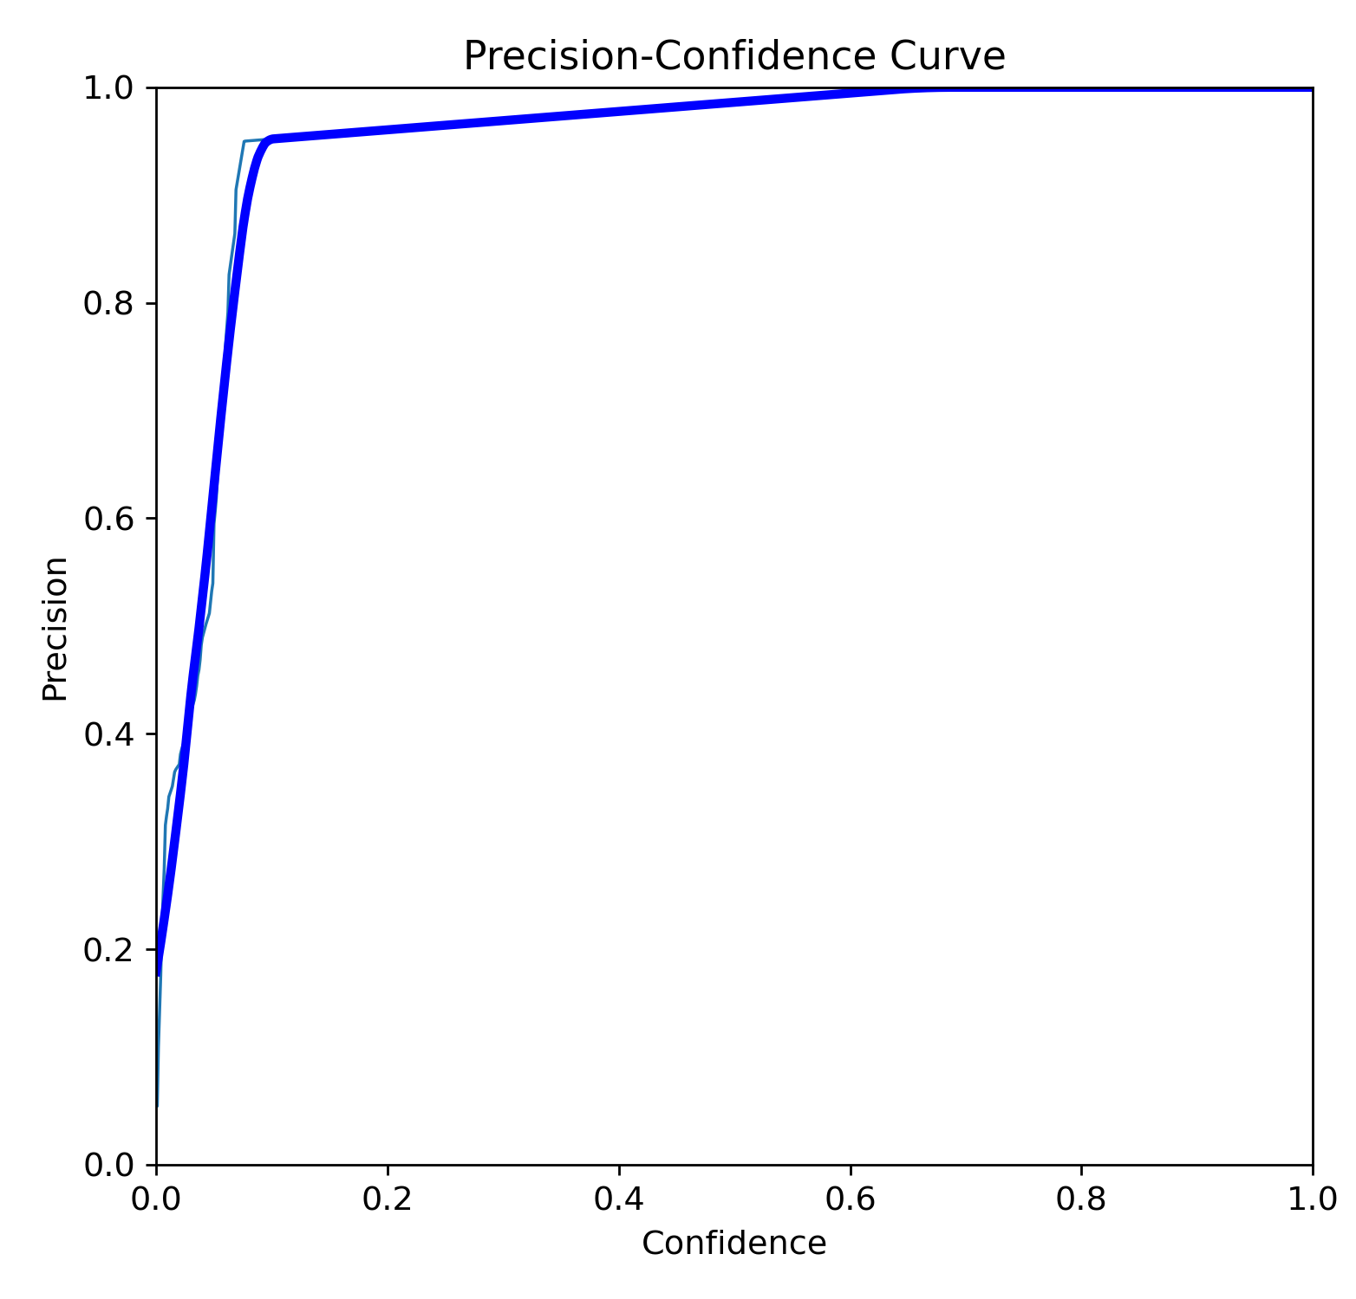
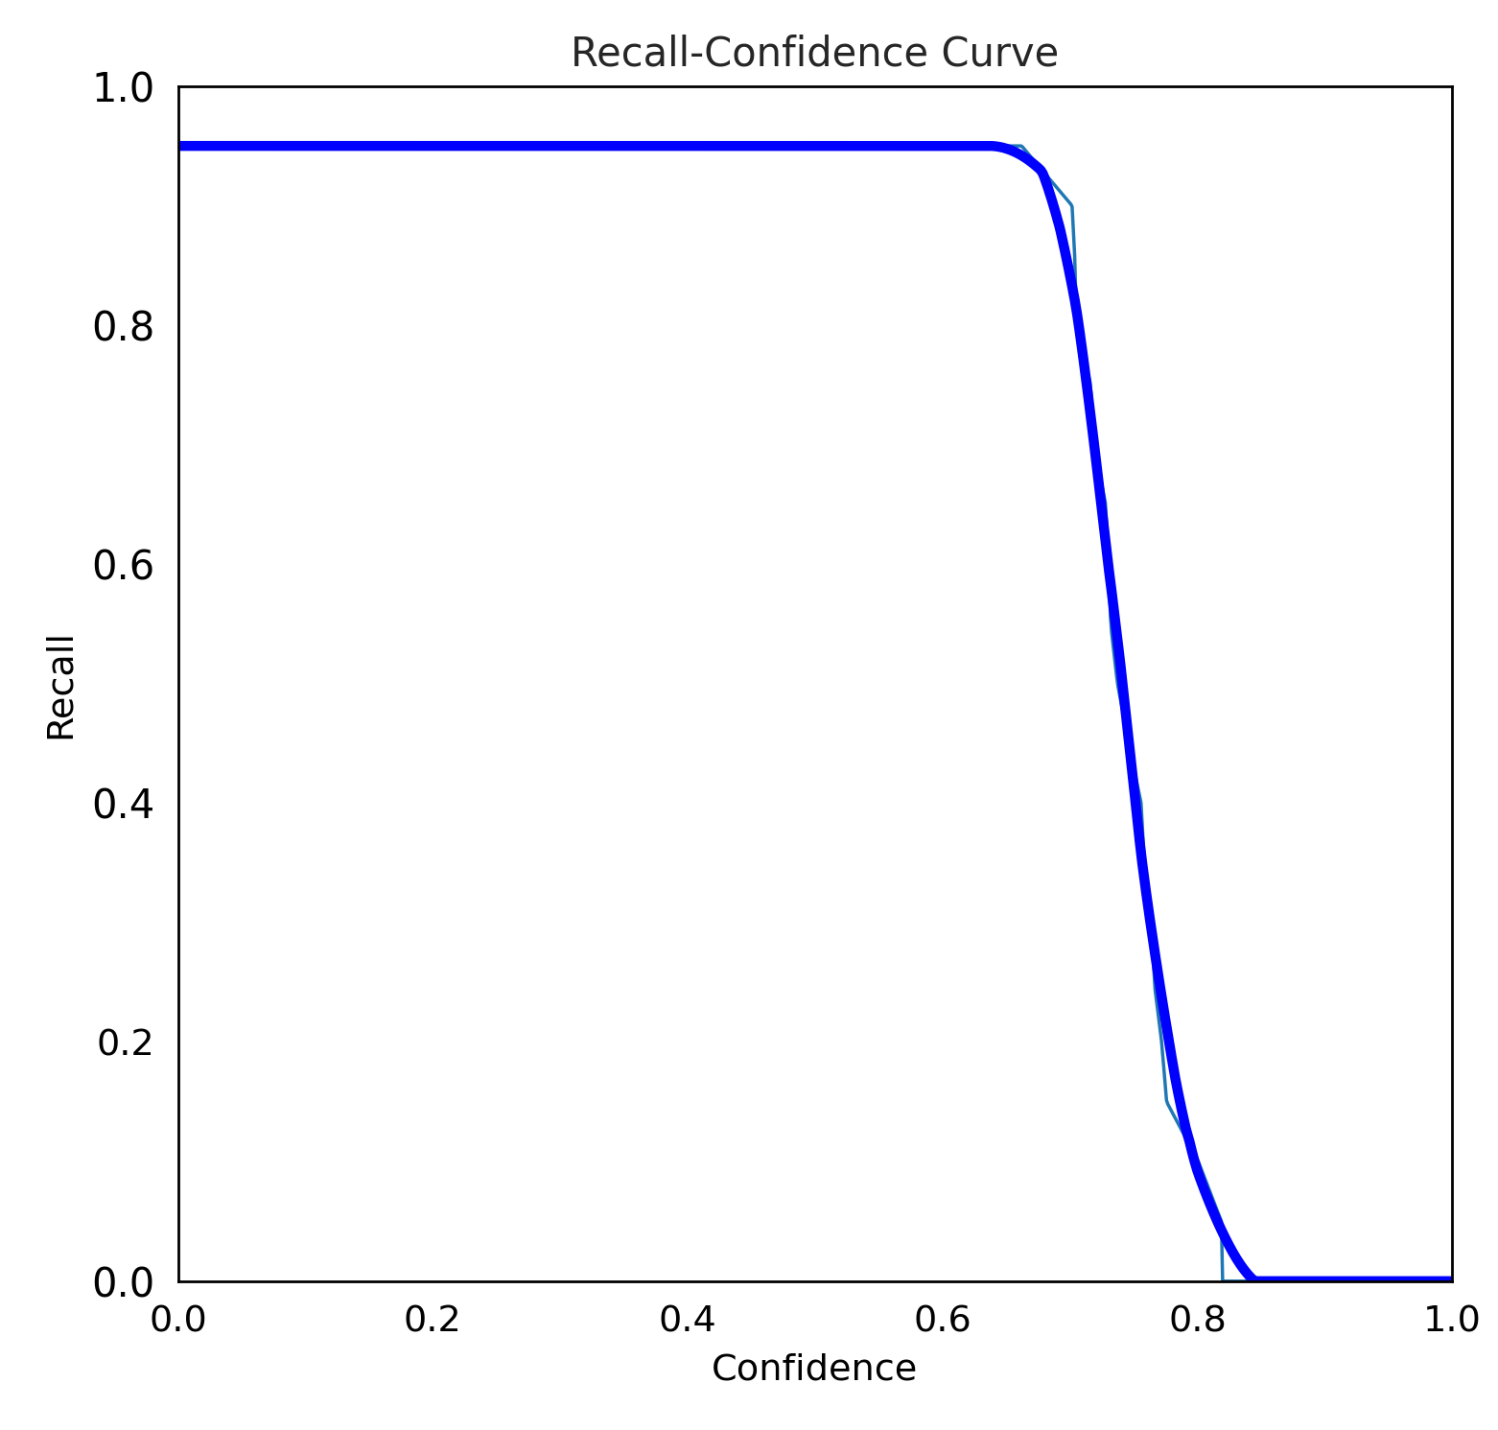
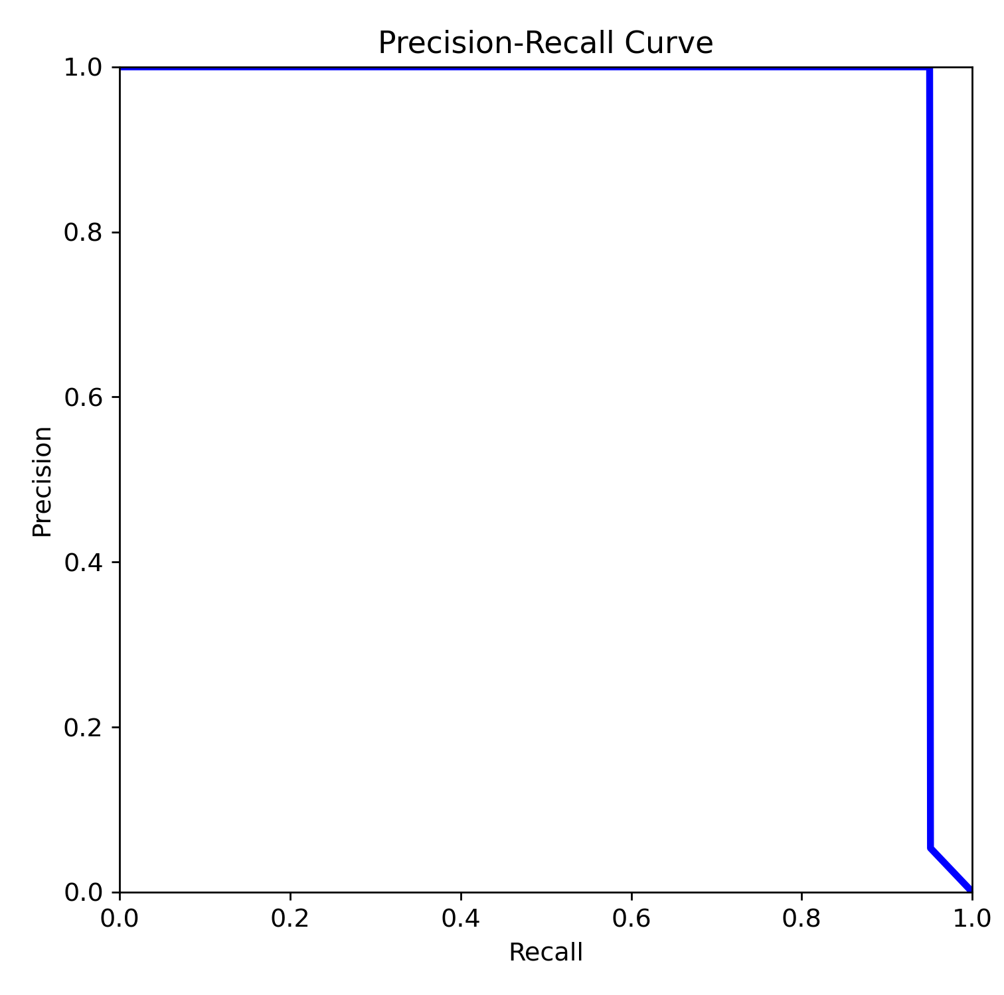
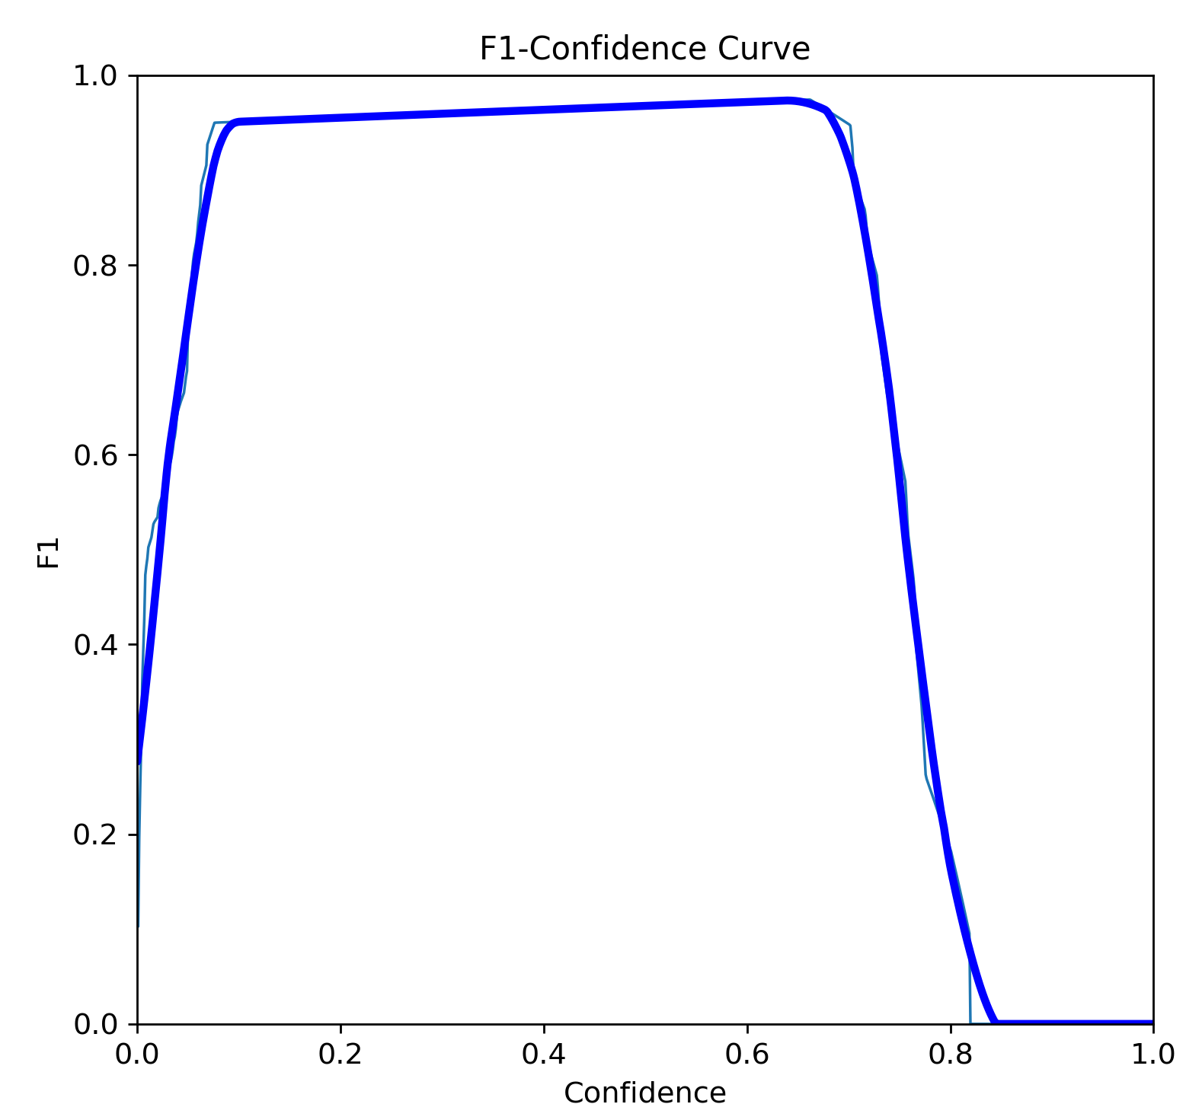
RESULTS
Precision, Recall and Confidence Curves
- Confidence is the classification threshold over IoU
Precision vs Confidence
Recall vs Confidence
Precision vs Recall
F1-Score vs Confidence
$$F1 Score= \frac{2∗Precision ∗Recall}{Precision+Recall}$$

Slide 23
RESULTS
Metrics (at best epoch)
Metric | Value | Interpretation
Precision | 0.996 | Value of precision at the maxima of the F1-confidence curve
Recall | 0.95 | Value of recall at the maxima of the F1-confidence curve
mAP50 | 0.947 | Mean Average Precision when confidence threshold is set to 0.5
mAP50-95 | 0.507* | mAP averaged across confidence thresholds from 0.5 to 0.95 with step size of 0.05
We are getting very good values of precision, recall and mAP50 while mAP50-95 value is not very optimal

Slide 24
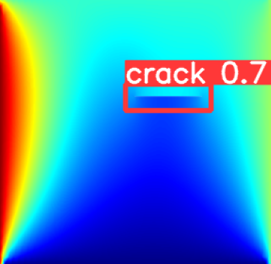
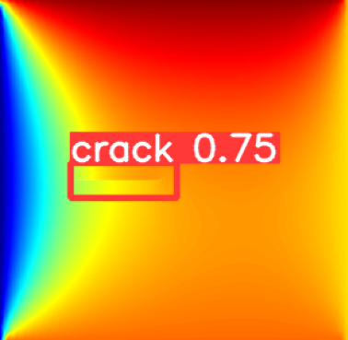
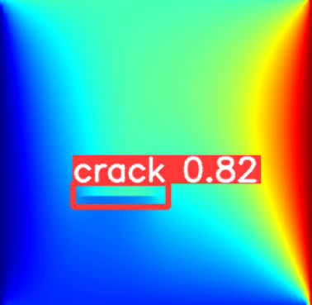
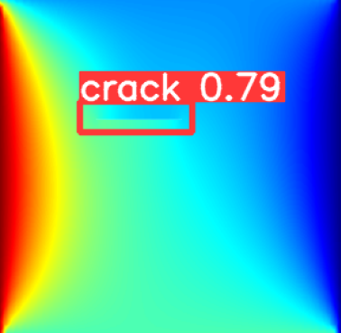
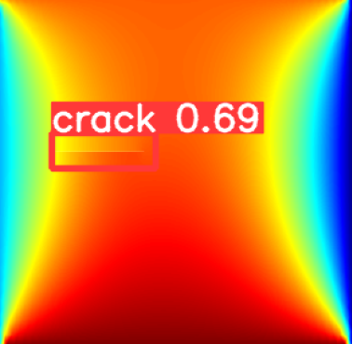
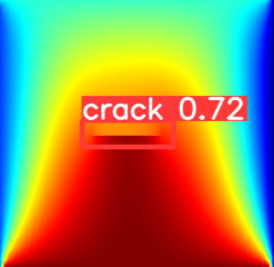
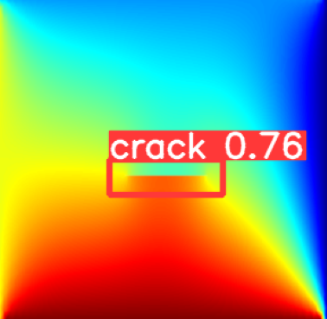
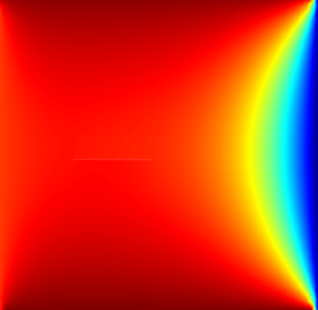
RESULTS
Example Model Predictions/Inference
Correct Predictions
Failed to Predict
We can thus see that the model is able locate the crack correctly in most cases, but it fails during
hard cases, when even a human eye is unable to locate the crack

Slide 25
POSSIBLE IMPROVEMENTS
Domain Adaptation
Model predictions are good on synthetic data, but how well does it do in real life scenarios?
2. Increasing the Data Diversity
- Try out more boundary conditions
- Multiple cracks in image
- Noisy/low resolution images
3. Optimizing the model hyperparameters
What is the best optimizer? The best learning rate? The best batch-size?
4. Trying out different model architectures
- Experimentation with different other kinds of object detection models, such as Faster R-CNN

Slide 26
THANK YOU!!!

Slide 27
APPENDIX

Slide 28
EXISTING LITERATURE
1) Yang, Wang et al. “Infrared Thermal Imaging-Based Crack Detection Using Deep Learning (2019)”
- Use experimental data, employ a varying heat flux and use thermal imagery
- Use a Faster Region Proposal based Convolutional Neural Network for Object Detection
2) Jaeger, Schmid et al. ``Infrared Thermal Imaging-Based Turbine Blade Crack Classification Using Deep Learning (2022) ”
- Use experimental data, focus on turbine blade data
- Try out various deep learning models and analyze their performance
3) Mohan, Poobal ``Crack detection using image processing: A critical review and analysis (2018)”
- Survey existing methods, mainly vanilla image processing, do not talk much about deep learning
4) Tian, Wang et al. ``A New GAN-based approach to Data Augmentation and Image Segmentation for Crack Detection in Thermal Imaging Datasets (2021)”
- Implement Generative Adversarial Nets (GANs) along with Principal Component Analysis (PCA) for feature extraction and also explore their feasibility for image augmentation on experimental data

Slide 29
EXISTING LITERATURE
5) Alexander, Hoskere et al. “Fusion of RGB and Thermal Images for automated deep learning crack detection in civil architecture (2022)”
- Use RFTNet (A Semantic Segmentation Network) specific to fusion of RGB and thermal images
6) Chandra, AlMansoor et al. ``Deep learning based Infrared Thermal Image Analysis of Complex Pavement Defect Conditions considering Seasonal Effect (2022)”
- Use external pavement data, but use thermogram images and try to take seasonal effects into account
- Use a vanilla Convolutional Neural Network
7) Kovacs et al. “Deep Learning approaches for Thermographic Imaging (2020)”
- Use synthetic data on virtual waves (a concept in thermography) for Non-Destructive Testing
8) Fang et al. ``Automatic Defects Segmentation and Identification by Deep Learning Algorithm with Pulsed Thermography: Synthetic and Experimental Data (2021)”
- Use synthetic data along with experimental data for simulations using CFRP materials

Slide 30
REFERENCES TO DATASETS
This is a list of references to datasets which I found. A lot of them are not directly applicable to our problem, so we shall need to look at how to use them
References to datasets 1. https://data.mendeley.com/datasets/v4knrwgj9y/2
2. https://www.kaggle.com/datasets/ziangwei/irtpvc/data
3. https://osf.io/zmdg4/
4. https://dataverse.harvard.edu/dataset.xhtml?persistentId=doi:10.7910/DVN/EGIEBY (Crack2Seg)
5. https://www.osti.gov/dataexplorer/biblio/dataset/1559947 (Spot Welding)

Slide 31
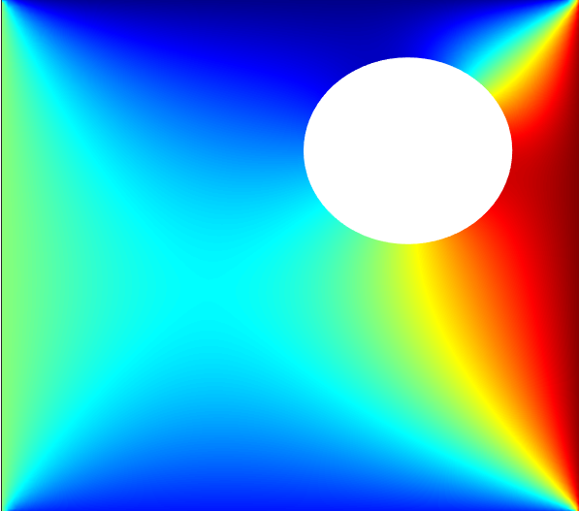
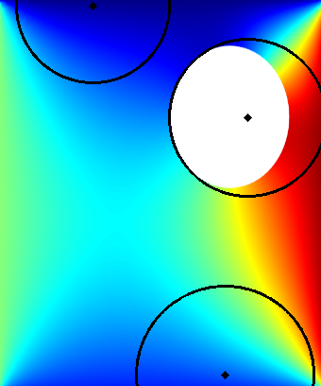
IMAGE PROCESSING
We also tried out a few techniques using simple image processing and observed the results
- Convolutional Filters worked much better than Statistical Image Processing Methods
Incorrect
Correct
Incorrect
Input Image
Detected Circles
Hough Transform
- Hough Transform is a technique used in Image Processing to detect circles and edges.
- However, it requires a lot of parameter tuning and there are no good function repositories to automate this
- Without appropriate parameters, the method is prone to errors as shown in the above figure

Slide 32

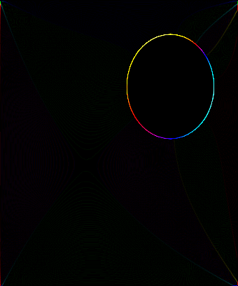
IMAGE PROCESSING
Convolution to obtain Feature Maps: Circular Hole
-1
-1
-1
-1
8
-1
-1
-1
-1
Input Image
Kernel
Output Feature Map
Edge Detection Kernel
- As we can see, the output feature map is almost completely black, except for the region where the hole is
- This feature map is then later processed to obtain the location of the hole

Slide 33


IMAGE PROCESSING
Convolution to obtain Feature Maps: Grayscale
-1
-1
-1
-1
8
-1
-1
-1
-1
Input Image
Kernel
Output Feature Map
Edge Detection Kernel
- It is important to check the effects when images are grayscale because grayscale neglects the channel-wise characteristics
- For grayscale images, the effect is much less pronounced, although it is still prevalent
- Using a neural network that combines such effects together in a structured manner is thus necessary

Slide 34
DEEP LEARNING
YOLOv5 Model for Object Detection
- Has proven to be good for detecting small objects
- Fast inference speed, easy to train, good support with Pytorch (about 2.5x faster than Faster RCNN, which lot of papers use)
- Can detect crowded objects and also gives little to low overlapping boxes
Reference: https://towardsdatascience.com/yolov5-compared-to-faster-rcnn-who-wins-a771cd6c9fb4
Backbone
A Convolutional Neural Network that Aggregates features at different granularities
Neck
A series of layers to mix and combine image features to pass them forward to prediction
Head
Consumes features from the neck and takes box and class prediction steps
YOLOv5 Model Architecture
- YOLO stands for ``You Only Look Once”
- YOLOv5 is a version of the YOLO model

Slide 35
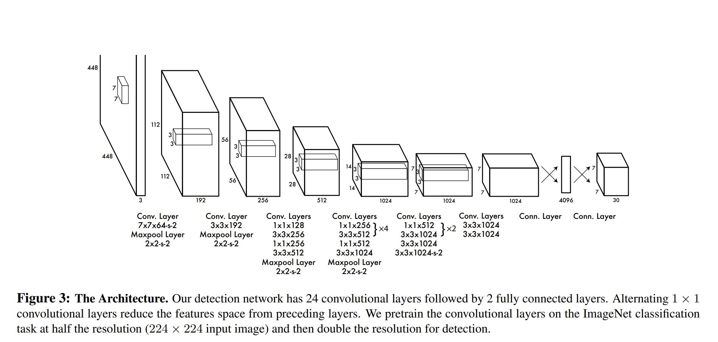
DEEP LEARNING
YOLO Architecture, Image from Original YOLO Paper
Reference: Redmon, Divvala et al. ``You Only Look Once: Unified, Real-time Object Detection
- The YOLOv5 Architecture is built on this original YOLO architecture

Slide 36
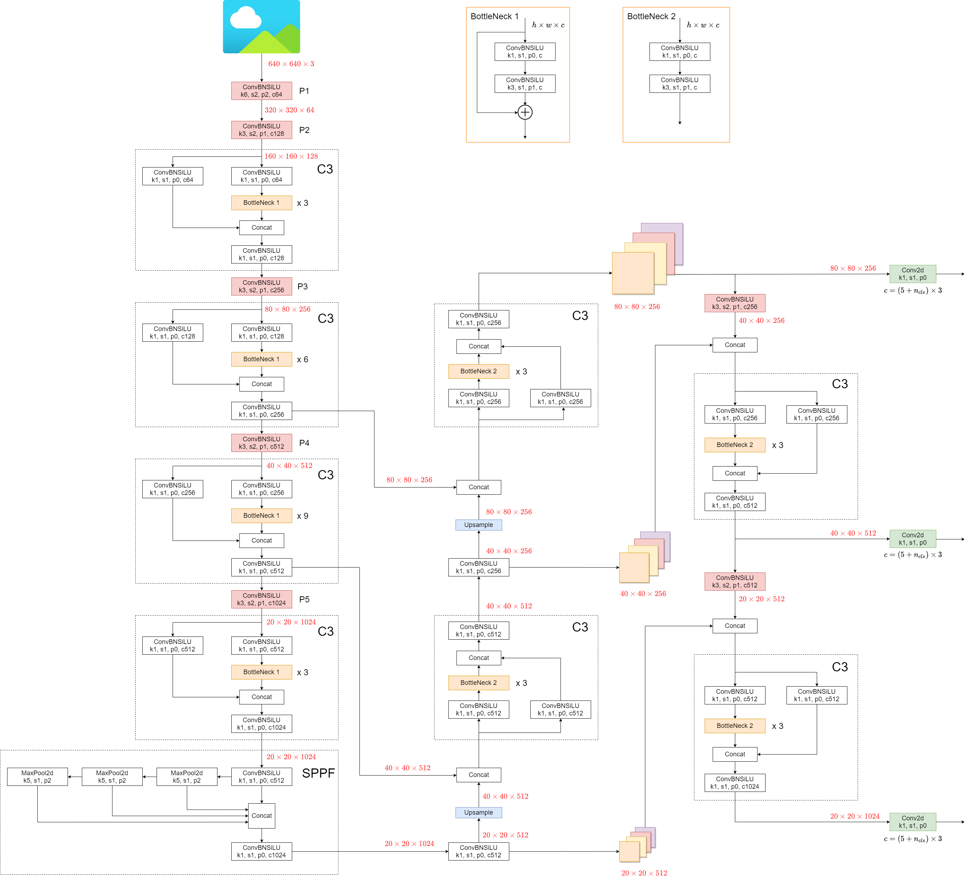
DEEP LEARNING
YOLOv5 Architecture
Reference: Ultralytics Docs

Slide 37
CHALLENGES FACED
1. Lack of existing thermogram and NDT datasets
- These datasets aren`t publicly available due to NDA issues, hence finding experimental data is challenging
2. Coding from Scratch
- Generally, GitHub starter code is available, but this time had to everything on my own which was a nice but arduous experience
- ChatGPT proved to be of great help while chalking out the codes and designs
3. Data Generation
- Had not worked with thermal simulations in Matlab before, so that was a learning point
4. Organization
- Had to make sure documentation was done well, as multiple softwares and tools are being used in the pipeline

Slide 38
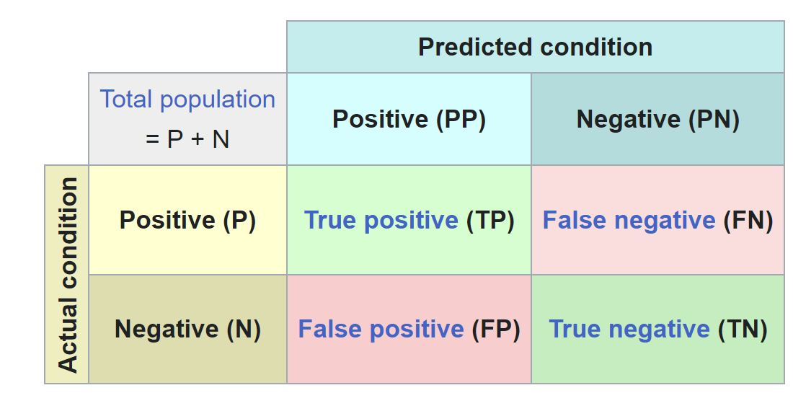
DEEP LEARNING
Metrics: Confusion Matrix, Precision and Recall
Confusion Matrix, Image Reference: Wikipedia
Precision = Number of true positives /(Number of positively labelled samples) = (TP)/(TP + FP)
Recall = Number of true positives /(Number of actually positive samples) = (TP)/(TP + FN)
A good algorithm should have high values for both precision and recall

Slide 39
DEEP LEARNING
Metrics: Intersection over Union (IoU)
Ground truth bounding box
Predicted bounding box
Intersection over Union
IoU = (Area of intersection of the two bounding boxes)/(Area of union of the two bounding boxes)
We set IoU thresholds and an object is considered detected if the IoU for that box is above the threshold

Slide 40
DEEP LEARNING
Metrics: Average Precision and Mean Average Precision
Precision
Recall
We iterate through the predictions and compute precision and recall values as we go on
The area under the curve is termed Average Precision
The mean of Average Precision taken across all classes is termed mean average precision (mAP)
mAP should be as high as possible (lies between 0 to 1)

Slide 41
LEARNINGS
This BTP was a very good experience for me as I had to put in independent efforts, which challenged my existing knowledge about the subject. Since group projects generally share the technical load over the set of group members, it does not harm much if one of the members lacks skills in any of the aspect since there are others to cover them up. However, here I could not afford the same and had to be sure that I was able to learn all the skills required. I also got to realize, that even though I believed I had a sound understanding of the theoretical concepts, the implementation of those concepts was a different ballgame altogether.
During the course of the project, I feel I have not only been able to hone my technical knowledge, but have also been able to focus on improving on skills such as research and survey, presentation as well as using new-age tools such as ChatGPT effectively for research. The skills would certainly be of great help for me in the future, and hence I can say that this project was certainly quite a satisfying experience

Slide 42
ACKNOWLEDGEMENTS
I am extremely thankful to Prof. Dnyanesh Pawaskar for letting me have this opportunity to work on a project which allowed me to apply my Machine Learning knowledge on a problem from the domain of Mechanical Engineering, which is my parent domain. His guidance throughout was valuable for me. Further, I was given a lot of freedom to explore new things, which led to me learning a lot of new things and gaining a lot of knowledge.

