Slide 1




PARTICIPANT PRESENTATION
Participant Details
Qiskit
Fall Fest
2026
PROJECT TITLE
Q-matrix · Quantum Space
TRACK
Quantum Education & Learning
TEAM NAME
Q-matrix
TEAM LEADER
Chinmay R
EMAIL / CONTACT
github.com/ChinmayRERC
Hackathon · Team Details
TEAM MEMBERS
Chinmay R · M Naveen · Thulasi Ram M
INSTITUTION / ORGANISATION
Visvesvaraya Technological University
COUNTRY
India
TEAM CODE VTU-QFF-HC-0024
Notes:
Team code: VTU-QFF-HC-0024. Project: Q-matrix · Quantum Space. Public repository: https://github.com/vtu-qiskit-fall-fest-2026/vtu-hc-q-matrix. Live demo: https://chinmayrerc.github.io/q-matrix/.

Slide 2
Problem Statement
THE GAP
▸ Quantum courses explain amplitudes, but learners cannot see them; notebooks and cloud queues add friction before the first insight.
▸ Generic AI tutors hallucinate circuits and cannot read the learner's live state or mistake.
▸ Instructors receive completion ticks, not evidence of conceptual change.
WHO FEELS IT
▸ Students in low-resource colleges without lab hardware or paid cloud credits.
▸ Self-learners who stall between a video and a working Qiskit program.
▸ Teachers who need a defensible mastery signal, not another quiz score.
DESIGN GOAL
▸ One browser workspace: learn → build → simulate → export real Qiskit.
▸ Grounded feedback from the circuit itself; every secret stays server-side.
Notes:
Problem framing from the 176-topic curriculum audit and the 7-stage lesson design. No learner PII is collected; progress is local-first.

Slide 3
Objectives & Novelty
OBJECTIVES
▸ Make quantum literacy measurable: a 7-stage loop from intuition to Qiskit export.
▸ Ground every tutor answer in the live circuit, simulator state and static analysis.
▸ Give educators an auditable mastery trail: BKT posterior, gain and challenge record.
NOVELTY
▸ Agent-reviewed content pipeline: deterministic analyzer + NVIDIA Nemotron tutor.
▸ Challenge mode loads scaffolds, never solutions; Reset restores a clean start.
▸ Browser-native density simulation with noise, mid-circuit measurement and feed-forward.
SCALE
▸ 176 topics · 20 domains · 8 learning paths · 13 circuit templates · 11 challenges.
▸ 147 automated checks, including 15 Qiskit 2.5.2 reference-algorithm tests.
Notes:
Metrics are counted from src/content/topics.generated.ts and src/lib/challenges.ts. Tests: 120 Vitest + 12 API + 15 Qiskit = 147.

Slide 4
Solution & Quantum Advantage
WHAT WE BUILT
▸ Q-matrix is the app, Quantum Space is the platform, Chinnu is the grounded tutor.
▸ Learn → Compose → Practice → Galaxy → Progress: one continuous learning loop.
▸ React SPA + FastAPI on Render; GitHub Pages demo; NVIDIA Nemotron 3.5 Lightning server-side.
QUANTUM ADVANTAGE
▸ Real statevector/density simulation exposes superposition, interference, entanglement and measurement.
▸ Noise and feed-forward are first-class: teleportation and mid-circuit correction run in-browser.
▸ Every artifact is portable: OpenQASM 2.0, Qiskit, Cirq and PennyLane exports.
WHY NOW
▸ Qiskit 2.5.2 maturity + browser compute + grounded LLMs = a real quantum classroom.
Notes:
The simulator is implemented in TypeScript; the backend mirrors the same statevector contract in NumPy for API parity. NVIDIA model: nvidia/nemotron-3.5-lightning-30b-a3b.

Slide 5
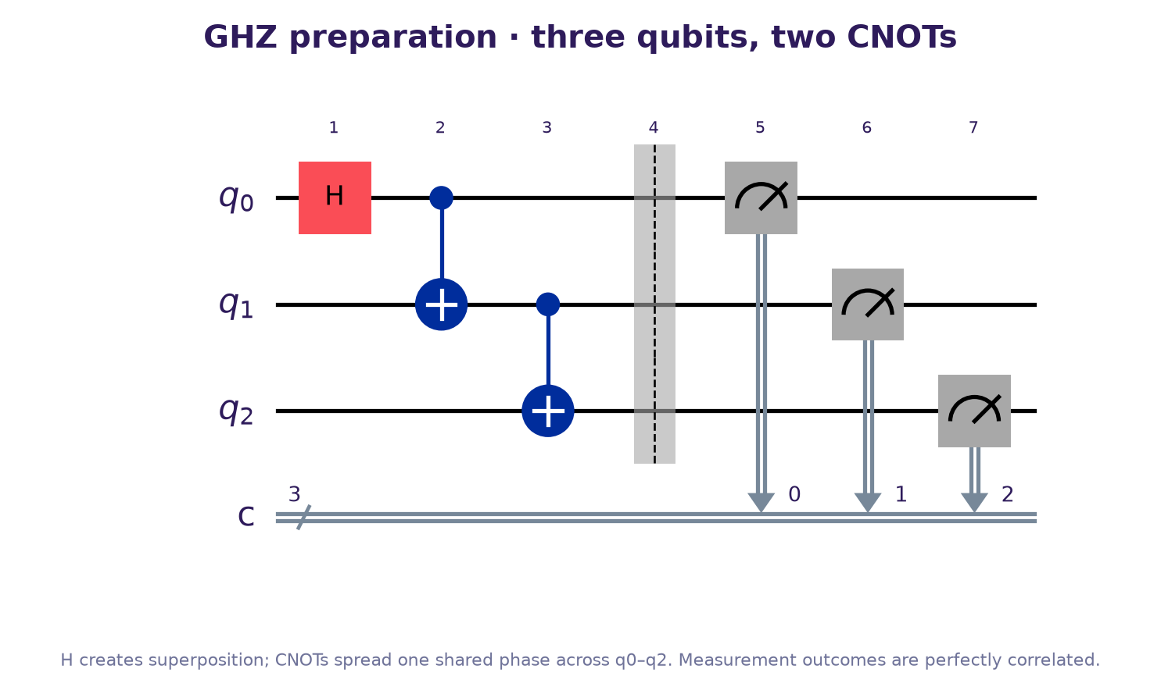
Algorithm & Circuit Design
ALGORITHM
▸ GHZ: H(q0), CNOT(q0,q1), CNOT(q1,q2) → (|000⟩+|111⟩)/√2.
▸ Each column is one simultaneous moment; gates in a column commute.
ENGINE
▸ Statevector for ideal runs, density matrix for noise; measurement collapse + `if_test` feed-forward.
▸ QASM parser reconstructs moments with per-qubit scheduling.
EVIDENCE
▸ Bell/GHZ, Deutsch–Jozsa, Bernstein–Vazirani, Grover, QFT, QPE, teleportation, noisy Bell.
▸ Web QFT matches QFTGate to 1e-12; Bell payload returns [0.5, 0, 0, 0.5].
Notes:
Circuit rendered with Qiskit 2.5.2. Reference implementations live in qiskit_ref/ and are exercised by 15 pytest cases.

Slide 6
Implementation & Tech Stack
FRONTEND
▸ React 19 + Vite + TypeScript; custom SVG circuit board with keyboard placement and ARIA labels.
▸ Hash routing keeps GitHub Pages deep links working without rewrites.
QUANTUM CORE
▸ TypeScript complex arithmetic; statevector and density simulation; QASM import/export.
▸ 13 templates; optimizer; static analyzer; Qiskit/Cirq/PennyLane exporters.
BACKEND & INFRA
▸ FastAPI proxy keeps NVIDIA_API_KEY server-side; deterministic fallback when offline.
▸ Single-origin Docker service on Render; GitHub Actions deploys the static demo.
▸ 176-topic generated curriculum; BKT mastery and CSV/JSON educator export.
Notes:
Deployment: https://q-matrix.onrender.com (Docker) and https://chinmayrerc.github.io/q-matrix/ (static). The API key is never bundled in the client.

Slide 7
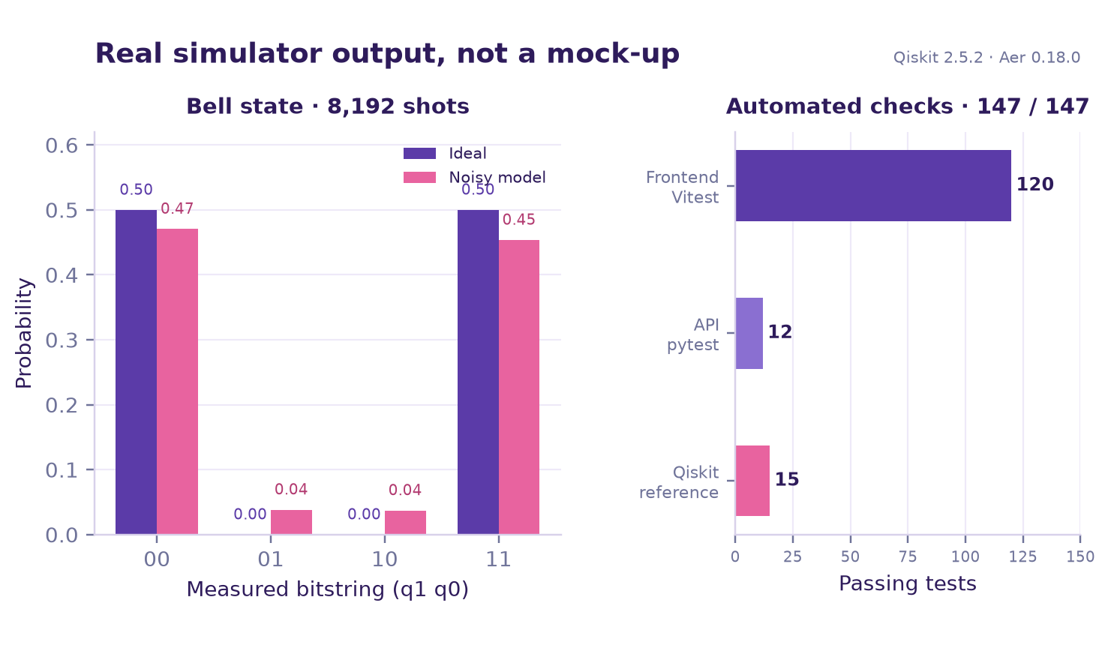
Results & Analysis
WHAT THE DATA SHOWS
▸ Ideal Bell: 4,095 / 4,097 counts for |00⟩ / |11⟩ in 8,192 shots.
▸ Noise moves 7.7% of shots into |01⟩/|10⟩ and lowers purity; the UI surfaces entropy and concurrence.
VERIFICATION
▸ 120 Vitest + 12 API + 15 Qiskit = 147/147 passing.
▸ QFT vs QFTGate: max error 1.2e-12; TypeScript strict; production build clean.
LIVE
▸ API health: numpy-statevector + NVIDIA; tutor verified end-to-end on Pages.
▸ Bell API returns [0.5, 0, 0, 0.5].
Notes:
The left panel is an actual Aer run with depolarising + readout error (seed 7). The right panel reports the repository's automated checks, not a projected metric.

Slide 8
Impact & Real-World Applications
FOR LEARNERS
▸ Zero install, low bandwidth; first simulated circuit in under a minute.
▸ Immediate, grounded feedback when a gate is misplaced or a state is separable.
FOR EDUCATORS
▸ Class-level mastery map, pretest/posttest, normalised gain and challenge record.
▸ CSV/JSON export for spreadsheets or LMS import; no database required.
FOR INSTITUTIONS
▸ Low-cost quantum lab on existing laptops; no GPU or cloud queue.
▸ Reproducible Qiskit artifacts bridge classroom work to real SDK workflows.
FOR INDUSTRY
▸ Faster onboarding for quantum software teams; a reusable simulator/analysis core.
Notes:
Impact hypothesis: a browser-native, grounded lab removes the two biggest drop-off points we observed: environment setup and ungrounded feedback.

Slide 9
Challenges & Future Scope
WHAT IS HARD
▸ Browser compute ceilings; density simulation is expensive beyond small registers.
▸ Approximate noise models; LLM latency and provider availability.
▸ Content authoring quality; multi-user persistence is not yet included.
HOW WE MITIGATE
▸ Statevector cap + density path; deterministic fallback; server-side key; localStorage.
▸ Content generator + agent review; explicit limitations in the README.
NEXT
▸ Qiskit Runtime/hardware labs, adaptive BKT + spaced repetition, LMS/LTI integration.
▸ WebGPU simulator, VQE/QAOA/Shor modules, multilingual Chinnu, classroom pilots.
Notes:
The roadmap prioritises hardware-backed labs and classroom pilots; the current build is intentionally local-first and single-user.

Slide 10
CLOSING
Thank You
Questions?
Inspiring Minds. Shaping Tomorrow.
GITHUB REPOSITORY
vtu-qiskit-fall-fest-2026/vtu-hc-q-matrix
LIVE DEMO / VIDEO
chinmayrerc.github.io/q-matrix
Live demo · https://chinmayrerc.github.io/q-matrix
Demo video (24 s) · github.com/ChinmayRERC/q-matrix/blob/main/docs/q-matrix-demo.mp4
API · https://q-matrix.onrender.com
Team code · VTU-QFF-HC-0024
Notes:
Public repo: https://github.com/vtu-qiskit-fall-fest-2026/vtu-hc-q-matrix. Live demo: https://chinmayrerc.github.io/q-matrix/. Demo video: https://github.com/ChinmayRERC/q-matrix/blob/main/docs/q-matrix-demo.mp4. API: https://q-matrix.onrender.com.

