Slide 1
A Holistic Approach to Autonomic Self-Healing Cloud Computing Architecture
Abhishek Bhavsar
Ameya More
Chinmay Kulkarni
Dheeraj Oswal
Under the guidance of
Dr. J.V. Aghav

Slide 2
The Need…
“Recent studies have pointed out that the mean-time-between-failure (MTBF) of teraflop and soon-to-be-deployed petaflop machines are only on the order of 10 - 100 hours” ^{[1][2]}

Slide 3
Need Contd.
Hardware failures difficult to heal
Prediction essential to make the system robust
Failure prediction – the core
Notes:
Hence to build a robust cloud computing system, it is essential to predict failures so that their effect can be mitigated.
Failure prediction is the core of any self healing system

Slide 4
Problem Statement
“To provide a robust, self-healing, autonomic cloud-computing system that is fault tolerant and exhibits capabilities to resist and resolve future failures thus making the system impervious to faults.”

Slide 5
Objectives
The project aims to come up with an architecture that provides:
a system to predict failures
a system to take necessary corrective actions
a generic architecture, hence holistic
an architecture that is adaptable, hence pluggable modules

Slide 6
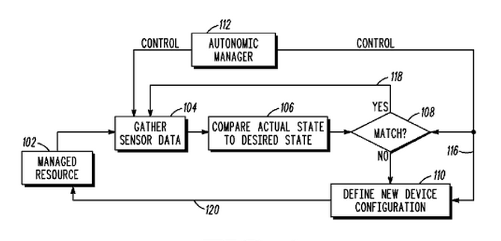
Existing Solutions
Autonomic computing system with model transfer^{[3]}

Slide 7
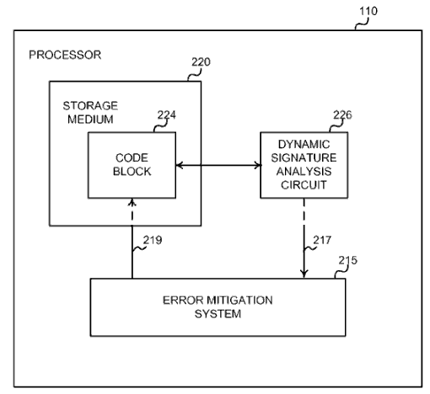
Existing Solutions
Architecture for a Self-Healing Computer System^{[4]}

Slide 8
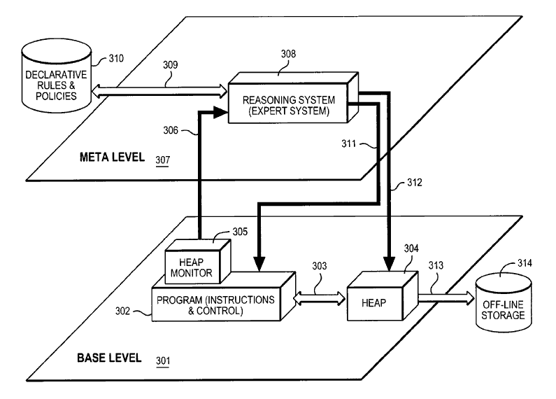
Existing Solutions
System and Method for Achieving Autonomic Computing Self Healing Utilizing Meta Level Reflection and Reasoning^{[5]}

Slide 9
Existing Solutions
Checkpointing^{[6]}
Create periodic snapshots of the entire system
On failure, revert to the most recent stable snapshot
Notes:
Blue Gene uses Failure aware scheduling and still we could find a large number of failures in its RAS Logs.

Slide 10
Comparison of Existing Solutions
Features | Autonomic computing system with model transfer | Architecture for a Self-Healing Computer System | System and Method for Achieving Autonomic Computing Self Healing Utilising Meta Level Reflection and Reasoning
Comparison Parameters | Sensor State Comparison | Dynamic Signature Comparison | Reification Message
Separate Level used | No | No | Yes – Meta Level
Action Recommendation Logic | Learning based on creating models and mapping them to ontology includes semantic processing, dependency processing and action determination. | Static rules based. Uses Lookup table to map fault to strategy. Also has alternate configurations in case the basic strategy fails and a retry module. Strategy Optimisation is proposed not implemented. | Uses a reasoning system. Job is divided into two parts - detection (base level) and action recommendation (meta level). Transparency provided because of meta level.
Architecture specific requirements | Sensors | Error Mitigation System | Reasoning Expert System
Transparency | No | No | Yes – Multilevel
Feasibility | Excessive use of sensors. Too much of information collected, requires comparable hardware to process so much information. | Uses a specific processor which executes a code block and needs to interact with error mitigation system. Too much message passing | Meta level is idle most of the time. Less messages passed. Base level only sends messages when error is detected. Strategy can be easily decided and changed without modifications to the base level.
Dynamic Learning | Yes | No | Possible

Slide 11
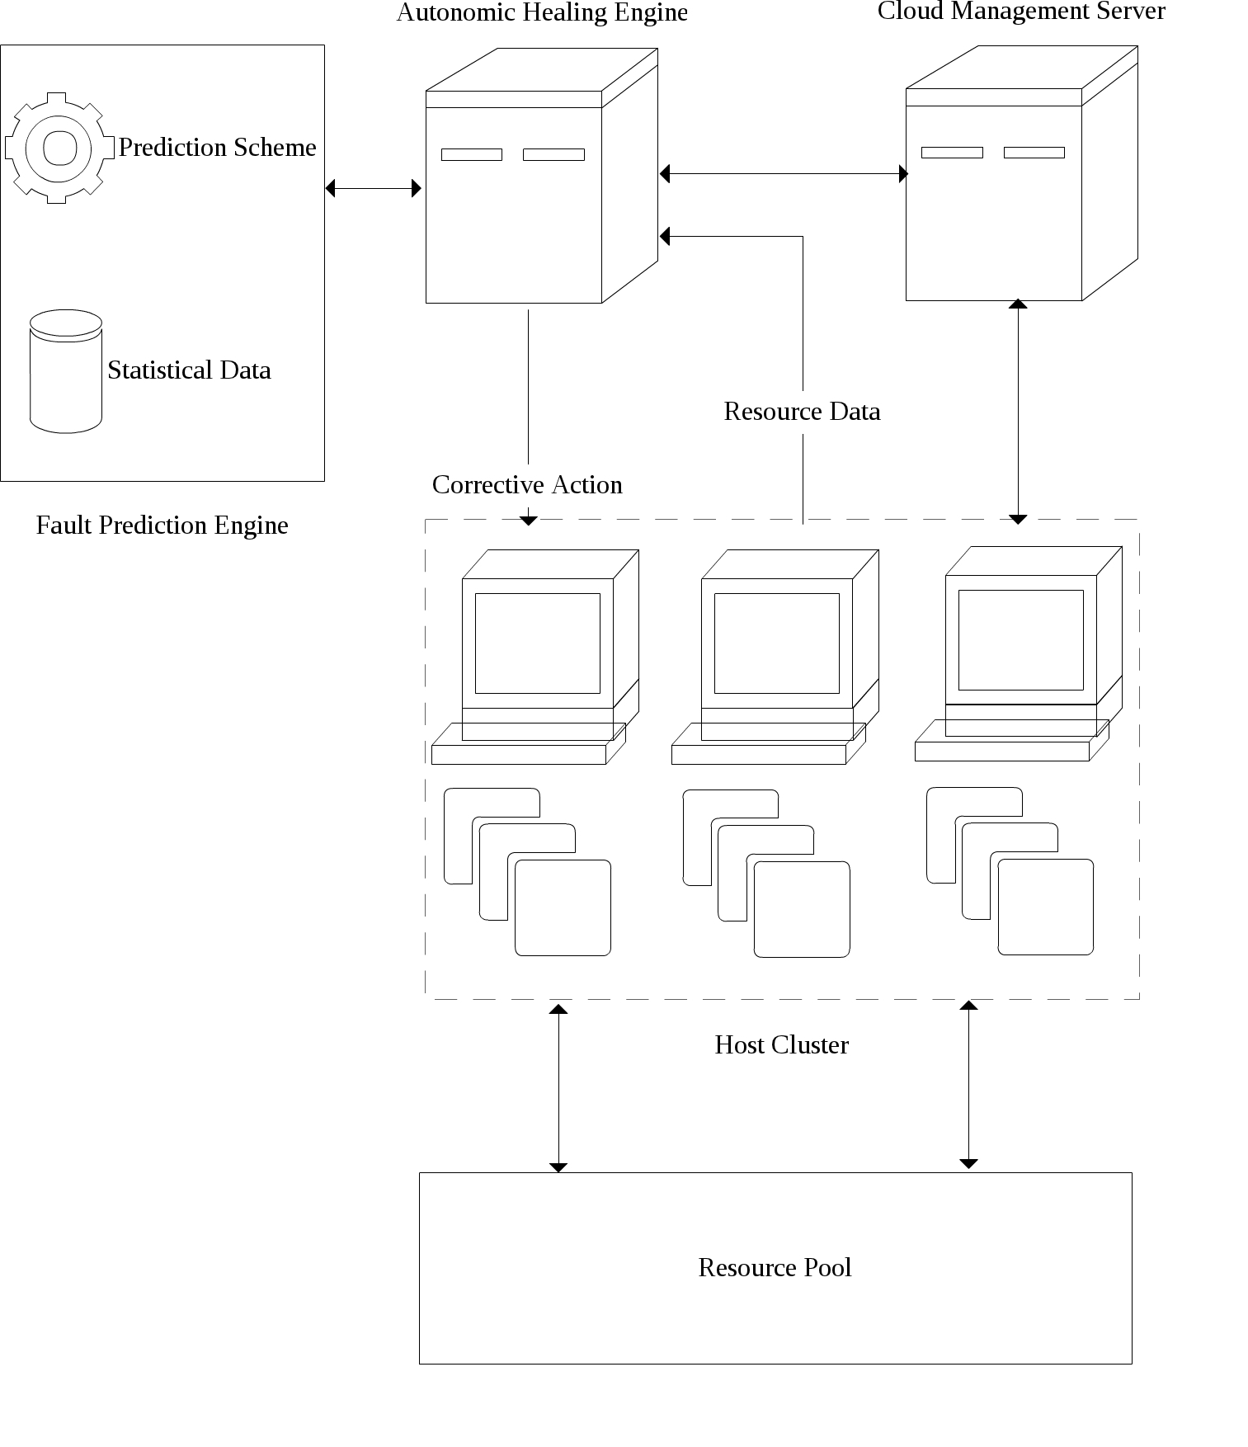
Proposed Architecture

Slide 12
Resource Pool
Consists of resources allocated to various virtual machines that are executing on the cloud host cluster
Includes computational power, network bandwidth, memory, storage capacity, etc
Provides for the virtual machines

Slide 13
Host Cluster
Consists of all the compute units
Provides for all the computing power in the cloud, used to power VMs through respective hypervisors
The hosts have a monitoring agent installed on them
Monitoring agent forwards log messages to the autonomic healing engine
Notes:
Hosts though independent are managed by the cloud management server.
This monitoring agent monitors the system and the log messages forwards

Slide 14
Cloud Management Server
Powers the cloud and is the backbone
Acts as a link between hosts and resources
Provides a unified view of the entire computing environment
Provides various management consoles for easy management
Notes:
Console Proxy VM and Secondary Storage VM

Slide 15
Autonomic Healing Engine
Middleware between the hosts cluster and the fault prediction engine
Receives the system log messages from the hosts cluster
Forwards them to the fault prediction engine for analysis and storage
Receives the analyzed information from the fault prediction engine, which helps to decide action to be taken in case of possible fault
Notes:
(Explain Action Flow)
The separation from the fault prediction engine allows for plugability.
Healing actions can be independent of the fault prediction scheme. Flexibility makes the system holistic.

Slide 16
Fault Prediction Engine
Analyses statistical data received from the autonomic healing engine
Uses data mining and machine learning techniques
It comprises of two parts:
Statistical Data: Central data store that stores all previously analyzed results
Prediction Scheme: Predicts failures through generated rules
Notes:
Data mining to recognize fault patterns and irregular behaviour in logs
In “statistical data” : Includes the learning and trainset for the prediction scheme.
In “Prediction Scheme” : Rules are generated by data mining techniques such as apriori algorithm
independent of the autonomic healing engine, so upgradable.

Slide 17
Our work
Case Study – Blue Gene RAS logs
Scrubbing the logs
Filtering the logs
Association rules generation
Prediction of faults
Healing
Notes:
What is blue gene
Why Blue Gene
RAS – Reliability Availability Servicability. Shows records of failures in the Blue Gene computer.

Slide 18
Blue Gene/L - Overview
Midplane
Service card
Node Cards
Compute Cards
I/O Nodes
Compute Chips
Notes:
A compute card contains two computer chips
node card contains 16 compute cards, and a midplane holds 16 node cards with a total of 1024 processors.
A midplane also contains several I/O nodes which are configured to handle file I/O and host communication.
Each midplane also has one service card that performs system management services.
These system management services include activities such as monitoring node heartbeat and checking errors.

Slide 19
A RAS log record
recid | event time | location | event type | facility | severity | entry data
1 | 2005-06-03- 15.42.50.363779 | R02-M1- N0-C:J12- U11 | RAS | KERNEL | INFO | instruction cache parity error cor- rected
Notes:
Types of data
Graphs

Slide 20
Scrubbing
Error messages originally very elaborate
Difficulty in NLP
Ontology based classification
Easy and efficient prediction
Some errors reported as fatal but not actually fatal and vice versa

Slide 21
Statistics after scrubbing
No. of distinct entries (many of which may be logically similar) : 329482
No. of truly distinct entries after scrubbing : 101
Percentage reduction in types of error messages : 99.97%

Slide 22
Scrubbing
Facility | Number of types of failures
APP | 6
BGLMASTER | 4
CMCS | 2
DISCOVERY | 11
HARDWARE | 6
KERNEL | 71
LINKCARD | 2
MMCS | 6
MONITOR | 5
SERV_NET | 2

Slide 23
Filtering
Log reporting at microsecond frequency
Same error reported multiple times
Temporal filtering at the same location by removing similar entries within a time window
Significant reduction in the log size

Slide 24
Filtering
Number of entries before filtering : 4747963
Number of entries after filtering : 2832849
Percentage reduction in number of entries : 40.34 %

Slide 25
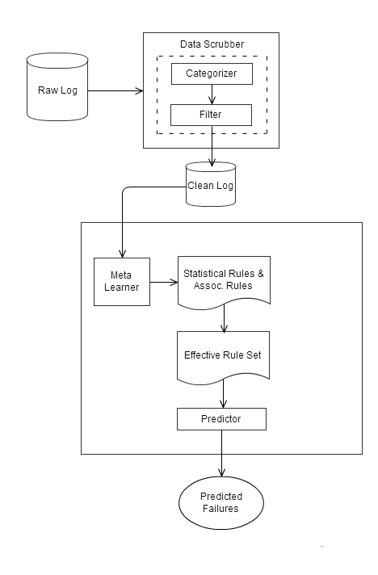
Failure Prediction Scheme

Slide 26
Association Rules – Why^{[7]}
High confidence
Involve larger subsets of the data set
Better for multiple target attributes
They are easier to interpret
Eg.
nodeError=true linkCardFailure=true ==> nodeFailure=true <conf: (0.93)>
Notes:
Example : An example of an association rule would be "If a customer buys a dozen eggs, he is 80% likely to also purchase milk.”
Support is an indication of how frequently the items appear in the database. Confidence indicates the number of times the if/then statements have been found to be true.

Slide 27
The Predictor
Triggered failures list(TF List) – Failures triggered by an event
Triggering events list(TE List) – Events triggering a failure
nodeError=true linkCardFailure=true ==> nodeFailure=true
TF list:
nodeError – nodeFailure
linkCardFailure – nodeFailure
TE list:
nodeFailure – nodeError, linkCardFailure

Slide 28
Predictor Algorithm

Slide 29
Evaluation metrics

Slide 30
Results
Graphs – precision, recall, comparison of actual Vs predicted failures

Slide 31
Results – Precision and Accuracy

