Slide 1


KINDERED TAIL

Slide 2
Introduction
Children safety is a matter of concern and crime against children are on rise.
Kindred tail minimises the problem by providing a feasible solution
EMF generation: 130 V/m (safe limit: 200V/m)
AIM
Modify children accessories for their safety.

Slide 3
Objective
To create the circuit for the ESP32 and its modules.
To create website for the storage and company UI.
To create application for service access by the guardian.
To use a drill to make a hole for the camera lens.
To apply waterproofing for the electrical components.
To assemble the components together.

Slide 4
Innovation
Creating smart badges.
Smart badges will be equipped with sensors.

Slide 5

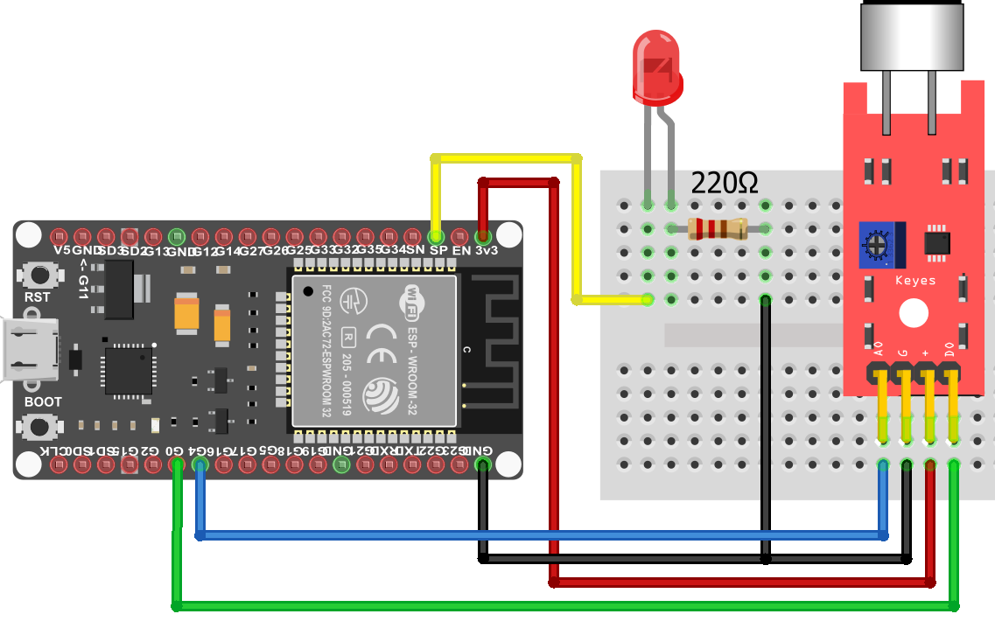
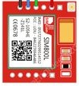
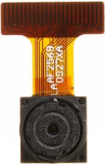
CIRCUIT DIAGRAM

Slide 6
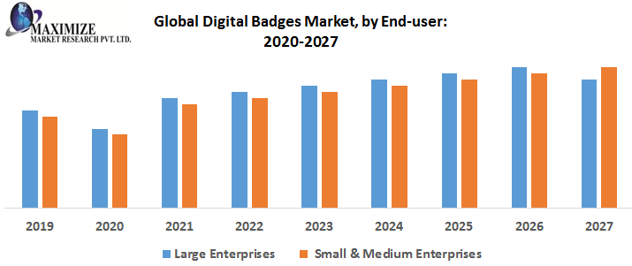

Slide 7
Features
Location will be provided by cell towers.
Peer to peer video streaming.
Voice to text and speech recognition for red flag text.
Secure and fast performance data storage facility.
Security by secure algorithm SHA-256.
Image recognition for allergic food.
Waterproof circuit making it washable.
Custom designs with light weight framework.

Slide 8
Advantages:
High performance and security.
No maintenance.
Low EMF production.
Cheap to operate.
Children safety.
Low crime rate.
Drawbacks:
Need to charge its battery every 13 hours.
Possibility of false alarm.
Location and internet data transmission will be halted in remote areas.

Slide 9
3D Model
7 MM
5 MM
5 CM

Slide 10
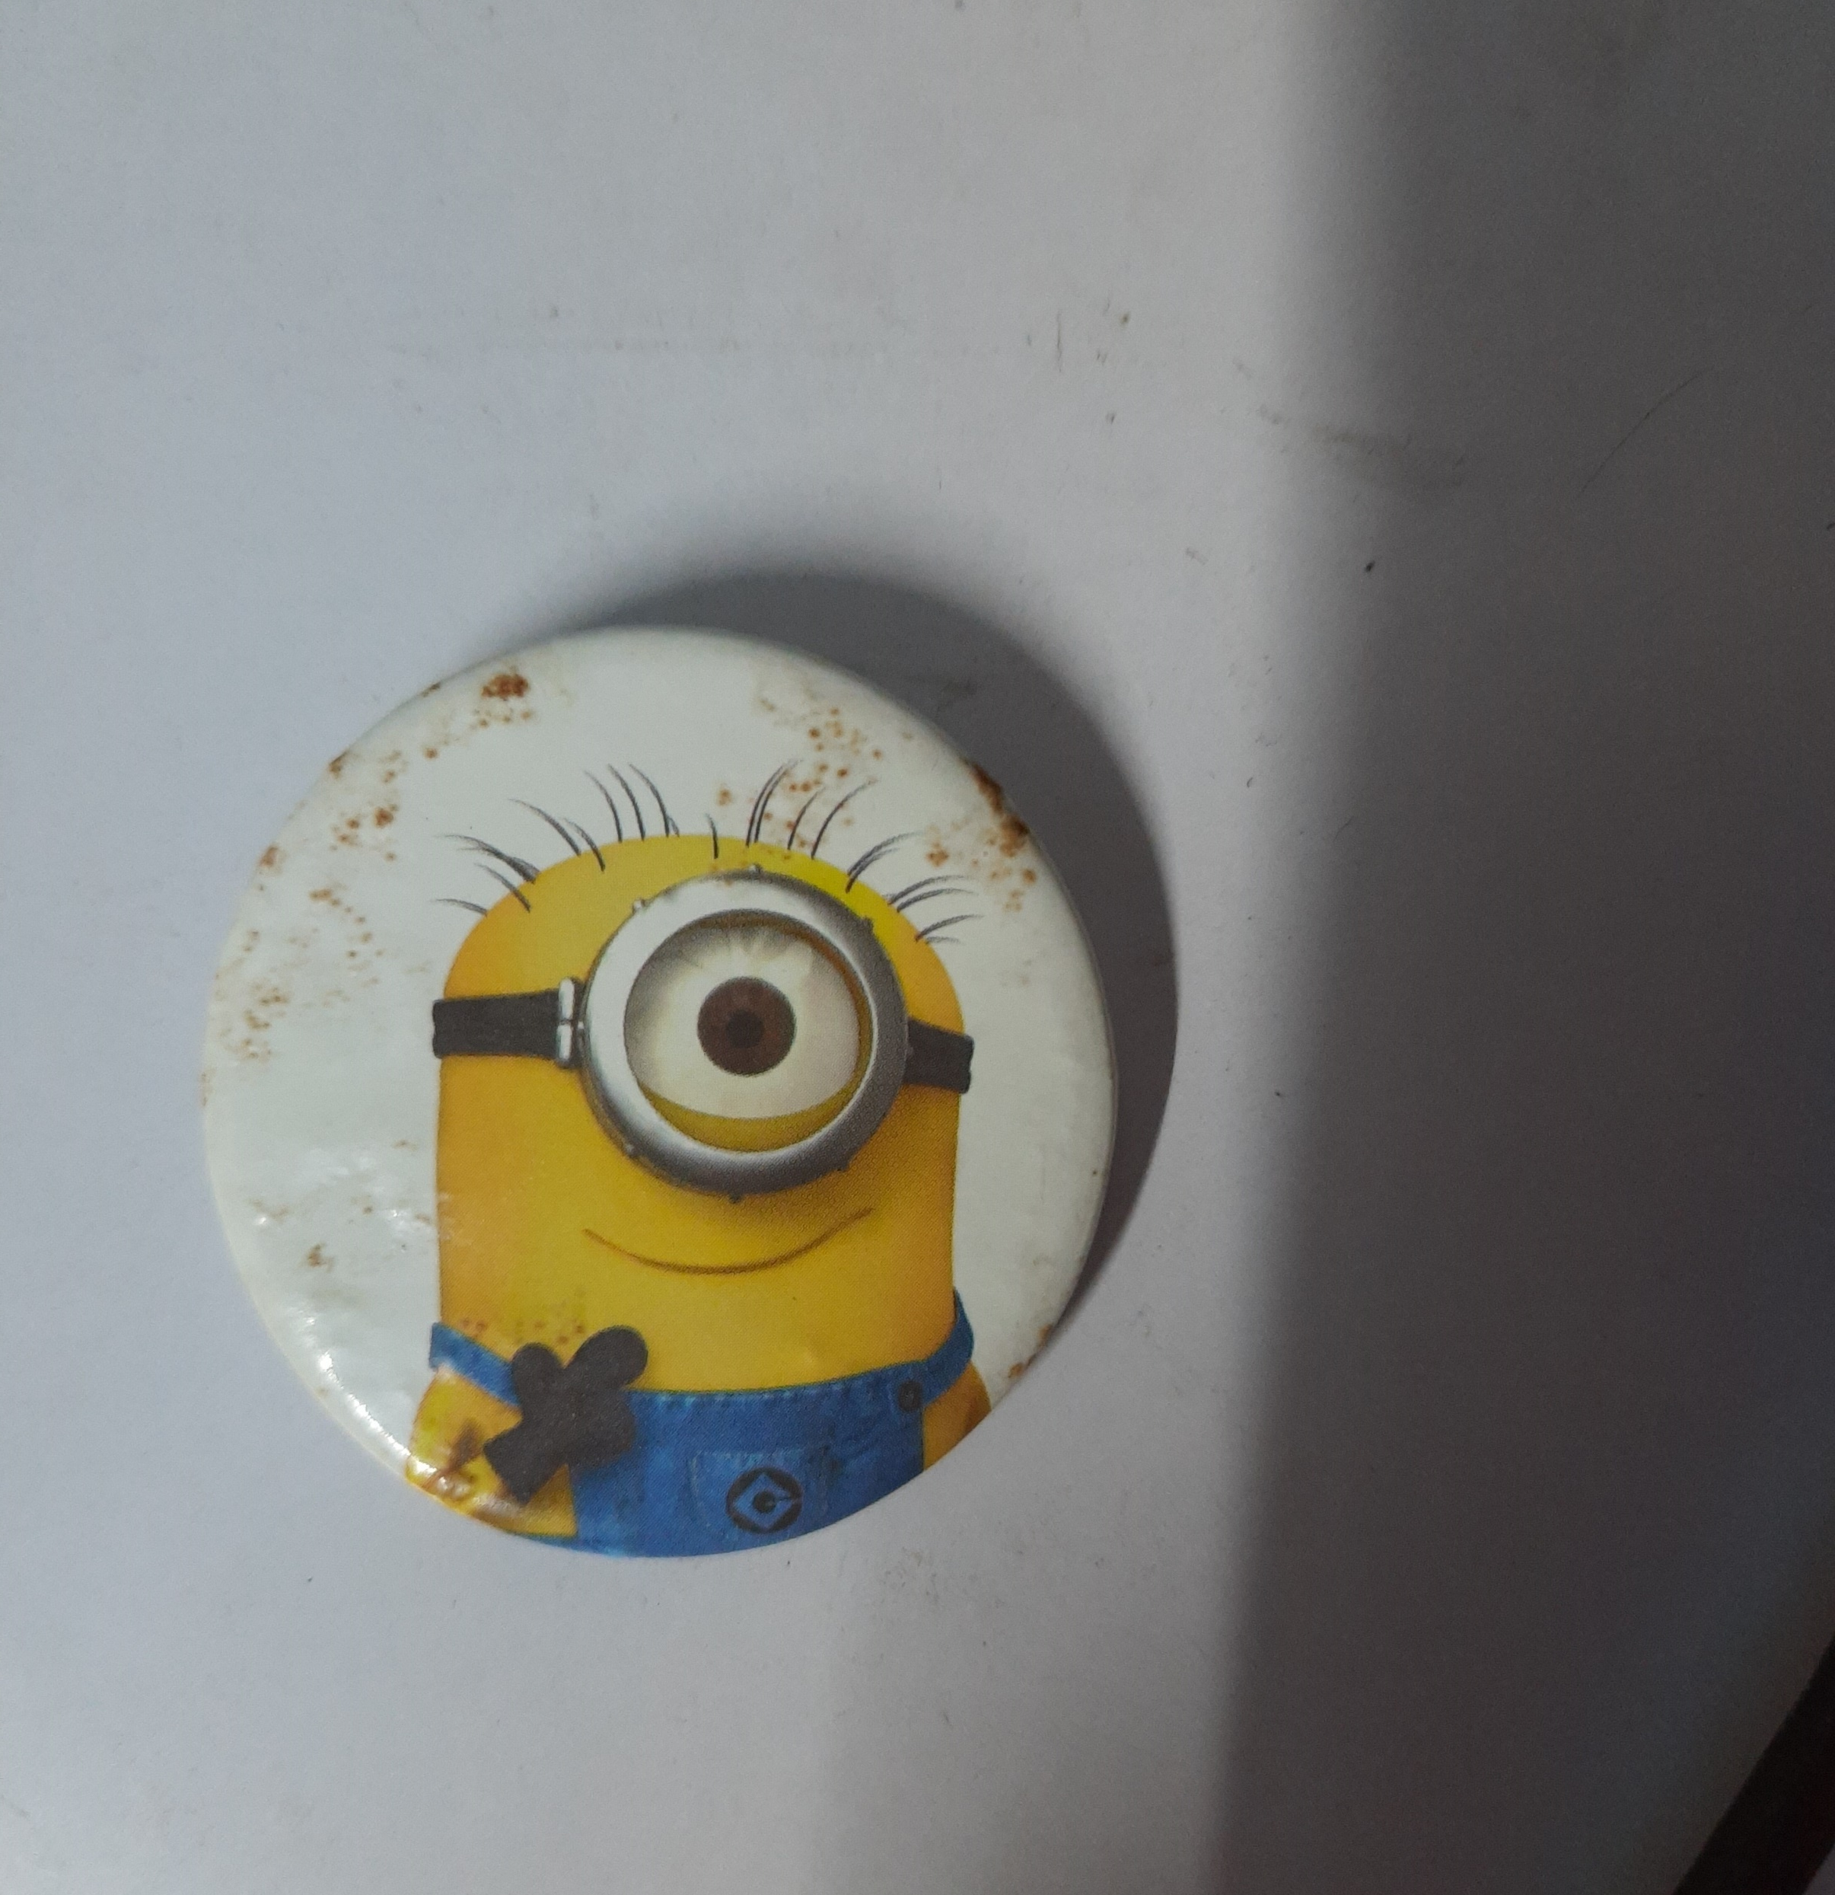
Prototype:

Slide 11
PROPOSED BUDGET
Sr. No | Equipment | Approx. cost
1. | ESP32 CAM + OV2640 | 1417/-
2. | Battery and Motor | 795/-
3. | Transformer | 449/-
4. | Carbon Fibre | 3,913/-
 | Total Hardware | 6,574/-
Cost for google services combined is: 34,344.15 INR
Cost for waterproof additives and product theme selection is: 4,412.63 INR
Cost for camera installation with installation service (8x 1080p): 23,192.00 INR
TOTAL COST: 68,522.78 INR

Slide 12
THANK YOU!

