Slide 1
💳
Loan Approval Prediction
Machine Learning Project Presentation
From data cleaning and model comparison to a Streamlit deployment that predicts whether a loan application is approved or rejected.

Slide 2
What this project covers
Problem & objective
Dataset & preprocessing
Why loan prediction matters and what the project aims to solve.
Data size, features, cleaning, encoding, and scaling steps.
Model building
Results & deployment
Comparison of multiple ML algorithms using key performance metrics.
Best model selection and Streamlit web app features.

Slide 3
Problem statement
Why this matters
Faster screening of large numbers of applications.
More consistent decision support using historical patterns.
Better use of applicant variables like income, credit score, and loan burden.
Financial institutions need a reliable way to decide whether a loan application should be approved or rejected using applicant details and credit-related information. Manual review can be slow and inconsistent when decisions depend on many variables at once.

Slide 4
Objective and solution
🎯
🛠️
Objective
Solution
Build a machine learning model that predicts loan approval status accurately and supports faster, more consistent decisions.
Train multiple classification models on historical loan data, select the best one, and deploy it in Streamlit for real-time predictions and user-friendly feedback.

Slide 5
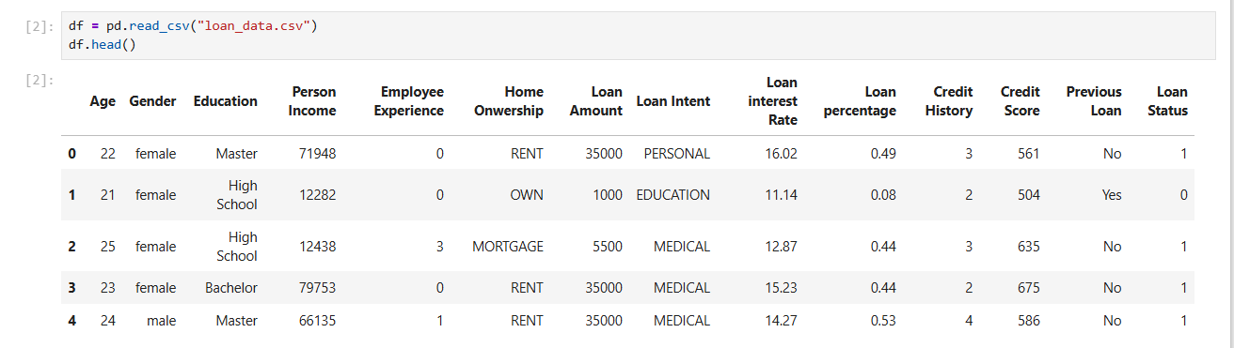
Data overview
45000
14
5
9
Initial rows
Original columns
Categorical features
Numeric fields incl. target

Slide 6
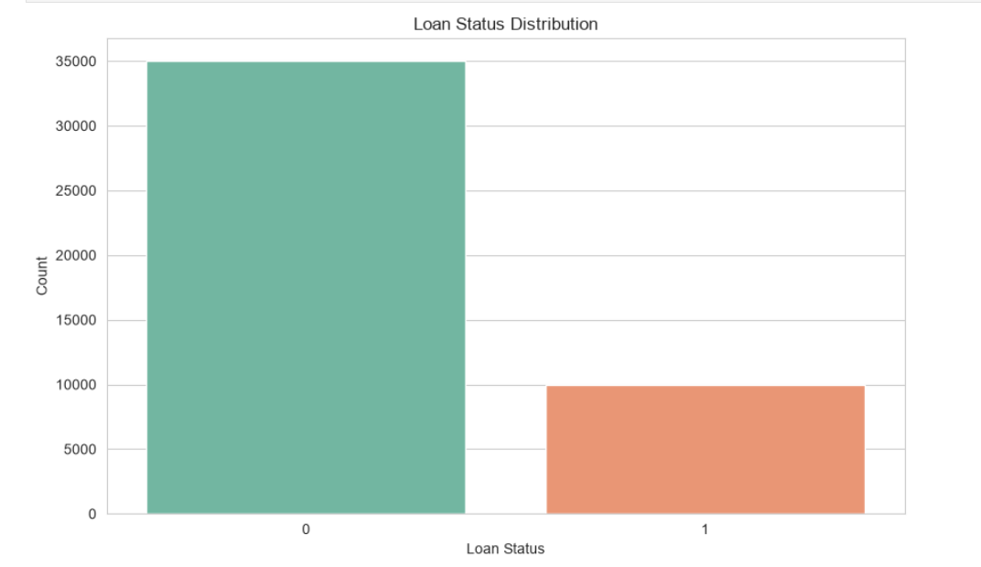
Data overview

Slide 7
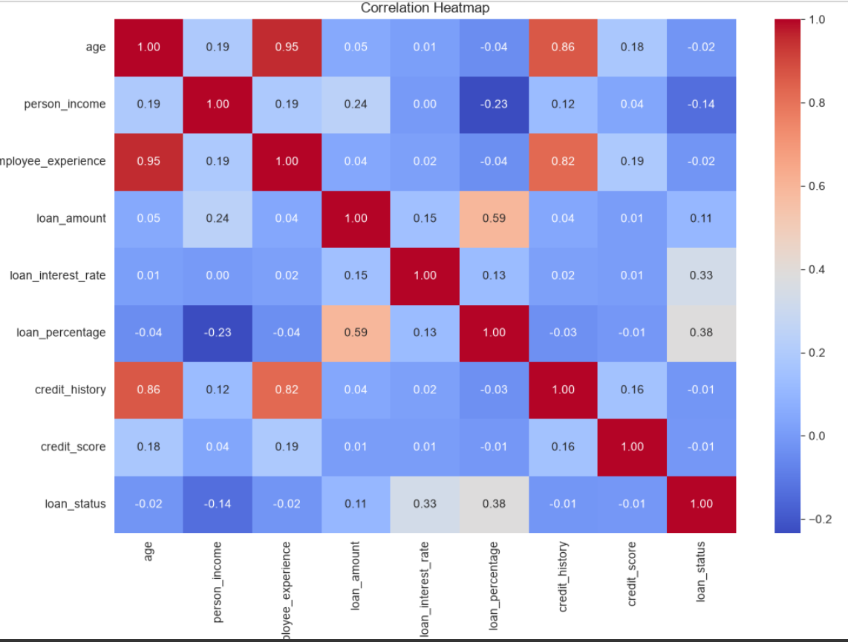
Data overview

Slide 8
Preprocessing workflow
🧹
📉
🔤
Cleaning
Transformation
Encoding & scaling
Removed impossible values by keeping age between 18 and 80 and employee experience between 0 and 60.
Applied log transformation to person income and replaced the original income field with person_income_log.
Encoded categorical columns with LabelEncoder and prepared scaled numeric data using StandardScaler.
After cleaning, the dataset size became 44,990 rows. The final model input consisted of 13 features.

Slide 9
Training setup
Feature matrix size after preprocessing: 44,990 rows × 13 features.
Train-test split: 80% training and 20% testing with stratification.
Training set size: 35,992 rows; test set size: 8,998 rows.
Multiple models were compared using Accuracy, Precision, Recall, F1 Score, and ROC-AUC.
Models evaluated
• Logistic Regression
• Decision Tree
• XGBoost
• Random Forest
• LightGBM
• CatBoost

Slide 10

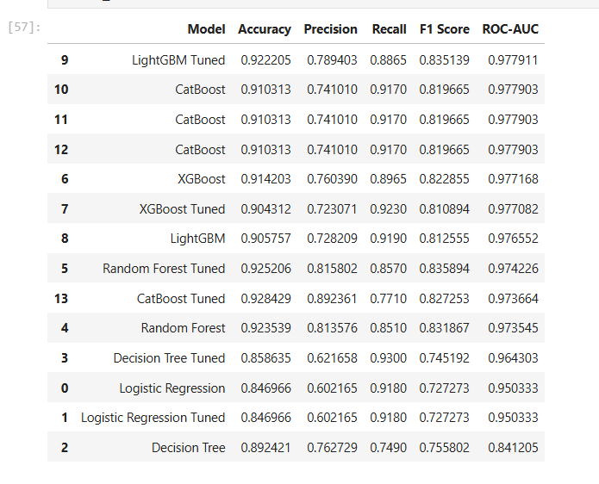
Top model comparison

Slide 11
Selected model: LightGBM Tuned
0.92220
0.8865
0.8351
0.9779
0.7894
Accuracy
Precision
Recall
F1 Score
ROC-AUC
The final model was selected by sorting results using ROC-AUC, F1 Score, and Accuracy, which placed LightGBM Tuned at the top among all evaluated algorithms.

Slide 12
Streamlit application
🧾
📊
💡
Interactive input form
Informative result view
Decision support
Users enter 13 applicant features and receive an instant prediction.
The app shows status tags, input summary, prediction probabilities, and model inputs used.
For rejected profiles, the app can show risk signals and suggestions for improvement.
Deployment artifacts saved in the project include best_model.pkl, scaler.pkl, label_encoders.pkl, and feature_columns.pkl.

Slide 13
Learning
Key outcomes
Practical ML pipeline
The project covered end-to-end work: dataset inspection, cleaning, feature engineering, preprocessing, training, evaluation, and deployment.
Strong predictive performance
Tree-based boosting methods clearly outperformed simpler baselines, with LightGBM Tuned producing the best overall balance of metrics.
User-facing deployment
The Streamlit application converts the trained model into an accessible tool that can help demonstrate real-time decision support.

Slide 14
🙏
Thank You
Loan approval prediction using Machine Learning and Streamlit
This presentation summarized the problem statement, objective, preprocessing, model comparison, best result, and deployed Streamlit solution.

