Slide 1
CS 291A - Scalable Internet Services
Team AZ Fan Club
Winter 2021

Slide 2
Application Details

Slide 3
What is schedule.me?
schedule.me enables groups to find the most optimal times to meet based on each member’s availability.
Main features:
View all polls
Create a new poll
Poll details
Add participant to a poll
Optimal time frame selection
Notes:
Show demo of each feature here

Slide 4
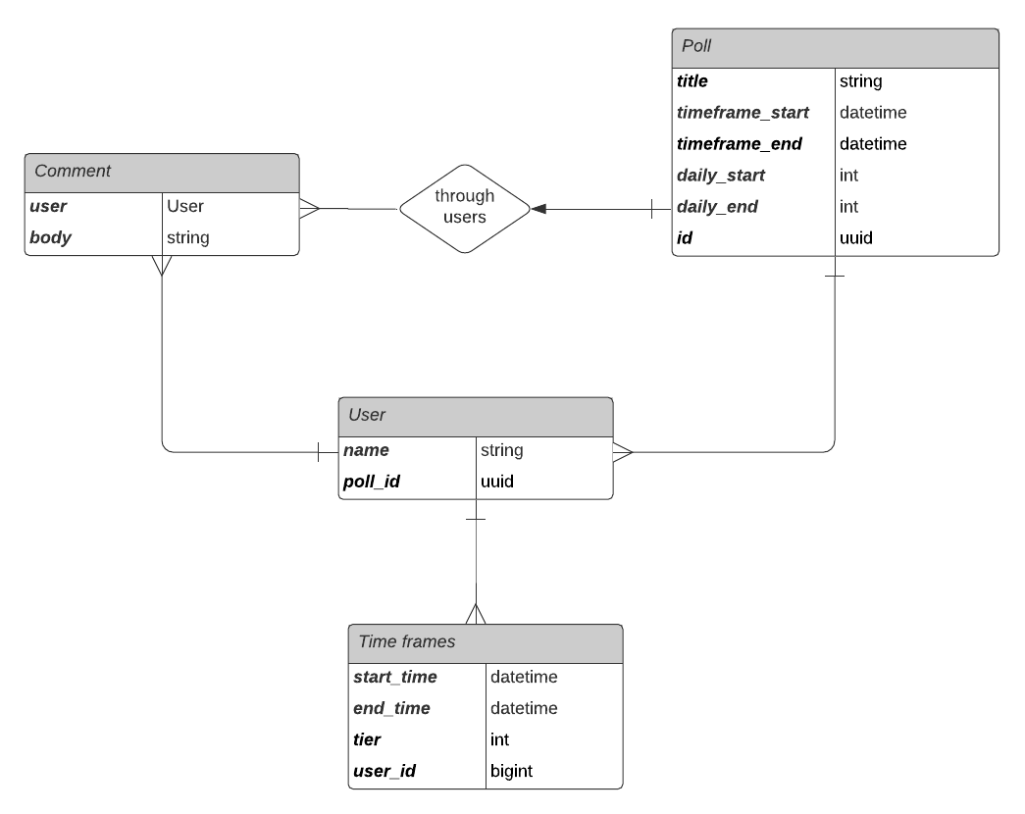
Under the hood😳
Notes:
Models (nested):
Timeframes
Users (participants)
Polls
Comments
Top level model is the poll object, which has users nested underneath it.
Users own timeframes and comments, and comments are accessible to the poll via the user.

Slide 5
Load testing ⚖️

Slide 6
Setup
Seeding🌱:
1,000 polls
10,000 users
10,000 comments
20,000 timeframes
Transactions💳:
create_poll, create_user, create_timeframe, create_comment, view_poll, view_user
Sessions📋:
Create poll (weight 1)
Populate poll with users (weight 1)
Create new user within a poll + enter their availability (weight 1)
Existing user enters their availability (weight 1)
User enters 1-10 comments (weight 1)
User views a poll (weight 10)
Notes:
We wanted to set up our db with existing polls and users to better replicate real world loads.
Set up a framework to randomly access users and polls in our load tests
Defined 6 transactions, which is defined as atomic operation in Tsung.
We then defined a session as a workflow consisting of multiple transactions.
Here are the main workflows we identified to be the most realistic when using our application.
You can see here that session 6 has a much greater weight compared to the others. This is because this user workflow would be the most common in our app.

Slide 7
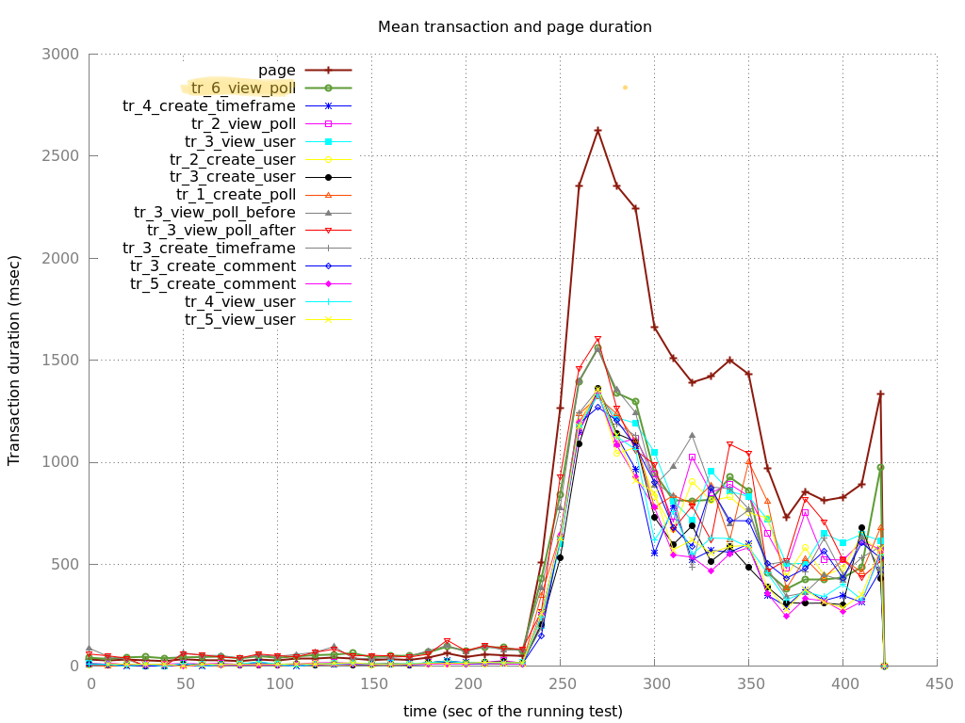
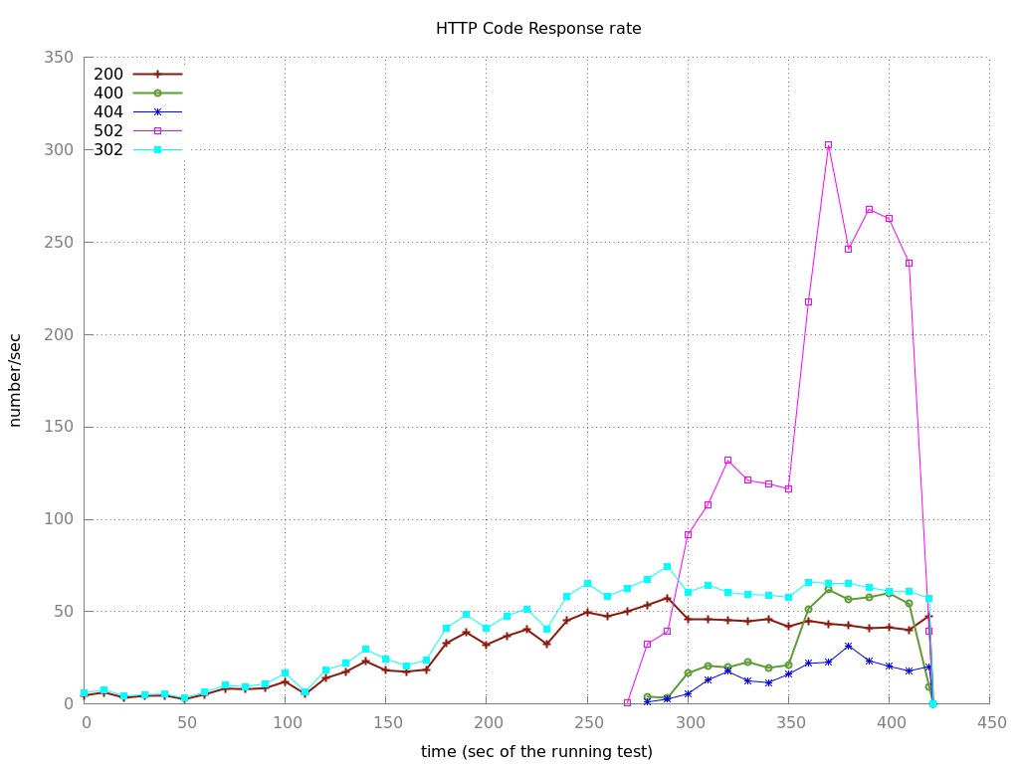
Baseline 🏁
Single ec2 m5.large instance
7 arrival phases, each phase 60 sec.
Begins with 2 users per second, doubles each subsequent phase
Notes:
Workflow 6 - view poll is used as our point of reference for most of the performance measurements
502 is an upstream error, implies database throttling/overloading at that load
Return 502 errors around the same time we reach the highest transaction time.

Slide 8
Optimizations 📈

Slide 9
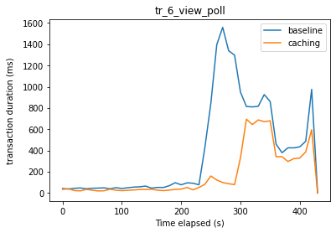
Caching
In-memory in application server (1024 MB)
Russian Doll caching
Poll views + associated users & comments
Optimal time frame calculations
Significant performance improvements✅

Slide 10
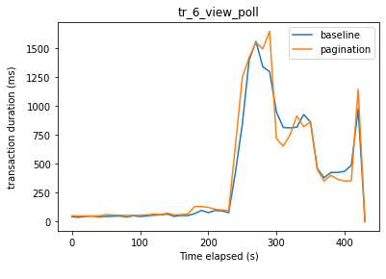
Pagination
Paginating users and comments on on a given poll’s page
Displays 5 users/polls per sub-page
Little to no improvements😫
Notes:
Explain why it didnt work
***

Slide 11
N+1 Query Optimizations
Scenario 1: Accessing a user’s time frames for (1) computing optimal timeframes and (2) rendering the polls page
Original query:
SELECT "polls".* FROM "polls" WHERE "polls"."id" = $1 LIMIT $2 SELECT "users".* FROM "users" WHERE "users"."poll_id" = $1 for user_id: SELECT "time_frames".* FROM "time_frames" WHERE "time_frames"."user_id" = $1
Optimized query:
SELECT "polls".* FROM "polls" WHRE "polls"."id" = $1 LIMIT $2 SELECT "users".* FROM "users" WHERE "users"."poll_id" = $1 SELECT "time_frames".* FROM "time_frames" WHERE "time_frames"."user_id" in ($1, $2, ...)

Slide 12
N+1 Query Optimizations (cont.)
Scenario 2: Accessing the associated users for a given poll’s comments when rendering the poll’s page
Original query:
SELECT "comments".* FROM "comments" INNER JOIN "users" ON "comments"."user_id" = "users"."id" WHERE "users"."poll_id" = $1 for user_id: SELECT "users".* FROM "users" WHERE "users"."id" = $1 LIMIT $2
Optimized query:
SELECT "comments".* FROM "comments" INNER JOIN "users" ON "comments"."user_id" = "users"."id" WHERE "users"."poll_id" = $1 SELECT "users".* FROM "users" WHERE "users"."id" in ($1, $2, ...)
Notes:
***

Slide 13
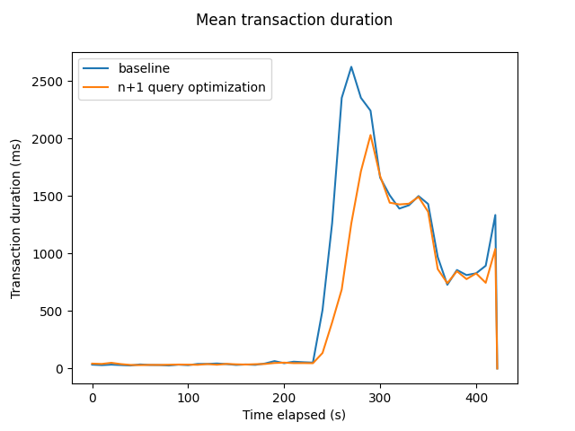
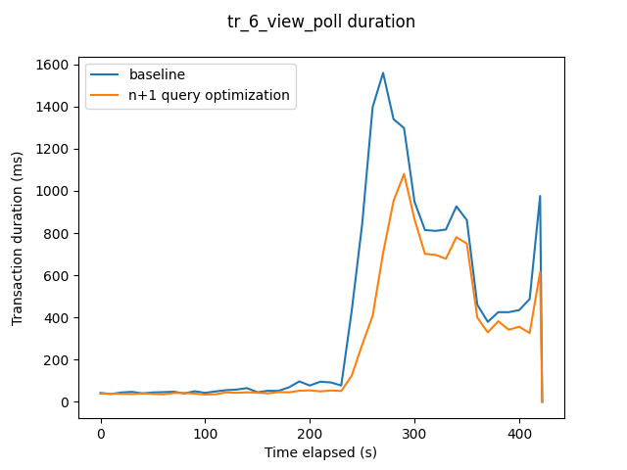
N+1 Query Optimizations (cont.)
Results:

Slide 14
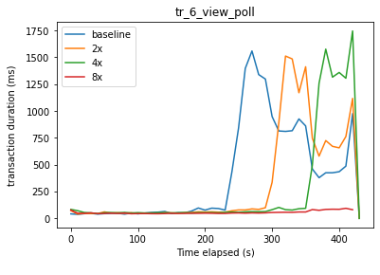
Horizontal Scaling
Increasing # of m5 instances to 2, 4, and 8.

Slide 15
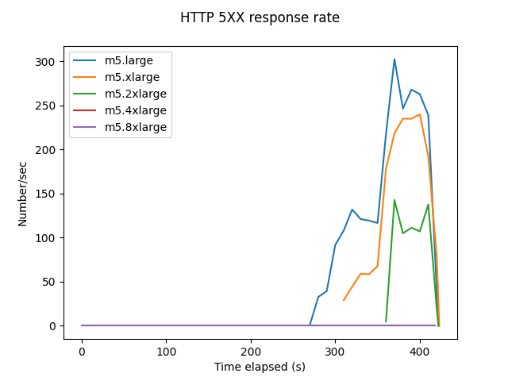
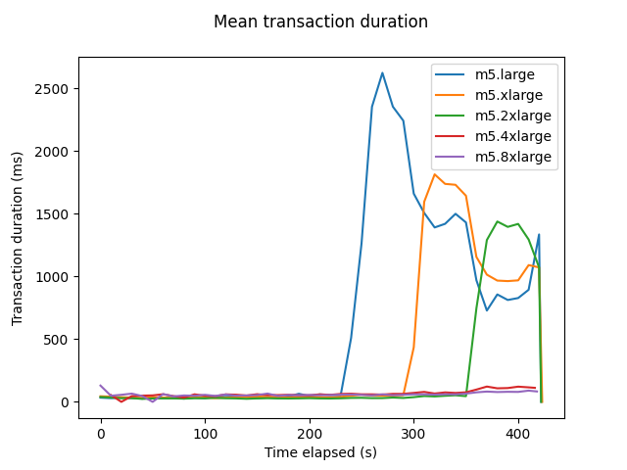
Vertical Scaling
Increasing the size of each m5 instance.
m5.large (initial) → m5.xlarge → m5.2xlarge → m5.4xlarge → m5.8xlarge

Slide 16


Slide 17
Cost Analysis💸
Horizontal Scaling
Vertical Scaling
Type | Time until failure (sec) | Phase / Arrival rate | Cost
m5.large (baseline) | 240 | 5/32 | $0.096
2x m5.large | 300 | 6/64 | $0.192
4x m5.large | 360 | 7/128 | $0.384
8x m5.large | 360ish? | 7/128+ | $0.768
Type | Time until failure (sec) | Phase / Arrival rate | Cost
m5.xlarge | 300 | 6/64 | $0.192
m5.2xlarge | 360 | 7/128 | $0.384
m5.4xlarge | 360ish? | 7/128 | $0.768
m5.8xlarge | N/A | 7/128++ | $1.536

Slide 18
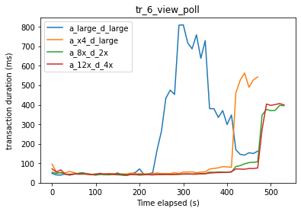
Pushing Further
Combining vertical scaling and code optimizations
Notes:
Added 2 extra phases with 256 and 512 users/sec
Tried vertically scaling with all code optimization
4xlarge app server, large db could support 128 users/sec before transaction time spiked and we saw errors
8xlarge app server, 2xlarge db and 12xlarge app, 4xlarge db could support 256 users/sec before transaction time spiked and we saw errors
Not worth it to go up to 12xlarge app 4xlarge db

Slide 19
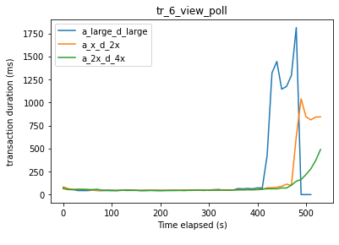
Pushing Further
Combining horizontal scaling, vertical scaling, and code optimizations
Notes:
Tried horizontal with vertical and code optimization, all using 8 app servers
Large app servers and large db could support 128 users/sec before transaction time spiked and we saw errors
Xlarge app servers and 2xlarge db could support 256 users/sec before transaction time spiked and we saw errors
2xlarge app servers and 4xlarge db could support 512 users/sec before transaction time spiked and we saw errors

Slide 20
Cost Analysis💸
Horizontal + Vertical Scaling
App Type | DB Type | Time until failure (sec) | Phase / Arrival rate | Cost
m5.large (baseline) | m5.large | 240 | 5/32 | $0.096 + $0.178 = $0.274
8x m5.large | m5.large | 420 | 8/256 | $0.768 + $0.178 = $0.946
8x m5.xlarge | m5.2xlarge | 480 | 9/512 | $1.536 + $0.712 = $2.248
8x m5.2xlarge | m5.4xlarge | 540ish | 9/512+ | $3.072 + $1.424 = $4.496
Notes:
Cost analysis of combining horizontal and vertical scaling with code optimization
We were able to see about double performance when scaling up, but the cost goes up more that double when we scale up m5.large to m5.2xlarge db (I’m not sure why they skipped xlarge db LOL)

Slide 21

Conclusion
built a web service
load testing is very hard
we learned a great deal
- rupi kaur

Slide 22
Conclusion (Not Clickbait)
Built with Rails, deployed with AWS, load tested with Tsung
Optimizations:
N+1 query optimization ✅
Caching ✅
Pagination 😐
Future Goals: Better UI, Nosql Database
Notes:
Learned a lot building with Ruby on Rails and AWS, and testing with Tsung
Incrementally load tested, found caching and N+1 optimizations effective while pagination didn’t help much
In the future, want to clean up UI and use a non-SQL database for better horizontal scaling
****

