Slide 1
INTERACTIVE BALLOON BURST GAME
USING PYTHON

Slide 2
INTRODUCTION
For my project I developed an interactive game using OpenCV, Mediapipe and Pygame in python.
I took the idea of a basic balloon popping game, where random balloons would appear on the screen and the player used to pop them, using click of the mouse but rather than using mouse I added a feature where player can use their index finger to pop them.
PROBLEM STATEMENT
As an internship completion task, I was asked to make a project using python modules and things I have learned there.

Slide 3
PROGRAMMING LANGUAGE USED
Used Python Programming Language to develop this project
Python boasts a vast collection of libraries and frameworks that cover almost every imaginable use case.
Python has a clean and intuitive syntax, making it easy to read and understand.
Python has a vibrant and supportive community of developers. This community actively contributes to the language's development, continuously improving its capabilities and ensuring the availability of resources, tutorials, and documentation.

Slide 4
LIBRARIES USED
OPENCV
OpenCV offers a wide range of functions and algorithms for computer vision tasks, including image and video processing, object detection and tracking, feature extraction, facial recognition, augmented reality, and more.
OpenCV is implemented in C/C++ and optimized for performance. It utilizes hardware acceleration and takes advantage of multicore processors to ensure fast and efficient processing of images and videos.
OpenCV is well-suited for real-time applications, as it provides optimized algorithms and techniques for processing video streams and performing real-time analysis on live video input.

Slide 5
PYGAME
Pygame provides a straightforward and intuitive API, making it accessible to beginners and those new to game development. It offers a high-level interface that simplifies tasks such as drawing graphics, handling user input, and playing audio.
Pygame offers a wide range of multimedia capabilities, including handling graphics, playing sounds and music, and capturing user input. It provides functionality for rendering and manipulating images, creating animations, and implementing audio effects.
Pygame provides a built-in Sprite class, which simplifies the management and manipulation of game objects. It also includes collision detection mechanisms, allowing developers to detect and respond to collisions between game entities.

Slide 6
MEDIAPIPE
MediaPipe focuses on real-time processing of various multimedia inputs, such as video, audio, and sensor data. It provides a framework to build pipelines that can process and analyze these inputs in real-time, enabling applications like augmented reality, gesture recognition, object tracking, and more.
MediaPipe offers a flexible and modular architecture that allows developers to construct custom processing pipelines. It provides a wide range of pre-built components, called "calculators," which perform specific tasks like object detection, face tracking, pose estimation, and more. Developers can combine these calculators to create complex pipelines tailored to their specific needs.
MediaPipe is optimized for high-performance multimedia processing, utilizing techniques such as multi-threading, hardware acceleration, and efficient resource management. This allows it to achieve real-time performance even on resource-constrained devices.

Slide 7
PROJECT SCREENSHOTS

Slide 8
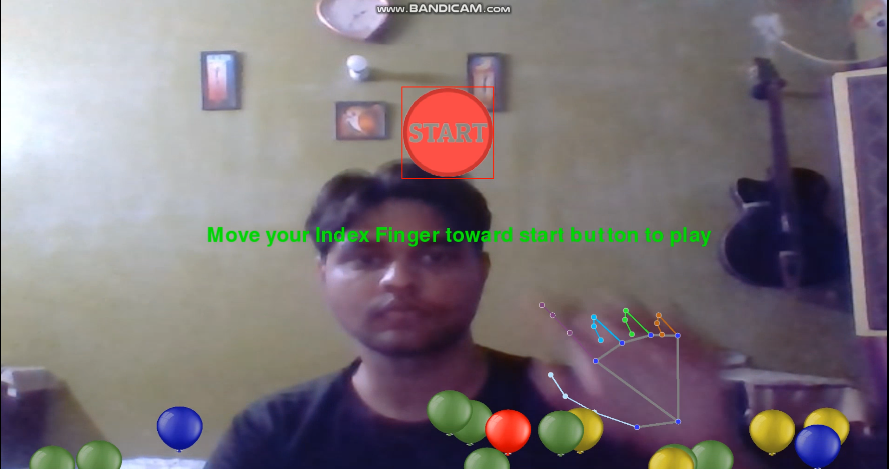
INRTO WINDOW

Slide 9
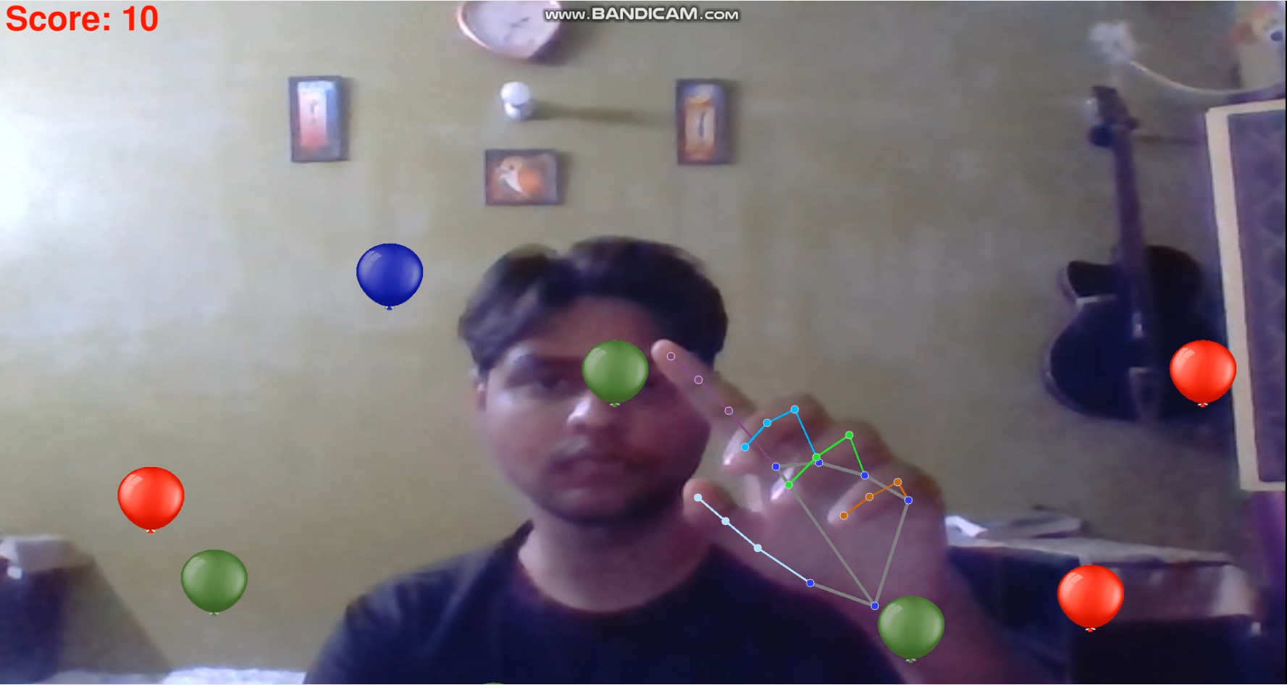
MAIN WINDOW

Slide 10
PROBLEMS FACED
Issue related to balloons images –
The images I used didn’t have their background removed so it was looking unusual and unconventional. Removed the background from images using photoshop.
Performance Issue –
Using default BGR color format for game made an impact on its performance. I converted the frame from BGR to RGB to increase the performance

Slide 11
References
https://www.assemblyai.com/blog/mediapipe-for-dummies/
https://www.pygame.org/docs/tut/SpriteIntro.html
https://www.makeuseof.com/pygame-collision-detection-physics/

