Slide 1
UPI TRANSACTION ANALYSIS
Analytical Report Deck
Data Analytics with GenAI - Capstone Project
Prepared by: Chinmaya Panigrahi
Registration ID: 24CRD05066

Slide 2
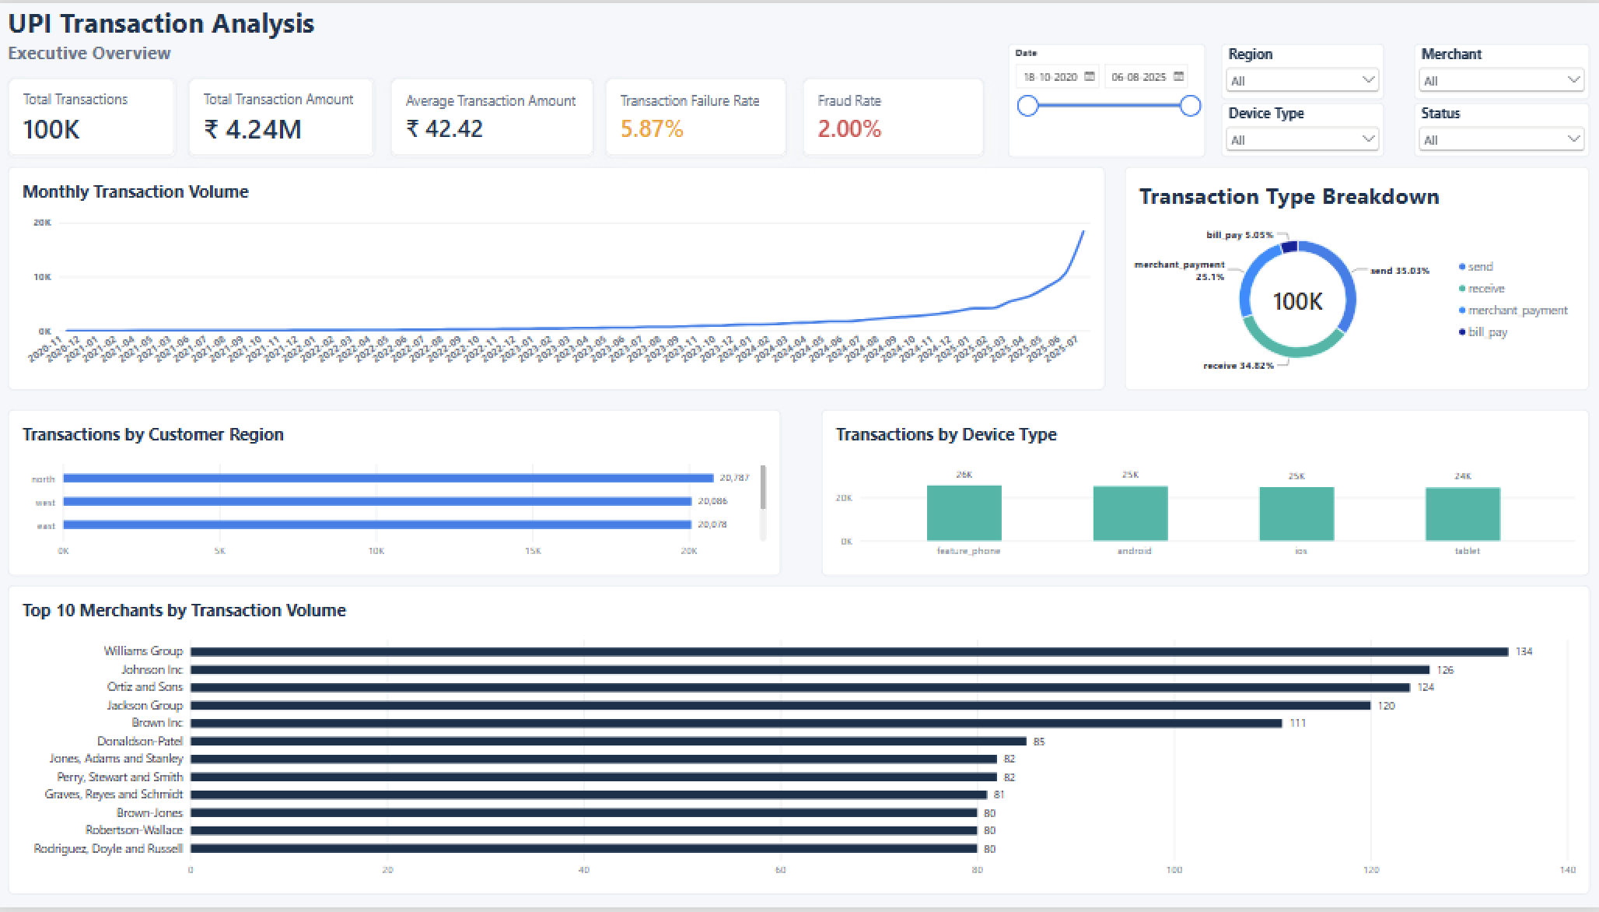
UPI Transaction Analysis | Capstone Project
Chinmaya Panigrahi
Business Problem & Objectives
Problem context
A UPI platform needs visibility into transaction volume, operational failures, fraud flags, device risk and alert resolution. The goal is to convert raw operational tables into clear findings that can support decisions.
Measure transaction health and payment performance
Identify fraud-risk patterns without overstating causality
Diagnose transaction-failure drivers
Design an interactive dashboard for monitoring
Convert findings into strategic actions
Output focus: clean data, valid relationships, clean analysis and an interactive dashboard
UPI Transaction Analysis | Adda247 Capstone Project
2

Slide 3
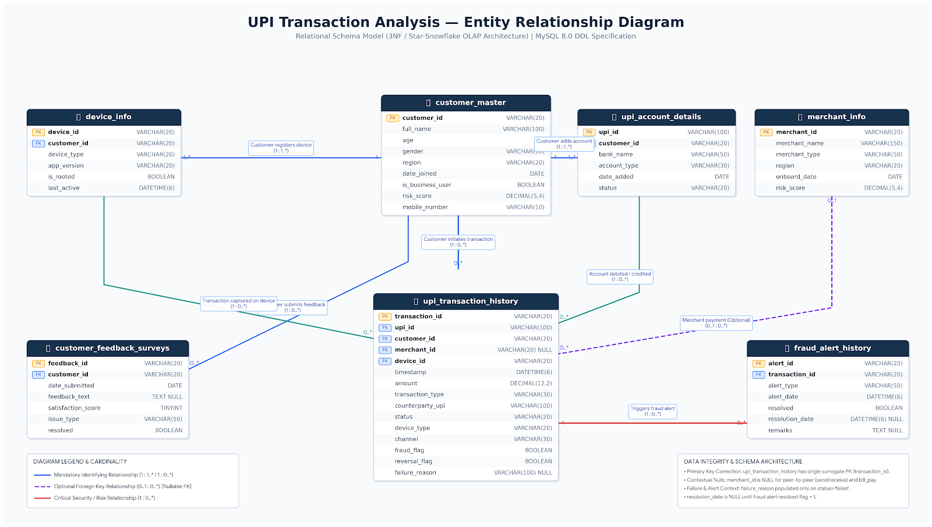
UPI Transaction Analysis | Capstone Project
Chinmaya Panigrahi
Data Sources & Project Architecture
Source table | Role in analysis | Key use
customer_master | Customer profile dimension | Region, age, business-user context
upi_account_details | UPI-account dimension | Bank, account type, account status
upi_transaction_history | Core fact table | Transactions, status, fraud flag, amount
device_info | Device dimension | Root status, device type, last active
merchant_info | Merchant dimension | Merchant category and risk score
customer_feedback_surveys | Feedback table | Issue type, satisfaction, resolution
fraud_alert_history | Fraud alert table | Alert type, resolved status, resolution date
Architecture: Excel validation -> MySQL schema & ingestion -> Python EDA/statistics -> Power BI dashboards -> executive report
UPI Transaction Analysis | Adda247 Capstone Project
3

Slide 4
UPI Transaction Analysis | Capstone Project
Chinmaya Panigrahi
Data Validation & Quality Results
Datasets validated | Source records | Duplicate PKs | Orphan FKs | FK checks passed
7 / 7 | 140,500 | 0 | 0 | 100%
Validation area | Result | Treatment decision
Primary keys | No duplicate primary identifiers detected | Proceed to SQL ingestion
Referential integrity | Required foreign-key relationships passed | Use relational model confidently
Contextual nulls | merchant_id, failure_reason and resolution_date blanks explainable by context | Retain; do not impute or delete
Outliers | 5,457 transaction-amount outliers flagged | Retain for EDA and business review
Categorical consistency | No detected categorical inconsistencies | Proceed to modeling and dashboarding
Why this matters
The validation stage protects later SQL, Python and dashboard outputs from structural errors. No aggressive deletion was needed, because the biggest missing-value patterns were contextual rather than invalid.
Submission value
The validation workbook and presentation document the quality controls evaluators expect: row checks, key checks, FK checks, null treatment and outlier review.
UPI Transaction Analysis | Adda247 Capstone Project
4

Slide 5
UPI Transaction Analysis | Capstone Project
Chinmaya Panigrahi
Database & Analytical Methodology
Validate structure first → analyse patterns second → recommend only where evidence supports
01
Excel
Validation
02
MySQL
Database
03
Python
Analysis
04
Statistics
Validation
05
Power BI
Dashboard
06
Strategy
Report
• Row-count checks
• PK / FK validation
• Null classification
• Outlier review
• 7-table schema
• PK/FK constraints
• CSV ingestion
• Post-load checks
• SQL extraction
• Cleaning & transforms
• EDA summaries
• Visual checks
• Hypothesis testing
• Supported vs unsupported
• Avoid overclaiming
• Interpret evidence
• Executive overview
• Fraud operations
• Interactive slicers
• KPI monitoring
• Top insights
• Recommendations
• Impact scenarios
• Decision summary
Method principle
1. Validate structure
2. Analyse patterns
3. Recommend actions
Confirm keys, relationships, null logic and row counts.
Use Python, EDA and statistics to separate signal from
noise.
Convert only evidence-backed findings into business actions.
Result: a complete workflow that can be checked and reproduced.
UPI Transaction Analysis | Adda247 Capstone Project
5

Slide 6
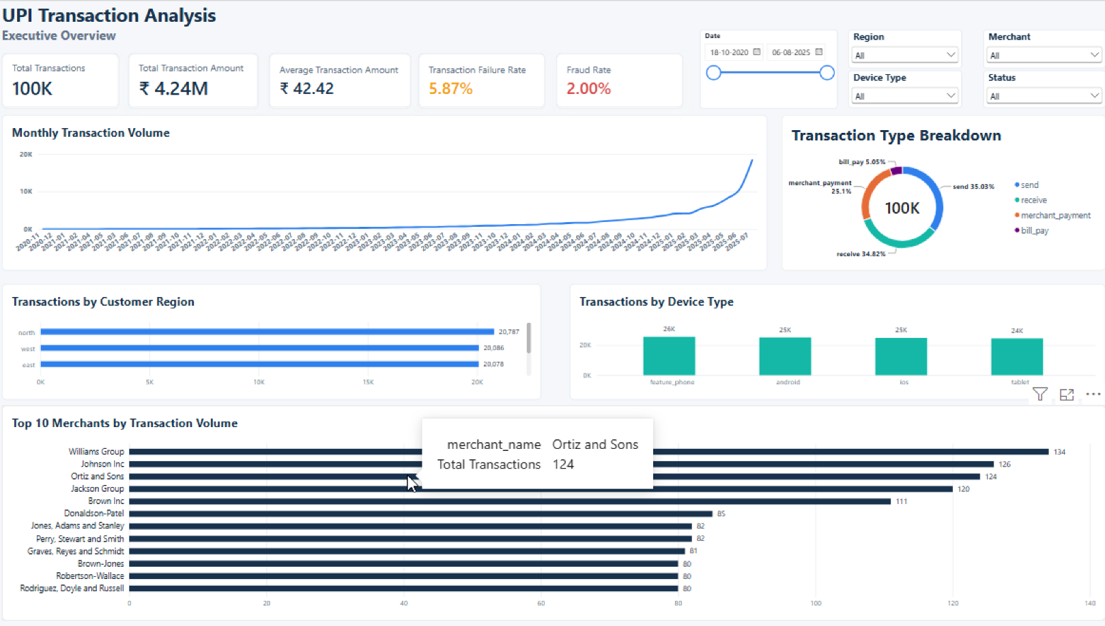
UPI Transaction Analysis | Capstone Project
Chinmaya Panigrahi
Executive KPI Overview
Total Transactions | Transaction Amount | Average Amount | Failure Rate | Fraud Rate
100K | INR 4.24M | INR 42.42 | 5.87% | 2.00%
Executive reading | Meaning
Scale | 100K transactions provide sufficient volume for operational monitoring.
Reliability gap | 5.87% failure rate points to measurable friction.
Fraud baseline | 2.00% observed fraud-flag rate becomes the core risk KPI.
Dashboard purpose | Enable leaders to monitor volume, failure and fraud together.
UPI Transaction Analysis | Adda247 Capstone Project
6

Slide 7
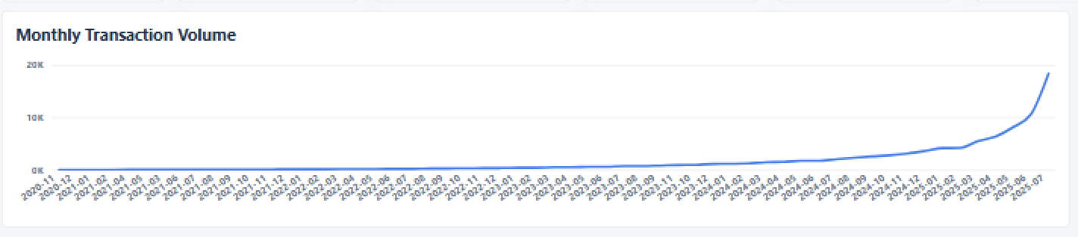
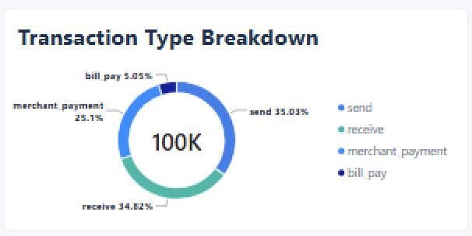
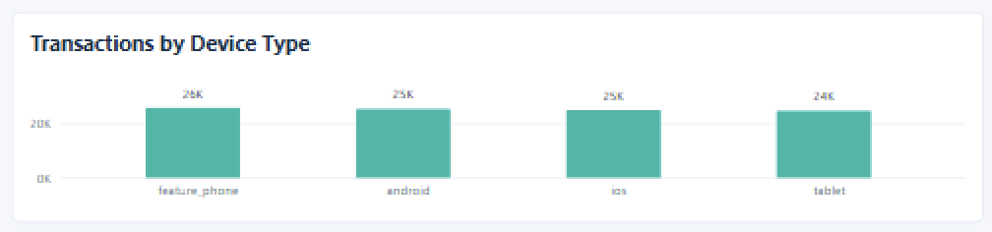
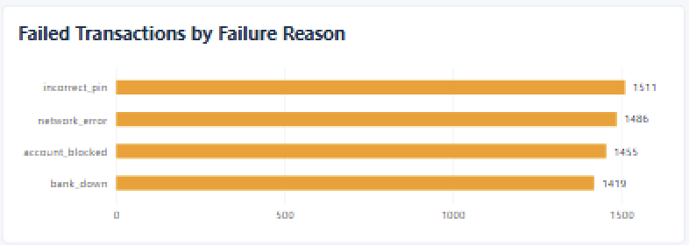
UPI Transaction Analysis | Capstone Project
Chinmaya Panigrahi
Transaction & Operational Insights
Failure reason | Count | Share
Incorrect PIN | 1,511 | 25.74%
Network error | 1,486 | 25.31%
Account blocked | 1,455 | 24.78%
Bank down | 1,419 | 24.17%
Key operational message
Failure causes are nearly evenly distributed. Improving reliability needs a multi-cause programme rather than fixing only one category.
UPI Transaction Analysis | Adda247 Capstone Project
7

Slide 8
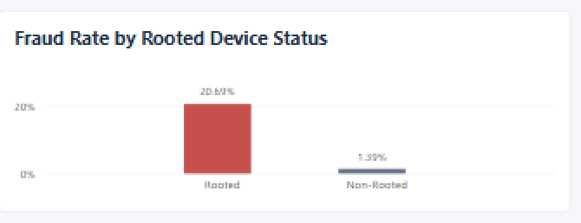
UPI Transaction Analysis | Capstone Project
Chinmaya Panigrahi
Fraud Risk: Rooted Device Finding
Rooted fraud rate | Non-rooted fraud rate | Rooted fraud flags | Observed gap
20.69% | 1.39% | 656 | ~14.9x
Metric | Value
Rooted transactions | 3,171
Rooted share of transaction volume | 3.17%
Rooted fraud flags | 656
Rooted share of all fraud flags | 32.8%
Business priority | Device-integrity controls
Interpretation
Rooted-device status is the strongest validated risk signal in the project. Describe it as an association, not as proof that rooting causes fraud.
UPI Transaction Analysis | Adda247 Capstone Project
8

Slide 9
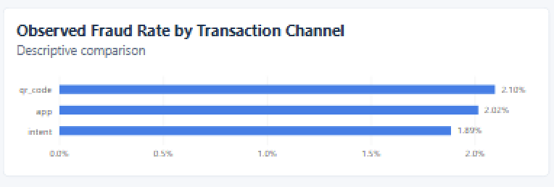
UPI Transaction Analysis | Capstone Project
Chinmaya Panigrahi
Statistical Validation
Evidence / test area | Result | Decision interpretation
Rooted device status vs fraud flag | Supported by completed Step-7 testing | Device integrity is a meaningful risk-monitoring signal.
Transaction channel vs fraud flag | p = 0.143 | No statistically significant channel-fraud association was detected.
Failure-pattern analysis | Observed failure reasons are balanced | Operational response should address all major causes.
Entity fraud ratios | High ratios appear with tiny transaction counts | Use denominator context before escalation.
Interpretation
The dashboard may show small channel differences, but the statistical test does not support channel-specific restrictions. Therefore, I did not recommend channel-specific restrictions.
Good analytical practice
I used statistical tests to check whether visual differences were meaningful.That is what makes the project decision-ready.
UPI Transaction Analysis | Adda247 Capstone Project
9

Slide 10
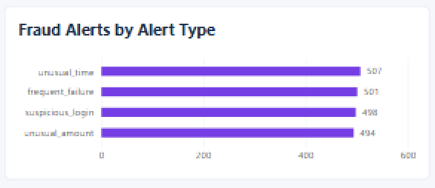
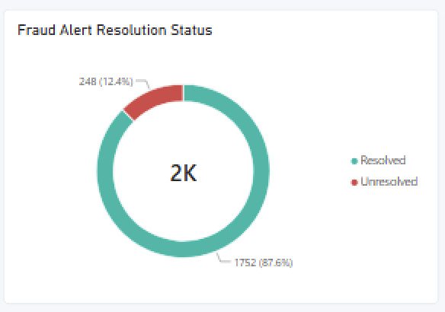
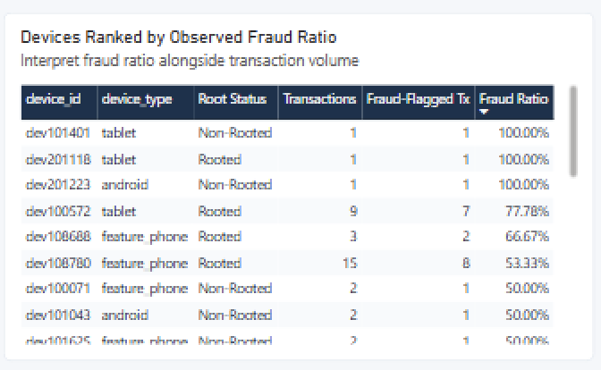
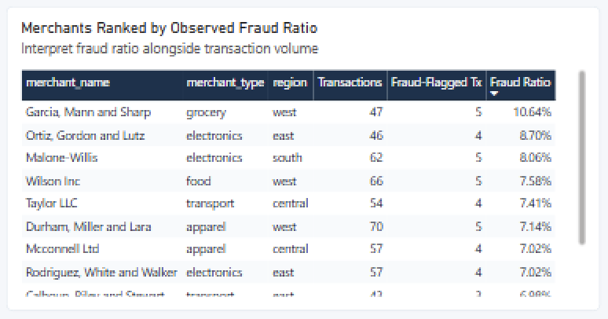
UPI Transaction Analysis | Capstone Project
Chinmaya Panigrahi
Fraud Alert & Entity Monitoring
Fraud alerts | Resolved | Unresolved | Resolution rate
2,000 | 1,752 | 248 | 87.60%
Monitoring principle: use fraud ratio together with transaction count and fraud-flag count. A high percentage on one transaction is not the same as high business exposure.
UPI Transaction Analysis | Adda247 Capstone Project
10

Slide 11
UPI Transaction Analysis | Capstone Project
Chinmaya Panigrahi
Strategic Recommendations
Priority | Recommendation | Evidence basis | Action
1 | Strengthen rooted-device controls | 20.69% rooted fraud rate vs 1.39% non-rooted | Device-integrity checks, step-up authentication, enhanced monitoring
2 | Improve transaction reliability | 5,871 failures across four balanced causes | PIN guidance, network resilience, blocked-account and bank-availability review
3 | Reduce unresolved alert backlog | 248 unresolved alerts | Ageing, prioritization, SLA ownership and review cadence
4 | Avoid unsupported channel restrictions | Channel p = 0.143 | Continue cross-channel monitoring without premature channel blocking
5 | Use exposure-aware entity monitoring | High ratios can occur on tiny counts | Combine fraud ratio with transactions and fraud flags
I prioritized rooted-device risk first, followed by transaction failures and the unresolved-alert backlog.
UPI Transaction Analysis | Adda247 Capstone Project
11

Slide 12
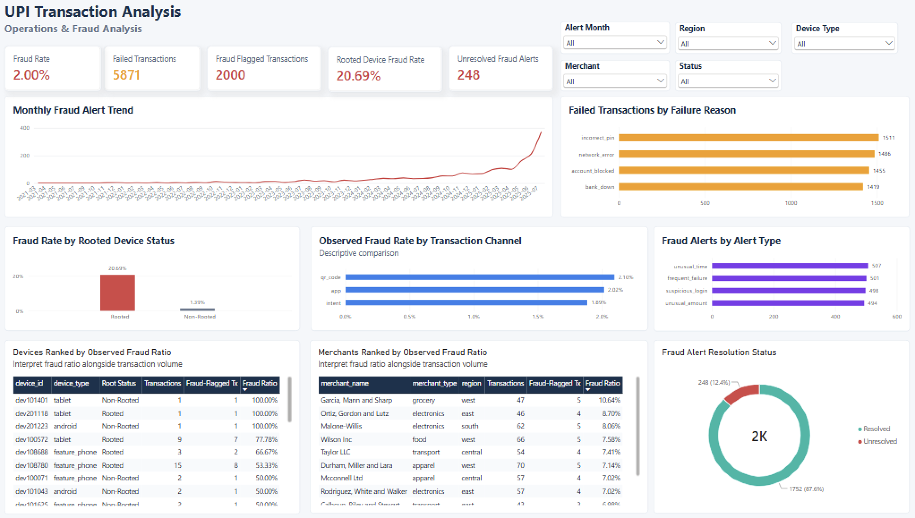
UPI Transaction Analysis | Capstone Project
Chinmaya Panigrahi
Expected Impact & Conclusion
Scenario | Illustrative impact
25% reduction in rooted-device fraud flags | ~164 fewer fraud flags; fraud flags fall from 2,000 to ~1,836; observed fraud rate ~1.84%
10% reduction in transaction failures | ~587 fewer failures; failures fall from 5,871 to ~5,284; failure rate ~5.28%
Resolve half of unresolved alert backlog | Unresolved alerts fall from 248 to 124; resolution rate rises from 87.60% to ~93.80%
Final conclusion
Note on estimates
The capstone delivers a validated end-to-end analytics workflow and a decision-ready monitoring solution. The clearest priority is rooted-device risk, followed by multi-cause failure reduction and alert backlog management.
The impact values are scenario estimates based on observed metrics. They are not forecasts and should be validated after implementation.
UPI Transaction Analysis | Adda247 Capstone Project
12

