Slide 1
Project-3: Call Center Performance Analysis
End-to-End Workflow: Python | SQL | Power BI

Slide 2
Project-3: Agenda
1. Dataset Source & Objective
2. Data Preparation in Python
3. SQL Summary & Queries
4. Power BI Visualizations
5. Key Metrics
6. Agent Performance
7. Customer Experience Insights
8. Business Recommendations

Slide 3
Project-3: Dataset Overview
Source: Kaggle Call Center Dataset
Contains details on customer calls, topics, resolution, agents
Data Volume: 5000 calls
Attributes: Call ID, Agent, Topic, Call Duration, Resolution, Rating

Slide 4
Project-3: Data Preparation in Python
Cleaned missing values
Removed duplicates
Standardized categorical values
Exported cleaned dataset to CSV for SQL/Power BI

Slide 5
Project-3: SQL Summary
Queries written to calculate:
Average call duration per topic
Resolution ratios
Calls answered per agent
SQL results validated against raw dataset

Slide 6
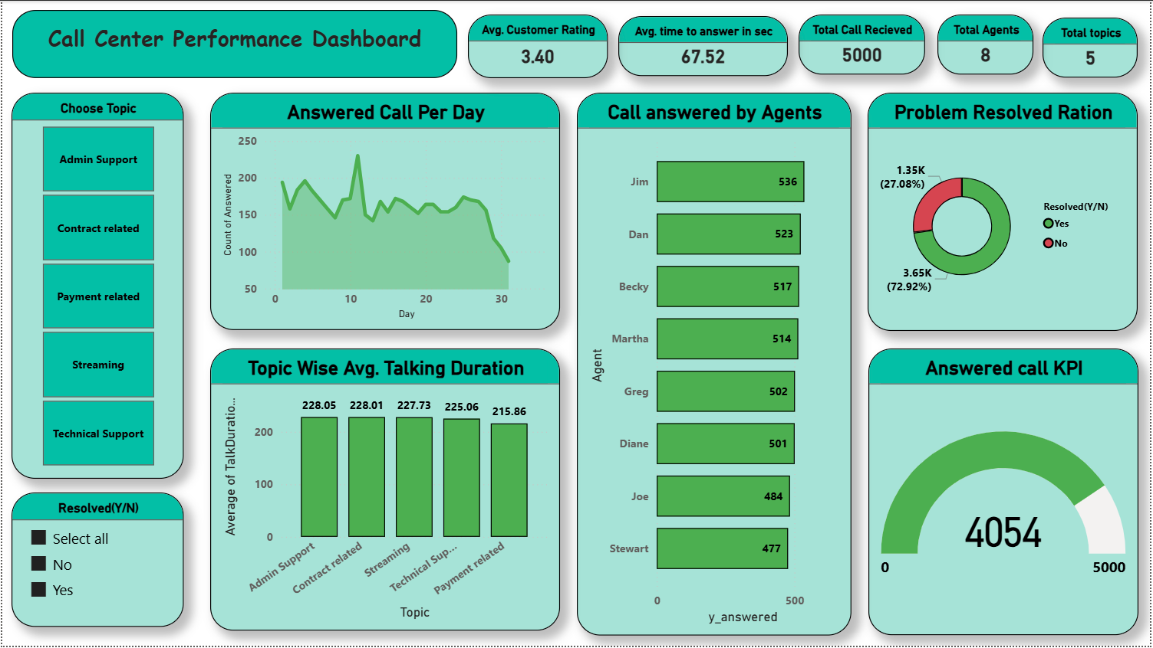
Project-3: Power BI Dashboard

Slide 7
Project-3: Key Metrics
Average Customer Rating: 3.4
Average Answer Time: 67.5 sec
Total Calls Received: 5000
Answered Calls: 4054 (~81%)
Resolution Rate: 72.9%

Slide 8
Project-3: Agent Performance
Jim handled the most calls (536)
Dan and Becky also strong performers
Stewart managed the least calls (477)
Fairly balanced workload across 8 agents

Slide 9
Project-3: Customer Experience Insights
Average customer rating at 3.4 indicates room for improvement
Longest talk durations: Admin Support & Contract Related
Resolution rate at ~73% shows efficiency but with gaps

Slide 10
Project-3: Business Recommendations
Improve first-call resolution with better training
Streamline Admin & Contract support processes
Set KPI targets for call handling & resolution
Monitor agent performance monthly with dashboards

Slide 11
Project-3 Information
Prepared by: Chinmaya Agrawal
Email: chinmaya_2312res228@iitp.ac.in
Institute: Indian Institute of Technology Patna

