Slide 1
Restaurant Order Analytics
By Chinmaya Agrawal
chinmaya2312res228@iitp.ac.in
Internship: GUVI

Slide 2
Project Objective
Question:
Can you visualize which dishes are most ordered and how order patterns change by meal time?
Summary:
This project helps restaurant managers identify best-selling items and busy periods for better inventory planning.

Slide 3
Procedure
Import restaurant order data
Categorize by meal time and dish
Create visuals showing order frequency and revenue
Add filters for day and customer type
Display insights in Power BI

Slide 4
ETL Process (Python + pandas)
Merged orders and restaurant datasets
Converted dates and extracted hour
Created Meal Time column
Cleaned missing/invalid data
Standardized categorical fields
Saved cleaned data as Cleaned_Restaurant_Orders.csv

Slide 5
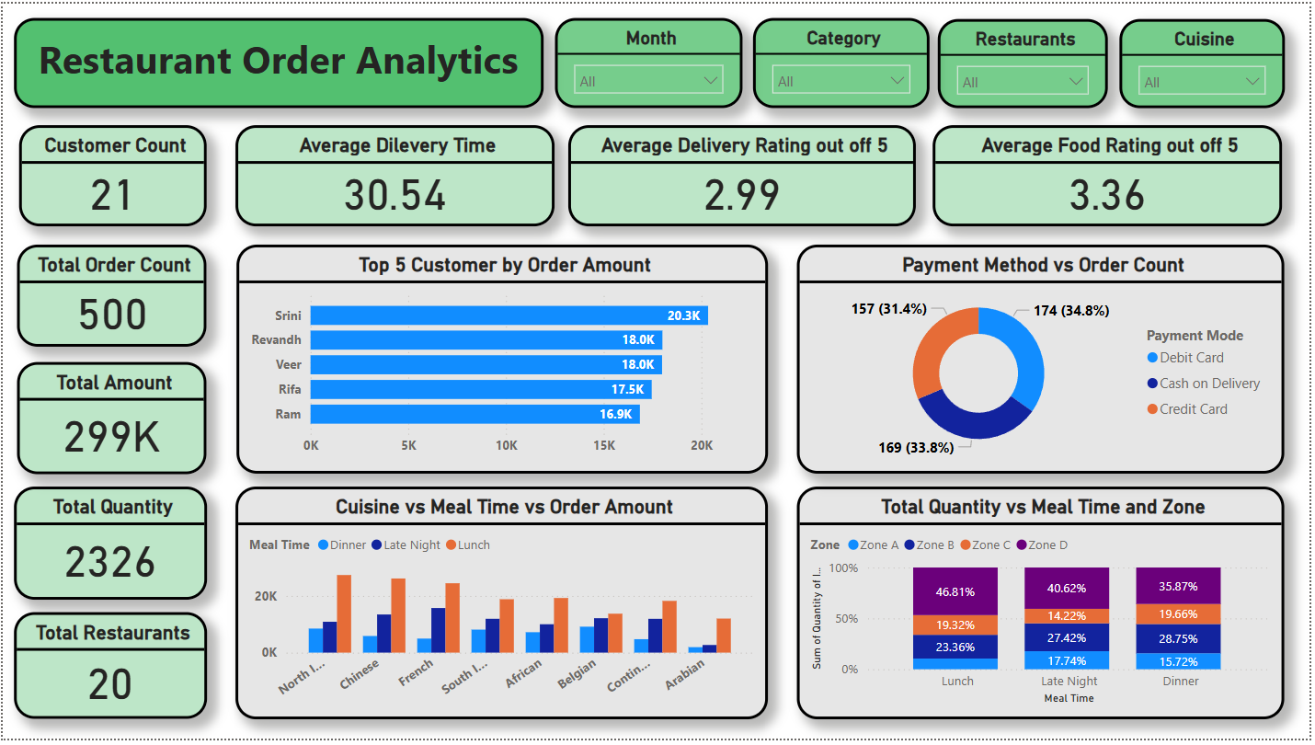
Dashboard Overview

Slide 6
Key Insights
✅ Top Dishes & Customers
✅ Peak Hours by Meal Time
✅ Customer Payment Preferences
✅ Zone-wise Quantity Trends

Slide 7
Visualizations
Top 5 Customers by Order Amount (bar chart)
Payment Methods vs Order Count (donut chart)
Cuisine vs Meal Time vs Order Amount (stacked column chart)
Quantity vs Meal Time vs Zone (stacked bar chart)

Slide 8
Filters & Interactivity
Slicers included:
Month
Customer Category
Restaurants
Cuisine
Enables drilldown into specific timeframes, locations, or cuisines.

Slide 9
Conclusion
The dashboard helps identify peak demand times and popular dishes.
Insights guide staffing, inventory, and marketing decisions.
A data-driven approach improves customer satisfaction and operations.

Slide 10
Contact Details
Chinmaya Agrawal
College Email: chinmaya2312res228@iitp.ac.in
LinkedIn: https://www.linkedin.com/in/chinmaya-agrawal
GitHub: https://github.com/chinmayaagrawal
Internship Company: GUVI

