Slide 1






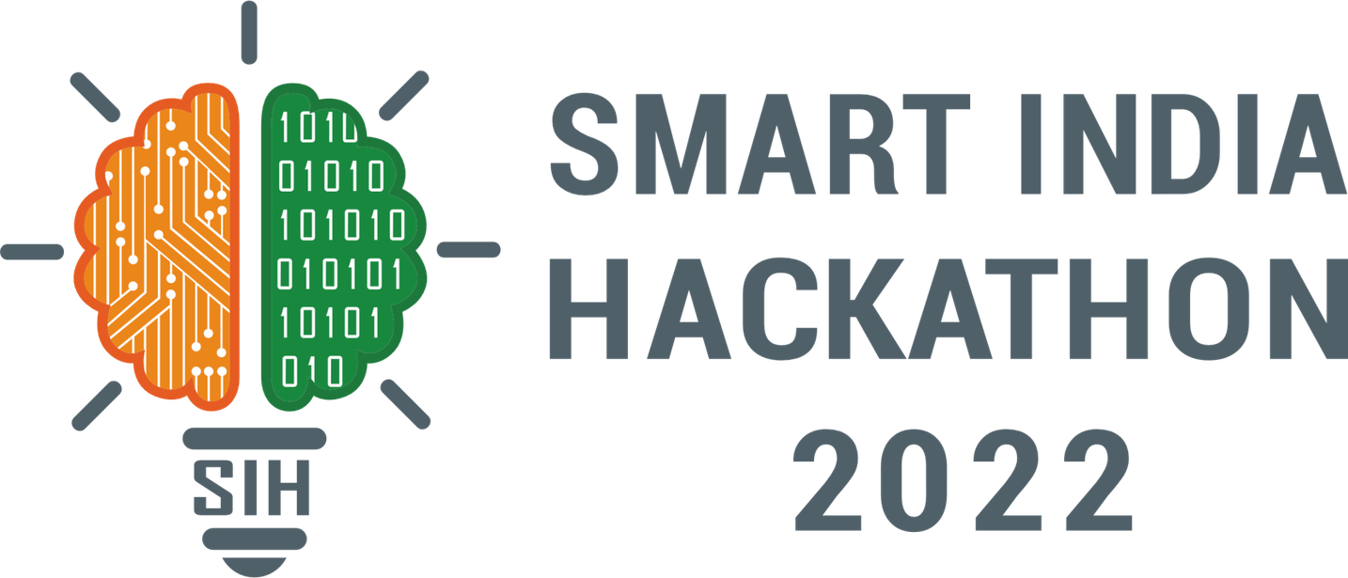
VITISH 2026
(SIH Internal Hackathon)
TITLE PAGE
Problem Statement ID: PS17
Problem Statement Title: Space Debris & Collision Avoidance
Theme: Space Technology
PS Category: Hardware

Slide 2
IDEA TITLE
Edge-Vision Collision Avoidance & AI-Driven Error Ellipsoid Reduction​
Ground AI: Predicts drag via NOAA solar flux to shrink CDM error.
Edge Hardware: FPGA taps Star Trackers for real-time visual confirmation via frame-differencing.
Eliminates false positives from radar "error ellipsoids".
Preserves critical Δv propellant, extending satellite lifespan.
Zero Added Mass: Repurposes existing optics.
Hardware Isolation: Prevents vision logic from hijacking ADCS.
Active-Active Protocol: Matrix negotiates right-of-way to prevent double-burns.
2
Notes:
2

Slide 3
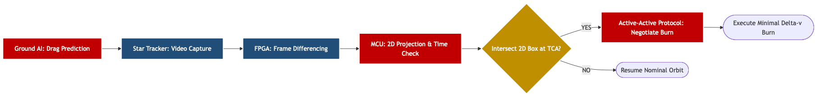
TECHNICAL APPROACH
Hardware: FPGA (Altera DE-10), Star Tracker Optics
Software: Python (XGBoost, Skyfield), Verilog, C/C++
Data & UI: NOAA API, Space-Track.org, CesiumJS
3
Notes:
3

Slide 4
SOLUTION FEASIBILITY & VIABILITY
Highly feasible to rapidly prototype using a Hardware-in-the-Loop (HITL) testbench.
Utilizes proven Commercial Off-The-Shelf (COTS) Star Trackers and standard FPGA (Altera DE-10) architecture.
Optical Blindness: Debris cannot be tracked while in the Earth's shadow (eclipse).
Streak Smearing: Head-on relative velocities (>15 km/s) spread point sources into unreadable faint streaks.
Blindness Mitigation: Orbit propagator detects eclipse conditions and automatically defaults to conservative ground-radar estimates.
Smearing Mitigation: FPGA runs parallelized Hough transforms tuned specifically for multi-frame transient line detection.
4
Notes:
4

Slide 5
REAL WORLD IMPACTS, BENEFITS & RELEVANCE
IMPACT: Replaces guesswork with deterministic, onboard tracking data for commercial constellation operators and defense agencies.
BENEFITS:
Economic: Saves critical Delta V (ΔV) propellant, directly delaying End-of-Life (EOL) decommissioning and extending the satellite's revenue-generating lifespan.
Operational: Minimizes service downtime during conjunctions via the active-active maneuver negotiation protocol.
Environmental: Actively prevents the runaway spread of Kessler Syndrome by tracking and avoiding otherwise untrackable micro-debris.
5
Notes:
5

Slide 6
TEAM CAPABILITY
Team’s experience in the domain :-
Previously worked with FPGA,HDL,Flight control softwares,Orbital mechanics,PCBs and basic circuiting.
Why choosing the domain :-
Relentless focus on aerospace dynamics and solving high-speed edge computing bottlenecks for orbital autonomy and propellant preservation.
6
Notes:
6

Slide 7
RESEARCH AND REFERENCES
Links of the litrature review: click here
7
Notes:
7

