Slide 1
Team and Problem Statement
Problem Statement – 3
To develop a Centralized Server and do object detection on streams to identify potholes, in a target area, in real-time.
Real time relay of information to the concerned authorities.
Pothole detection with highly accurate location.
Real time streaming from devices like drone for object detection.
Team Name: Ctrl Shift Hack
Members:
Aman Jain (CSE 5th Sem)
K Venkat Nag Sai (CSE 5th Sem)
Aarif Khan (CSE 5th Sem)
Chinmaya Kumar Das (Elec 5th Sem)
College: NIT Raipur

Slide 2
Understanding the Problem, and Idea
Sub problems identified:
Developing a Machine Learning model to identify potholes.
Improving inference time to do object detection at high FPS.
Creating a centralized server to store information about the detected potholes, and their location.
Relaying the insights to the concerned authorities, like PWD, Municipal Corporation, etc.
Our Idea:
Developing a Machine Learning Model for object detection using pretrained YOLOv8 model using our own custom pre processed data and further fine tuning its hyperparameters
Deployed RTMP server for real time camera feed for pot hole detection
Interface for municipal corporation to authenticate pot hole filling and user to raise complaint about potholes

Slide 3
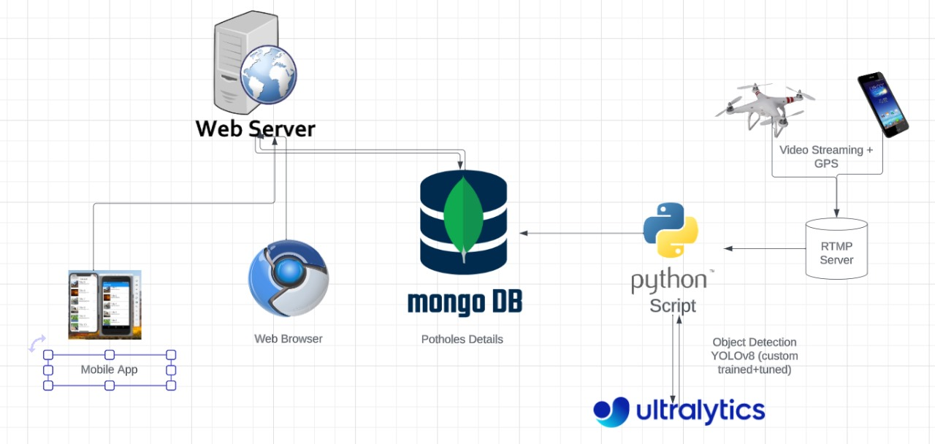
IDEA IMPLEMENTATION FLOW DIAGRAM

Slide 4
CONCLUSION AND RESULTS
Developed a customed tuned YOLOv8 model by using custom pothole dataset and further preprocessed data using data augmentation.
Further finetuned the hyperparameters of the model for improving accuracy of the model.
Interface for registering pothole complaints and verification of pothole filing for municipal corporation are established.
Established RTMP server for camera feed stream and UDP server for GPS coordinates.
Proper overview of the work progress is stimulated on website.

