Slide 1
GraphQL-Shield
Dual-Layer Protection of GraphQL APIs against Broken Object Level Authorization (BOLA)
Review 3
[Student Name 1] · [Student Name 2] · [Student Name 3] · [Student Name 4]
Guide: [Guide Name], [Designation]
Department of [Department], [College / University Name]

Slide 2
Outline
1. Introduction
2. Problem Statement & Motivation
3. Objectives
4. Literature Survey
5. Research Gap
6. Proposed System
7. System Architecture / Methodology
8. Implementation
9. Results and Discussion
10. Conclusion
11. Future Scope
12. References
13. Research Paper Template
GraphQL-Shield | Review 3
2

Slide 3
What is an API, and what is GraphQL?
▸ Apps (Instagram, banking, hospital portals) talk to their servers through an API.
▸ GraphQL is a modern API style made by Facebook: one address, and the app asks for exactly the data it wants.
  – Example: “give me my name, my documents, and the files inside my folder” – in one request.
▸ Flexible and fast – so it is now widely used.
▸ But the flexibility opens a new security hole.
In simple words: REST is like a fixed restaurant menu. GraphQL is like telling the waiter exactly what to bring. Very convenient – but the kitchen must still check that you only get your order.
GraphQL-Shield | Review 3
3

Slide 4
The Threat: BOLA
▸ BOLA = Broken Object Level Authorization.
▸ The server knows who you are (you logged in), but forgets to check whether the item you asked for is yours.
▸ Attacker simply changes a number: resource(id: 101) → resource(id: 102) and reads someone else’s data.
▸ Ranked #1 risk in the OWASP API Security Top 10 (2023).
▸ Firewalls cannot see it – the request looks completely normal.
In simple words: Like a hotel key card that opens every room if you just type a different room number. You are a real guest – but you should only open your own room.
GraphQL-Shield | Review 3
4

Slide 5
Our Solution in One Line
▸ GraphQL-Shield: a security gateway placed in front of any GraphQL app.
▸ It checks ownership at two independent points:
  – Layer 1 – before the request runs: “does this request name anything that isn’t yours?”
  – Layer 2 – while it runs: “is every item actually being returned or changed yours?”
▸ Novel idea: Layer 2 also reports what Layer 1 missed, so the system measures and repairs its own gaps.
In simple words: Two security guards: one at the hotel entrance checks your request, one in the corridor checks every door you open – and writes down anything the entrance guard missed.
GraphQL-Shield | Review 3
5

Slide 6
Problem Statement
▸ Problem: Design and implement a runtime defence that stops logged-in users of a GraphQL API from reading or changing objects they do not own – in every form GraphQL allows – while:
  – keeping legitimate access working,
  – adding very little delay,
  – and showing where the defence itself is incomplete.
Form of attack | Example | ID visible in request?
Direct | resource(id: 102) | Yes
Nested | user(id:101){resource(id:102)} | Yes, deeper
Disguised | variable, alias, fragment, batch | Only after decoding
Relationship | folder(201){children{...}} | No – hidden
Write | updateResource(id:102, ...) | Yes
GraphQL-Shield | Review 3
6

Slide 7
Motivation – Why This Matters
▸ BOLA directly causes data breaches of personal, medical and financial records.
▸ Existing tools only test for BOLA before release, or need a hand-written rule for every field – one forgotten rule silently leaks data.
▸ Checking only the request cannot see items reached through links (folder → children).
▸ Wrongly placed blocks in GraphQL can wipe out the user’s own data too (null propagation).
▸ No existing defence tells the developer where it is weak.
In simple words: Current locks either get checked once at the factory, or need a separate lock on every drawer. We want a lock that checks itself and tells you when a drawer was left open.
GraphQL-Shield | Review 3
7

Slide 8
Objectives
▸ Block every form of BOLA – direct, nested, disguised, relationship and write attacks.
▸ Defence in depth: two independent layers (before and during execution).
▸ Cross-layer evidence: Layer 2 records every object Layer 1 never checked.
▸ Blind-spot prediction: XGBoost model with SHAP explanations, trained from that evidence.
▸ Self-repairing configuration: verified fixes, applied only with admin approval.
▸ Formal security properties (Safety, Non-interference, Write safety, Availability) tested automatically.
▸ Close side channels – same error and same timing for “not yours” and “does not exist”.
▸ Secure accounts (hashed passwords, lockout, token revocation) and low overhead (~1 ms).
GraphQL-Shield | Review 3
8

Slide 9
Literature Survey
Work | Approach | Limitation for us
OWASP API Top 10 (2023) [1] | Ranks BOLA as #1 API risk | Guidance only
GraphQLer (Tsai et al., 2025) [2] | Replays GraphQL requests as other users | Test-time, no runtime blocking
AuthProbe (Barach, 2026) [3] | Multi-identity BOLA testing from OpenAPI | REST only, test-time
Santos Filho et al. (2025) [4] | OpenAPI → Petri nets attack models | REST only, detection
BolaZ (Wu et al., 2026) [5] | Static taint + runtime checks (Spring Boot) | Java REST, no self-measurement
Lambers et al. (2026) [6] | Taint analysis for graph APIs | Static only
graphql-shield library [7] | Permission rule per type/field | Many rules; can null own data
Hartig & Pérez; Cha et al. [8],[9] | GraphQL semantics, query cost | Not about ownership
Kaur (2026) [11]; CVE-2022-39275 [12] | 100+ real BOLA bug reports; Saleor ID bug | Shows the threat is real
GraphQL-Shield | Review 3
9

Slide 10
Key Observations from the Survey
▸ Testing tools find BOLA before deployment but give no protection at runtime – and most target REST, not GraphQL.
▸ Enforcement tools either inspect only the request (miss relationship links) or need one rule per field (leak when one is forgotten).
▸ GraphQL research studies query cost and semantics, not who owns the data.
▸ Classic security principles – reference monitor, complete mediation, non-interference – are well known but never combined into a self-checking GraphQL defence.
In simple words: Others built either a scanner (finds problems before opening day) or a rulebook (one rule per door). Nobody built a guard that also audits itself.
GraphQL-Shield | Review 3
10

Slide 11
Research Gap
▸ 1. No runtime defence covers all GraphQL BOLA forms (relationship links are missed).
▸ 2. No defence measures itself – none uses one layer to check another’s coverage.
▸ 3. No automatic, verified repair of a wrong security configuration.
▸ 4. Availability ignored – rule-based tools can delete the user’s own data from the answer.
▸ 5. Side channels – different errors or timings reveal which objects exist.
▸ 6. No stated and tested security properties.
▸ 7. Tied to one framework.
In simple words: GraphQL-Shield is designed to close each of these seven gaps.
GraphQL-Shield | Review 3
11

Slide 12
Proposed System: GraphQL-Shield
▸ Configured once with a small ShieldConfig: which data types are private, and how to find an item’s owner.
▸ No security code needed inside the app itself.
▸ Attacker model: a real, logged-in user who tries to read or change other people’s items.
▸ Four guarantees (for a normal user u):
  – P1 Safety – the answer never contains another user’s object.
  – P2 Non-interference – changing other users’ data never changes u’s answer.
  – P3 Write safety – u can never modify or delete others’ objects.
  – P4 Availability – u’s own objects are always returned.
GraphQL-Shield | Review 3
12

Slide 13
Main Components
▸ Layer 1 – Entrance gate: reads the request before it runs; any foreign ID → HTTP 403, nothing executes.
▸ Layer 2 – Inside guard: checks every object actually returned and every write target; removes foreign items.
▸ Cross-layer evidence: logs every object Layer 1 never saw → shows Layer 1’s blind spots.
▸ Blind-spot predictor: XGBoost on 17 request features (advisory only).
▸ Self-repair: diagnoses the gap, proposes a fix, replays old traffic to verify it, admin approves.
▸ Uniform denials, account protection, tamper-evident (hash-chained) audit log, live dashboard.
GraphQL-Shield | Review 3
13

Slide 14
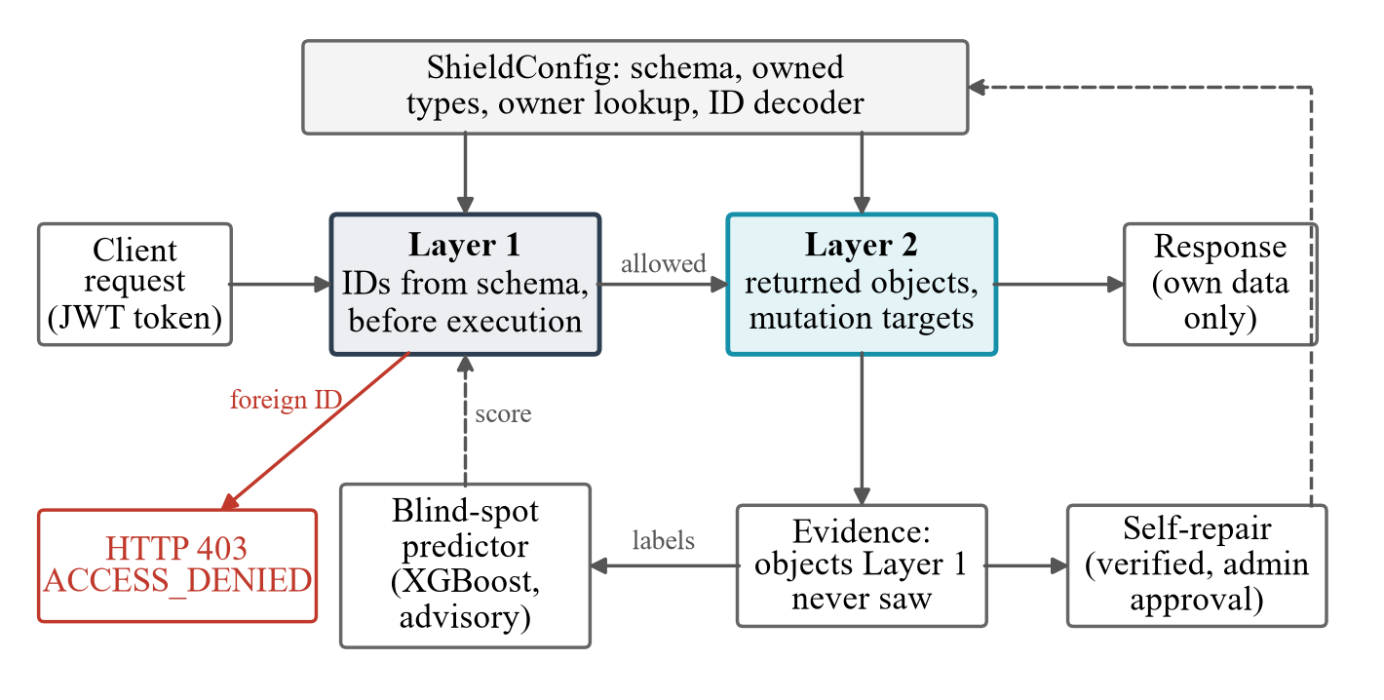
System Architecture
In simple words: Request → Layer 1 (block if foreign ID) → app runs → Layer 2 (remove foreign items) → only your data comes back. Disagreements between the layers feed the predictor and the self-repair module.
GraphQL-Shield | Review 3
14

Slide 15
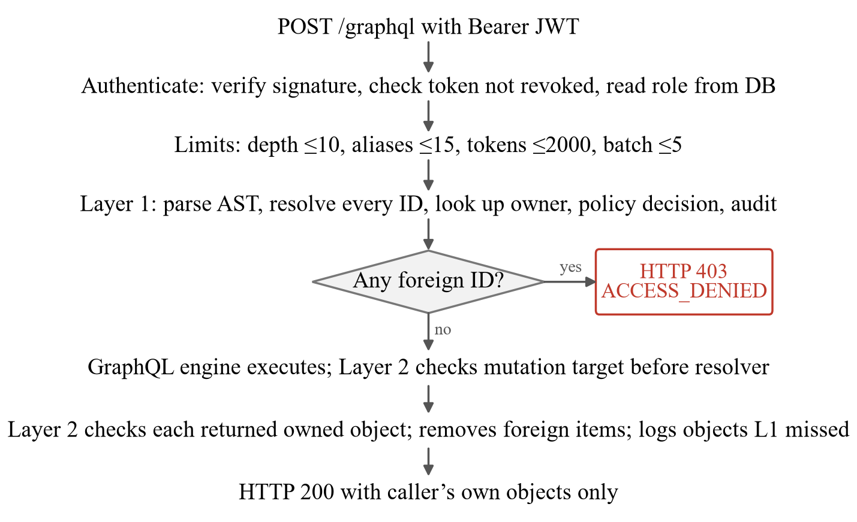
Methodology: Life of One Request
GraphQL-Shield | Review 3
15

Slide 16
Methodology: How Each Part Works
▸ Layer 1: walks the parsed query, decodes every ID (variables, defaults, aliases, fragments, batches, Relay IDs), looks up the owner – one foreign ID rejects the whole request.
▸ Layer 2: runs inside the GraphQL engine; checks the real mutation target before the write; filters lists before GraphQL’s null rules apply, so your own data survives.
▸ Evidence: Layer 1 marks what it checked; Layer 2 records anything unmarked = proof of a Layer 1 gap.
▸ Self-repair: a fix is offered only if replay shows it closes gaps and blocks no legitimate request.
▸ Evaluation: 6 research questions – ablation, fault detection, properties, comparison, latency, self-repair.
GraphQL-Shield | Review 3
16

Slide 17
Implementation: Technology Stack
Component | Technology
Language / web | Python 3.13, FastAPI, Uvicorn
GraphQL | Strawberry, graphql-core, Graphene, Ariadne
Authentication | JWT (HS256), PBKDF2-SHA256 passwords, lockout
Database | SQLite with connection pooling
Machine learning | XGBoost, scikit-learn, SHAP
Testing | pytest, Hypothesis – 427 automated tests
Comparison baseline | Node.js + graphql-shield 7.6.5
Front-end / DevOps | HTML/JS dashboard, Docker, GitHub Actions
In simple words: Two separate apps are protected (a document app and a clinic app with patient records) – the clinic app has zero security code of its own.
GraphQL-Shield | Review 3
17

Slide 18
Implementation: Live Demo Scenarios
Demo (user 101 attacks) | Request | Outcome
Legitimate access | resource(id: 101) | 200 OK
Direct BOLA | resource(id: 102) | 403 – Layer 1
Nested BOLA | user(101){resource(102)} | 403 – Layer 1
Unauthorised write | updateResource(102, "Hacked") | Blocked, DB unchanged
Relationship traversal | resource(201){children} | 200 – foreign child removed
Admin override | admin reads resource(102) | 200 – logged
In simple words: Dashboard (/dashboard): run every attack with one click, switch layers off to see what each one stops, view the ML models, self-repair and the audit log.
GraphQL-Shield | Review 3
18

Slide 19
Result 1: Which Layer Stops Each Attack?
Attack | Both layers | L1 only | L2 only | None
Direct | L1 | L1 | L2 | leaked
Nested lookup | L1 | L1 | L2 | leaked
Inline fragment | L1 | L1 | L2 | leaked
Relationship | L2 | leaked | L2 | leaked
Batch | L1 | L1 | L2 | leaked
Update mutation | L1 | L1 | L2 | leaked
In simple words: Layer 1 alone misses the hidden “children” attack; Layer 2 catches it. Together: zero leaks, and most attacks stopped before anything runs.
GraphQL-Shield | Review 3
19

Slide 20
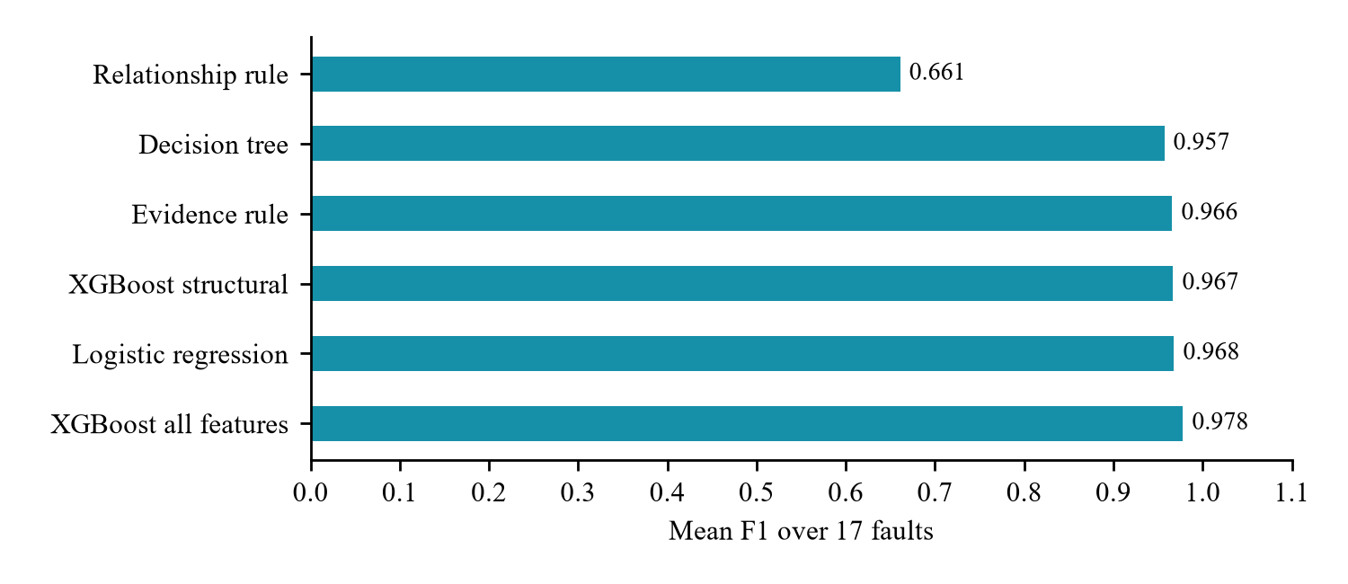
Result 2: The Evidence Finds Bugs
▸ Real bug found: Layer 1 ignored default values of variables – 585 requests slipped past it (Layer 2 still stopped them). Fixed.
▸ 17 bugs deliberately planted in Layer 1, 5 runs each:
  – 17 / 17 detected, 0 false alarms.
  – A one-line rule predicts affected requests with F1 = 0.966.
In simple words: The value is in the evidence, not the fancy model – XGBoost is no better than simple logistic regression.
GraphQL-Shield | Review 3
20

Slide 21
Result 3: Properties, Leaks and Comparison
▸ P1–P4 hold with protection on (Hypothesis, 120 examples each); P1–P3 fail with it off – proving the tests work.
▸ 4 hidden leak channels found and closed (error messages, interfaces, counts, refused deletes).
▸ Timing side channel closed: 0.352 ms gap before fix → no measurable gap after.
▸ vs. graphql-shield (13 attacks, 5 normal requests):
Measure | GraphQL-Shield | graphql-shield
Attacks leaked | 0 / 13 | 0 / 13
Legitimate requests broken | 0 / 5 | 1 / 5
Configuration written | ~4 entries + owner lookup | 8 entries + 4 rules
GraphQL-Shield | Review 3
21

Slide 22
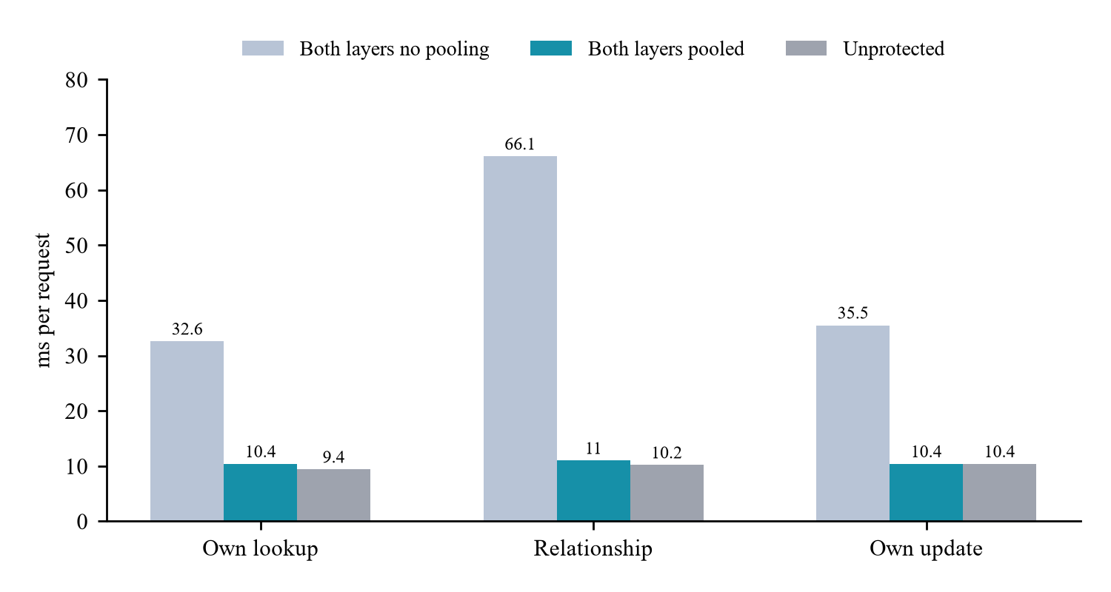
Result 4: Speed and Self-Repair
▸ Protection costs about 1 ms per request (with connection pooling).
▸ Self-repair: 10 planted config mistakes × 3 runs:
  – 30 / 30 detected and fixed by the first verified repair
  – 33 / 33 wrong repairs refused
  – 0 legitimate requests blocked
▸ Limitations: apps and attacks written by us; synthetic ML data; owner-or-admin policies only.
GraphQL-Shield | Review 3
22

Slide 23
Conclusion
▸ Checking ownership at two independent points stops BOLA in every form tested – including hidden relationship attacks.
▸ Layer 2’s record of what Layer 1 missed detected all 17 planted bugs with no false alarms.
▸ The same evidence repaired all 10 configuration mistakes and refused all 33 wrong fixes.
▸ Side channels closed; own data never lost; ~1 ms overhead; works on 4 Python GraphQL frameworks.
▸ Demonstrates defence in depth, complete mediation and fail-safe defaults on a modern API.
In simple words: We built a lock that not only keeps intruders out, but also notices when it is weak and fixes itself – with an admin’s approval.
GraphQL-Shield | Review 3
23

Slide 24
Future Scope
▸ Test on real open-source GraphQL apps (e.g. Saleor) with independent attackers.
▸ Richer policies: sharing, teams, attribute-based access control.
▸ Suggest code patches, not only configuration fixes.
▸ Measure timing over real networks; production deployment with TLS, Redis, Kong / Envoy.
▸ Train ML models on real anonymised traffic.
▸ Port to Node.js (Apollo), Java and Go; add MFA / OAuth 2.0; stream logs to SIEM tools.
GraphQL-Shield | Review 3
24

Slide 25
References (1/2)
[1] OWASP, “API Security Top 10 – 2023: API1 Broken Object Level Authorization,” 2023.
[2] O. Tsai et al., “GraphQLer: Enhancing GraphQL security with context-aware API testing,” arXiv:2504.13358, 2025.
[3] J. Barach, “AuthProbe: Specification-driven, multi-identity detection of BOLA,” arXiv:2607.20574, 2026.
[4] A. Santos Filho, R. J. Rodríguez, E. L. Feitosa, “Automated BOLA attack detection in REST APIs through OpenAPI to colored Petri nets,” Int. J. Inf. Security, 24(2), 2025.
[5] A. Wu et al., “Rethinking broken object level authorization attacks under zero trust principle,” ACM TOSEM, 2026.
[6] L. Lambers et al., “Taint analysis for graph APIs focusing on broken access control,” LMCS, 22(1), 2026.
[7] graphql-shield, npm package v7.6.5.
[8] O. Hartig, J. Pérez, “Semantics and complexity of GraphQL,” WWW, 2018.
[9] A. Cha et al., “A principled approach to GraphQL query cost analysis,” ESEC/FSE, 2020.
[10] E. Wittern et al., “An empirical study of GraphQL schemas,” ICSOC, 2019.
[11] B. Kaur, “Broken object level authorization in the wild,” arXiv:2605.25865, 2026.
[12] CVE-2022-39275: Saleor mutations did not validate object ID types, 2022.
GraphQL-Shield | Review 3
25

Slide 26
References (2/2)
[13] GraphQL Foundation, “GraphQL specification: Handling field errors.”
[14] J. P. Anderson, “Computer security technology planning study,” ESD-TR-73-51, 1972.
[15] J. H. Saltzer, M. D. Schroeder, “The protection of information in computer systems,” Proc. IEEE, 1975.
[16] J. A. Goguen, J. Meseguer, “Security policies and security models,” IEEE S&P, 1982.
[17] W. M. McKeeman, “Differential testing for software,” Digital Tech. J., 1998.
[18] Y. Jia, M. Harman, “An analysis and survey of mutation testing,” IEEE TSE, 2011.
[19] K. Claessen, J. Hughes, “QuickCheck,” ICFP, 2000.
[20] D. R. MacIver et al., “Hypothesis: A new approach to property-based testing,” JOSS, 2019.
[21] A. Ratner et al., “Snorkel: Rapid training data creation with weak supervision,” PVLDB, 2017.
[22] T. Chen, C. Guestrin, “XGBoost: A scalable tree boosting system,” KDD, 2016.
[23] S. M. Lundberg, S.-I. Lee, “A unified approach to interpreting model predictions,” NeurIPS, 2017.
GraphQL-Shield | Review 3
26

Slide 27
Research Paper (IEEE Conference Template)
Item | Details
Title | GraphQL-Shield: Dual-Layer Enforcement Against GraphQL BOLA with Cross-Layer Coverage Evidence
Template | IEEE Conference (two-column)
Authors | [Author 1], [Author 2], [Author 3], [Author 4]
Keywords | GraphQL, API security, BOLA, access control, defense in depth, fault injection, property-based testing
Length | 8 pages, 23 references, 2 figures, 7 tables
Files | paper/main.tex, paper/references.bib, paper/main.pdf
In simple words: The full work is written up as an 8-page IEEE two-column research paper, compiled from LaTeX.
GraphQL-Shield | Review 3
27

Slide 28
Thank You
Questions?
github.com/Chinmayanand03/GraphQL-Shield-

