Slide 1
DICTIONARIES AND STRUCTURING DATA
The dictionary data type, provides a flexible way to access and organize data
A dictionary is a collection of many values.
Dictionaries can use many different data types, not just integers.
Indexes for dictionaries are called keys, and a key with its associated value is called a key-value pair.
In code, a dictionary is typed with braces - { }
>>> myCat = {'size': 'fat', 'color': 'gray', 'disposition': 'loud'}
Dictionary’s keys are 'size', 'color', and 'disposition‘ and the values for these keys are 'fat', 'gray', and 'loud', respectively.

Slide 2
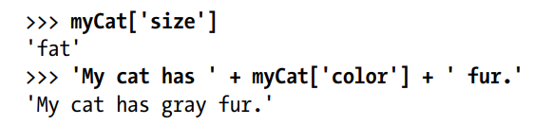
These values can be accessed through their keys
Dictionaries can use integer values as keys, but need not have to start at 0 and can be any number

Slide 3
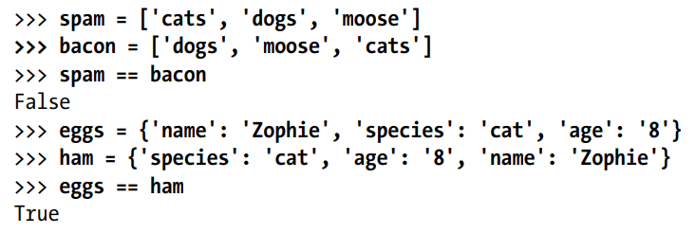
Dictionaries vs. Lists
Items in dictionaries are ordered.
There is no “first” item in a dictionary.
The order of items does not matter for determining whether two dictionaries are the same
They can be sliced
They are useful for associating keys with values
Items in lists are ordered.
The first item in a list is index 0.
The order of items matters for determining whether two lists are the same
They can be sliced
Lists are useful to contain an ordered series of values

Slide 4
Lists and Dictionary
Dictionaries and lists share the following characteristics:
Both are mutable.
Both are dynamic. They can grow and shrink as needed.
Both can be nested. A list can contain another list. A dictionary can contain another dictionary. A dictionary can also contain a list, and vice versa.
Dictionaries differ from lists primarily in how elements are accessed:
List elements are accessed by their position in the list, via indexing.
Dictionary elements are accessed via keys.

Slide 5
Defining a dictionary in python
d = {
<key>: <value>,
<key>: <value>,
.
.
.
<key>: <value>
}
IPL = {
‘Bengaluru’: ‘RCB’,
‘Chennai’: ‘CSK’,
.
.
‘Kolkota’: ‘KKR’
‘Mumbai’: ‘MI’
}

Slide 6
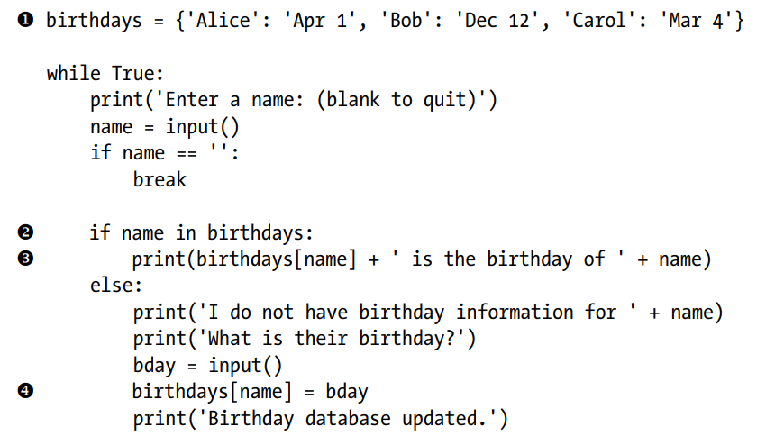
Create an initial dictionary with name and birthday
  Input a name until blank
Check if input name is in dictionary by comparing the input name with keys,
If matches, access the associated value of the key using square bracket
If not, add it using the same square bracket syntax combined with the assignment operator

Slide 7
The keys(), values(), and items() Methods
There are three dictionary methods that will return list-like values of the dictionary’s keys, values, or both keys and values: keys(), values(), and items().
The values returned by these methods are not true lists: They cannot be modified and do not have an append() method.
But these data types (dict_keys, dict_values, and dict_items, respectively) can be used in for loops.
Using the keys(), values(), and items() methods, a for loop can iterate over the keys, values, or key-value pairs in a dictionary, respectively.
Also the values in the dict_items value returned by the items() method are tuples of the key and value.

Slide 8
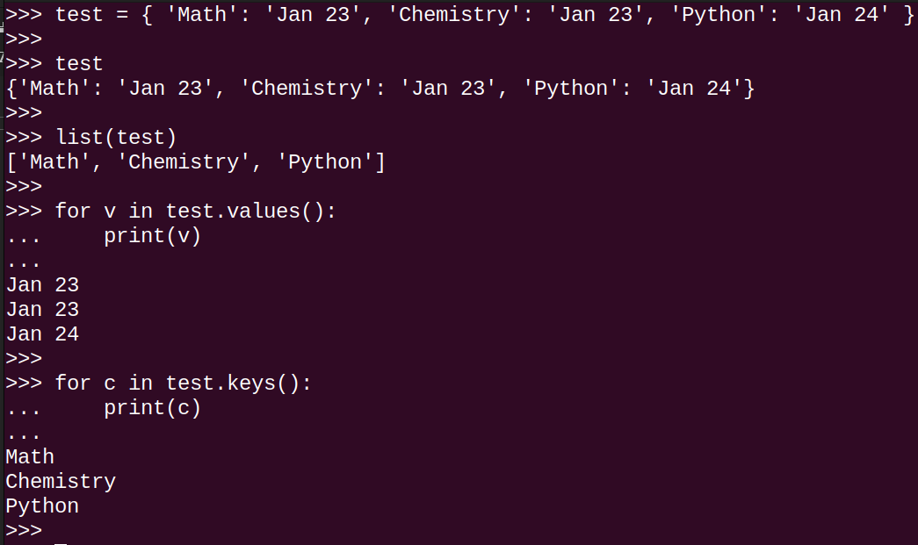
Accessing keys() and values()

Slide 9
>>> spam = {'color': 'red', 'age': 42}
>>> for v in spam.values():
print(v)
red
42
values()- extracts values of dictionary.
Here, a for loop iterates over each of the values in the dictionary.
keys() - extracts keys of dictionary
Here, a for loop iterates over each of the keys in the dictionary.
items() – extracts both key-value pairs in the dictionary.
>>> for k in spam.keys():
print(k)
color
Age
>>> for i in spam.items():
print(i)
('color', 'red')
('age', 42)

Slide 10
A true list from one of these methods can be extracted by passing its list-like return value to the list() function.
The multiple assignment can be used in a for loop to assign the key and value to separate variables.
>>> spam = {'color': 'red', 'age': 42}
>>> spam.keys()
dict_keys(['color', 'age'])
>>> list(spam.keys())
['color', 'age']
>>> spam = {'color': 'red', 'age': 42}
>>> for k, v in spam.items():
print('Key: ' + k + ' Value: ' + str(v))
Key: color Value: red
Key: age Value: 42

Slide 11
Checking Whether a Key or Value Exists in a Dictionary
The in and not in operators is used to check whether a key or value exists in a dictionary.
>>> spam = {'name': 'Zophie', 'age': 7}
>>> 'name' in spam.keys()
True
>>> 'Zophie' in spam.values()
True
>>> 'color' in spam.keys()
False
>>> 'color' not in spam.keys()
True
>>> 'color' in spam # shorter version of writing 'color' in spam.keys()
False

Slide 12
The get(key , fallback value) Method
get() method takes two arguments: the key of the value to retrieve and a fallback value to return if that key does not exist
Used as an alternative to in and not in, Instead of checking whether a key exists in a dictionary before accessing that key’s value
>>> picnicItems = {'apples': 5, 'cups': 2}
>>> 'I am bringing ' + str(picnicItems.get('cups', 0)) + ' cups.'
'I am bringing 2 cups.'
>>> 'I am bringing ' + str(picnicItems.get('eggs', 0)) + ' eggs.'
'I am bringing 0 eggs.'

Slide 13
As of Python version 3.7, dictionaries are ordered. In Python 3.6 and earlier, dictionaries are unordered.
As of Python version 3.7, dictionaries are ordered.
When we say that dictionaries are ordered, it means that the items have a defined order, and that order will not change.
Unordered means that the items does not have a defined order, you cannot refer to an item by using an index.
Dictionaries are changeable, meaning that we can change, add or remove items after the dictionary has been created.

Slide 14
Duplicates Not Allowed
Dictionaries cannot have two items with the same key:
thisdict = {
"brand": "Ford",
"model": "Mustang",
"year": 1964,
"year": 2020
}
print(thisdict)
Output:
{'brand': 'Ford', 'model': 'Mustang', 'year': 2020}

Slide 15
Slicing dictionary in Python
itertools is one of the best modules which helps us to slice dictionaries very easily in python.
The itertools is used to manipulate data structures in python, and it is used to iterate through different data structures.
This module is very fast, efficient, and easy to use. This module is part of Python’s standard libraries so you don’t need to install it separately.
Example:
import itertools
student = {'RNo' : 10, 'Marks' : 90, 'Percentage' : 90}
new_dict = dict(itertools.islice(student.items(), 2))
print(new_dict)
Output
{'RNo': 10, 'Marks': 90}

Slide 16
Example:
import itertools
student = {'RNo' : 10, 'Marks' : 90, 'Percentage' : 90}
new_dict = dict(itertools.islice(student.items(), 1,3))
print(new_dict)
Output:
{'Marks': 90, 'Percentage': 90}

Slide 17
The setdefault(key,value) Method
You’ll often have to set a value in a dictionary for a certain key only if that key does not already have a value. The code looks something like this:
spam = {'name': 'Pooka', 'age': 5}
if 'color' not in spam:
spam['color'] = 'black'
The setdefault() method offers this in one line of code.
The first argument passed to the method is the key to check for, and the second argument is the value to set at that key if the key does not exist.
If the key does exist, the setdefault() method returns the key’s value.

Slide 18
Setdefault when key and its value is present in dictionary
dict={'name':'pooka','age':26,'color':'white'}
dict.setdefault('color')
dict
Output:
{'name': 'pooka', 'age': 26, 'color': 'white'}
Setdefault when key and its value is not present in dictionary
dict={'name':'pooka','age':26}
dict.setdefault('color')
dict
Output:
{'name': 'pooka', 'age': 26, 'color': None}

Slide 19
‘color’ not exists, so includes and sets the default value ‘black’ and returns the value
dict={'name':'pooka','age':26}
dict.setdefault('color','black')
print(dict)
Output:
{'name': 'pooka', 'age': 26, 'color': 'black'}
color’ exists, so does not set the default value ‘white’
dict={'name':'pooka','age':26}
dict.setdefault('color','black')
print(dict)
dict.setdefault('color','white')
dict
Output:
{'name': 'pooka', 'age': 26, 'color': 'black'}
{'name': 'pooka', 'age': 26, 'color': 'black'}

Slide 20
What is the output?
dict={'name':'pooka','age':26}
dict.setdefault('color','black')
print(dict)
Output:
{'name': 'pooka', 'age': 26, 'color': 'black'}
What is the output?
dict={'name':'pooka','age':26}
dict['age']
Output
26
Is it possible to extract key using value:
dict={'name':'pooka','age':26}
dict[26]
Output:
KeyError

Slide 21
Is it possible to setdefault for already existing key and its value?
dict={'name':'pooka','age':26,'color':'white'}
dict.setdefault('age',5)
print(dict)
Output:
{'name': 'pooka', 'age': 26, 'color': 'white'}

Slide 22
program that counts the number of occurrences of each letter in a string
message = 'It was a bright cold day in April, and the clocks were striking thirteen.'
count = {}
for character in message:
count.setdefault(character, 0)
count[character] = count[character] + 1
print(count)
Output:

Slide 23
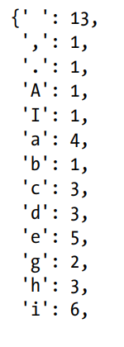
Pretty Printing
pprint() and pformat() functions “pretty print” a dictionary’s values by importing the pprint module.
This is helpful when a cleaner display of the items in a dictionary is needed than what print() provides.
If the prettified text is to be obtained as a string value instead of displaying it on the screen, use pprint.pformat() instead.
These two lines are equivalent to each other:
pprint.pprint(someDictionaryValue)
print(pprint.pformat(someDictionaryValue))
import pprint
message = 'It was a bright cold day in April, and the clocks were striking thirteen.'
count = {}
for character in message:
count.setdefault(character, 0)
count[character] = count[character] + 1
pprint.pprint(count)

Slide 24
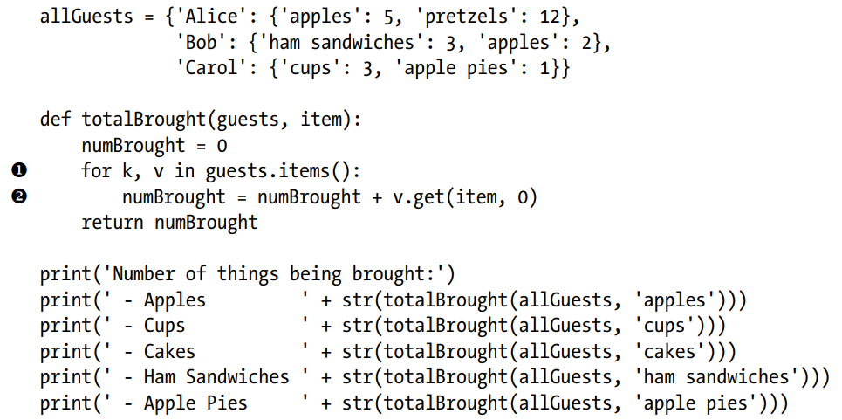
Nested Dictionaries and Lists
Dictionaries and lists that contain other dictionaries and lists can be used
Inside the totalBrought() function, the for loop iterates over the keyvalue pairs in guests
Inside the loop, the string of the guest’s name is assigned to k, and the dictionary of picnic items they’re bringing is assigned to v.
If the item parameter exists as a key in this dictionary, it’s value (the quantity) is added to numBrought
If it does not exist as a key, the get() method returns 0 to be added to numBrought.

Slide 25
OUTPUT???
Number of things being brought:
Apples 7
Cups 3
Cakes 0
Ham Sandwiches 3
Apple Pies 1

Slide 26
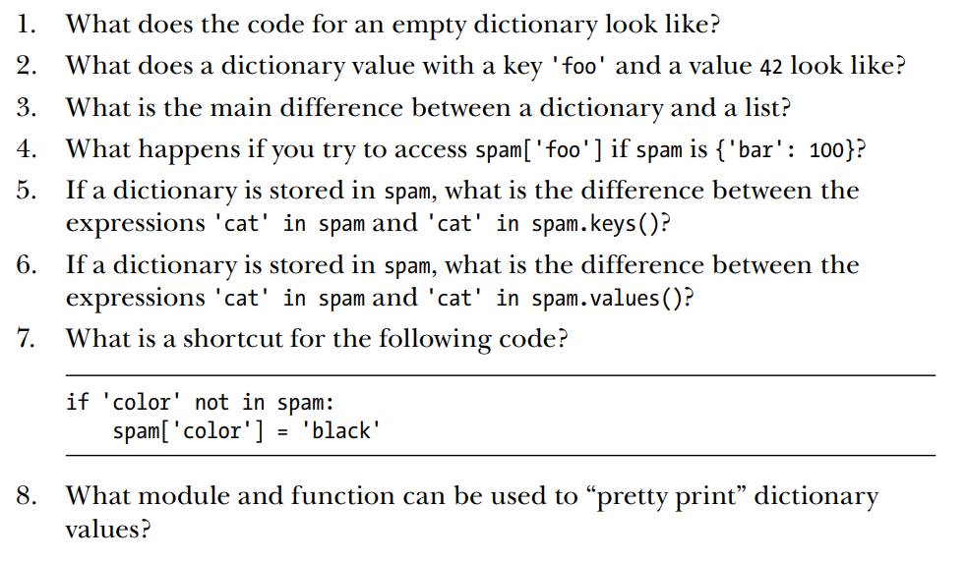
Assignment 5

Slide 27
Read N numbers from the console and create a list. Develop a program to print mean, variance, and standard deviation with suitable messages.
N = int(input("Enter the number of elements: ")) # Read and create a list
numbers = [int(input("Enter a number: ")) for i in range(N)]
mean = sum(numbers) / N # Calculate mean
variance = sum((x - mean) ** 2 for x in numbers) / N # Calculate variance
standard_deviation = variance ** 0.5 # Calculate standard deviation
print("Mean:", mean)
print("Variance:", variance)
print("Standard Deviation:", standard_deviation)

Slide 28
Read a multi-digit number (as chars) from the console and print the frequency of each digit
number = input("Enter a multi-digit number: ")
# Create a dictionary to store the frequency of each digit
frequency = {str(i): 0 for i in range(10)}
# Iterate over the number and update the frequency of each digit
for char in number:
if char.isdigit():
frequency[char] += 1
# Print the frequency of each digit with a suitable message
for digit, count in frequency.items():
if count > 0:
print(f"Frequency of {digit}: {count}")

Slide 29
How to read nested list?
list=[]
for i in range(0,3):
list.append([])
for j in range(0,3):
k=int(input())
list[i].append(k)
print(list)
Output:
2
0
1
2
3
4
5
6
0
[[2, 0, 1], [2, 3, 4], [5, 6, 0]]

