Slide 1
Introduction to Python Programming Module 2
AUTOMATE THE BORING STUFF WITH PYTHON
BY
AL SWEIGART

Slide 2
LISTS
Lists and tuples can contain multiple values, which makes it easier to write programs
They handle large amounts of data.
Lists themselves can contain other lists, and hence can be used to arrange data into hierarchical structures.

Slide 3
The List Data Type
A list is a value that contains multiple values in an ordered sequence.
The term list value refers to the list itself (which is a value that can be stored in a variable or passed to a function like any other value), not the values inside the list value.
List value means List – not the contents
A list value looks like this: ['cat', 'bat', 'rat', 'elephant'].
A list begins with an opening square bracket and ends with a closing square bracket, [].
Values inside the list are also called items. Items are separated with commas.

Slide 4

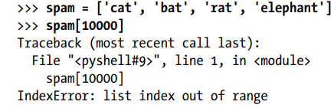
List /List Value
items
Each item of the list is identified with an index value starting from 0 to n-1 for n items
Indexes can be only integer values, not floats.
Python gives an IndexError error message if an index that exceeds the number of values is used in the list value.

Slide 5
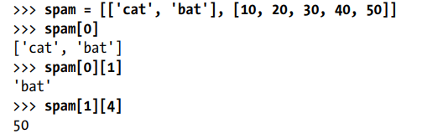
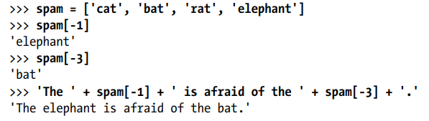
Lists can also contain other list values. The values in these lists of lists can be accessed using multiple indexes
Negative Indexes
While indexes start at 0 and go up, negative integers can also be used for the index.
The integer value -1 refers to the last index in a list, the value -2 refers to the second-to-last index in a list, and so on

Slide 6
Program
import math
list1 = [ ] # creating an empty list
n = int(input("Enter number of elements : "))
for i in range(0, n): # iterating till the range
num = int(input()) or list.append(int(input()))
list1.append(num) # adding the element
for x in range(len(list1)): or for x in list1: # printing list elements print (list1[x]) print(x)

Slide 7
Read N numbers from the console and create a list. Develop a program to print mean, variance, and standard deviation with suitable messages.
import math
list = [ ] # creating an empty list
n = int(input("Enter number of elements : "))
for i in range(0, n): # iterating till the range
num = int(input())
list.append(num) # adding the element
or
list.append(int(input()))
sum=0
for i in list:
sum+=i
mean=sum/n
term = 0;
for i in list:
term = term + (i - mean) ** 2
variance = term/ n;
dev = math.sqrt(variance)
print(‘The list is ‘)
for i in range(len(list)):
print(list[i])
print('Mean is ', mean)
print('Variance is ', variance)
print('Standard Deviation is ', dev)

Slide 8
Generate and print all prime numbers from 1 to N
list1 = []
count = 0
num = int(input('Enter a range ')) for p in range(1, num+1): flag = 0 for i in range(2, p//2): if p % i == 0: flag = 1 break if flag == 0: list1.append(p) count += 1 print('The prime numbers from 1 to %d are' % num) print(list1)

Slide 9
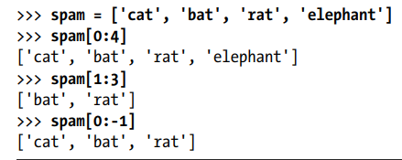
Getting Sublists with Slices
A slice can get several values from a list, in the form of a new list.
A slice is typed between square brackets, like an index, but it has two integers separated by a colon.
Notice the difference between indexes and slices.
spam[2] is a list with an index (one integer).
spam[1:4] is a list with a slice (two integers).
In a slice, the first integer is the index where the slice starts and The second integer is the index where the slice ends, but will not include, the value at the second index.
A slice evaluates to a new list value.
Try these in prime number program
print(list1[4:6]) print(list1[4:]) print(list1[:8])
Print(list1[n1:n2])

Slide 10
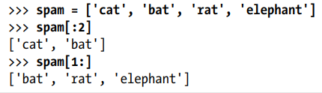


One or both of the indexes on either side of the colon in the slice can be left out.
Leaving out the first index is the same as using 0, or the beginning of the list.
Leaving out the second index is the same as using the length of the list, which will slice to the end of the list.
The len() function returns the number of items in a list value passed to it.

Slide 11
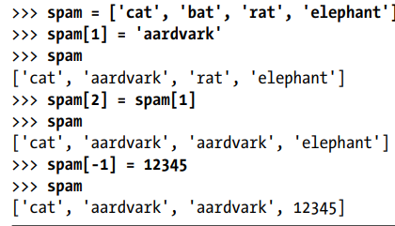
Changing Values in a List with Indexes

Slide 12
How it will print the values of lst?
lst=[50,70,30,20,90,10,50]
for i in range(7):
print(lst[i])
How can i display or print the lst values
in the form of list?
lst=[50,70,30,20,90,10,50]
lst
or
lst=[50,70,30,20,90,10,50]
print(lst[:])
Output
[50, 70, 30, 20, 90, 10, 50]
Output
50
70
30
20
90
10
50

Slide 13
List Slicing
Syntax:
Lst[ Initial : End : IndexJump ]
What is the output?
print(List[::2])
Output
[1, 3, 5, 7, 9]
What is the output
print(List[::])
Output
[1, 2, 3, 4, 5, 6, 7, 8, 9]
# Initialize list
List = [1, 2, 3, 4, 5, 6, 7, 8, 9]
What is the output?
print(List[3:9:2])
Output
[4, 6, 8]

Slide 14
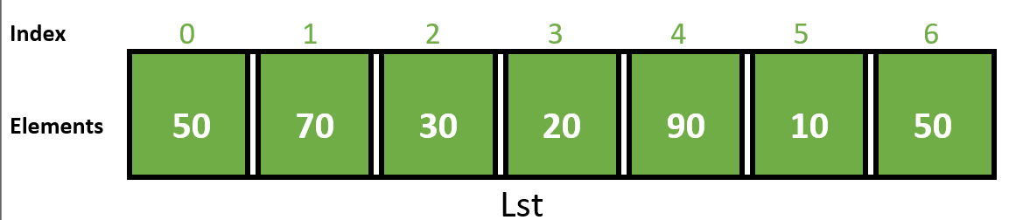
Indexing
1. Positive Indexes
How to Initialize list?
Lst = [50, 70, 30, 20, 90, 10, 50]
Output:
[50, 70, 30, 20, 90, 10, 50]
How to display list?
print(Lst[::])

Slide 15
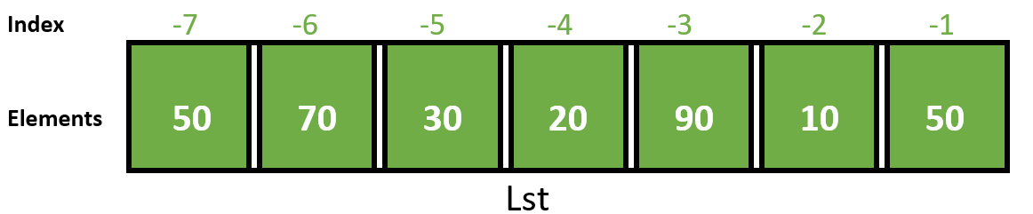
2. Negative Indexes
How to display list?
Output:
[50, 70, 30, 20, 90, 10, 50]
print(Lst[-7::1])
Print(lst[:-1]

Slide 16
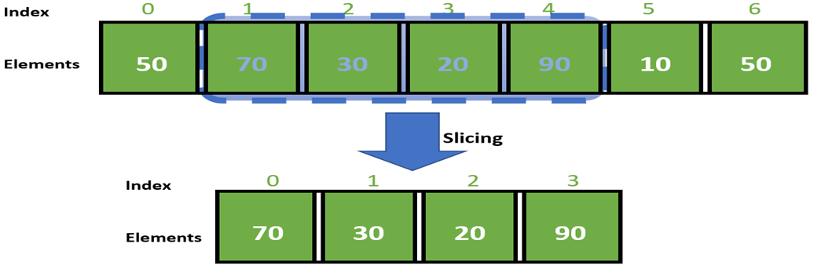
3. Slicing
Lst
What is the syntax to slice the above list
print(Lst[1:5])

Slide 17
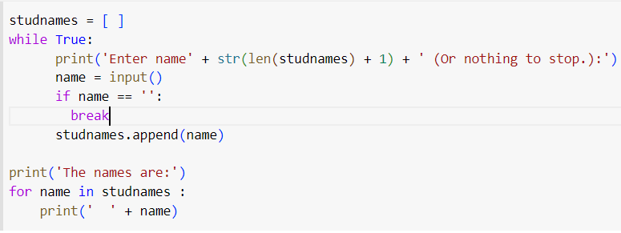
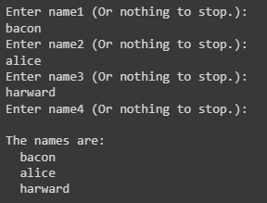
Working with Lists- Program to Input n names

Slide 18
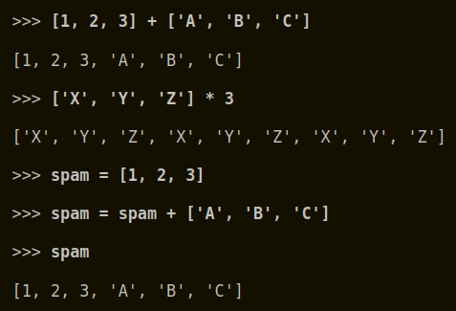
List Concatenation and List Replication
The + operator combines two lists to create a new list.
The * operator is used with a list and an integer value to replicate the list.

Slide 19
+ And * operators for List
List concatenation is done by + operator
>>> bacon = ['Zophie']
>>> bacon = bacon + bacon
>>> bacon
[‘Zophie’, ‘Zophie’]
List replication is done by * operator
>>> bacon = ['Zophie']
>>> bacon = bacon * 3
>>> bacon
['Zophie', 'Zophie', 'Zophie‘]
What is the output?
bacon=['zophie']
bacon=bacon+bacon
bacon
bacon=bacon*3
bacon

Slide 20
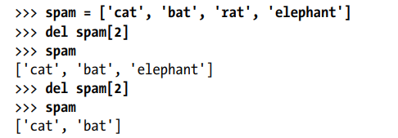
Removing Values from Lists with del Statements
The del statement will delete values at an index in a list.
All of the values in the list after the deleted value will be moved up one index position.

Slide 21
The in and not in Operators
Whether a value is in a list or not can be determined with the in and not in operators respectively.
in and not in are used in expressions and connect two values: a value to look for in a list and the list where it may be found.
item in list or item in [item(s)]
item not in list or item not in [item(s)]
These expressions will evaluate to a Boolean value.

Slide 22
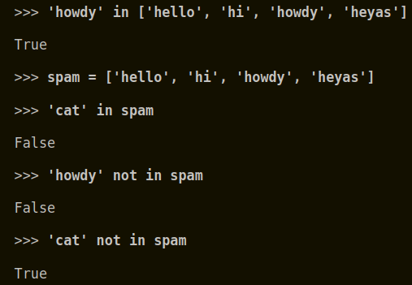
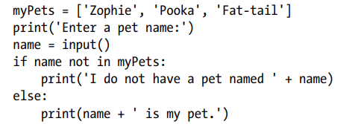

Slide 23
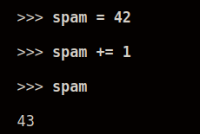
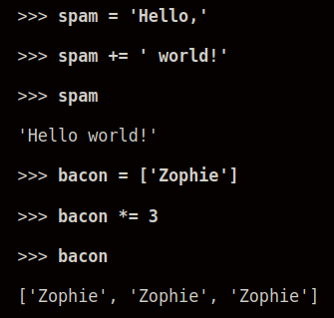
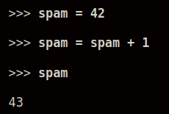
Augmented Assignment Operator

Slide 24
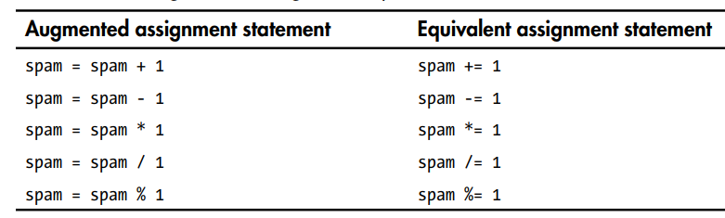
Augmented Assignment Operators
There are augmented assignment operators for the +, -, *, /, and % operators, described in the Table

Slide 25
Methods of List
A method is the same thing as a function, except it is “called on” a value.
The method part comes after the list value, separated by a period
For example, if a list value were stored in spam, call of the list-method - index() on that list
>>>spam [‘hi’ , ‘hello’]
>>>spam.index('hello')
1
Each data type has its own set of methods.
The list data type, has several useful methods for finding, adding, removing, and manipulating values in a list.

Slide 26
More on Methods
In Python, a function is a standalone block of code that performs a specific task, and is defined using the "def" keyword. It can be called multiple times and from different parts of the program, and can take arguments and return a value.
A method, on the other hand, is a function that is associated with an object or a class. It is defined inside a class and can access and modify the data within the object or class. A method is called on an object, and it operates on the data within that object.

Slide 27
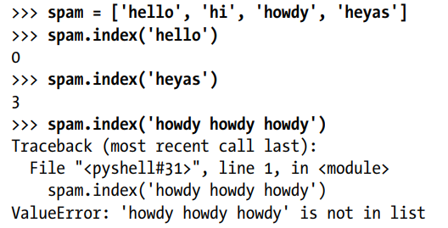

index()
Used for finding an item in a List with the index() Method
List values have an index() method that can be passed a value, and if that value exists in the list, the index of the value is returned.
If the value isn’t in the list, then Python produces an error called ValueError
When there are duplicates of the value in the list, the index of its first appearance is returned.

Slide 28
Finding a Value in a List with the index( ) Method
number=[10,20,30,30,40,10,20]
print(number)
number.index(30)
Output
[10, 20, 30, 30, 40, 10, 20]
2
number.index(10) ?
0
>>>csedivision=['A','B','C','D','E']
>>>print(csedivision)
['A', 'B', 'C', 'D', 'E']
>>>csedivision.index('D')
3

Slide 29
Adding Values to List with the append() and insert() Methods
To add new values to a list, the append() and insert() methods are used.
The append() method call adds the argument to the end of the list.
The insert() method can insert a value at any index in the list.
The first argument to insert() is the index for the new value/item, and the second argument is the new value/item to be inserted.
The append() and insert() methods are list methods and can be called only on list values, not on other values such as strings or integers.
>>> spam = ['cat', 'dog', 'bat']
>>> spam.append('moose')
>>> spam ['cat', 'dog', 'bat', 'moose']
>>> spam = ['cat', 'dog', 'bat']
>>> spam.insert(1, 'chicken')
>>> spam ['cat', 'chicken', 'dog', 'bat']

Slide 30
Example:
niedept=['CSE','ISE','ECE','MECH']
print('Before appending')
print(niedept)
niedept.append('EEE')
print('After appending')
niedept
niedept=['CSE','ISE','ECE','MECH']
niedept.insert(1,'CIV')
niedept
Output
['CSE', 'CIV', 'ISE', 'ECE', 'MECH']
Output:
Before appending
['CSE', 'ISE', 'ECE', 'MECH']
After appending
['CSE', 'ISE', 'ECE', 'MECH', 'EEE']

Slide 31
Removing Values from Lists with remove()
>>> spam = ['cat', 'bat', 'rat', 'elephant']
>>> spam.remove('bat')
>>> spam
['cat', 'rat', 'elephant‘]
The remove() method is passed the value to be removed from the list it is called on.
Attempting to delete a value that does not exist in the list will result in a ValueError error.
If the value appears multiple times in the list, only the first instance of the value will be removed
>>> spam = ['cat', 'bat', 'rat', 'elephant']
>>> spam.remove('chicken')
Traceback (most recent call last):
File "", line 1, in <module>
spam.remove('chicken')
ValueError: list.remove(x): x not in list
>>> spam = ['cat', 'bat', 'rat', 'cat', 'hat', 'cat']
>>> spam.remove('cat')
>>> spam ['bat', 'rat', 'cat', 'hat', 'cat']

Slide 32
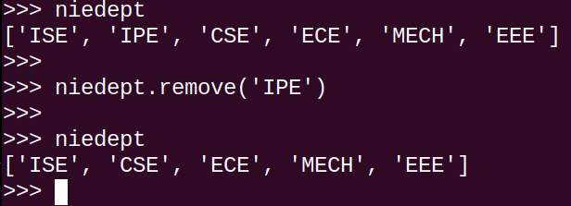
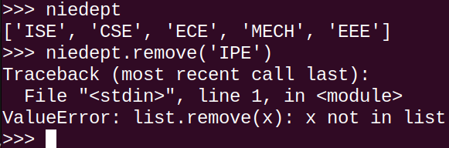
The del statement is good to use when the index of the item is known to remove from the list.
The remove() method is good to use when item to remove from the list is known.

Slide 33
Sorting the Values in a List with the sort() Method
Lists of number values or lists of strings can be sorted with the sort() method.
Reverse sorting can be done by passing True for the reverse keyword argument
>>> spam = [2, 5, 3.14, 1, -7]
>>> spam.sort()
>>> spam [-7, 1, 2, 3.14, 5]
>>> spam = ['ants', 'cats', 'dogs', 'badgers', 'elephants']
>>> spam.sort()
>>> spam ['ants', 'badgers', 'cats', 'dogs', 'elephants']
>>> spam.sort(reverse=True)
>>> spam ['elephants', 'dogs', 'cats', 'badgers', 'ants‘]

Slide 34
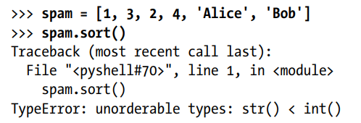
Three things to note about the sort() method
Lists that have both number values and string values cannot be sorted
The sort() method sorts the list in place but the sorted list cannot be stored; like spam = spam.sort() is not allowed.
spam=[2,4,1,3,8,6,5]
spam=spam.sort()
print(spam)
Output
None

Slide 35
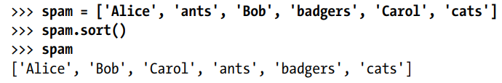
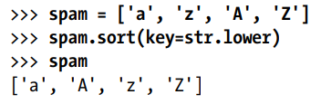
3. sort() uses “ASCIIbetical order”, not the actual alphabetical
order for sorting strings.
This means uppercase letters come before lowercase letters.
Therefore, the lowercase ‘a’ is sorted so that it comes after the uppercase ‘Z’.
If sorting the values in regular alphabetical order is needed, pass str.lower for the key keyword argument in the sort() method call.

Slide 36
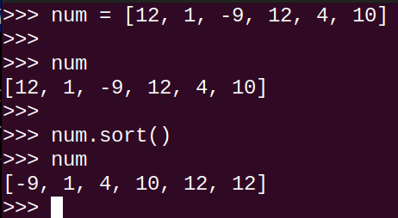
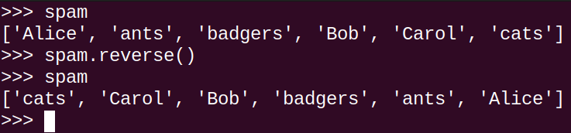
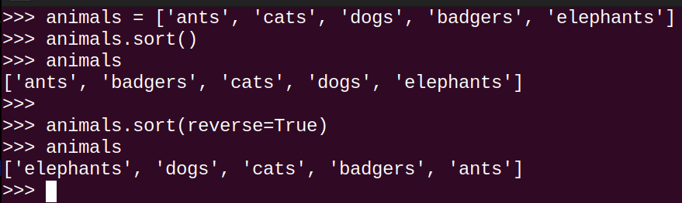
Sorting the values
Reversing a list
Reverse sort a list

Slide 37
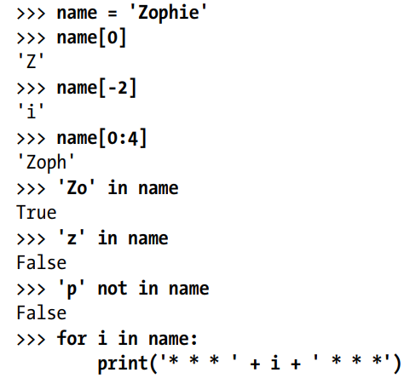
List-like Types: Strings and Tuples
Strings are similar to lists, it’s a list of single characters
Many functions can be used with strings: indexing; slicing; and using them with for loops, with len(), and with the in and not in operators.
* * *Z* * *
* * *o* * *
* * *p* * *
* * *h* * *
* * *i* * *
* * *e* * *
OUTPUT???

Slide 38
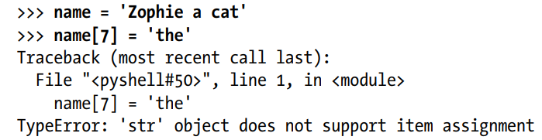
Mutable and Immutable Data Types
Though lists and strings are similar in many ways, they are different in an important way.
A list value is a mutable data type: It can have values added, removed, or changed.
However, a string is immutable: It cannot be changed.
Trying to reassign a single character in a string results in a TypeError error

Slide 39
Solution!!!
The proper way to “mutate” a string is to use slicing and concatenation to build a new string by copying from parts of the old string.
>>> name = 'Zophie a cat'
>>> newName = name[0:7] + 'the' + name[8:12] >>> name
'Zophie a cat’
>>> newName
'Zophie the cat’

Slide 40
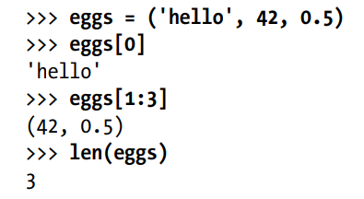
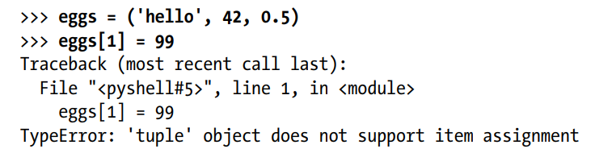
The Tuple Data Type
The tuple data type is almost identical to the list data type
Tuples are typed with parentheses - ( and )
Tuples are immutable - cannot have their values modified, appended, or removed

Slide 41
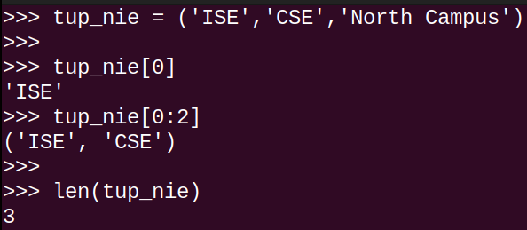
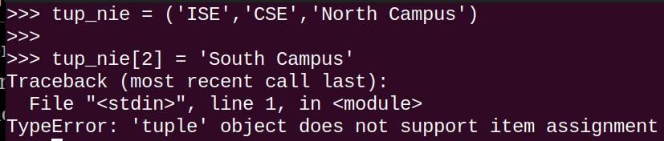
Immutable list = tuple
Tuple is created using a paranthesis ‘(‘ and ‘)’ unlike square brackets [ ] which is used for list.
Items in a tuple cannot be changed (immutable)

Slide 42
Converting Types with the list() and tuple()
The functions list() will convert the values passed to it into list type and tuple() will convert the values passed to it into tuple version respectively
This is done to convert mutable to immutable and vice versa
>>> tuple(['cat', 'dog', 5]) # tuple(List)
('cat', 'dog', 5)
>>> list(('cat', 'dog', 5)) # list (tuple) ['cat', 'dog', 5]
>>> list('hello') #list(string)
['h', 'e', 'l', 'l', 'o']

Slide 43
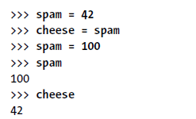
References
As you’ve seen, variables store strings and integer values.
When you later change the value in spam to 100, this doesn’t affect the value in cheese. This is because spam and cheese are different variables that store different values.

Slide 44
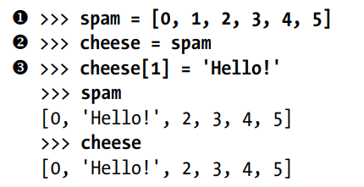
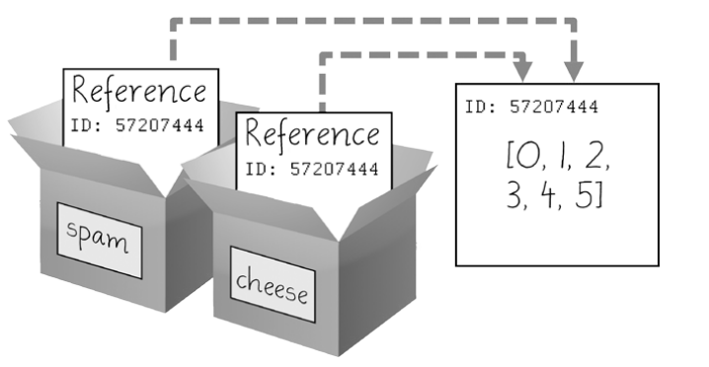
References
A reference is a value (ID numbers ) that points to some bit of data
When a list is assigned to a variable, it is assigning a list reference to the variable.
Python uses references whenever variables must store values of mutable data types, such as lists or dictionaries.
For values of immutable data types such as strings, integers, or tuples, assigned variables will store the value itself.

Slide 45
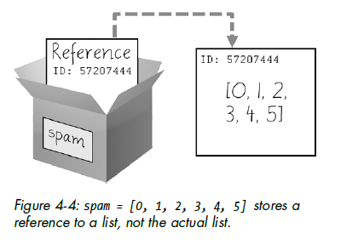
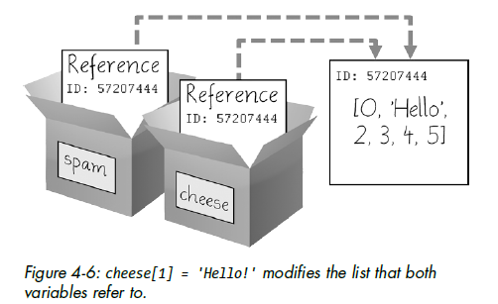
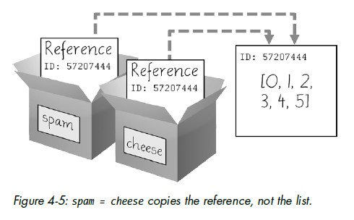

Slide 46
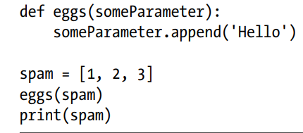
Passing References
a = 20
b = 25
def add(a,b):
print(‘Sum=‘ + (a+b))
x=20
y=25
add(x,y)
When a function is called, the values of the arguments are copied to the parameter variables. (replicated)
Pass By Value
Pass By Reference
For lists and dictionaries, a copy of the reference is used for the parameter
a = x , b = y
x = 20
y = 25
spam[0] | 1
spam[1] | 2
spam[2] | 3
someParameter = spam
spam[0] | 1
spam[1] | 2
spam[2] | 3
spam[3] | ‘Hello’

Slide 47
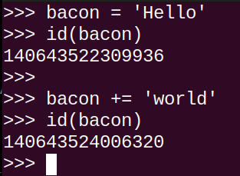
id function in python
id function returns the reference of the variable.
Immutable objects like string cannot be changed. This can be demonstrated with the help of a id( )

Slide 48

type function in python
If you have only one value in your tuple, you can indicate this by placing a trailing comma after the value inside the parentheses.
Otherwise, Python will think you’ve just typed a value inside regular parentheses. The comma is what lets Python know this is a tuple value.

Slide 49
Guess the type
1. type([1,2,3,4,5])
Output: list
2. type(1)
Output: int
3. type(‘hello’)
Output : str
4. type((‘hello’))
Output: str
5. type((‘hello’,)
Output : tuple
6. type(0.5)
Output: float
7. type({1,2,3,4,5,6,7})
Output : set
8.type({1:'hi',3:'hello',10:'pink'})
Output : dict

Slide 50
Copy Modules - Copying of lists
Using ‘ = ‘ notation
Only one memory location for the first list, and all other copies are reference to the original one and no duplicates are created
Any changes made to aliases will change the original itself
Using copy()
Copies or duplicates of lists get different memory location and any changes to the duplicates will not reflect on original or vice versa
Using deepcopy()

Slide 51
Using = notation
list1 = [1, 2, 3, 4, 5] list2 = list1 print(list1) print(list2) print('list1 reference = ', id(list1)) print('list2 reference = ', id(list2))
list2[3] = 88 print(list1) print(list2)
[1, 2, 3, 4, 5]
[1, 2, 3, 4, 5]
list1 reference = 2783439106560
list2 reference = 2783439106560
[1, 2, 3, 88, 5]
[1, 2, 3, 88, 5]

Slide 52
The copy Module’s copy()
If the function modifies the list or dictionary that is passed, and these changes should not be reflected in the original list or dictionary value, then the copy module provides the copy() function.
copy.copy() can be used to make a duplicate copy of a mutable value like a list or dictionary, not just a reference
>>> import copy
>>> spam = ['A', 'B', 'C', 'D']
>>> cheese = copy.copy(spam)
>>> cheese[1] = 42
>>> spam ['A', 'B', 'C', 'D']
>>> cheese ['A', 42, 'C', 'D']

Slide 53
import copy list1 = [11, 22, 33, 44, 55] list2 = copy.copy(list1) list3 = copy.copy(list2) print(list1) print(list2) print(list3) print(' list1 reference = ', id(list1)) print(' list2 reference = ', id(list2)) print(' list3 reference = ', id(list3)) list3[2] = 999 print(list1) print(list2) print(list3) list2[1] = 888 print(list1) print(list2) print(list3)
[11, 22, 33, 44, 55]
[11, 22, 33, 44, 55]
[11, 22, 33, 44, 55]
list1 reference = 2357165907072
list2 reference = 2357165707840
list3 reference = 2357165709056
[11, 22, 33, 44, 55]
[11, 22, 33, 44, 55]
[11, 22, 999, 44, 55]
[11, 22, 33, 44, 55]
[11, 888, 33, 44, 55]
[11, 22, 999, 44, 55]

Slide 54
The copy Module’s deepcopy()
>>> import copy
>>> spam = [['A', 'B‘], ['C', 'D‘]]
>>> cheese = copy.deepcopy(spam)
>>> cheese[0,1] = 42
>>> spam [‘[A', 'B‘], ['C', 'D‘]]
>>> cheese [‘[A', 42], ['C', 'D‘]]
>>>cheese[0] = ‘Z’
>>> spam [‘[A', 'B‘], ['C', 'D‘]]
>>> cheese [‘Z’, ['C', 'D‘]]
If there exists Nested lists or multiple lists within a list then to not change the sublist of original, use the copy.deepcopy() function
The deepcopy() function will copy these inner lists also.

Slide 55
import copy list1 = [[11, 22, 33], [44, 55]] list2 = list1 list3 = copy.copy(list1) list4 = copy.deepcopy(list1) print('LIST1 = ', list1) print('LIST2 = ', list2) print('LIST3 = ', list3) print('LIST4 = ', list4) print('list1 reference = ', id(list1)) print('list2 reference = ', id(list2)) print('list3 reference = ', id(list3)) print('list4 reference = ', id(list4)) list3[0] = 888 # does not reflect other two lists - sublist list3[1][1] = 777 # reflects other two lists – item in sublist list4[0] = 666 # does not reflect other two lists - sublist list4[1][1] = 333 # does not reflects other two lists – item in sublist list1.append([9, 8, 7]) print('LIST1 = ', list1) print('LIST2 = ', list2) print('LIST3 = ', list3) print('LIST4 = ', list4)
LIST1 = [[11, 22, 33], [44, 55]]
LIST2 = [[11, 22, 33], [44, 55]]
LIST3 = [[11, 22, 33], [44, 55]]
LIST4 = [[11, 22, 33], [44, 55]]
list1 reference = 2155236342208
list2 reference = 2155236342208
list3 reference = 2155235912256
list4 reference = 2155236510336
LIST1 = [[11, 22, 33], [44, 777], [9, 8, 7]]
LIST2 = [[11, 22, 33], [44, 777], [9, 8, 7]]
LIST3 = [888, [44, 777]]
LIST4 = [666, [44, 333]]

Slide 56
Try yourself: (copy())
import copy
L1=[2,5,3,1,0.5,-3]
L2=copy.copy(L1)
print('L1 is\n',L1)
print('L2 is\n',L2)
L1[1]=-5
print('L1 after modification:\n',L1)
print('No changes in L2 bcz its a copy of L1\n',L2)
L2[3]=0
Print(L2)
Print(L1)
L3=copy.copy(L1)
print('Modified list L1 is stored in L3\n', L3)
Consider the given list [2,5,3,1,0.5,-3] and do the following
Create a list and assign that list to variable L1
Copy L1 to L2(Using built in function)
Modify the items in L1 and print the list L1 {L1[1]=-5}
Modify the items in L2 and print the list L2 {L2[3]=0}
Find the difference and What are the items present in L1 and L2
Copy L1 to L3 and print L3
Output
L1 is [2, 5, 3, 1, 0.5, -3]
L2 is [2, 5, 3, 1, 0.5, -3]
L1 after modification: [2, -5, 3, 1, 0.5, -3]
No changes in L2 bcz its a copy of L1
[2, 5, 0, 1, 0.5, -3]
[2, -5, 3, 1, 0.5, -3]
Modified list L1 is stored in L3 [2, -5, 3, 1, 0.5, -3]

Slide 57
Is it possible to use deepcopy in normal list?
Yes
How it works?
import copy
L1=[2,5,3,1,0.5,-3] # deepcopy function works like copy function in normal list
L2=copy.deepcopy(L1)
print(L2)
Output:
[2, 5, 3, 1, 0.5, -3]

Slide 58
How copy() works in nested list?
import copy
l1=[[1,2],[3,4]]
l2=copy.copy(l1)
print(l2)
Output:
[[1, 2], [3, 4]]
we can modify but it will reflect in another variable
import copy
l1=[[1,2],[3,4]]
l2=copy.copy(l1)
l2[0][1]=10
Print(l1)
print(l2)
Output:
[[1, 10], [3, 4]]
[[1, 10], [3, 4]]
To overcome the drawback of copy()using deepcopy()
import copy
l1=[[1,2],[3,4]]
l2=copy.deepcopy(l1)
l2[0][1]=10
print(l1)
print(l2)
Output:
[[1, 2], [3, 4]]
[[1, 10], [3, 4]]

Slide 59
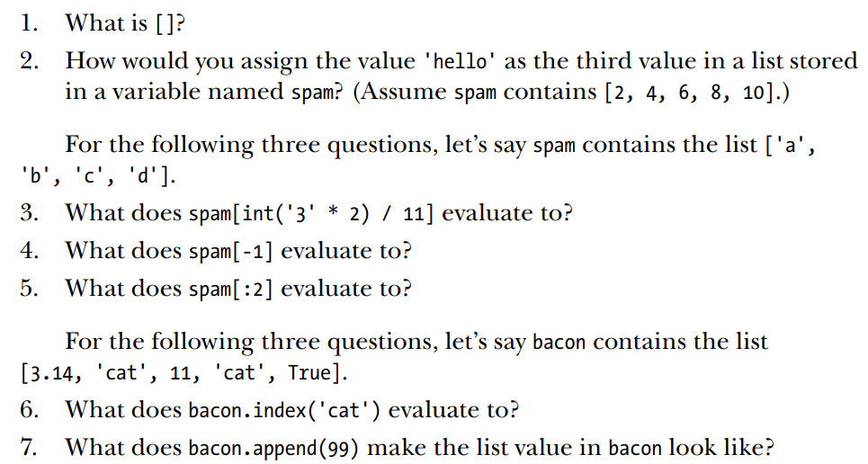
Assignment 4

Slide 60
