Slide 1
Module 4 Organizing files

Slide 2
Topics
Organizing Files: The shutil module
copy, move, rename, delete
Compressing and zipping files

Slide 3
The shutil Module
* shutil (shell utilities) module
* copy, move, rename and delete files from python code.

Slide 4
Copying Files and Folders
The shutil module provides functions for copying files, as well as entire folders.
Calling shutil.copy(source, destination) will copy the file at the path source to the folder at the path destination. (Both source and destination are strings.)
If destination is a filename, it will be used as the new name of the copied file.
This function returns a string of the path of the copied file

Slide 5
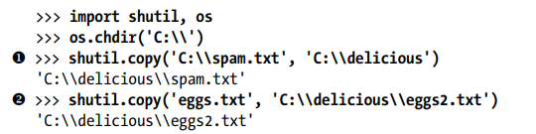
the original spam.txt filename is used for the new, copied file’s filename.
The second shutil.copy() call 2. also copies the file at C:\eggs.txt to the folder C:\delicious but gives the copied file the name eggs2.txt
shutil.copy(source, destination)

Slide 6
Example:
import shutil import os os.chdir('D:\\') h = shutil.copy('D:\\hello.txt', 'D:\\delicious') # First print('hello = ', h) if h: print('Hello.txt file copied to Delicious folder') hi = shutil.copy('hello.txt', 'D:\\delicious\\hi.txt') # Second print('hi = ', hi) if hi: print('Hello.txt file copied to Delicious folder as hi.txt')
hello = D:\delicious\hello.txt
Hello.txt file copied to Delicious folder
hi = D:\delicious\hi.txt
Hello.txt file copied to Delicious folder as hi.txt

Slide 7
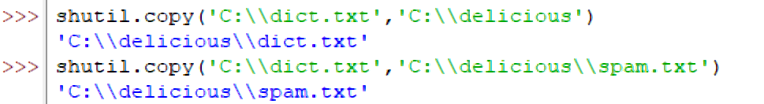
Try yourself………..
>>>import shutil

Slide 8

While shutil.copy() will copy a single file, shutil.copytree() will copy an entire folder and every folder and file contained in it.
Calling shutil.copytree(source, destination) will copy the folder at the path source, along with all of its files and subfolders, to the folder at the path destination.
The source and destination parameters are both strings.
shutil.copytree(source, destination)
The shutil.copytree() creates a new folder named del_backup with the same content as the original delicious folder

Slide 9
Example:
import shutil import os print('Current Working Directory', os.getcwd()) os.chdir('D:\\') if shutil.copytree('D:\\delicious', 'C:\\del_backup'): print("del_backup folder and its contents are copied to C Drive")
D:\delicious\walnut\waffles
C:\del_backup\walnut\waffles
Current Working Directory C:\Users\Lenovo\PycharmProjects\pythonProject
del_backup folder and its contents are copied to C Drive

Slide 10

Moving and Renaming Files and Folders
Calling shutil.move(source, destination) will move the file or folder at the path source to the path destination and will return a string of the absolute path of the new location.
If destination points to a folder, the source file gets moved into destination and keeps its current filename.
Example:

Slide 11
Example:
import shutil import os os.chdir('C:\\') ctoc = shutil.move('C:\\sample\\sss.txt', 'C:\\del_backup') print('Path of sss.txt moved --- ', ctoc) ctod = shutil.move('C:\\sample\\yyy.txt', 'D:\\delicious') print('Path of yyy.txt moved --- ', ctod)
Path of sss.txt moved --- C:\del_backup\sss.txt
Path of yyy.txt moved --- D:\delicious\yyy.txt

Slide 12
The destination path can also specify a filename, wherein the source file is moved and renamed in the destination.
Consider this : filedir = shutil.move(‘D:\\sample\\abc.txt', 'D:\\eggs')
What happens ? Is “eggs” a new file or a folder?
newfn = shutil.move('C:\\sample\\hello.txt', 'D:\\delicious\\new_hello.txt') print('Path of hello.txt moved --- ', newfn)
Path of hello.txt moved --- D:\delicious\new_hello.txt

Slide 13
Note
Copy() - Copy Paste
Move() – Cut paste

Slide 14
Permanently Deleting Files and Folders os.unlink(path), os.rmdir(path), shutil.rmtree(path)
A single file or a single empty folder can be deleted with functions in the os module
But to delete a folder and all of its contents, shutil module is used.
os.unlink(path) deletes the file at path specified.
os.rmdir(path) deletes the folder at path, but the folder must be empty of any files or folders.
shutil.rmtree(path) removes the folder at path, and all files and folders it contains will also be deleted.
Be careful when using these functions in your programs!

Slide 15
Verifying before deletion is important confirm by printing the filename before deleting it
import os
for filename in os.listdir():
if filename.endswith('.txt'):
os.unlink(filename)
import os
for filename in os.listdir():
if filename.endswith('.txt'):
# os.unlink(filename)
print(filename)

Slide 16
Safe Deletes with the send2trash Module
Since shutil.rmtree() function irreversibly deletes files and folders, it can be dangerous to use.
A much better way to delete files and folders is with the third-party send2trash module.
Install this module by running pip install send2trash from a Terminal window. (See Appendix A for a more in-depth explanation of how to install third-party modules.)
Using send2trash is safer than Python’s delete functions, because it sends folders and files to the computer’s trash or recycle bin instead of permanently deleting them.
If a bug in the ,program deletes something with send2trash, that was not intended to delete, it can be later restored from the recycle bin

Slide 17
Walking a Directory Tree – os.walk()
Python provides a function to handle the process to walk through the directory tree, looking each file as traversed for example to rename every file in some folder and also every file in every subfolder of that folder.
The os.walk() function is passed a single string value: the path of a folder.
os.walk() is used in a for loop statement to walk a directory tree.
The os.walk() function returns three values on each iteration through the loop:
1. A string of the current folder’s name
2. A list of strings of the folders in the current folder
3. A list of strings of the files in the current folder

Slide 18
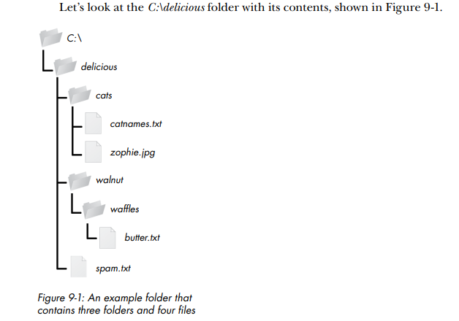

Slide 19
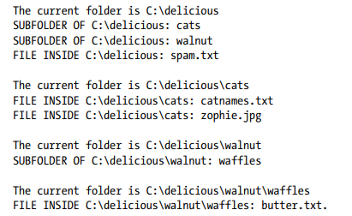
import os for folderName, subfolders, filenames in os.walk('D:\\delicious'): print('The current folder is ' + folderName) for subfolder in subfolders: print('SUBFOLDER OF ' + folderName + ': ' + subfolder) for filename in filenames: print('FILE INSIDE ' + folderName + ': ' + filename) print('')

Slide 20
Since os.walk() returns lists of strings for the subfolder and filename variables, use these lists in their own for loops.
Replace the print() function calls with your own custom code. (Or if you don’t need one or both of them, remove the for loops.)

Slide 21
Compressing Files with the zipfile Module
Compressing a file reduces its size, which is useful when transferring it over the Internet.
And since a ZIP file can also contain multiple files and subfolders, it’s a handy way to package several files into one.
This single file, called an archive file, can then be used to send or store thru email as attachment
Python programs can create and open (or extract) ZIP files using functions in the zipfile module.

Slide 22
Reading ZIP Files
To read the contents of a ZIP file, first create a ZipFile object (note the capital letters Z and F).
ZipFile objects are similar to the File objects returned by the open() function, which are values through which the program interacts with the file.
zipfile.ZipFile() function, is used to create a ZipFile object, passing it a string of the .zip file’s filename.
zipfile is the name of the Python module, and ZipFile() is the name of the function.
namelist() function extracts the file names into a list assigned

Slide 23
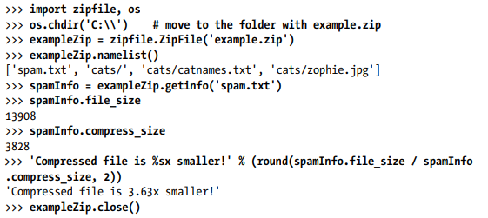
Example

Slide 24
Program for Reading ZIP File contents
import zipfile import os os.chdir('D:\\') # move to the folder with northcampus.zip exampleZip = zipfile.ZipFile('northcampus.zip') print('northcampus.zip namelist : ', exampleZip.namelist()) filenames = exampleZip.namelist() # List of filenames extracted using namelist function helloInfo = exampleZip.getinfo(filenames[1]) print('Information of ' + filenames[1], helloInfo) print('Actual File size of ' + filenames[1], ' : ', helloInfo.file_size) print('Compressed File size of ' + filenames[1], ' : ', helloInfo.compress_size) spamInfo = exampleZip.getinfo(filenames[0]) print('Actual File size of ' + filenames[0] + ': ', spamInfo.file_size) print('Compressed File size of '+ filenames[0]+ ' : ' , spamInfo.compress_size) print('Compressed file is %s times smaller!' % (round(spamInfo.file_size / spamInfo.compress_size, 4)))

Slide 25
Output
northcampus.zip namelist : ['North Campus (Faculty)Allotment.jpeg', 'hello.txt']
Information of hello.txt <ZipInfo filename='hello.txt' compress_type=deflate
external_attr=0x20 file_size=104 compress_size=86>
Actual File size of hello.txt : 104
Compressed File size of hello.txt : 86
Actual File size of North Campus (Faculty)Allotment.jpeg: 931045
Compressed File size of North Campus (Faculty)Allotment.jpeg : 913313
Compressed file is 1.0194 times smaller!

Slide 26
Extracting from ZIP Files
The extract() method for ZipFile objects extracts a single file from the ZIP file.
The extractall() method for ZipFile objects extracts all the files and folders from a ZIP file into the current working directory.
The string passed to extract() must match one of the strings in the list returned by namelist().
Optionally, a second argument can be passed to extract() function, to extract the file into a folder other than the current working directory.
If this second argument is a folder that doesn’t exist, Python will create the folder.
The value that extract() returns is the absolute path to which the file was extracted.

Slide 27


# Extract all files and folders
# Extract single file or folder

Slide 28
import zipfile import os os.chdir('D:\\') # move to the folder with example.zip exampleZip = zipfile.ZipFile('northcampus.zip') exampleZip.extractall()
exampleZip.extract('hello.txt') exampleZip.extract('hello.txt', 'C:\\some\\new\\folders')
exampleZip.close()
It is seen that files inside the northcampus.zip had two files and were extracted in D drive
Also, hello.txt was extracted into 'C:\\some\\new\\folders which were created
exampleZip.extractall('extra')
It is seen that files inside the northcampus.zip had two files and were extracted into a folder extra in D drive.
Since extra folder was not existing, folder is created and files are stored

Slide 29
Creating and Adding to ZIP Files
To create a compressed ZIP files, open the ZipFile object in write mode by passing 'w' as the second argument.
When a path argument is passed to the write() method of a ZipFile object, Python compresses the file at that path and add it into the ZIP file.
The first argument of write() method is a string of the filename to be added.
The second argument is the compression type parameter, which tells the computer what algorithm/type of compression to use to compress the files
Just setting this value to zipfile.ZIP_DEFLATED, specifies the deflate compression algorithm, which works well on all types of data.
import zipfile
newZip = zipfile.ZipFile('new.zip', 'w')
newZip.write(‘hello.txt', compress_type=zipfile.ZIP_DEFLATED)
newZip.close()

Slide 30
This code creates a new ZIP file named new.zip that has the compressed contents of hello.txt.
NOTE - write mode erases all existing contents of a ZIP file.
Hence, to add files to an existing ZIP file, open the ZIP file in append mode, by passing 'a' as the second argument to zipfile.ZipFile().
import zipfile
newZip = zipfile.ZipFile('new.zip', ‘a')
newZip.write(‘hello.txt', compress_type=zipfile.ZIP_DEFLATED)
newZip.close()

Slide 31
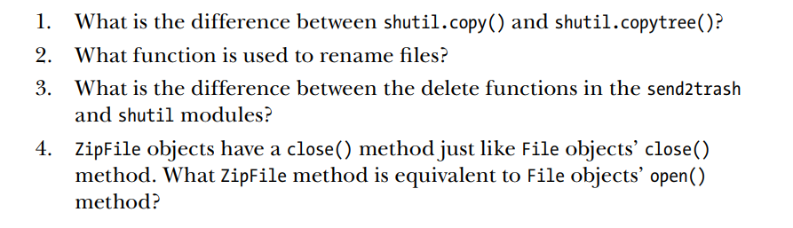
Assignment 8
Project: Backing Up a Folder into a ZIP File
Step 1: Figure Out the ZIP File’s Name
Step 2: Create the New ZIP File
Step 3: Walk the Directory Tree and Add to the ZIP File

