Slide 1
Optimum Location for a Student hostel
Chinmay KR

Slide 2
Optimum locations for a student hostel
With a large number of higher educational institutions, New York has seen a huge influx of student population.
Student hostels can benefit the students as well as the organization due to the huge demand for budget friendly accommodations.
But not all parts of the country are equally populated with colleges. It is therefore advantageous to know regions with high number of colleges and regions where the infrastructure needs some development.

Slide 3
Problem Statement
Most of the students pursuing a degree are on a budget, and house rents can be daunting. Low budget student hostels or dormitories can be a solution to this problem. A hostel which is situated in the right place and offering services at the right price can benefit a lot of students. This project aims to predict a suitable location for the construction of student hostels.
The stake holders interested in this project would be a hypothetical construction company, willing to enter into hostels and hospitality. Also, the students enrolled in colleges and universities in New York.

Slide 4
Data acquisition and Cleaning
New York community colleges, the number of students enrolled and their addresses were web scraped from ' https://www.communitycollegereview.com/college-size-stats/new-york ‘
The coordinates of the colleges were obtained from geopy library.
Trending hotspots were fetched from Foursquare API.
The final aggregated data has 21 rows(grouped by college names) 42 features.

Slide 5
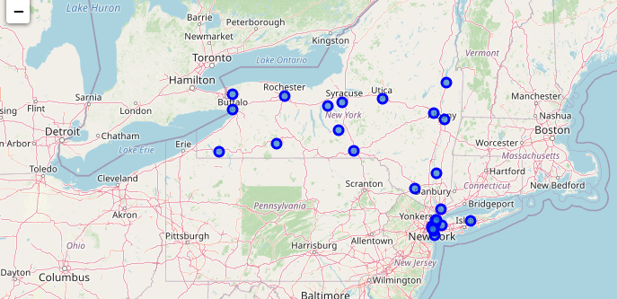
Colleges in scope
The community colleges in scope are plotted on a map

Slide 6
Exploratory Data Analysis/Insights
Top 5 hotspots by frequency of appearance :
The most popular hotspots are Coffee shops and Pizza places.
Gyms are the only non-eatery place that have made to the top 5 hotspots
Venue Category | Frequency
Coffee shops | 13
Pizza place | 7
Sandwich place | 5
Chinese restaurant | 4
Gym | 4

Slide 7
Top 5 colleges with most number of hotspots around them : These colleges' neighbourhoods could potentially make for a great place for a student hostel since it has all the amenities around and is also less than 200 meters from the college As intuition would suggest, all of these colleges are situated in the NYC metropolitan area.
COLLEGE | No. Of Hotspots
ASA College | 12
CUNY LaGuardia Community College | 10
Fashion Institute of Technology | 9
CUNY Hostos Community College | 8
Monroe College | 7

Slide 8
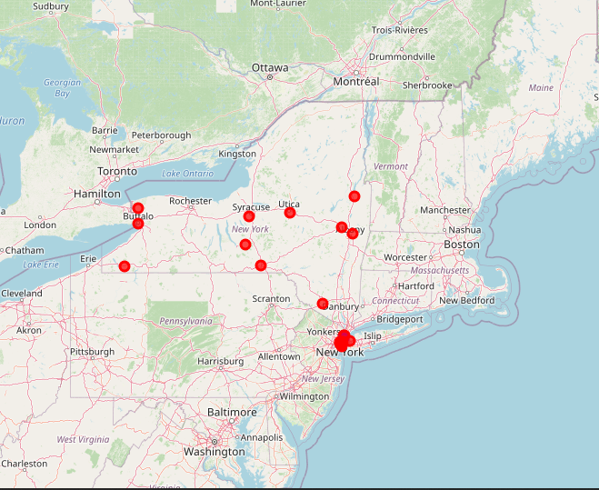
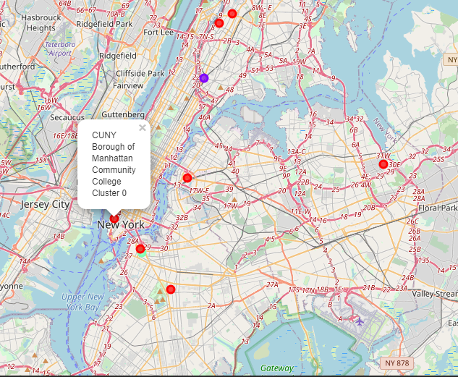
PREDICTIVE MODELLING - KMEANS
New York State
New York city

Slide 9
Kmeans summary
The colleges in cluster 1 (RED cluster) are surrounded by a wide variety of hotspots. These college neighbourhoods have a lot of amenities around them and it would be a safe bet to open a student hostel around any of these colleges.The neighbourhood around CUNY Borough of Manhattan Community College would be the best bet since it alone has more than 26000 students enrolled.
The colleges in cluster 2 (BLUE cluster) are surrounded by hotspots like Bars and fast food restaurants. These neighbourhoods are considerably less fancy compared to the college neighbourhoods in cluster 1. The students might not find as many hotspots or amenities around this neighbourhood.
The colleges in cluster 3 are surrounded by hotspots like International cuisine restaurants. The interesting point in this cluster is that it has only 1 college and it is surrounded by as many as 13 differet types of hotspots.

Slide 10
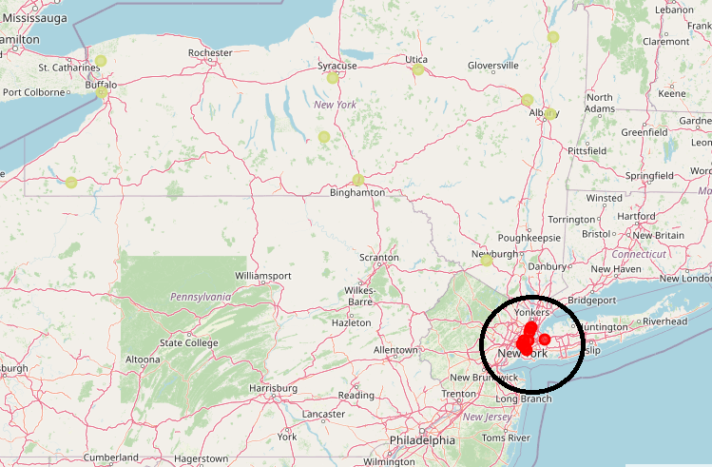
Predictive modelling - DBscan
DBSCAN cluster with a dense region in NYC and outliers

Slide 11
Dbscan - summary
If the builder were to establish just one hostel in the state of New York, then it is clear that he would make the most profit by situating the hostel in the dense region, i.e. Manhattan/Brooklyn/Bronx region.
A closer look at the cluster on the map would reveal that situating the hostel at the center of this dense region would be the best approach. Based on this, it would be best to establish the hostel near Central park, Manhattan.

Slide 12
Results
If the plan is to build multiple hostels in feasible areas, we should refer to the KMeans output. In KMeans, Colleges in cluster 1 have the best facilities in the neighbourhood and the number of students enrolled in these colleges also is on the higher side.
If the builder is planning on establishing just 1 hostel in the state, then we will have to go with the DBSCAN model. The centre of the dense cluster would be a good location which happens to be near Central park, Manhattan.

Slide 13
Future directions
The future scope and improvements would be :
1. To obtain a survey from a statistically large enough sample of students about their preferences in hostels,neighbourhoods and hotspots.
2. Assign different weights to the hotspots based on the survey to obtain a more realistic model.
3. Use DBSCAN with Haversine distance for geo spatial data.
4. Since there are 42 features, we could try dimensionality reduction methods before applying clustering.

