Slide 1



Water Quality Prediction
Chinmayee Reddy C STU67656487a18561734698119

Slide 2

Learning Objectives
Learn how to clean and prepare water quality datasets, as well as identify which features are most useful for making accurate predictions.
Evaluate the model’s performance using accuracy metrics, including Root Mean Square Error (RMSE) and R² score.
Design and deploy a simple interactive web application using Streamlit, allowing users to input data and receive instant pollutant predictions.
Gain hands-on experience with end-to-end machine learning workflows, from data preprocessing to deployment.
Understand how machine learning techniques, particularly the Random Forest Regressor (RFR), can be utilized to predict water pollutants.
Build a model that can predict pollutant levels, such as dissolved oxygen (DO), nitrate (NO₃), nitrite (NO₂), sulfate (SO₄), phosphate (PO₄), and chloride (Cl), using real-world water data.
GOAL
Source :
www.freepik.com/

Slide 3
Tools and Technology used
Data Science Tools
1.Python: Python was chosen as the core programming language for the project due to its simplicity, readability, and powerful ecosystem of data science libraries. It served as the foundation for all key phases of the project, including data preprocessing, model development, evaluation, and deployment.
2. pandas and numpy: To handle the water quality dataset efficiently, the pandas library was used for loading, transforming, and organizing tabular data. It provided powerful DataFrame structures to clean and analyze complex pollutant data. The numpy library complemented this by enabling fast numerical computations and array-based operations, especially during feature engineering and matrix transformations.
3. matplotlib and seaborn: Exploratory Data Analysis (EDA) was conducted using matplotlib and seaborn, two widely-used data visualization libraries. These tools helped in visualizing distributions, correlations, and trends among various pollutants (such as DO, NO₃, NO₂, etc.), thereby offering valuable insights into the structure and patterns of the dataset before model training.
4.Scikit-learn

Slide 4
Tools and Technology Used
Deployment Tools
5. joblib and pickle: To make the model reusable without retraining it every time, it was serialized using joblib, which efficiently stores large numpy arrays and model objects. The structure of the input features was also preserved using pickle, ensuring that the model receives data in the exact format it was trained on during deployment.
6. Streamlit: For the user-facing application, the project leveraged Streamlit, a lightweight Python framework for building interactive web apps. Streamlit allowed us to quickly deploy the trained model in a browser-based environment, where users could enter inputs such as year and station ID and receive real-time predictions for pollutant levels through an intuitive interface — without needing any programming knowledge.
7. Git and GitHub: Throughout the development process, Git was used for version control to manage code updates and track changes. The complete project code, including the data, scripts, and documentation, was hosted on GitHub, making it easy to collaborate, share, and deploy from a central, accessible repository

Slide 5
Methodology
1.Data Collection Collected historical water quality data with features such as Year, Station ID, and pollutant values from government/environmental sources.
Data Preprocessing
Handled missing values and cleaned the dataset
Performed label encoding or one-hot encoding for the Station ID
Split dataset into features (Year, Station ID) and multiple pollutant target variables
Model Selection & Training
Chose MultiOutputRegressor wrapped around RandomForestRegressor
Trained the model to predict multiple pollutants simultaneously
Saved the trained model using job lib along with the column structure
Model Evaluation
Evaluated using regression metrics: R² Score and Mean Squared Error (MSE)
Verified the model's performance was consistent across all pollutants

Slide 6
Methodology
Streamlit Web App Development
Built an intuitive UI using Streamlit
Collected user inputs: Year and Station ID
Encoded and aligned inputs with the saved model's format
Predicted pollutants: O₂, NO₃, NO₂, SO₄, PO₄, Cl⁻
Displayed output cleanly on the web interface
Deployment (Local)
Deployed the Streamlit app for local use
Allows users to interact and generate predictions in real time

Slide 7
Problem Statement:
Water is a fundamental necessity for all living organisms, yet its quality is increasingly compromised due to the discharge of industrial waste, domestic sewage, and agricultural runoff into rivers, lakes, and other natural water bodies. These pollutants have significantly degraded water quality, posing serious threats to human health, agriculture, and aquatic ecosystems. Conventional methods of assessing water quality rely heavily on laboratory testing, which is often time-consuming, resource-intensive, and limited in its ability to provide timely insights for large-scale environmental monitoring.
To address these limitations, this project proposes a machine learning-based approach to predict the concentration levels of key water pollutants—namely Dissolved Oxygen (DO), Nitrate (NO₃), Nitrite (NO₂), Sulphate (SO₄), Phosphate (PO₄), and Chloride (Cl)—based on input features such as year and station ID. By using a trained Random Forest Regressor model and deploying it through a user-friendly Streamlit interface, the system enables faster and scalable water quality predictions. This approach supports proactive decision-making by environmental authorities and contributes to the broader objective of sustainable and data-driven water resource management.

Slide 8
Solution:
To address the challenge of monitoring water quality efficiently, a machine learning solution was developed using a Random Forest Regressor (RFR) model. The model was trained on historical water quality data, with year and station ID as input features, and was designed to predict the concentration levels of six key pollutants: Dissolved Oxygen (O₂), Nitrate (NO₃), Nitrite (NO₂), Sulphate (SO₄), Phosphate (PO₄), and Chloride (Cl).
The trained model was saved using joblib, along with the expected input feature structure (model_columns.pkl) for use during deployment. A simple and interactive web interface was built using Streamlit, which allows users to enter the year and station ID. Upon receiving these inputs, the app performs one-hot encoding on the station ID to match the training format. It then aligns the new input with the model's expected column order to ensure compatibility.
Once the input is prepared, the Streamlit app uses the loaded model to predict the pollutant levels. These predicted values are then displayed clearly on the interface, allowing users to instantly view the estimated concentrations for each pollutant. This approach provides a quick, scalable, and user-friendly alternative to traditional lab-based water quality testing, making it easier for environmental authorities and stakeholders to monitor pollution trends over time.

Slide 9
import pandas as pd
import numpy as np
import joblib
import pickle
import streamlit as st
model = joblib.load("pollution_model.pkl")
model_cols = joblib.load("model_columns.pkl")
st.title("Water Pollutants Predictor")
st.write("Predict the water pollutants based on Year and Station ID")
year_input = st.number_input("Enter Year", min_value=2000, max_value=2100, value=2022)
station_id = st.text_input("Enter Station ID", value='1')
if st.button('Predict'):
if not station_id:
st.warning('Please enter the station ID')
else:
input_df = pd.DataFrame({'year': [year_input], 'id': [station_id]})
input_encoded = pd.get_dummies(input_df, columns=['id'])
for col in model_cols:
if col not in input_encoded.columns:
input_encoded[col] = 0
input_encoded = input_encoded[model_cols]
predicted_pollutants = model.predict(input_encoded)[0]
pollutants = ['O2', 'NO3', 'NO2', 'SO4', 'PO4', 'CL']
st.subheader(f"Predicted pollutant levels for the station '{station_id}' in {year_input}:")
for p, val in zip(pollutants, predicted_pollutants):
st.write(f'{p}:{val:.2f}')
Code:

Slide 10
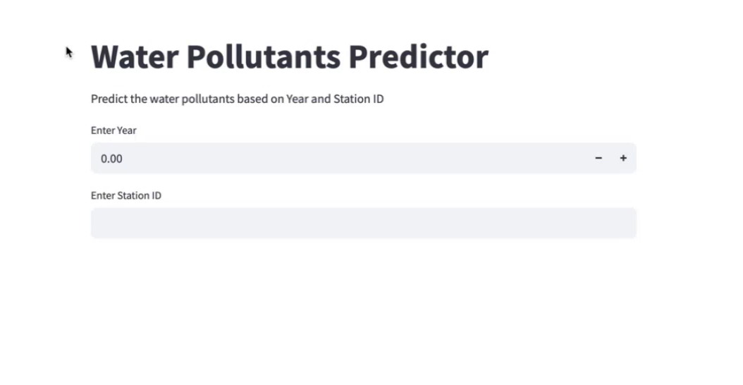
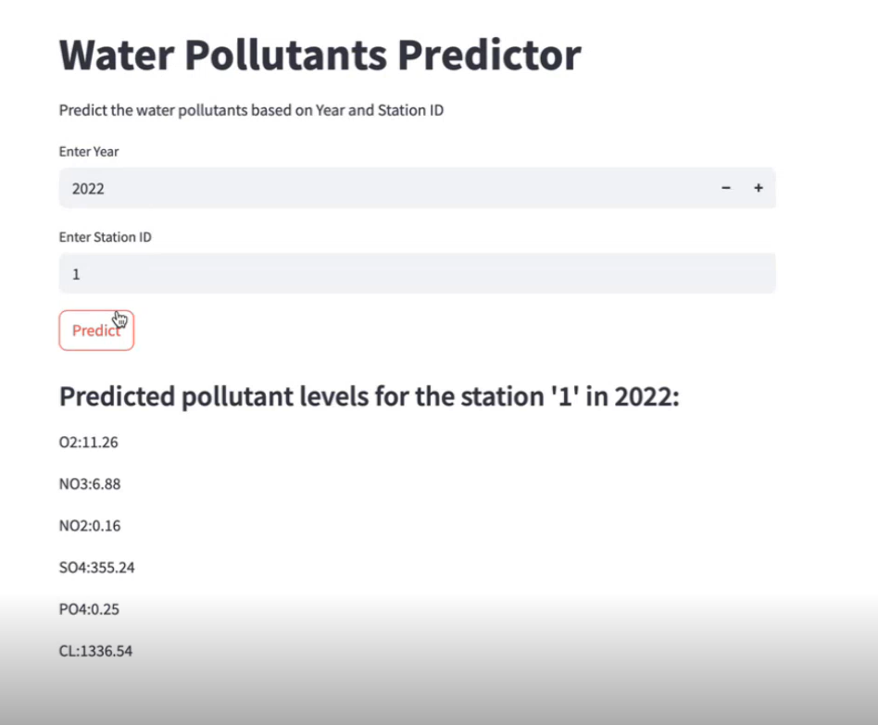
Screenshot of Output:

Slide 11
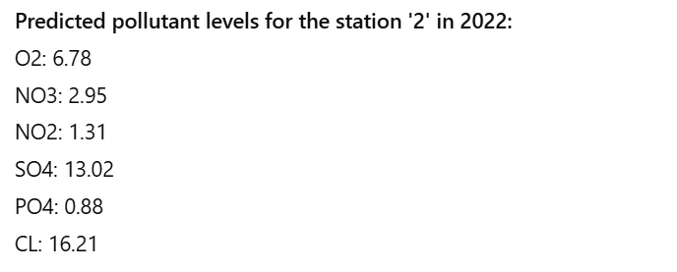
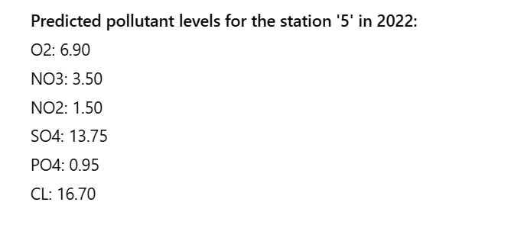
Screenshot of Output :

Slide 12
Conclusion:
This project demonstrates the effective use of machine learning in the field of environmental monitoring, specifically for predicting water quality parameters. By leveraging historical data and employing a Random Forest Regressor model, we were able to accurately estimate the concentration levels of key water pollutants such as Dissolved Oxygen, Nitrate, Nitrite, Sulphate, Phosphate, and Chloride.
The integration of this model into an interactive Streamlit web application further enhances its usability by allowing users to input simple features like year and station ID and instantly receive predictions. This not only saves time and resources compared to traditional laboratory testing but also enables more scalable and real-time monitoring of water bodies.
Overall, the project contributes to the broader vision of data-driven environmental management and supports efforts toward achieving clean and safe water for all. In future work, the system can be improved by incorporating real-time sensor data, expanding to additional pollutants, and integrating geospatial analysis for more comprehensive water quality assessment.
https://github.com/Chinmayee-Reddy/water_quality_Project

