Slide 1
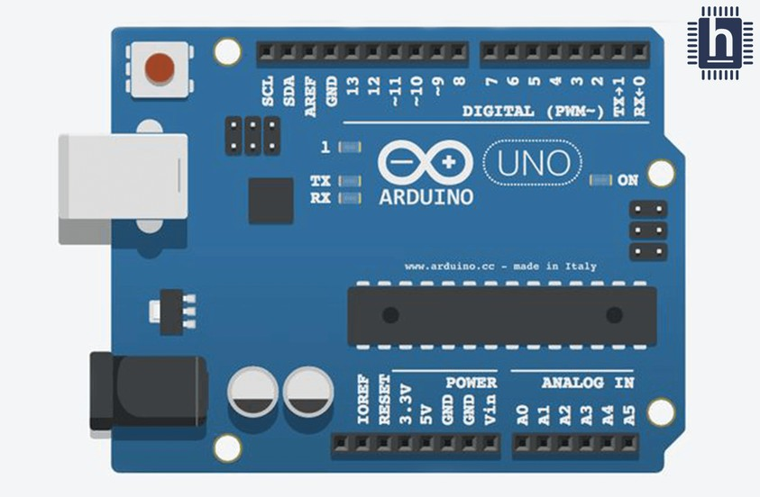



HARDWARE REQUIREMENTS
Camera
Arduino UNO
Single shaft BO motor(2)
Wires
Motor Driver(L293D) Battery 12V
Chasis
Wheels(2), castor wheel
TOOLS
Arduino 1.8.19 PyCharm
Circuit-diagram.org
PACKAGES
Media Pipe Numpy CV2
Tensorflow

Slide 2
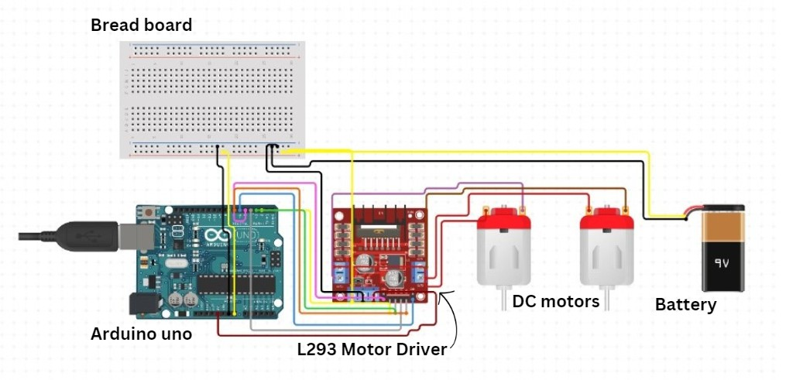
CIRCUIT DIAGRAM

