Slide 1
Education Institute Ranking

Slide 2
Running java code showing the implementation of a complete system at the department and college levels.
Presentation outlining your solution and implementation.
Sequence diagrams showing how to navigate the university object model to deliver performance metrics needed for performance and feedback.
An object model showing the changes to the university model to support the new capabilities.
This must include the additional methods and attributes required to deliver the results.
Investigate how we create digital education systems assuming a university is an intermediary (broker) between students and employers. Their brand is about credibility. How the implementation code will change based on this assumption?
Your application must enable the creation and update functions for any of the attributes of concern.
Deliverables:

Slide 3
Problem Statement :
To improve the quality of educational institutes by providing their students with optimum facilities and make them industry ready.
To create a performance measurement solution to enable universities to measure the quality of the education they deliver to their students.

Slide 4
Our Solution
Academics
Faculty
Industry Focused
Following performance metrics decide the quality of institution :
A] Academics:
Graduation Rate
Grade Point Average
B] Faculty :
Faculty: Students Ratio.
Faculty Specialization
Faculty Training
C] Industry Focused:
Courses with industrial importance
Employers
Employee Rating
Promotion

Slide 5
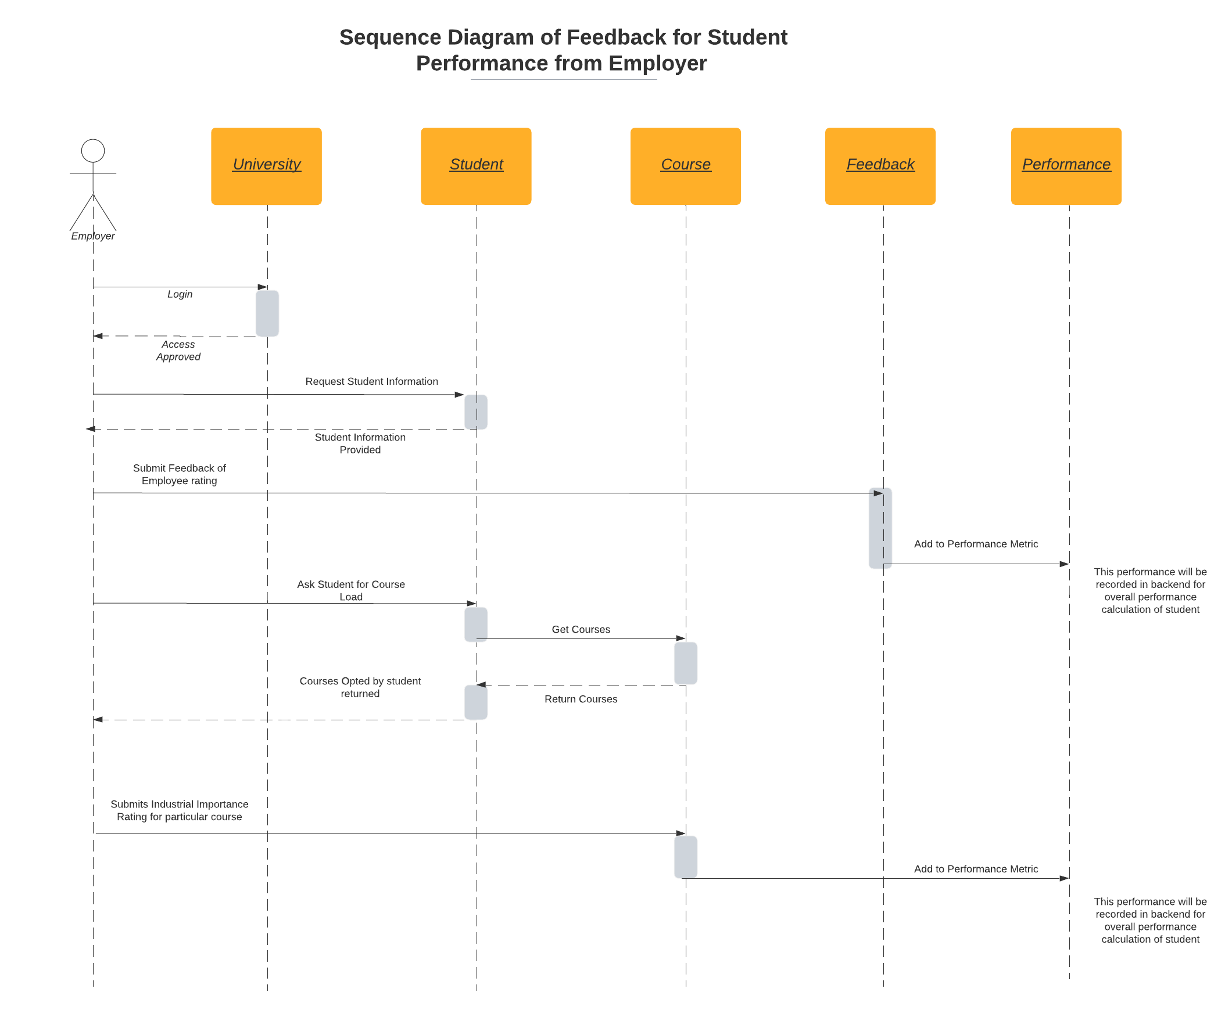
Sequence Diagram

Slide 7
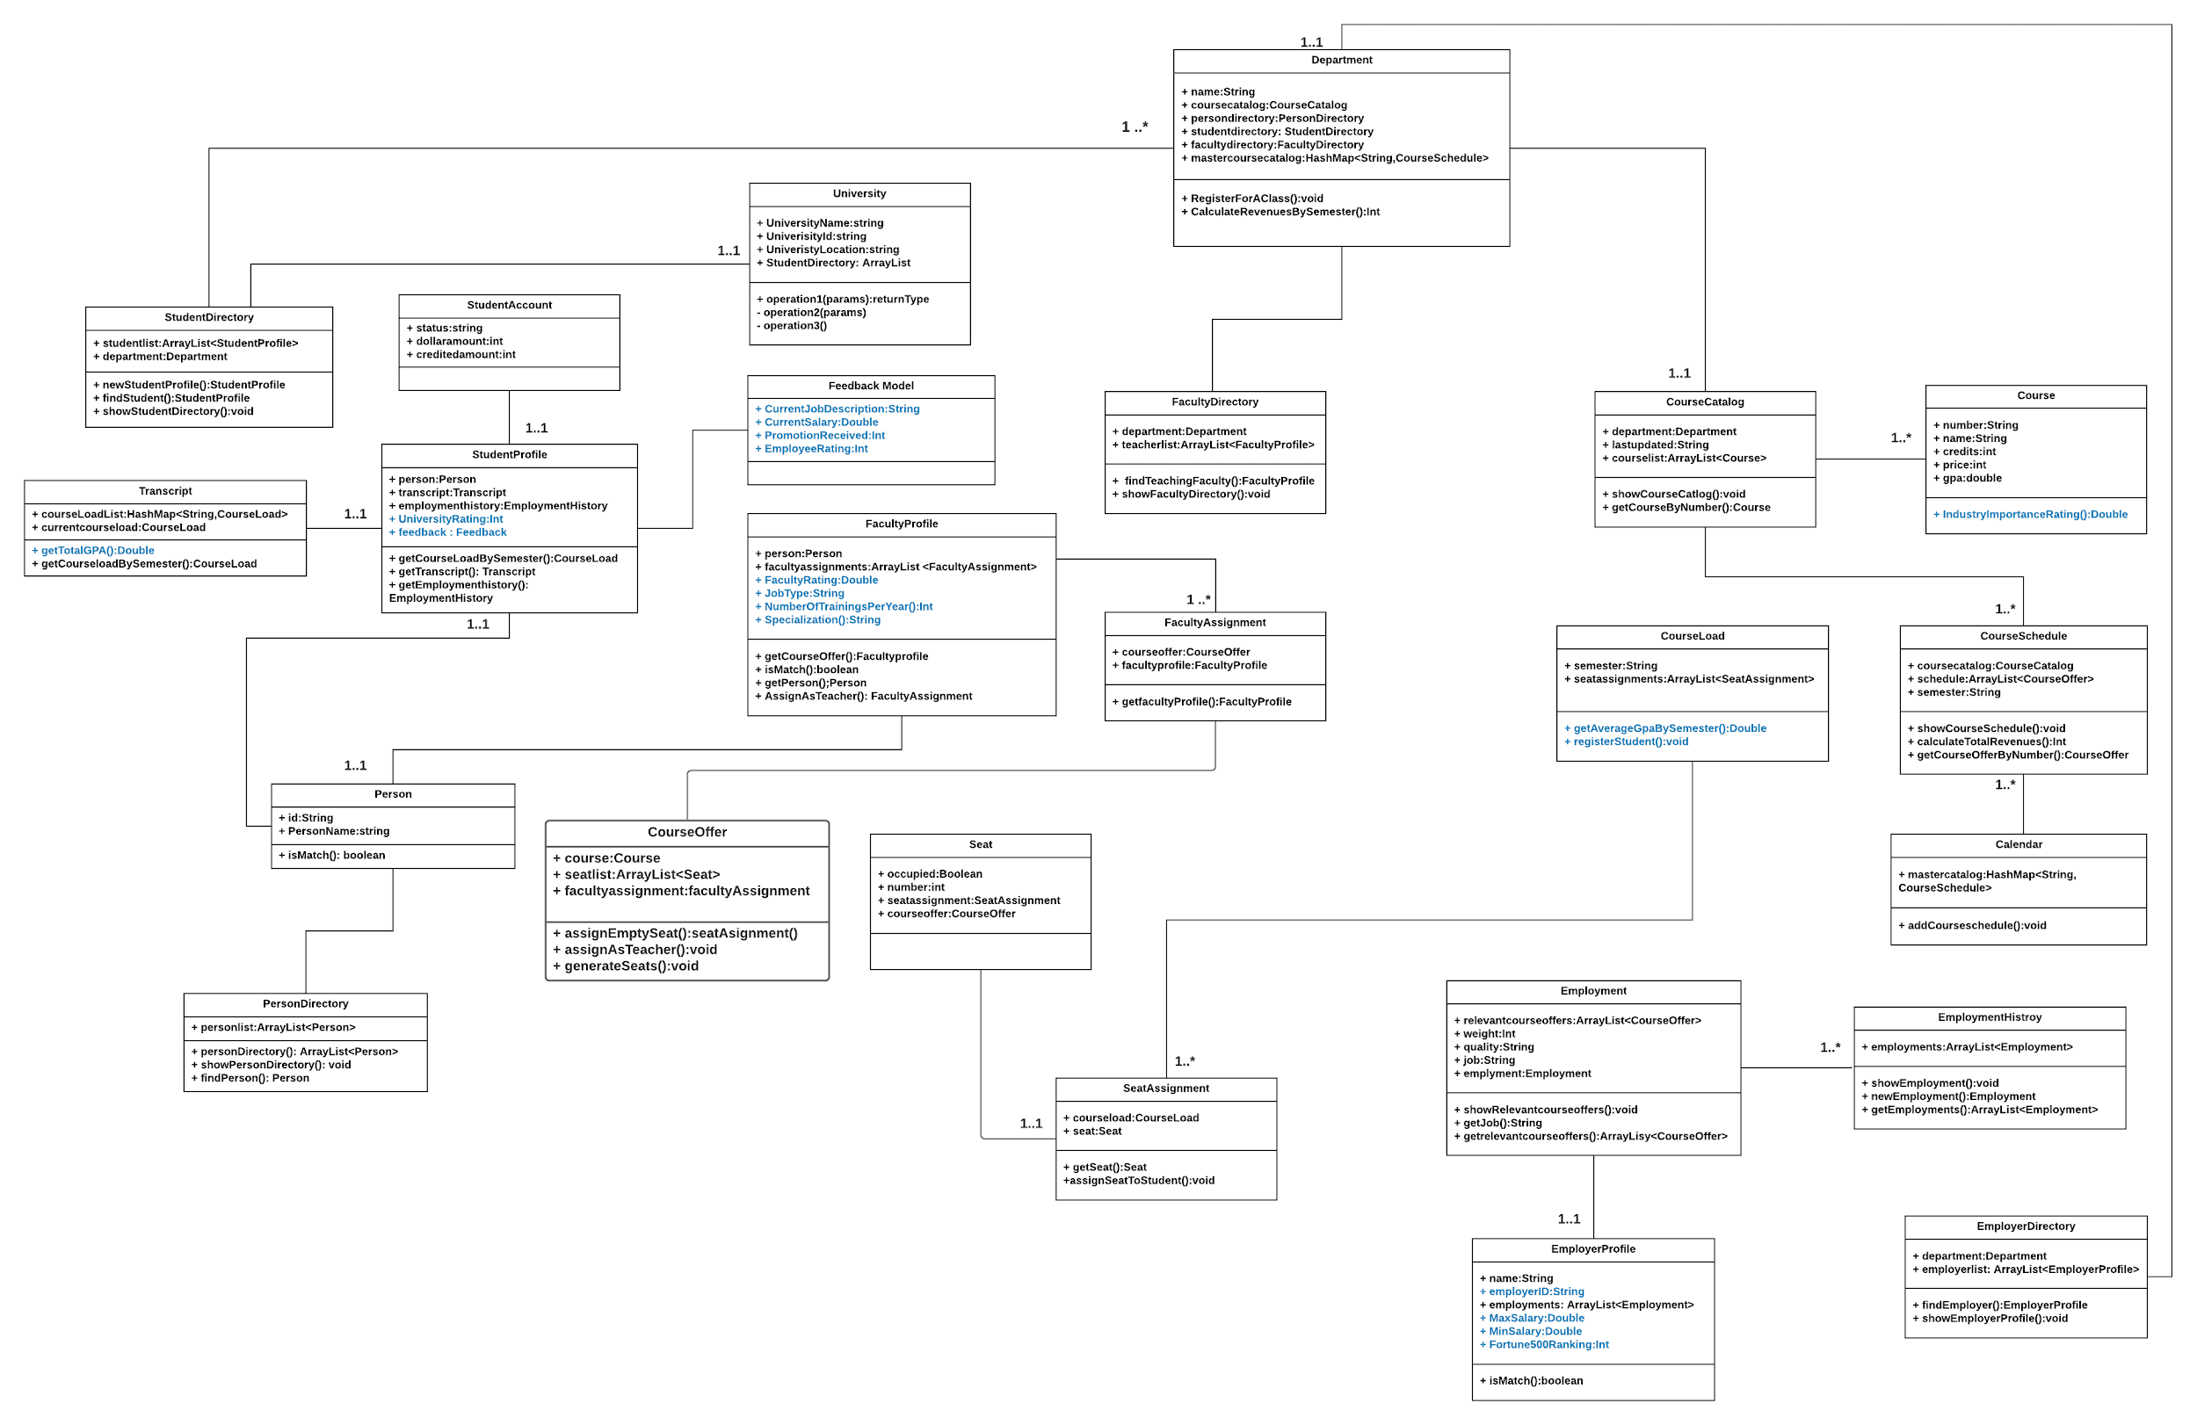
Object Model Diagram

Slide 8
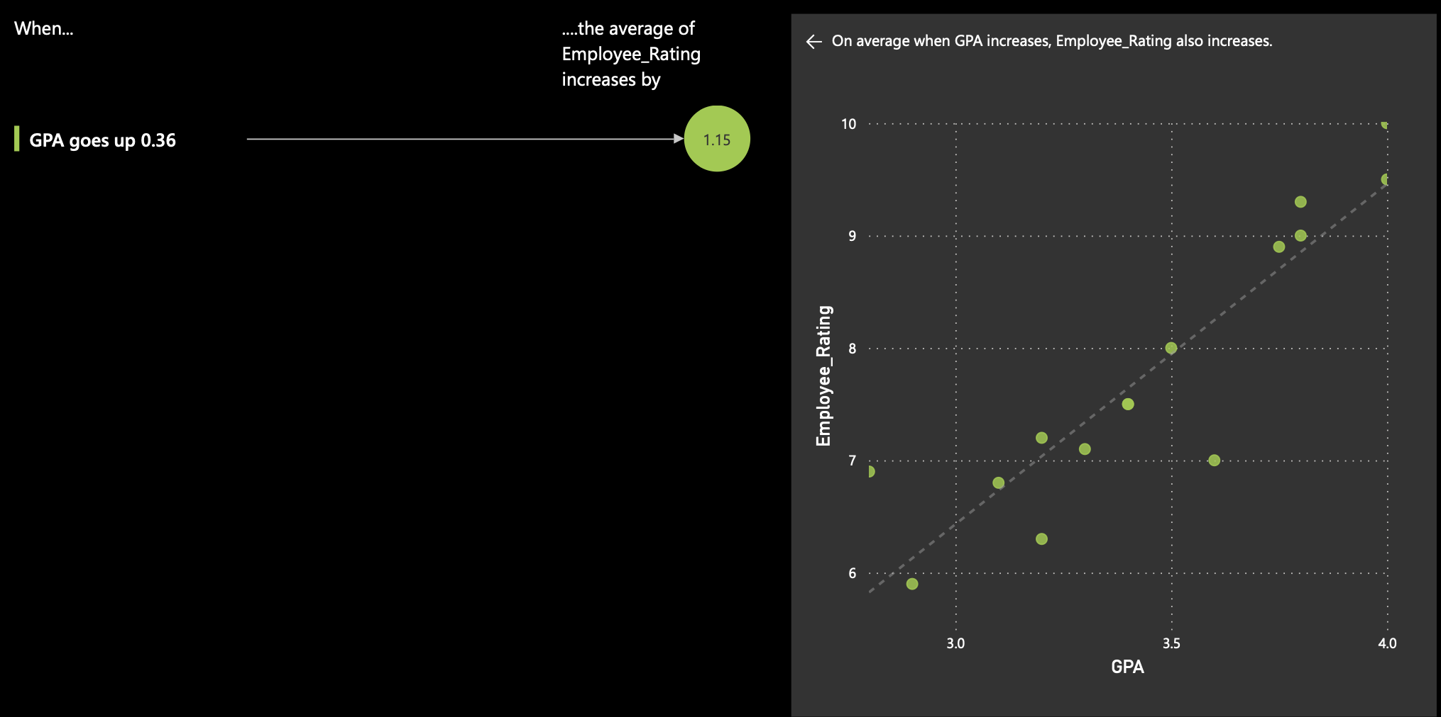
Do Grades Matter ?
This visualisation depicts the fact that grades are directly proportional to Employee rating .
More the Grade point Average scored by the student, more employee rating is scored by him in the company he is placed at.
This graph implies the solution stating that grades do matter.

Slide 9
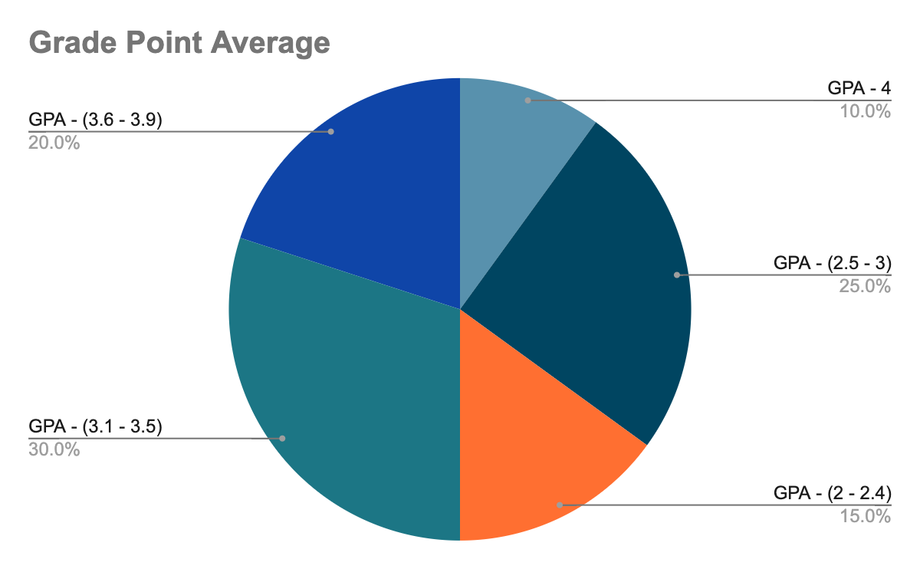
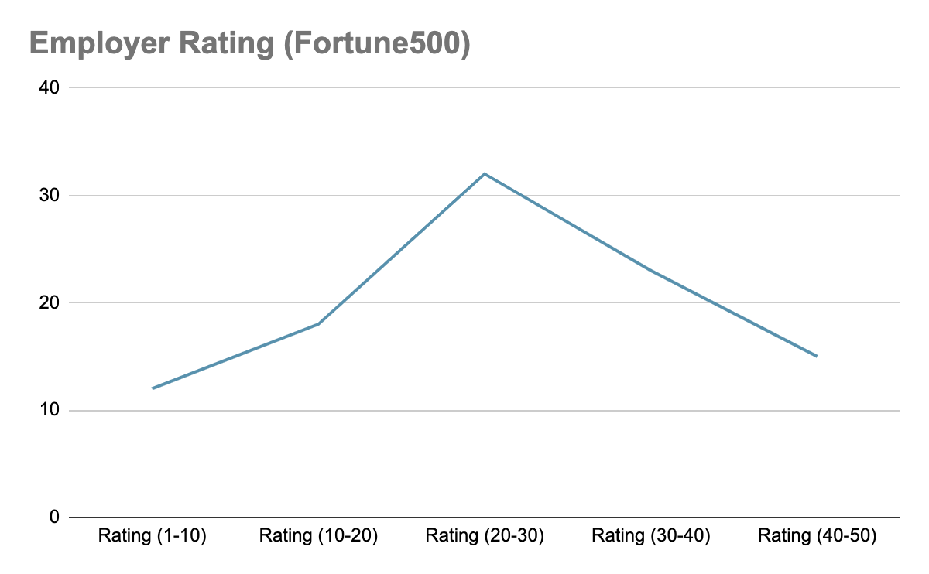
Comparison between GPA and Employee Ratings

Slide 10
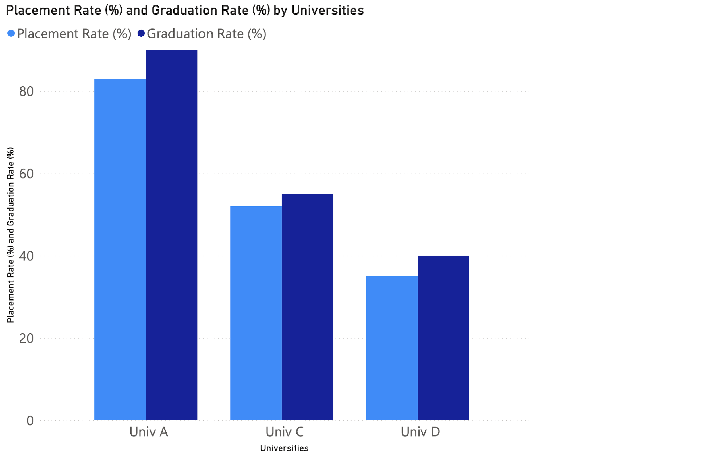
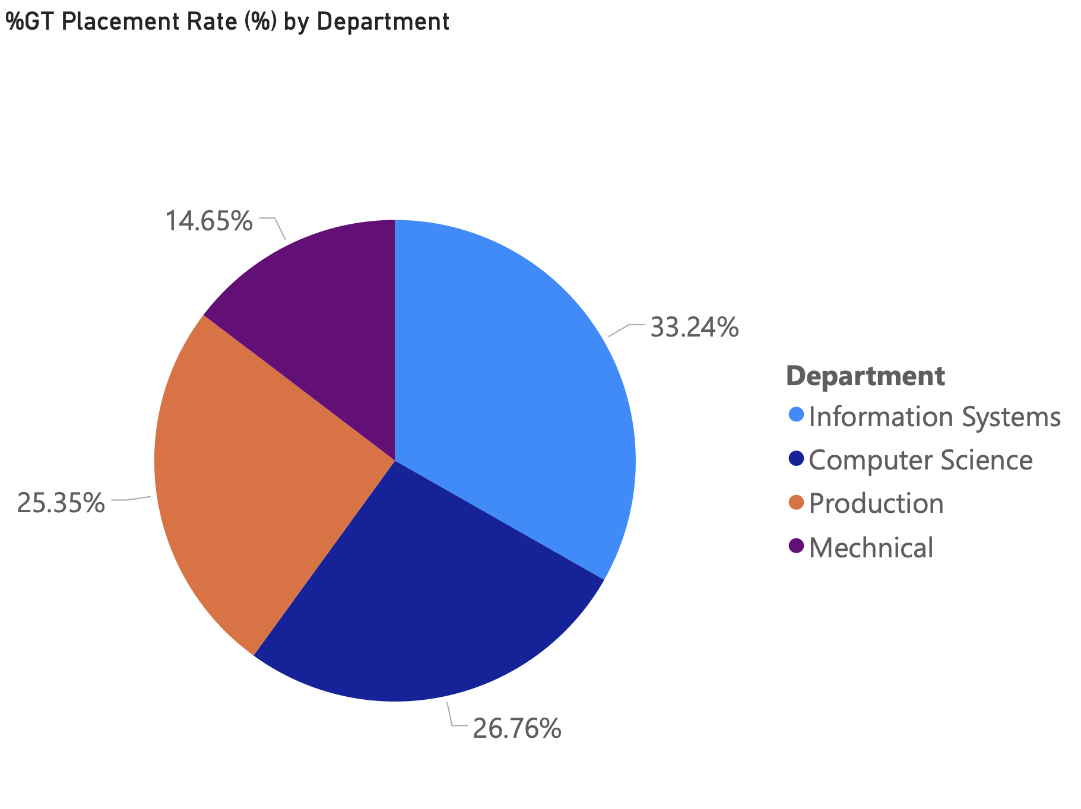
Better the graduation rate, better is the placement rate of the university.

Slide 11
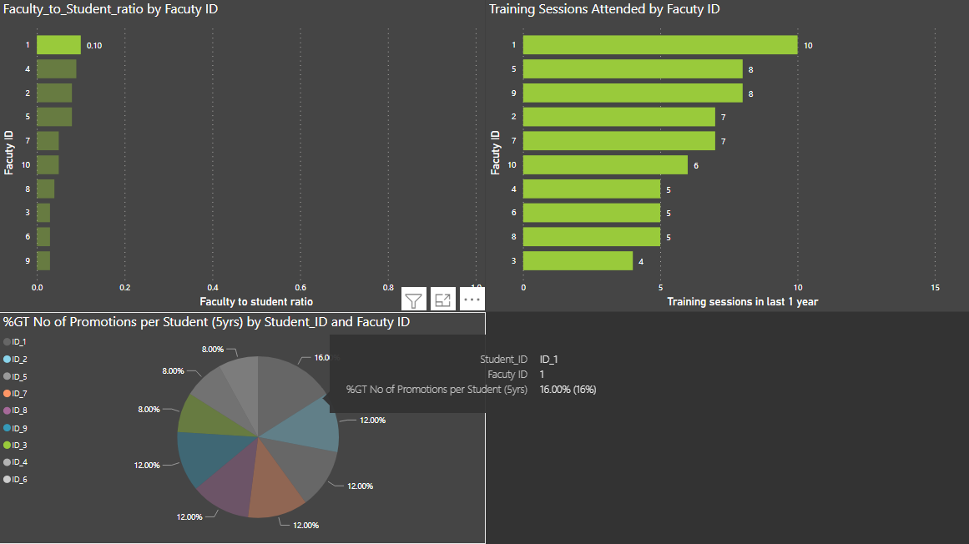
How does faculty influence student profile at work ?

Slide 12
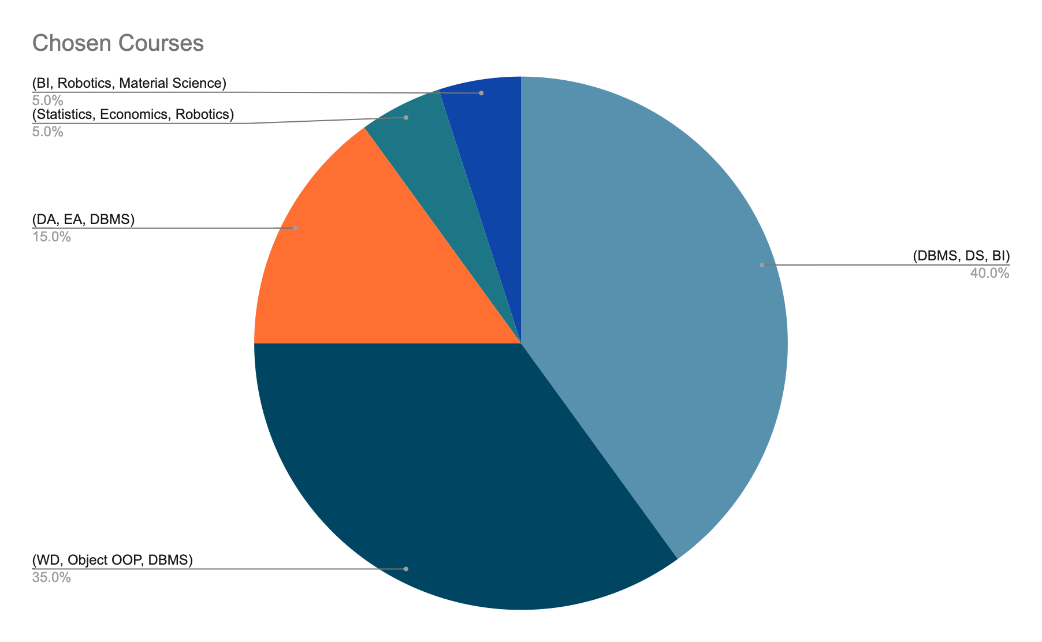
How courses influence student placement ?
This pie chart depicts the collective percentage of subjects opted by students who are placed in top 50 companies by Fortune 500 company list.
DS - Data Science
DBMS - DataBase Management
BI - Business Intelligence
OOP - Object Oriented Programming
DA - Design & Automation
EA - Engineering Analysis

Slide 13
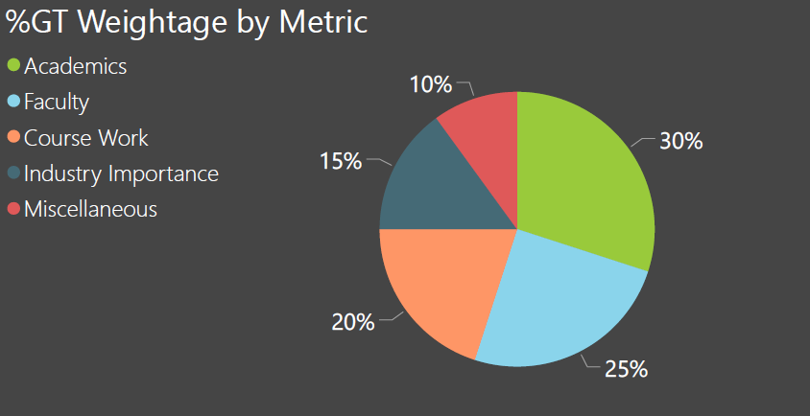
How our ranking system works ?
Our ultimate solution shows a distribution of how different factors/metrics are responsible to decide the quality of an educational institution.
A wide range of diverse metrics decide the quality of education, but the majority of the share which contributes in deciding the quality of an institution is as follows:

Slide 14
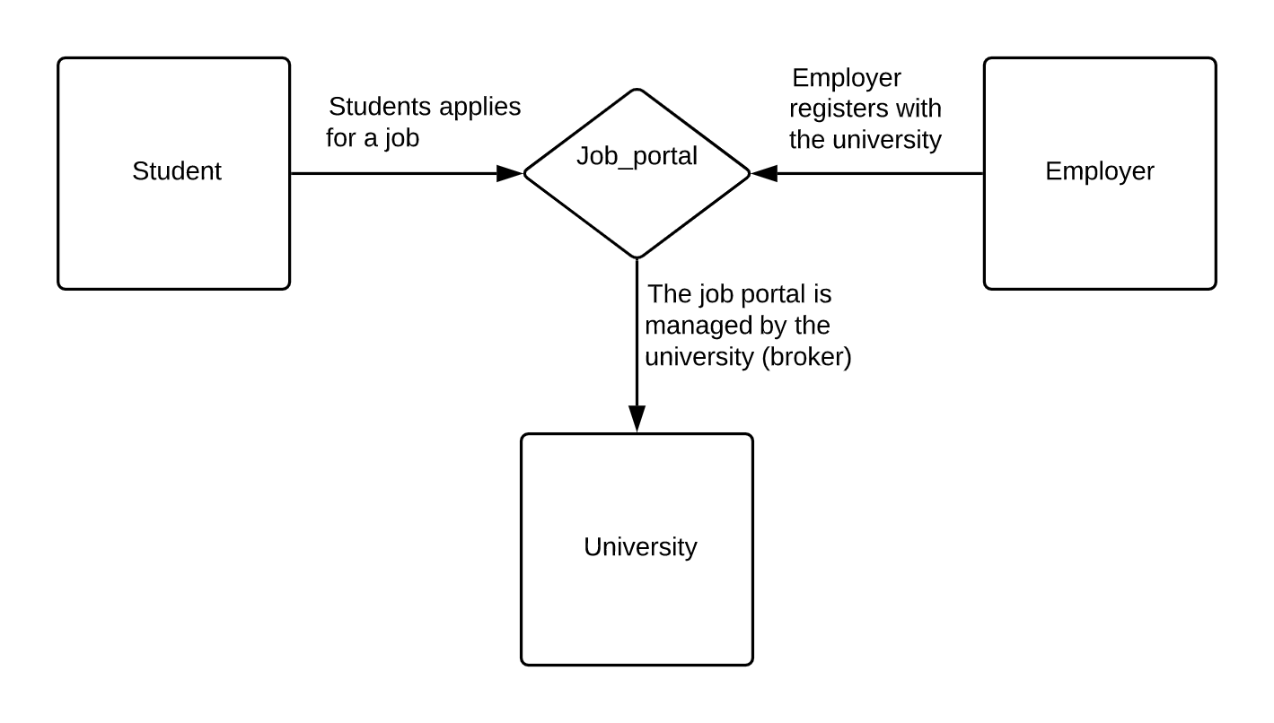
Broker Model
In this model, the University acts as the broker between the Student (seller) and the Employer (buyer).
The Employer class can be used to provide information to the university regarding job offers for the students. This can be done by including a new class (Job_portal) which would provision the registration of an employer with the university, by capturing details from the employer portal class and also allow the students to apply for jobs.
The current version of the University model doesn’t include such an intermediate (broker) class. Thus, the broker model can have a new Job_portal class which would allow the university class to link the employer and student classes.

Slide 15
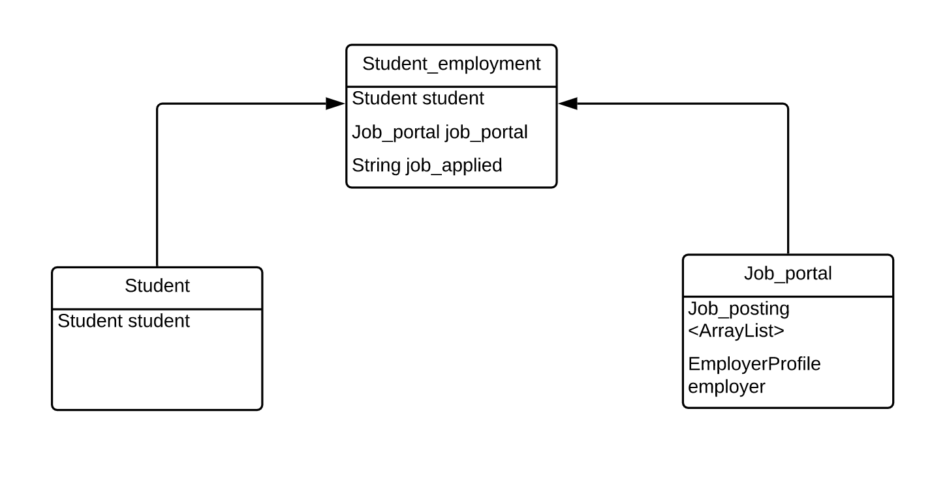
Contd….
This would allow the employers to provide information regarding job openings to the university. The students can then access such a portal and apply for jobs based on the requirements of the employer.
Also, the inclusion of an associative class between Student and Job_portal would allow us to track the job which any student has applied for in the Student_employment class, as shown below.

Slide 16
THANKS!
Any questions?

