Slide 1

Analysis of World Economic data and predictions based on it.
Presented by-
Chinmayi Mahadik

Slide 2
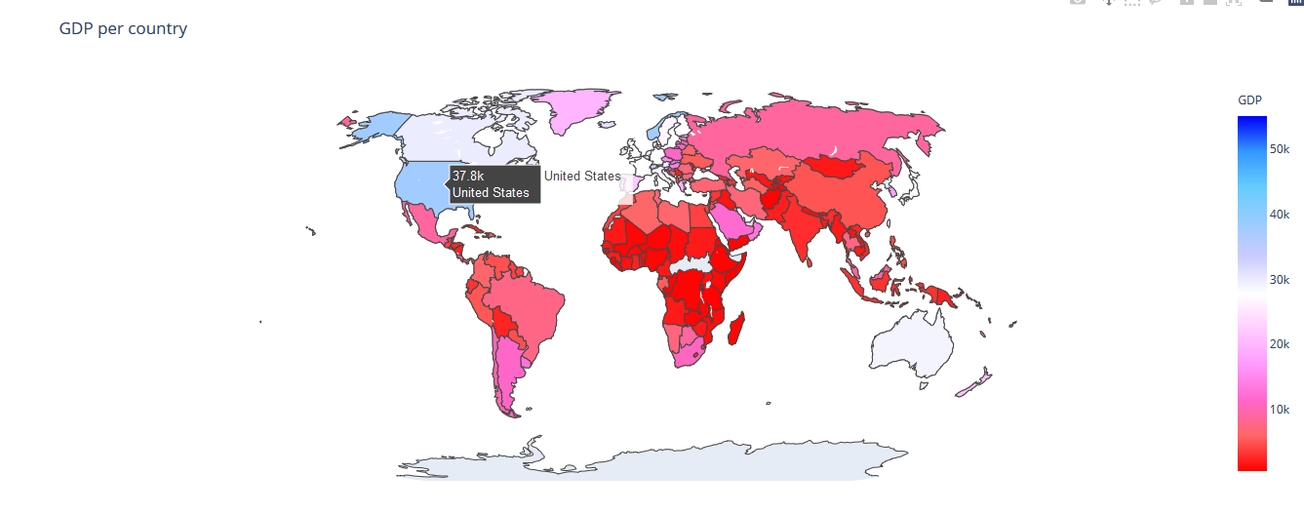
Goal of the project.
Perform exploratory data analysis to take a broad look at pattern trends using graphs and summary methods.
Identify how different factors like GDP, Infant mortality, literacy, and birthrate are correlated.
Build models using key methods of analysis like correlation and linear regression.

Slide 3
Description of data and it’s pre-processing
Data set: “Countries of the world” from Kaggle.com
Link: https://www.kaggle.com/fernandol/countries-of-the-world/discussion/58531
Source of data : Most of the data comes from the World Factbook which is a public domain.
Link: https://www.cia.gov/library/publications/the-world- factbook/docs/faqs.html
Data set consist of 20 different factors columns and data of 227 countries.
For our analysis we are using some important columns like:
Country, Region, Climate – Categorical data, Population, Area, Coastline, Net Migration, Infant mortality, GDP, Literacy, Phones, Birthrate, Agriculture, Industry and Services – Numerical data

Slide 4
Description of data and it’s pre-processing
For data cleaning, the first step was to format the comma separated numerical values and replace it with decimal separator.
Most of missing data were found from the source link of the data set.
Countries that were missing important data that was not finally found, they were eliminated. These countries were mainly territories which belonged to other countries and in terms of population and GDP were not representative.

Slide 5
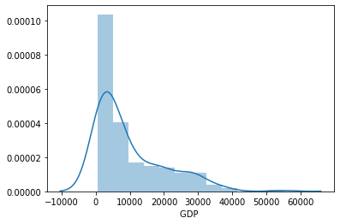
Exploratory Data Analysis
Univariate analysis:
For numerical data – histogram plot
For categorical data – bar graph
Bivariate analysis
Heatmap for correlation matrix
Scatter plot
Box plot
Multivariate analysis
Pair plot

Slide 6
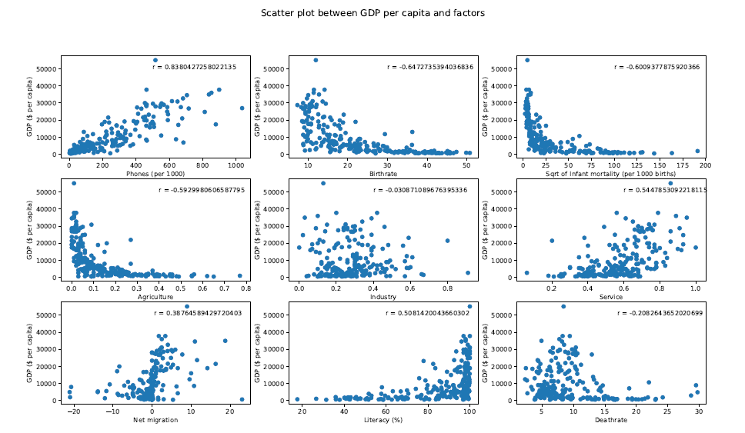
Major findings from EDA
China has the largest population, Russia has largest area where as the population density of Monaco is largest as compare to other countries.
Infant mortality rate is the highest in Angola.
Countries like Australia, Denmark and Finland have high literacy rate.
GDP has high correlation with Literacy rate, Phones, Birthrate, Agriculture and services.

Slide 7
Major findings from EDA
The increase in the use of technology(phones) indicates the high rate of GDP.
Most countries have high literacy rates. We see a positive correlation between literacy and GDP. In some places where the literacy rate is low, the GDP is too low.
Net Migration and GDP are positively correlated. With larger immigration there is higher per capita GDP.

Slide 8
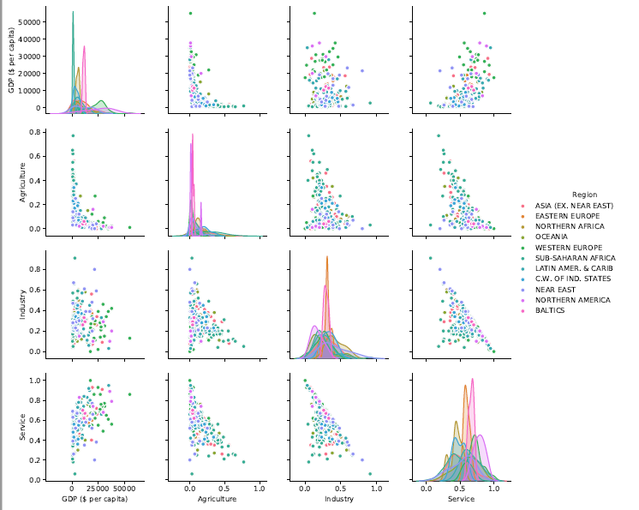
The multivariate graph shows that Western Europe is a more developed country and has higher GDP. Next comes Asia. Sub-Saharan Africa, C.W of Ind. States, Baltics are regions are developing and have a low GDP.

Slide 9
Data Scraping
To predict energy consumption (which is not a part of data set) based on GDP and population of countries, we performed data scraping.
Pulled data from below link:
https://www.cia.gov/library/publications/resources/the-world-factbook/fields/253rank.html
Used BeautifulSoup package for parsing HTML document.

Slide 10
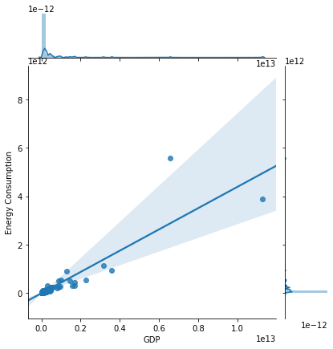
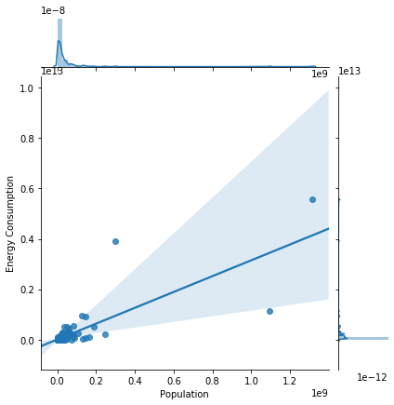
Linear regression model-Model 1
Predicting Energy Consumption using GDP and population
Energy Consumption log = -3.2226894937679873 - 0.25961265*Population log + 1.25123995*GDP log
Inference: If log of population increases by 1 unit and GDP log increase by 1 unit, energy consumption will increase by 0.26 and 1.25 times respectively.
R-square = 0.9245368 Adjusted R-square = 0.9237340
92% of the variability in energy consumption log can be explained by population log and GDP log.

Slide 11
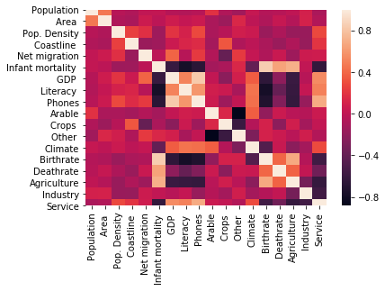
Linear regression model-Model 2
Predicting Literacy on the basis of GDP, infant mortality, phones, and birth rate.
Literacy = 106.70373858929594 -2.14326759e-01*Infant mortality - 1.76185927e-04*GDP + 9.44272674e-03*Phones - 7.16700770e-01*Birthrate
R-square = 0.7910148235286492 Adjusted R-square= 0.787090219275666
79% of the variability in literacy can be explained infant mortality, GDP, phones, and birth rate.

Slide 12
Linear regression model-Model 3
Predicting Infant Mortality on the basis of GDP, literacy, agriculture, birth rate, and phones.
Infant Mortality = 37.46180406923113 - 4.74253812e-01*Literacy + 3.48845353e-05*GDP -1.33317006e-02*Phones + 1.59955122e+00*Birthrate + 4.36334373e+01*Agriculture
R-square = 0.70937357 Adjusted R-square= 0.702519173
70% of the variability in literacy can be explained infant mortality, GDP, phones, and birth rate.

Slide 13
Linear regression model-Model 4
Predicting GDP based on Net Migration, Infant Mortality, literacy, phones, Services, Population, coastline, climate.
GDP= 41.488953886389936 + 432.88852888 (Net Migration ) + 35.01271072 (Literacy) + 32.56431735 (Phones) -1340.54097876 (Service) - 535.86429181 (categorical Coastline) + 435.86785249 ( Dry tropical) -542.583237 (Wet tropical)+ 1160.33772294 (Temperate) -1053.62233843 (Dry hot summers and wet winters)

Slide 14
Linear regression model-Model 4 cont…
R-square = 0.8999546
89.99 % of variability in the model an be attributed to Net Migration, Literacy, Technology(Phones), Service, Coastline existence and climate.

Slide 15
Conclusion
GDP is positively impacted by factors like population density, immigration, literacy rate, technology.
Countries which have a coastline may have a benefit of delivering services in a more efficient way leading to increase in GDP.
Most of the Countries have a literate population. Educated countries have the ability to make smarter and better decisions for the economy. We observed that most of the literate countries have higher GDP.
Countries which have a better GDP have low infant mortality rate. This may be because these countries have better facilities and health care systems. Healthy migration can cause surge in the GDP.
Temperate Climates act as a favorable influence thus enhancing the GDP of Western European regions like Luxembourg, UK.90% of variability in GDP can be attributed to Net Migration, Literacy, Technology (Phones), Service, Coastline existence and climatic conditions. 92% of the variability in energy consumption can be explained by a factor of population and GDP. 79% of the variability in literacy can be explained infant mortality, GDP, phones, and birth rate. 70% of the variability in literacy can be explained infant mortality, GDP, phones, and birth rate.

