Slide 1


CAD Project
Title: Breast Masses Segmentation and Classification from Mammograms
Presented by:
R214220361 – Chinmayi Parimal
Mentored By
Mr. Harvinder Singh

Slide 2
Content
Project Proposal
Technical Design and Requirements
Test and Result
References

Slide 3
Project Proposal

Slide 4
Introduction
Breast Cancer is a disease characterized by the uncontrolled growth and multiplication of abnormality in cells in the breast tissues. The primary goal is to determine whether or not mammograms show breast cancer of any type (malignant or benign). Breast Masses Segmentation is utilised in this project to automate breast cancer screening because manual detection is exceedingly time-consuming. The suggested methodology improves the detection of breast masses, which can then be used by oncologists to reduce the likelihood of a false diagnosis.

Slide 5
Motivation
Women have a one in thirty-nine chance of dying from breast cancer.
In women, breast cancer is the second largest cause of cancer death.
It is known that it has an asymptomatic phase that can only be diagnosed by mammography.
We intend to use machine learning techniques on mammographic patches of breast, implementing them in Python using the Sklearn framework.
Problem Statement
Performing image segmentation over breast masses using Supervised Learning.
Targeted Users
Health Science Industry.

Slide 6
Main Objective
To perform image segmentation over breast masses using Supervised Learning.
To perform feature extraction and model training techniques over mammographic patches of breast, implemented in Python Programming Language using openCV framework.
Sub Objective
The proposed model aims to improve medical expertise where manual detection of breast cancer is still very difficult with the significant evolution in technology.
The project deals with the diagnosis of breast cancer at an early stage so that women can be saved from its adverse effect(including death).

Slide 7
Technologies used
CLAHE (Contrast Limited Adaptive Histogram Equalization)- A computer image processing technique that improves image contrast by reducing noise amplification and local contrast over-amplification.
K means- It is used for segmentation of the ROI image into various pixels.
CNN- It is utilised to train the model for the mammography ROI using transfer learning.
Erosion and Dilation- It removes all the small anomalies over the image.
VGG16- It is a convolutional neural network framework, 16 layers deep, used to load a version of the network trained on breast cancer.

Slide 8
Literature Review
Breast Cancer Research [1]. Ribosomal biogenesis and ribosomal proteins have attracted attention in the context of tumor biology in recent years. Instead of being mere translational machineries, ribosomes might play an active role in tumor.
The authors of [2] applied DualCoreNet Algorithm for the segmentation. It is a breast mass classification and segmentation algorithm which uses a dual-path connection.
CAD using Machine Learning [3]:
Image pre-processing > Image segmentation > Feature extraction and selection > Classification.
CAD using Deep Learning: Image pre-processing > Convolutional layer > Pooling Layer > Fully Connected layer > Softmax Layer. Training from scratch > Transfer learning
A Review Paper on Breast Cancer Detection Using Deep Learning [4], extracts the best features of the images. CNN being the most popular technique to classify the images is used here.

Slide 9
Inference from Literature
To some extent, data augmentation may be valuable, but having more data is always the best solution.
The models are not scalable or rotation invariant, and they can readily misclassify photos with atypical item poses.
While the model may be very good at mapping input to output, it may be inadequate at grasping the context of the data.
The approach addresses the black box problem, which makes them difficult to debug or comprehend how they make judgements.

Slide 10
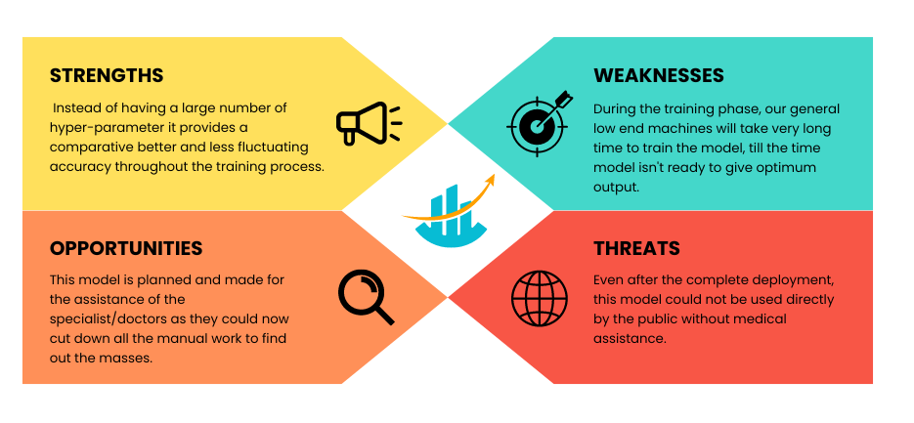
SWOT Analysis

Slide 11
Technical Design and Requirements

Slide 12
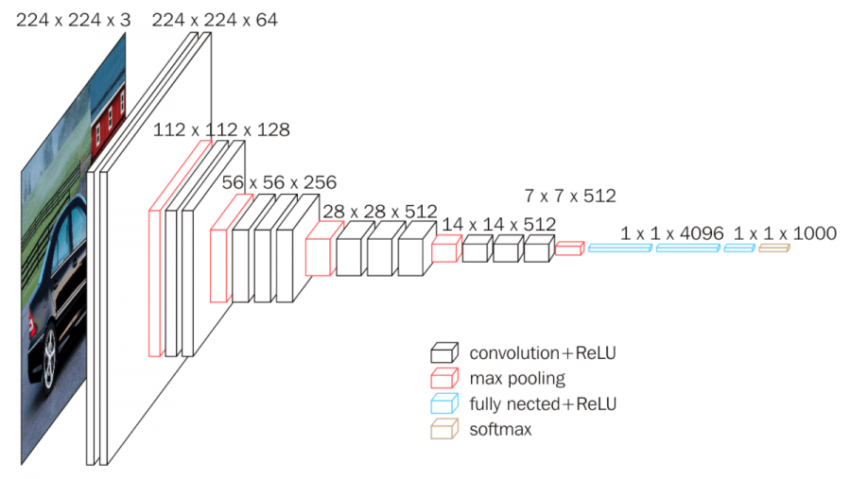
Reference Framework Model
A working model representation of VGG16 framework
Src- https://neurohive.io/en/popular-networks/vgg16/

Slide 13
Steps
Dataset acquisition- The proposed model is based on the MIAS dataset, which is publically available on Kaggle and from which we manually isolated ROIs.
Dataset preprocessing includes noise reduction, image equalisation, and edge sharpening.
Segmentation is the process of segmenting the masses using the K means Algorithm.
Model Training- We train our model with the VGG16 CNN framework.
Performance and error checking will be performed on the code. It will be unveiled alongside a new dataset.

Slide 14
Deliverable of each step or phase
Dataset Acquisition
The suggested model is based on the small MIAS dataset, which is freely available on Kaggle. The dataset below contains anonymous mammograms from three types of breast cancer: benign, malignant, and normal.
The model also works with a second dataset that was constructed by hand by removing ROIs from the MIAS dataset and modifying the classes to malignant and non-cancerous.
Data Pre-Processing
CLAHE (Contrast Limited Adaptive Histogram Equalisation) is used to enhance mammograms, which aids in edge enhancement and enhances overall apparent sharpness.
Following that, erosion is applied to the augmented image to remove all minor anomalies and pixels on object boundaries.

Slide 15
Deliverable of each step or phase
Segmentation
The suggested model employs the K-mean Algorithm to discriminate between image intensities.
In Classification, each input ROI sample (together with adjacent tissues) is classed as cancerous or not.
Each pixel in the segmentation task is labelled as 0 or 1 so that mass pixels may be reliably detected within the tight bounding box ROI.
Model Training
We used the VGG16 Convolutional Neural Network Framework in this case.
A 16-layer deep convolutional neural network was used to load a version of the network trained on breast cancer.

Slide 16
Deliverable of each step or phase
Testing and Analysis
The model's conclusion, findings, and observations are presented in the following phase. It will aid in the comparison of the proposed model with previously utilised models and will highlight the areas where the specific model falls short.
The main purpose of this stage is to mention the improvements made by the technique.

Slide 17
AWS
In this project, thread APIs can be used to manage multiple threads to perform tasks such as image pre-processing, segmentation, and classification simultaneously. The different types of threads and synchronization mechanisms can be used to ensure that these tasks are executed efficiently without interfering with each other.

Slide 18
Kubernetes
In this project, thread APIs can be used to manage multiple threads to perform tasks such as image pre-processing, segmentation, and classification simultaneously. The different types of threads and synchronization mechanisms can be used to ensure that these tasks are executed efficiently without interfering with each other.

Slide 19
Threads & Thread APIs
In this project, thread APIs can be used to manage multiple threads to perform tasks such as image pre-processing, segmentation, and classification simultaneously. The different types of threads and synchronization mechanisms can be used to ensure that these tasks are executed efficiently without interfering with each other.

Slide 20
Message Programming Interface
MPI (Message Passing Interface) can also be used in this project for parallel processing, especially when dealing with large datasets. MPI allows multiple processes to communicate with each other through messages, enabling parallel processing of tasks. The use of MPI can significantly improve the performance of the application when working with large datasets.

Slide 21
Task Programming
Task programming can also be applied in this project to divide the main task into smaller sub-tasks, which can then be executed concurrently using different threads or MPI processes. By breaking down the main task into smaller sub-tasks, the application can take advantage of parallelism and distribute the workload across multiple threads or MPI processes.

Slide 22
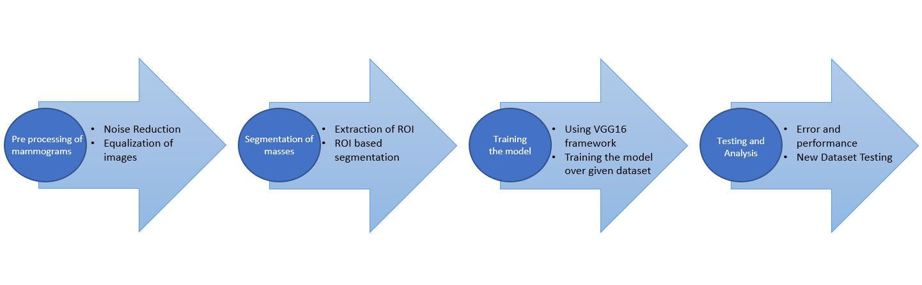
Technical Diagram (Flowchart)
Standard Model workflow

Slide 23
Test and Result

Slide 24
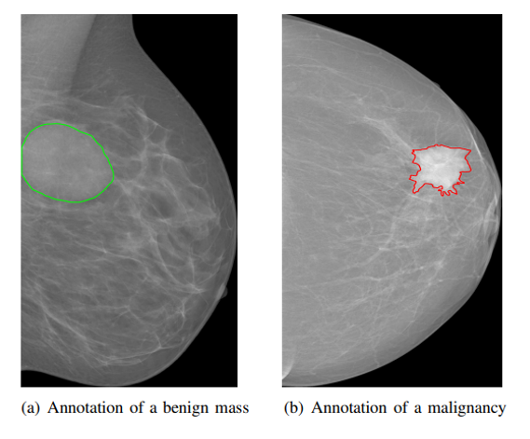
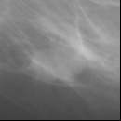
Dataset and Input Format
The suggested model is based on the MIAS dataset, which is freely available on Kaggle.
The dataset includes of anonymous mammograms from three types of breast cancer: benign, malignant, and normal.
The model also works with another dataset that we manually extracted, which consists of ROIs (Regions of Interest) from the MIAS dataset that are classified as cancerous or non-cancerous.
c) ROI of a cancerous mammogram

Slide 25
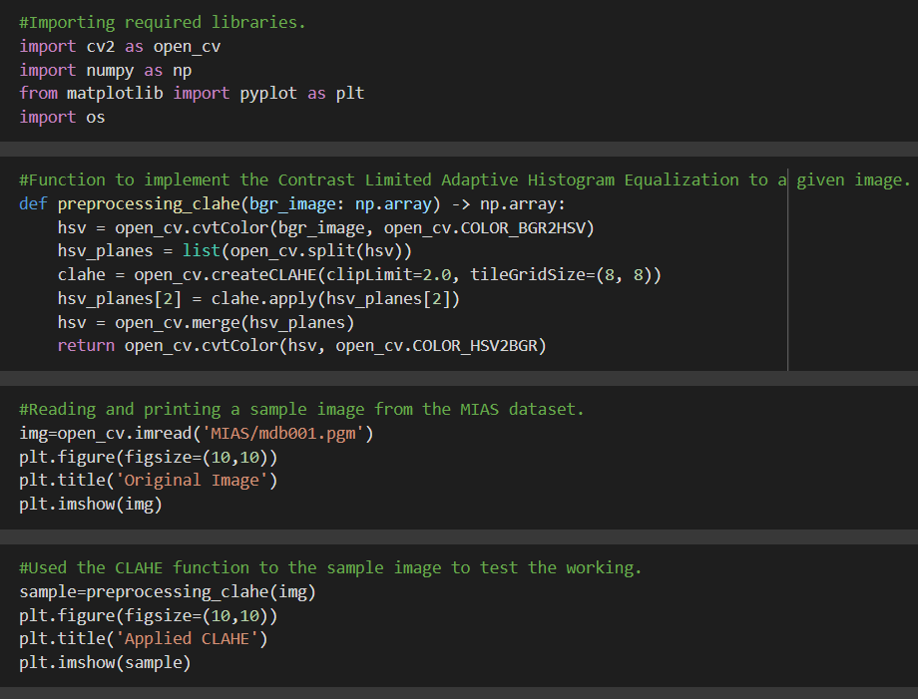
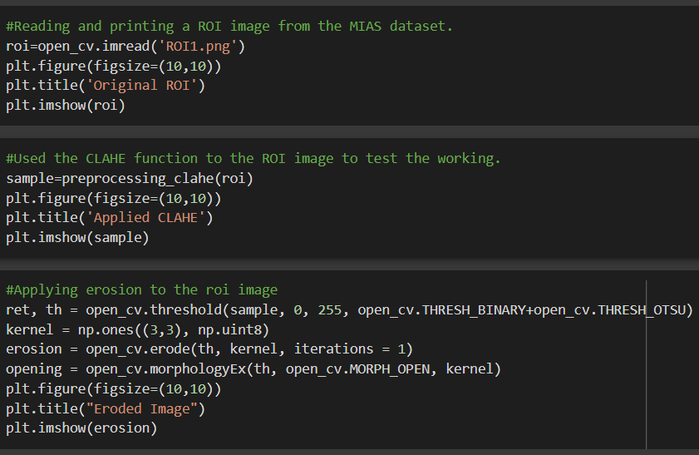
Working Module

Slide 26
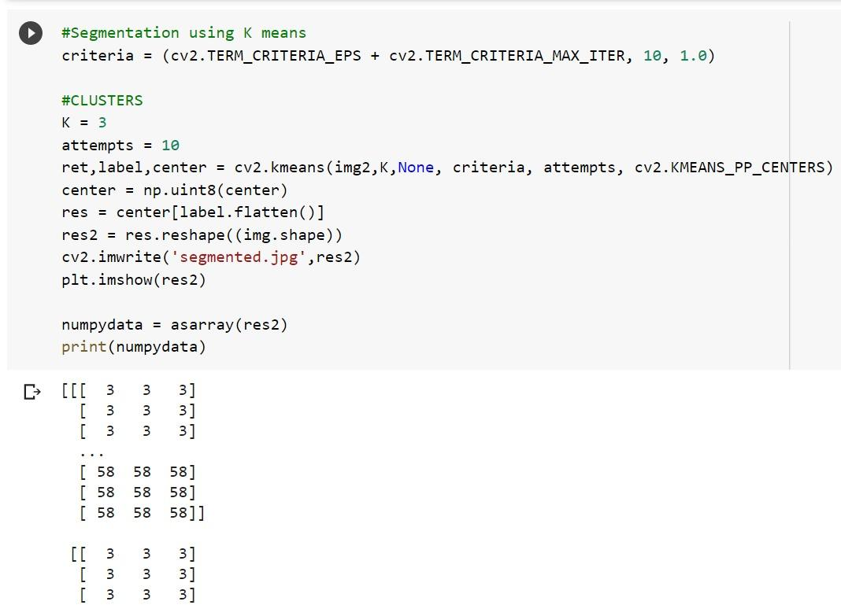
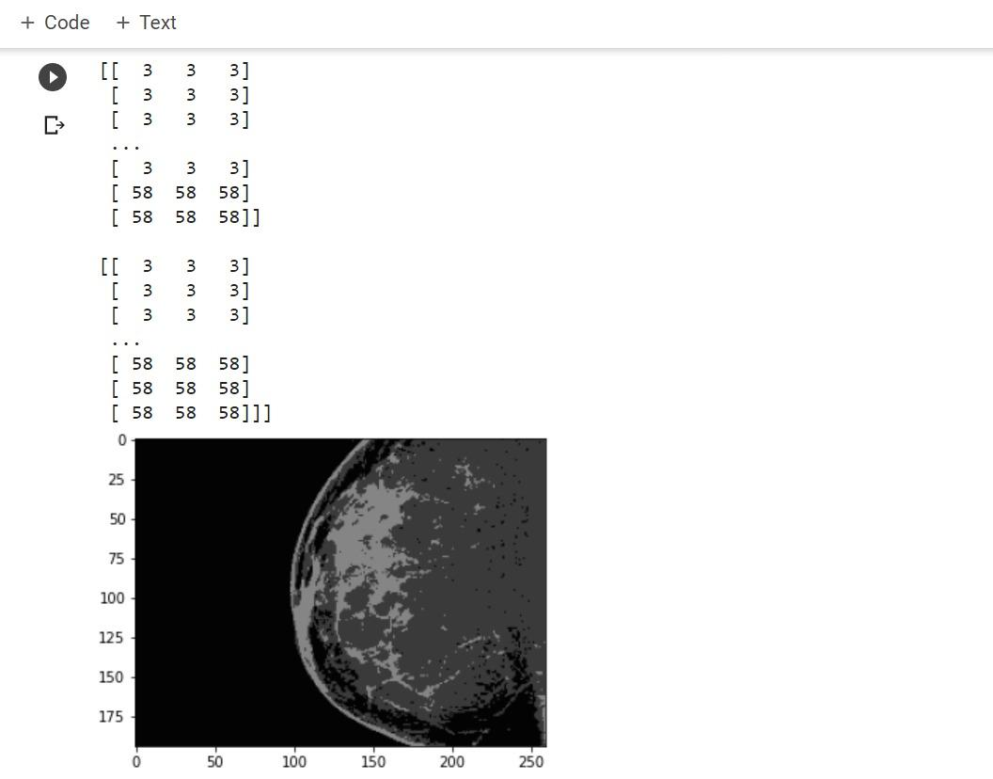
Working Module

Slide 27
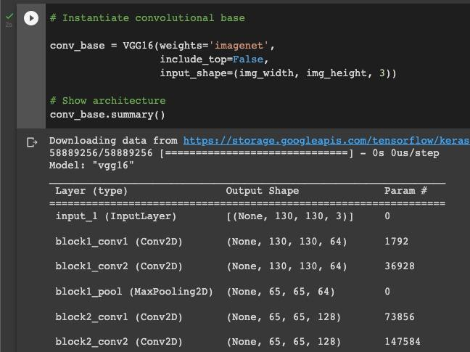
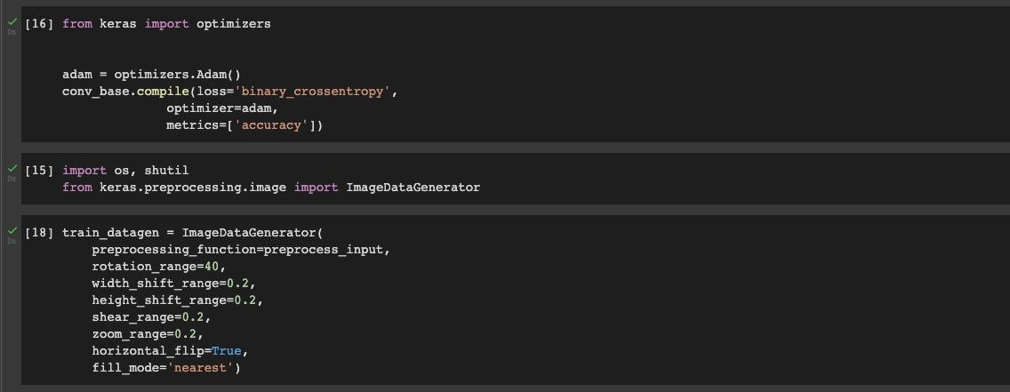
Working Module

Slide 28
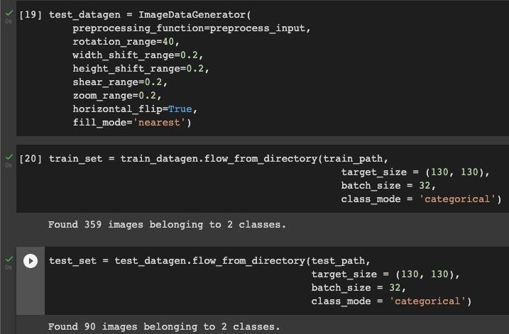
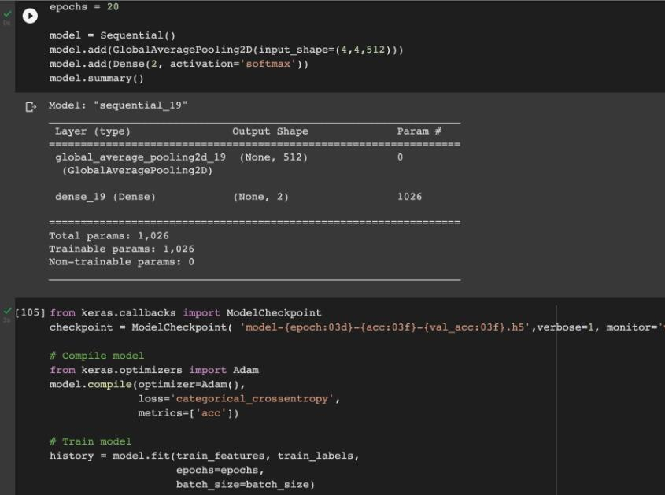
Working Module

Slide 29
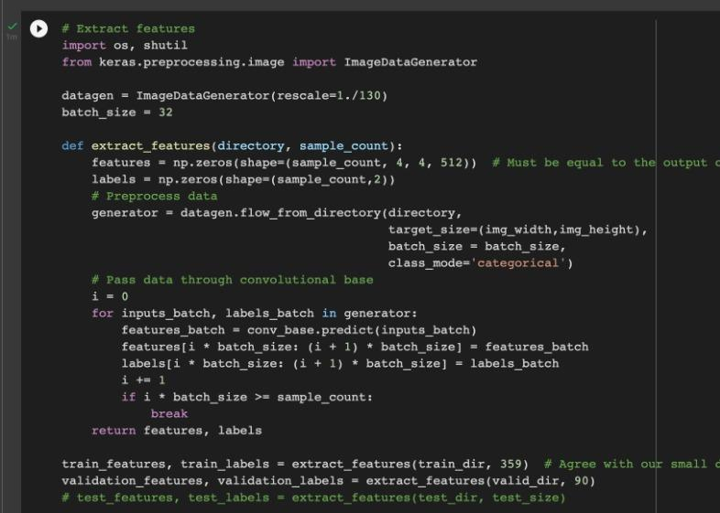
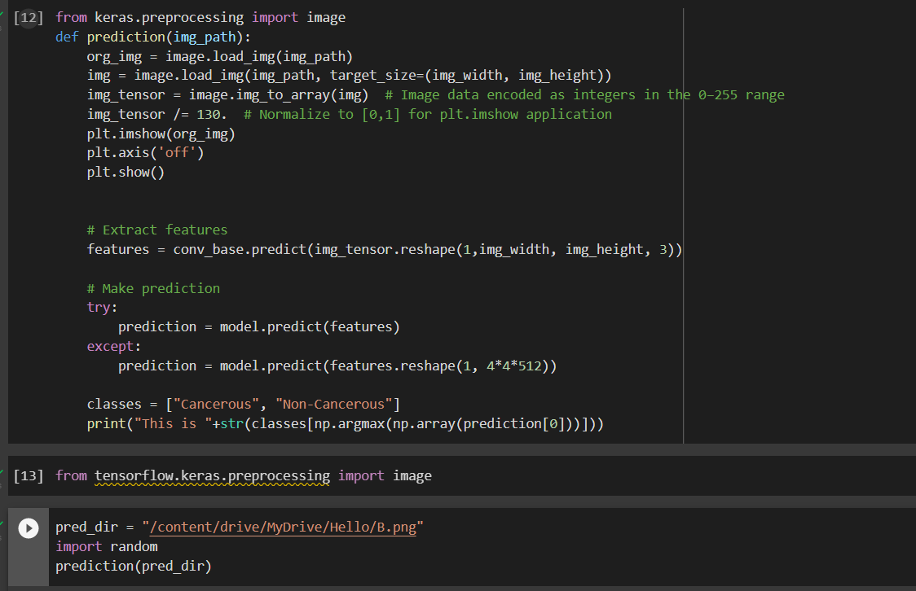
Working Module

Slide 30
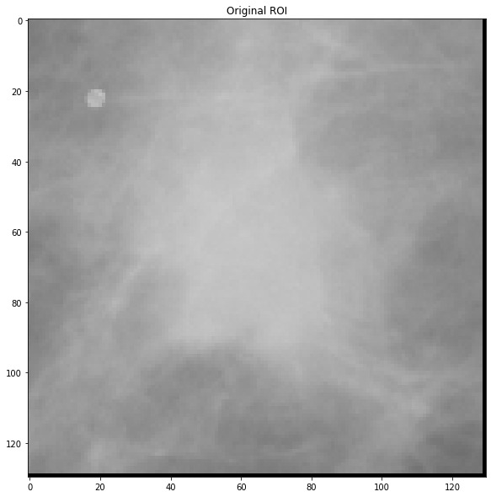
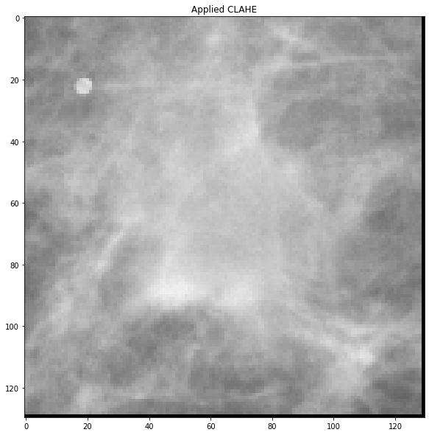
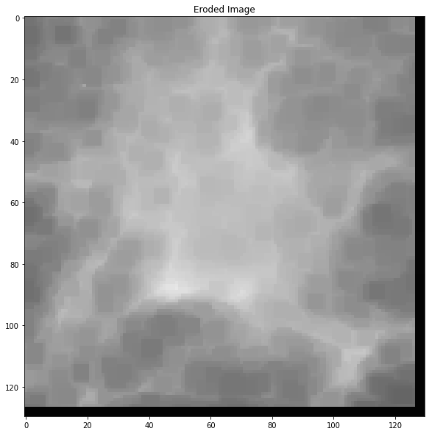
Attained Deliverable
a) Original ROI Image
b) ROI after applying CLAHE
c) ROI after applying erosion

Slide 31
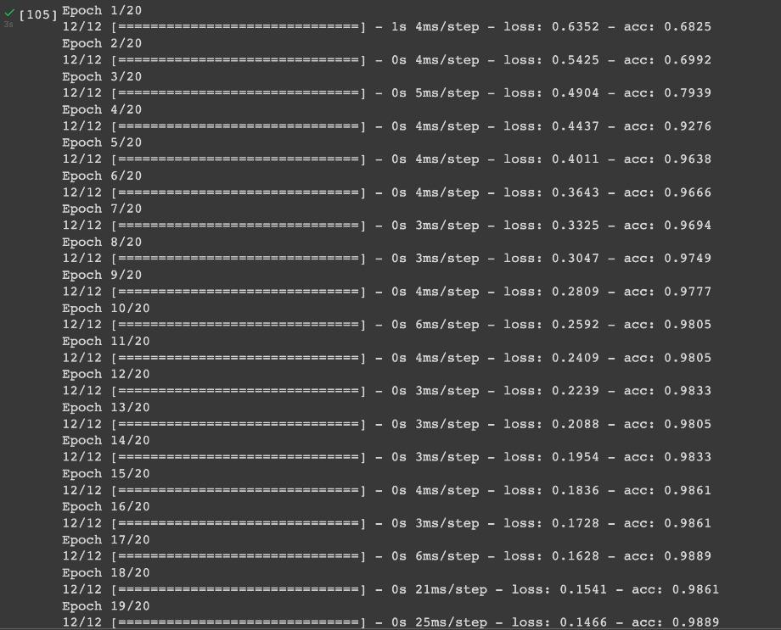
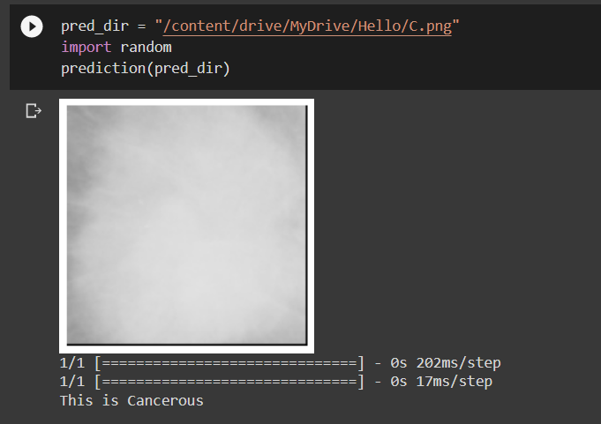
Attained Deliverable
a) Epochs with their respective accuracy

Slide 32
Attained Deliverable
Tests Cases
Test Case no: | Test Data | Expected Results | Actual Results | Case result
TU01 | https://drive.google.com/file/d/1aCxyw0A_kYBJ12d76nOUbgja33fEHnfg/view?usp=sharing, | Cancerous | Cancerous | Pass
TU02 | https://drive.google.com/file/d/1OnsyUDbzHWLHcpnN1QL3NEkZYXd0yTFE/view?usp=sharing, | Non Cancerous | Non Cancerous | Pass
TU03 | https://drive.google.com/file/d/1uymGNp8M2DAlmiXULeH8iSg1jk03ATUT/view?usp=sharing, | Cancerous | Cancerous | Pass
TU04 | https://drive.google.com/file/d/1VMz5zWarJSIX7stRpnuZv9nRTFJtQH5x/view?usp=sharing, | Non Cancerous | Non Cancerous | Pass
TU05 | https://drive.google.com/file/d/1w2N9h71a0azA1ZmjVODb00hBkgUERhtE/view?usp=sharing | Cancerous | Cancerous | Pass
TU06 | https://drive.google.com/file/d/1wtQOjW9-5IDp_IGrJta40OoEaphYIi9B/view?usp=sharing | Cancerous | Cancerous | Pass
TU07 | https://drive.google.com/file/d/1bhcYsjPo_rJrasHWcDtwRTdH3kq5oBe9/view?usp=sharing, | Non Cancerous | Non Cancerous | Pass
TU08 | https://drive.google.com/file/d/1f9x6Ag5oUT1j-Y-rnsc8Z_JnEdAQDPrp/view?usp=sharing | Non Cancerous | Non Cancerous | Pass

Slide 33
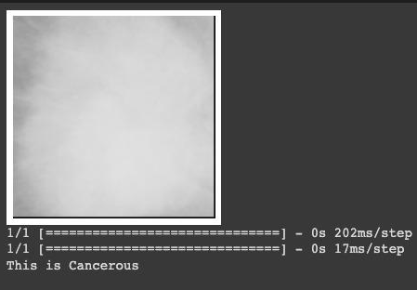
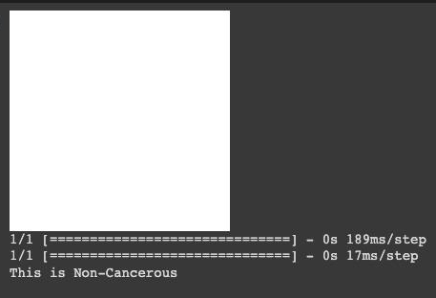
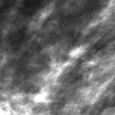
Attained Deliverable
Finally the model is able to differentiate and classify for cancerous and non cancerous

Slide 34
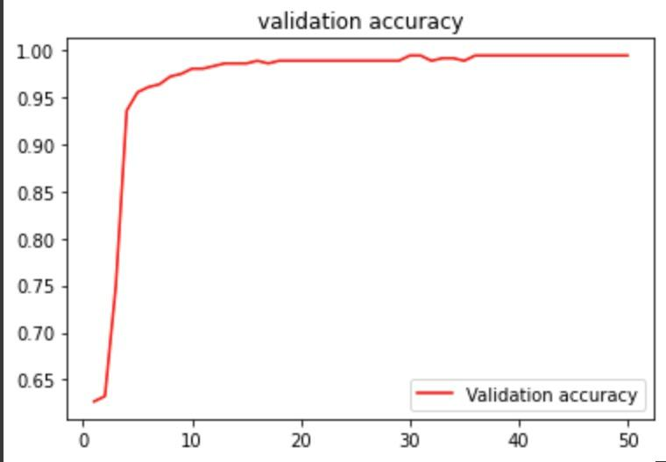
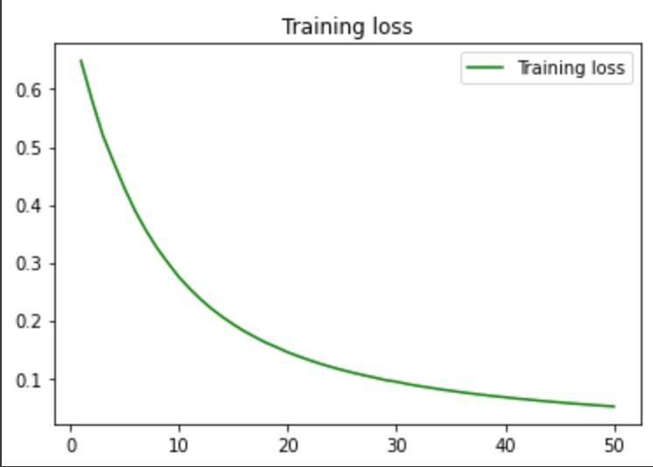
Attained Deliverable
Outcome Graphs

Slide 35
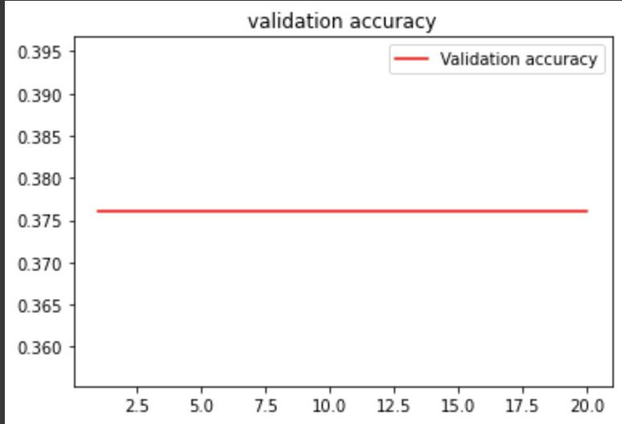
Attained Deliverable
Comparative Studies:
Use of SoftMax layer:
Use of Relu layer:

Slide 36
Attained Deliverable
Justification of Objectives
We were able to execute image segmentation over breast masses utilising Supervised Learning, as well as feature extraction and model training techniques over mammographic patches of breast, using the Python Programming Language and the openCV framework.
Future Scope
If this technique were widely used, it would have a significant impact on the field of health sciences. Also, when combined with deep learning approaches, it may produce greater outcomes.

Slide 37
Reference
A: List of Cited Papers
Gunjan Chugh, Shailendra Kumar, Nanhay Singh (2020). Survey on Machine Learning and Deep Learning Applications in Breast Cancer Diagnosis. LLC part of Springer Nature 2021.
Heyi Li, Dongdong Chen, William H. Nailon, Mike E. Davies (2020). Dual Convolutional Neural Networks for Breast Mass Segmentation and Diagnosis in Mammography. IEEE, and David Laurenson.
Yong Joon Suh, Jaewon Jung, Bum-Joo Cho (2020). Automated Breast Cancer Detection in Digital Mammograms of Various Densities via Deep Learning. Department of Breast and Endocrine Surgery, Hallym University Sacred Heart Hospital, Anyang 14068, Korea; Medical Artificial Intelligence Center, Hallym University Medical Center, Anyang 14068, Korea; Department of Ophthalmology, Hallym University Sacred Heart Hospital, Anyang 14068, Korea.
Lian Zou, Shaode Yu, Tiebao Meng, Zhicheng Zhang, Xiakun Liang, Yaokin Xie (2019). A Technical Review of Convulational Neural Network-Based Mammographic Breast Cancer Diagnosis. Shenzhen Institutes of Advanced Technology, Chinese Academy of Sciences, Shenzhen, China. Shenzhen College of Advanced Technology, University of Chinese Academy of Sciences, Shenzhen, China. Cancer Center of Sichuan Provincial People’s Hospital, Chengdu, China. Department of Radiation Oncology, 'e University of Texas Southwestern Medical Center, Dallas, TX, USA. Department of Medical Imaging, Sun Yat-sen University Cancer Center, Guangzhou, China. Medical Physics Division in the Department of Radiation Oncology, Stanford University, Palo Alto, CA, USA.

Slide 38
Thank You

