Slide 1


Project Report
domain: Machine Learning
Project Topics:
1. Detect Heart Disease using Patient Data
2. Predict Mobile Phone Pricing
By: Chinmayi Kishor Kelkar

Slide 2
1. Detect Heart Disease using Patient Data
Objective:
Build a system that can predict if a patient has heart disease.
Explore the data, understand the features, and figure out an approach.
Introduction:
Heart disease is a leading cause of death worldwide. Early detection of individuals at risk can significantly reduce mortality rates through timely intervention.
This project presents a machine learning approach to detect the presence of heart disease based on patient data.
The primary goal is to build a predictive model using classification algorithms to classify patients as at risk or not at risk of heart disease.

Slide 3
Dataset Overview:
The dataset used in this project is the heart disease dataset, typically containing the following features:
Age
Sex
Chest pain type
Resting blood pressure
Cholesterol level
Target: 1 indicates presence of heart disease, 0 indicates absence, etc.
The dataset was loaded using the pandas library and checked for missing values. No missing values were found, so further imputation was unnecessary.
Methodology:
a. Data Preprocessing
The feature columns were standardized using StandardScaler to bring all attributes to a similar scale.
The target column (target) was separated from the features.
The dataset was split into training (80%) and testing (20%) sets using train_test_split with stratification on the target variable.

Slide 4
c. Model Evaluation
The better performing model (selected based on accuracy) was further evaluated using:
o Accuracy Score
o Classification Report (Precision, Recall, F1-score)
o Confusion Matrix, visualized using a heatmap
d. Prediction on New Data
Two hypothetical patient records were created with known features.
The same scaler used during training was applied to transform the new data.
Predictions were made using the best model from earlier evaluation.
Methodology:
b. Model Training Two models were trained and evaluated:
Logistic Regression
A simple, interpretable linear model commonly used for binary classification.
Achieved a test accuracy of approximately 0.84.
2. Random Forest Classifier
An ensemble method that builds multiple decision trees and merges their output.
Achieved a test accuracy of approximately 0.93.

Slide 5
Results:
The Random Forest model (or Logistic Regression, based on which had higher accuracy) showed better performance.
The classification report revealed class-wise performance, helping assess false positives and negatives.
The confusion matrix heatmap visually demonstrated the distribution of predictions.
The model was able to make meaningful predictions on unseen data, indicating good generalization.
Example Output:
Prediction for New Data Row 1: No Heart Disease... Prediction for New Data Row 2: At Risk of Heart Disease!
Conclusion:
This project demonstrates the effectiveness of machine learning techniques, particularly Random Forests and Logistic Regression, in detecting heart disease based on structured patient data.
While Logistic Regression provides interpretability, Random Forests offer higher predictive performance.

Slide 6
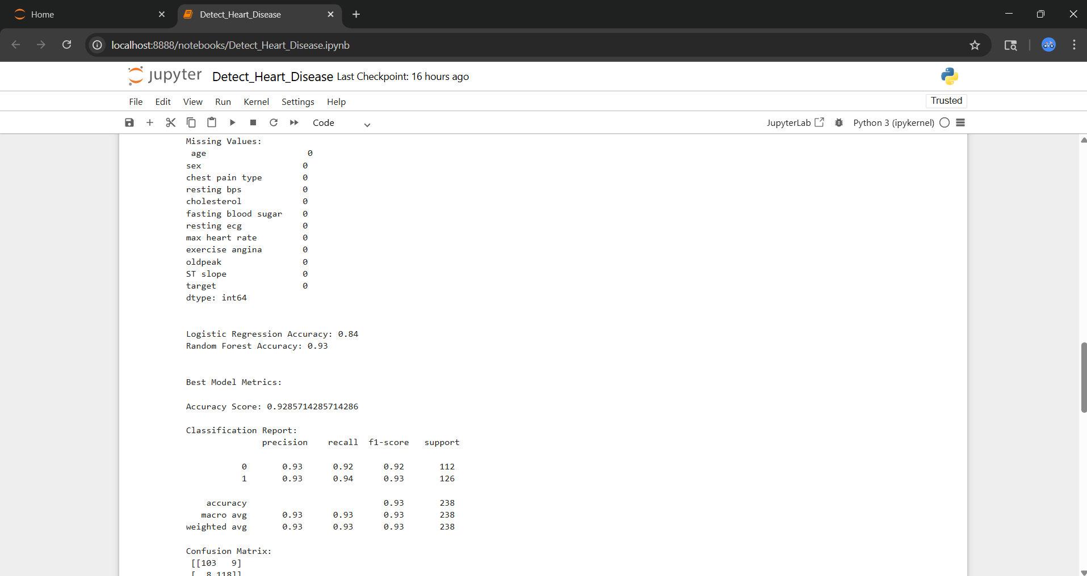
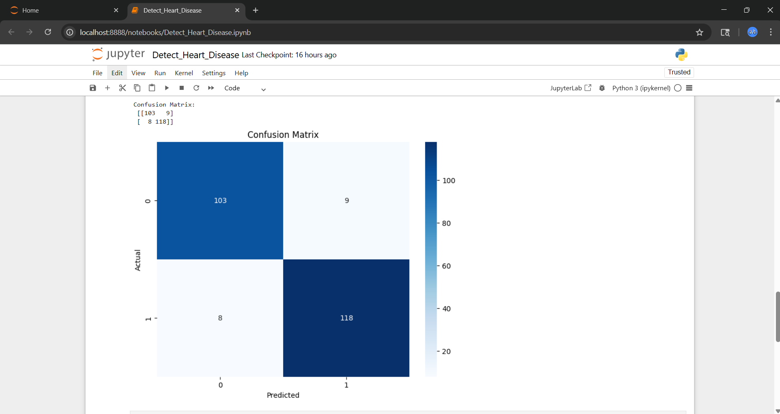
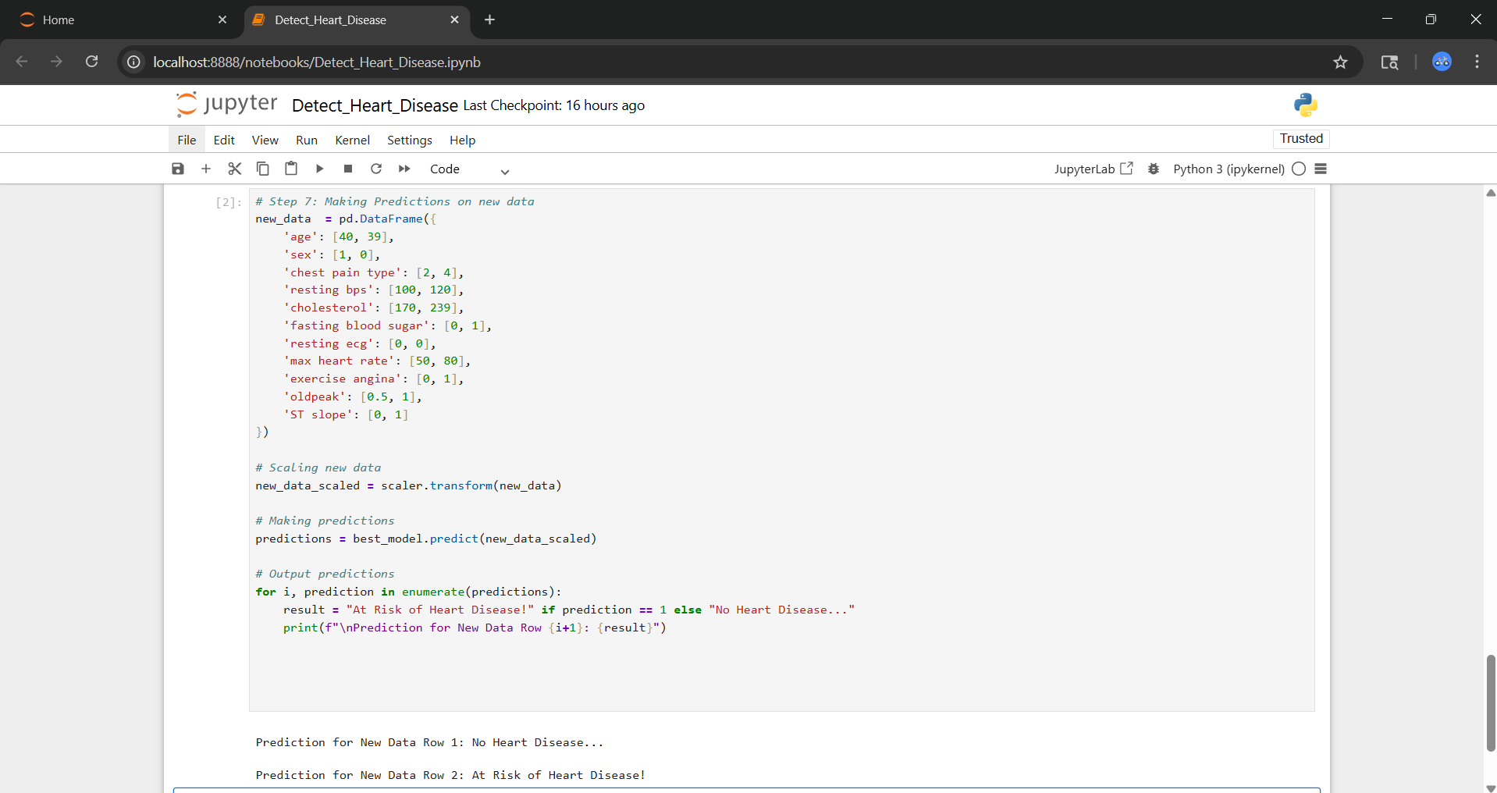
Screenshots of Result:

Slide 7
2. Predict Mobile Phone Pricing
Objective:
Build a system that can predict pricing for a mobile phone using data on available phones in the market.
Predict if the mobile can be priced low/med/high/very high. Explore the data to understand the features and figure out an approach.
Introduction:
In today’s competitive mobile phone market, determining the price range of a device based on its technical specifications can help manufacturers and retailers with pricing strategies, and assist consumers in making informed choices.
This project uses machine learning to classify mobile phones into four price categories—Low, Medium, High, and Very High—based on a variety of hardware features.

Slide 8
Dataset Overview:
The dataset consists of multiple features that describe mobile phone specifications:
battery_power: Total energy capacity of the battery
blue: Bluetooth availability (1 = Yes, 0 = No)
clock_speed: Speed at which microprocessor executes instructions
dual_sim: Dual SIM support (1 = Yes, 0 = No)
Target: price_range (0: Low Cost, 1: Medium Cost, 2: High Cost, 3: Very High Cost), etc
The dataset was loaded using pandas, and no missing values were found, eliminating the need for imputation.
Methodology:
a. Data Preprocessing
Feature Scaling: All features were standardized using StandardScaler to ensure uniform scale and improve model performance.
Feature & Target Split: The features and target (price_range) were separated for modeling.
Train-Test Split: The dataset was split into training (80%) and testing (20%) sets using train_test_split with stratification to preserve class distribution.

Slide 9
Methodology:
b. Model Training
Two models were trained and evaluated:
1. Logistic Regression
Used a multinomial logistic regression model with L-BFGS solver.
Achieved an accuracy of approximately 0.96
2. Random Forest Classifier
Trained using 100 estimators and a fixed random state for reproducibility.
Achieved an accuracy of approximately 0.88
c. Model Evaluation
The better performing model (selected based on accuracy) was further evaluated using:
o Accuracy Score
o Classification Report (Precision, Recall, F1-score)
o Confusion Matrix, visualized using a heatmap
d. Prediction on New Data
Two hypothetical mobile phone entries were constructed with known specifications.
The scaler from preprocessing was applied to these entries.
Predictions were made using the best-performing model.

Slide 10
Results:
Best Model: Based on test accuracy, the Random Forest Classifier (or Logistic Regression, if higher) was selected.
The classification report provided detailed class-wise performance.
The confusion matrix heatmap clearly showed the distribution of predictions across actual vs. predicted classes.
The model successfully predicted price ranges for new, unseen mobile phone data.
Example Output:
Prediction for New Data Row 1: Low Cost Prediction for New Data Row 2: Very High Cost
Conclusion:
This project demonstrates the utility of machine learning in solving real world classification problems using structured data.
Both Random Forest and Logistic Regression models showed strong performance, with Random Forest slightly outperforming in accuracy.
The model’s ability to generalize to new data shows promise for practical applications in product classification, pricing strategies, and recommendation systems.

Slide 11
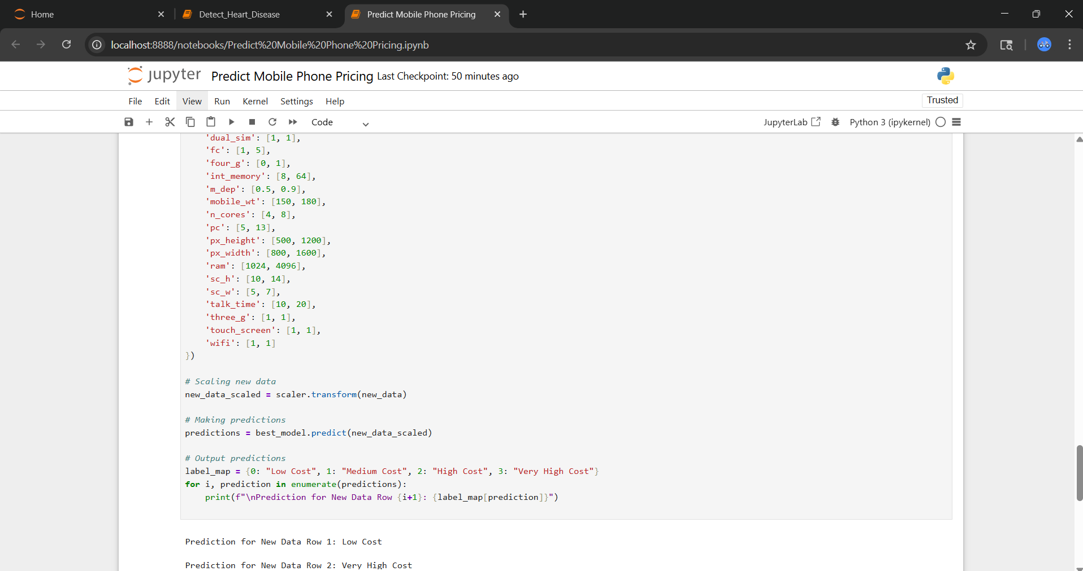
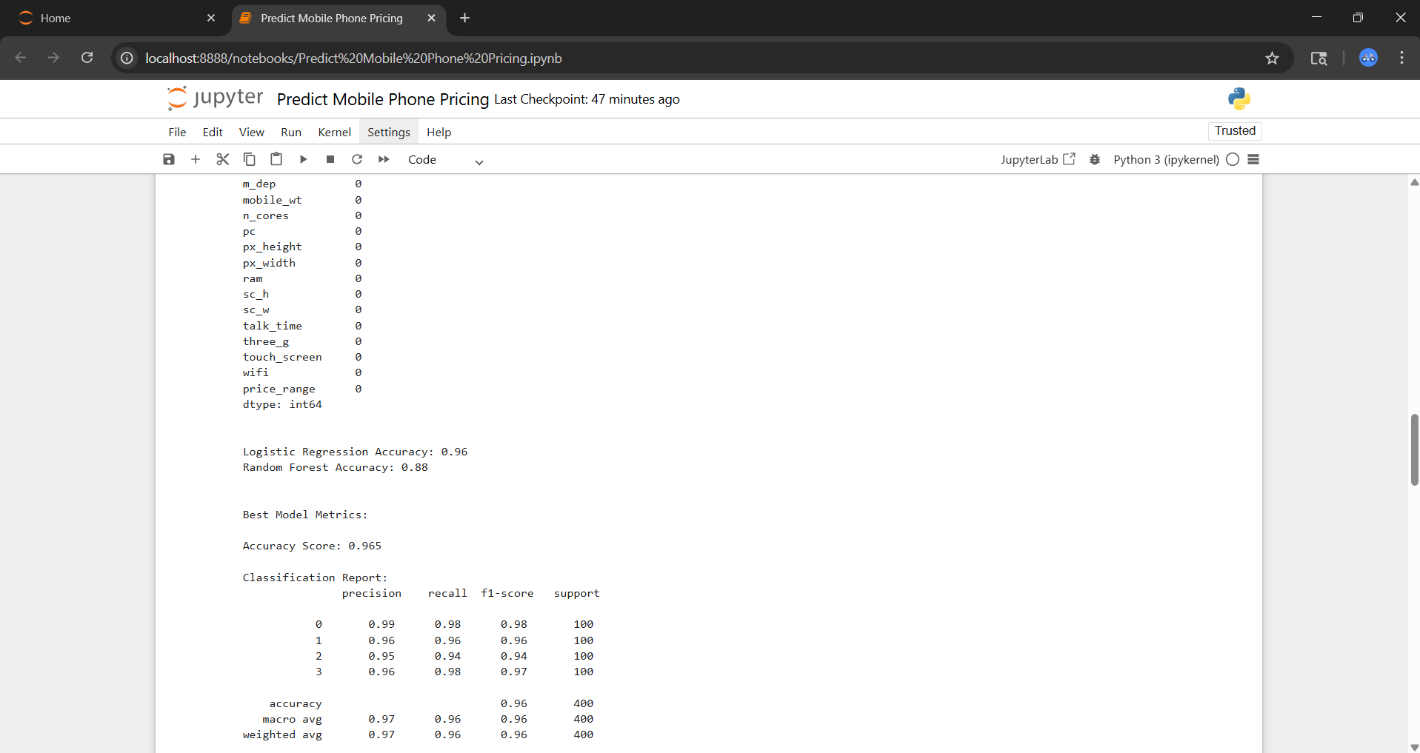
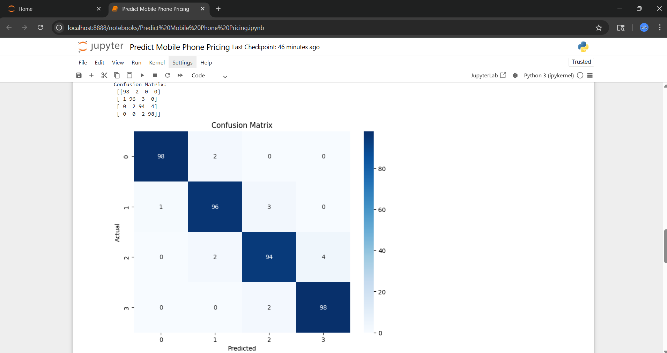
Screenshots of Result:

Slide 12

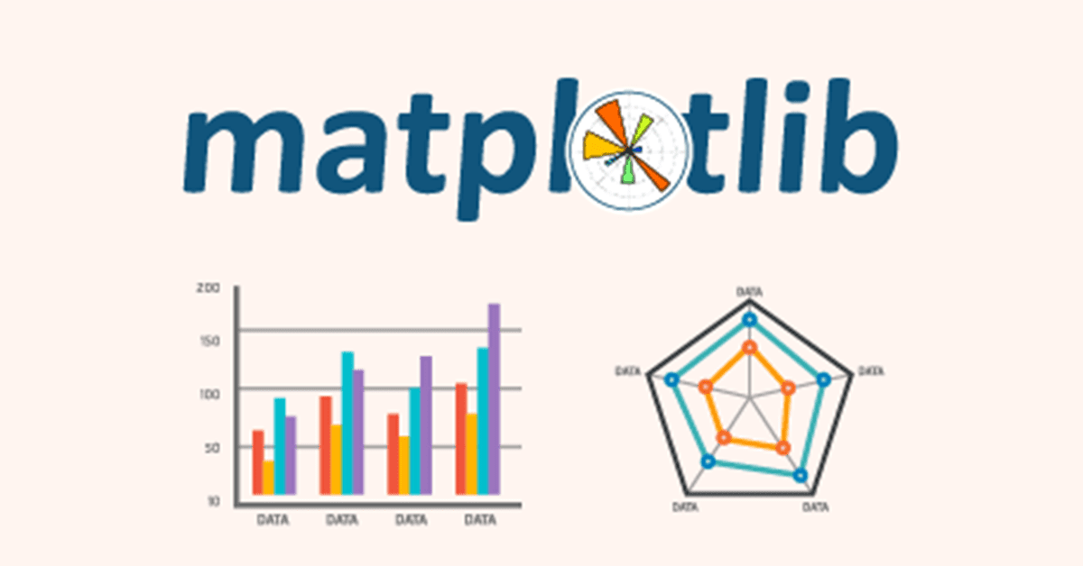




Tools Used:
jupyter==1.0.0
matplotlib==3.10.1
numpy==2.1.0
pandas==2.2.3
scikit-learn==1.6.1
seaborn==0.13.2
ipykernel==6.29.5
ipython==8.21.0
ipywidgets==8.1.2
notebook==7.4.2

Slide 13

Category | Tools/Libraries Used
Programming | Python
Data Handling | Pandas, NumPy
Preprocessing | Scikit-learn (StandardScaler, train_test_split)
ML Models | Scikit-learn (LogisticRegression, RandomForestClassifier)
Evaluation | Scikit-learn (accuracy_score, classification_report, etc)
Visualization | Matplotlib, Seaborn
Utility | Warnings

