Slide 1
MINOR PROJECT PRESENTATION
HANDWRITTEN DIGIT RECOGNITION USING DEEP LEARNING.
TEAM MEMBERS
AKSHIT JOSHI 18102004 A1
ASHUTOSH SHARMA 18102254 A2
HIMANSHU KUMAR 18102153 A6
SUBMITTED TO : Dr Richa Gupta
Dr.Neetu Singh

Slide 2
INTRODUCTION
The handwritten digit recognition is the ability of computers to recognize human handwritten digits. It is a hard task for the machine because handwritten digits are not perfect and can be made with many different flavours. The handwritten digit recognition is the solution to this problem which uses the image of a digit and recognizes the digit present in the image. We are going to implement a handwritten digit recognition app using the MNIST dataset. We will be using a special type of deep neural network that is Convolutional Neural Networks. In the end, we are going to build a GUI in which you can draw the digit and recognize it straight away.

Slide 3
METHODOLOGY TO BE FOLLOWED
We have divided our work in 3 phases
Phase 1
In the first phase we are going to import all the modules that we are going to need for training our model. The image data cannot be fed directly into the model so we need to perform some operations and process the data to make it ready for our neural network. Now we will create our CNN model in Python data science project.
Phase 2
In this phase we will start training the model using our dataset. We will have around 10,000 images in our dataset which will be used to evaluate how good our model works.
Phase 3
Now for the GUI, we have created a new file in which we build an interactive window to draw digits on canvas and with a button, we can recognize the digit.Then we will create the App class which is responsible for building the GUI for our application. We create a canvas where we can draw by capturing the mouse event and with a button.

Slide 4
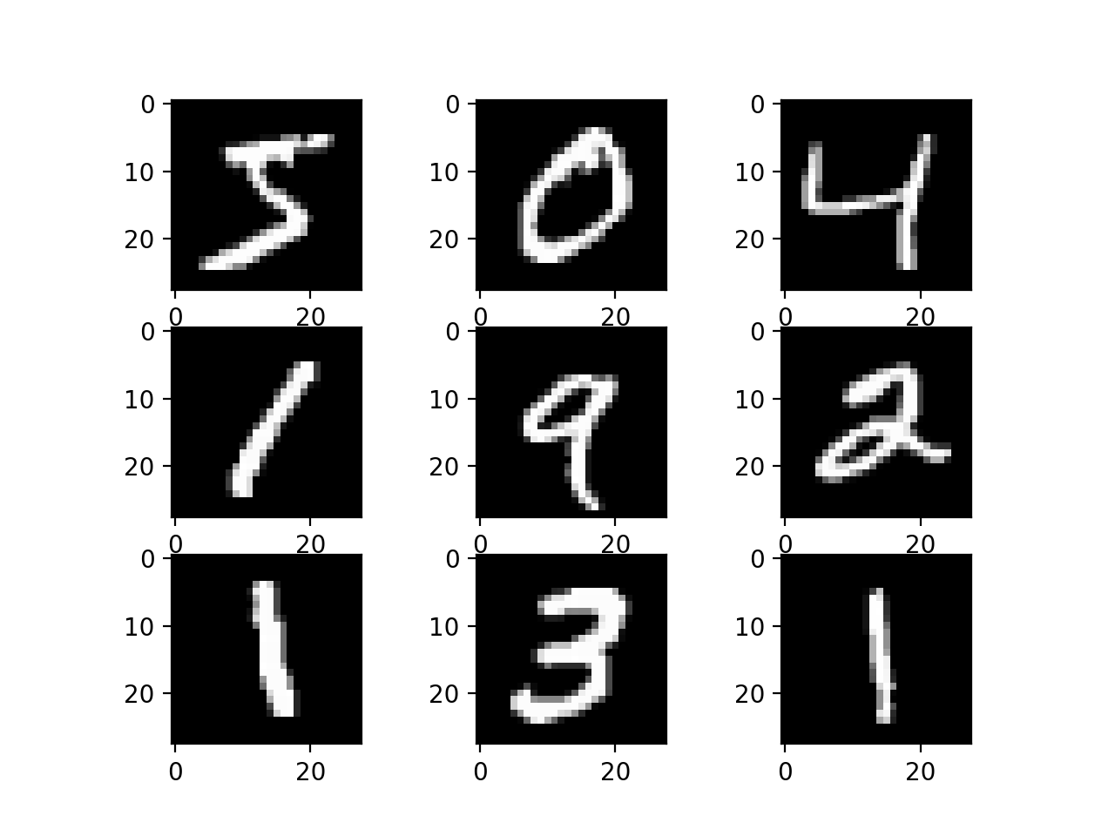
Dataset Used
We will use MNIST dataset is used in this project to train the model. The MNIST dataset contains 60,000 training images of handwritten digits from zero to nine and 10,000 images for testing. So, the MNIST dataset has 10 different classes. The handwritten digits images are represented as a 28×28 matrix where each cell contains grayscale pixel value.
Plot of a Subset of Images From the MNIST Dataset

Slide 5
SOFTWARE USED
GOOGLE COLABORATORY
Colab is a free Jupyter notebook environment that runs entirely in the cloud. Most importantly, it does not require a setup and the notebooks that you create can be simultaneously edited by your team members - just the way you edit documents in Google Docs. Colab supports many popular machine learning libraries which can be easily loaded in our notebook.It has all the libraries pre installed which just need to be imported.Our project requires the use of numpy, tensorflow, keras and pillow libraries.
Other features offered by Colab are:
Write and execute code in Python
Document your code that supports mathematical equations
Create/Upload/Share notebooks
Import/Publish notebooks from GitHub
Import external datasets e.g. from Kaggle
Integrate PyTorch, TensorFlow, Keras, OpenCV

Slide 6
FLOW OF WORK
Importing the Libraries
Load the dataset and Pre Process the data
Create the model

Slide 7
Train the model
Evaluate the model
Create GUI to predict digits.

Slide 8
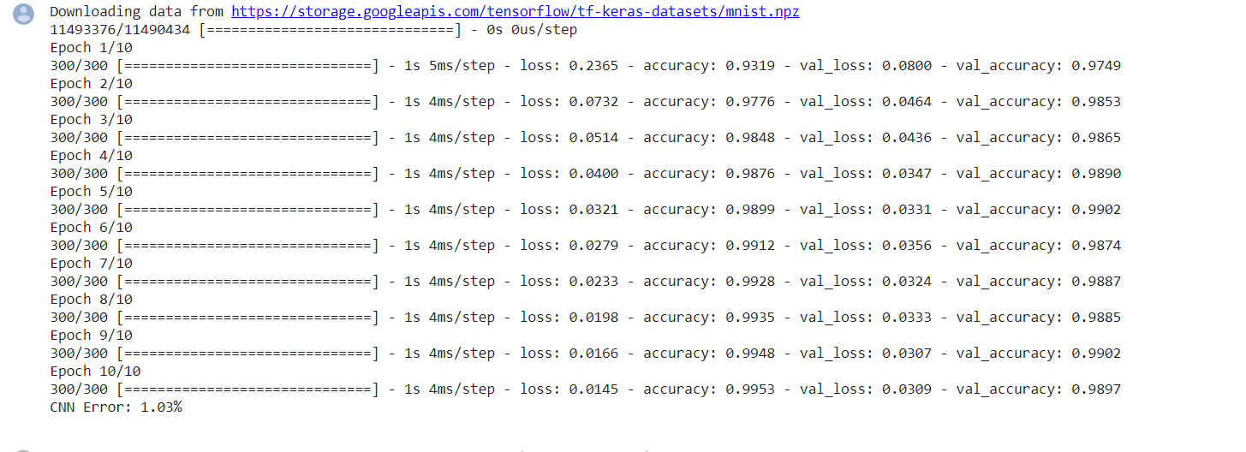
Results after testing the model on GOOGLE COLAB

Slide 9
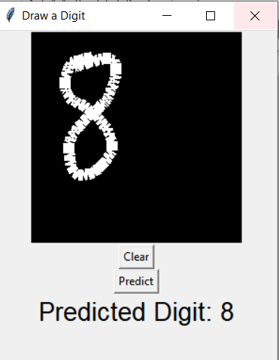
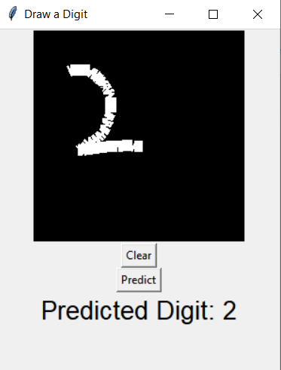
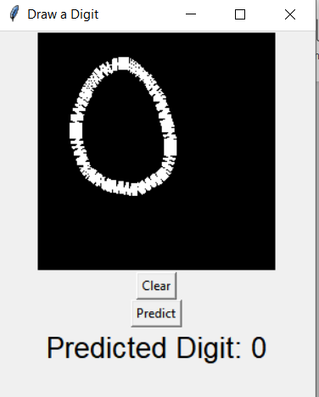
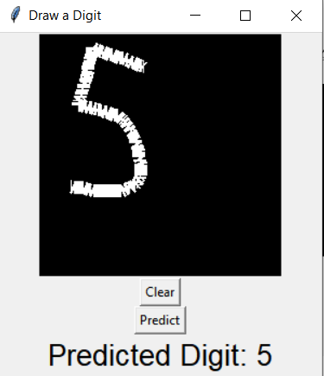
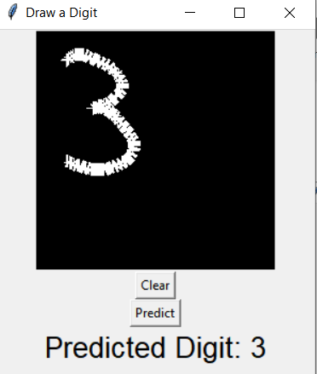
GUI Output

Slide 10
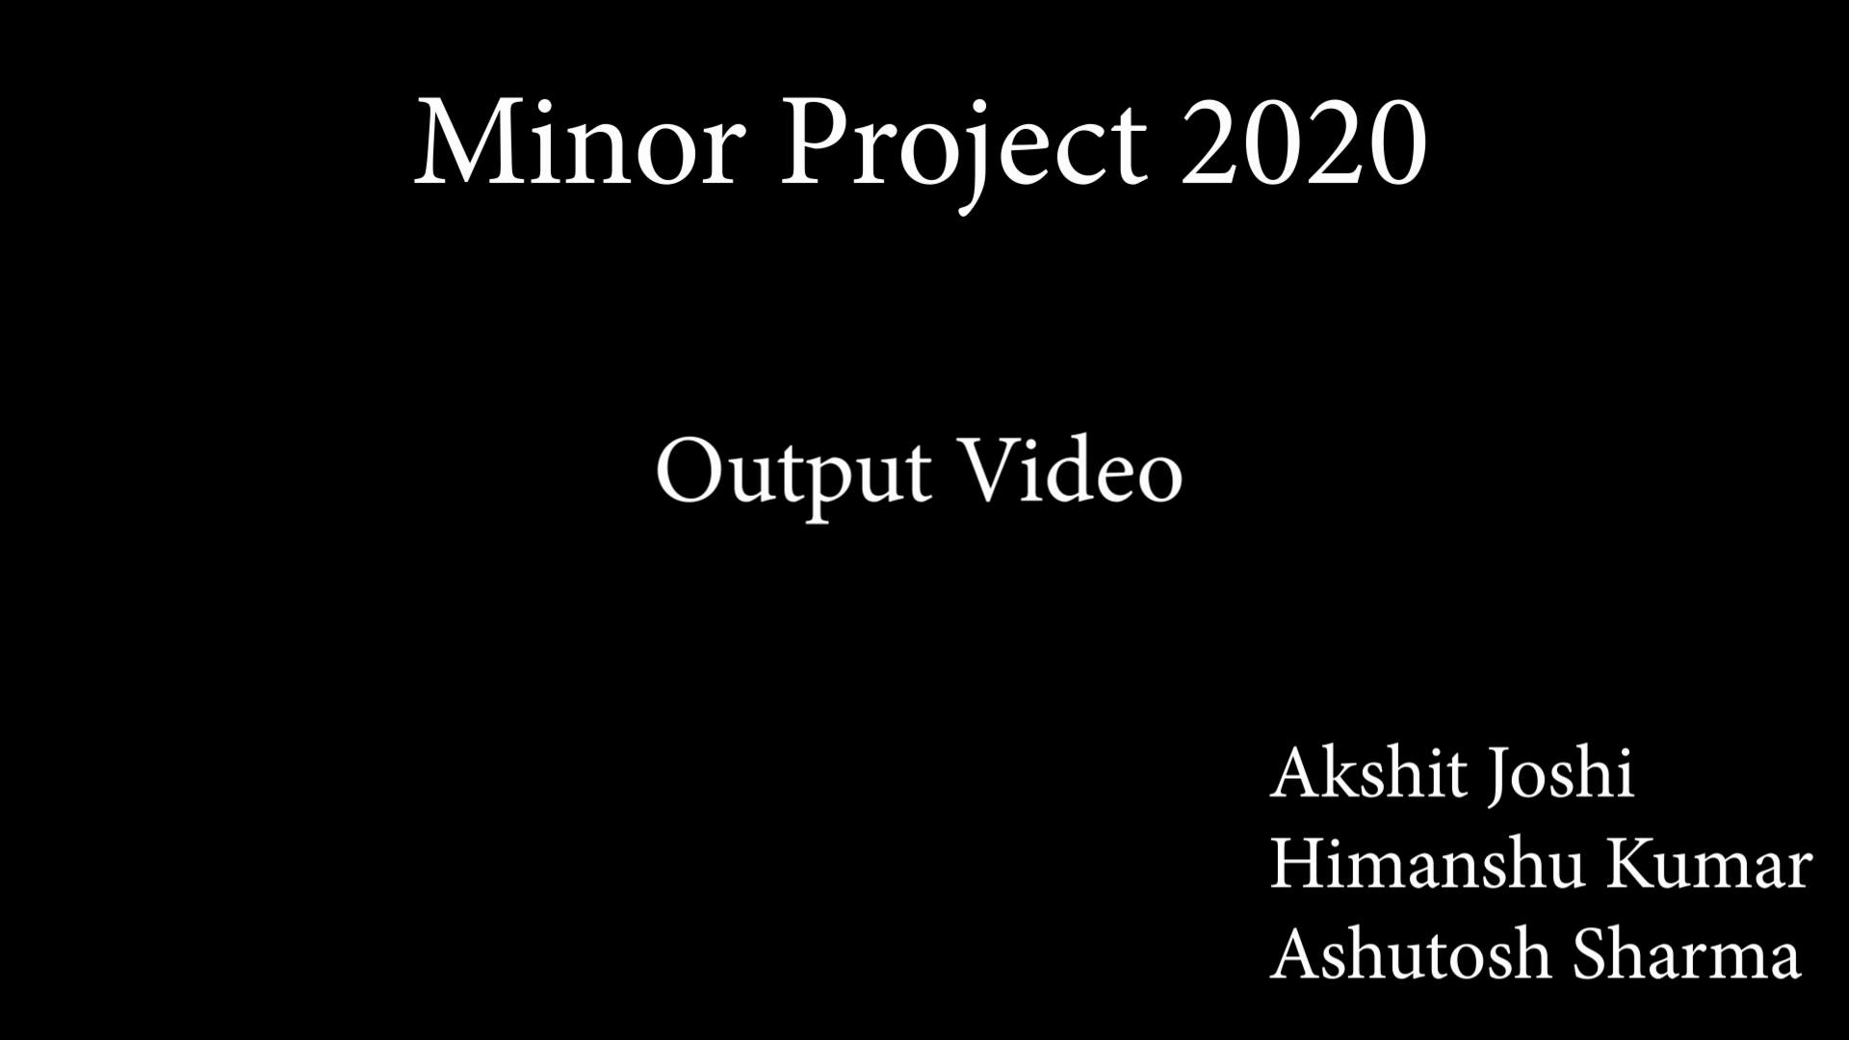
OUTPUT VIDEO

Slide 11
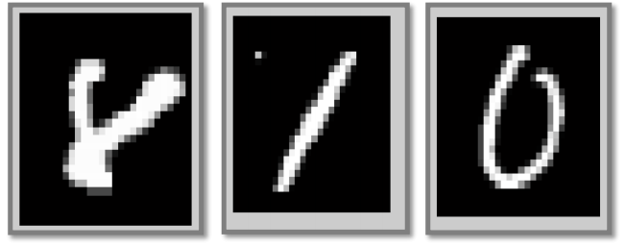
Difficulties
The overall accuracy of the handwritten image was 94.5%. Because it sometimes predicted Digit 8 as Digit 2. Also, since the raw data from the MNIST database, we used for training had been already processed, if we do more processing on the testing image we wrote, the accuracy can be improved further.
Digit not recognized correctly.

Slide 12
REFERENCES
[1] Deng L, Hinton G, Kingsbury B, “New types of deep neural network
learning for speech recognition and related applications: an overview,”
Proceedings of the IEEE International Conference on Acoustics, Speech
and Signal Processing. Vancouver BC: IEEE, 2013, pp. 8599-8603.
[2] Xu Peng, Bo Hua, “Facial expression recognition based on convolutional
neural networks,” Microcomputer & Its Applications, no. 12, pp. 45-47, 2015.
[3] Babu, U. R., Chintha, A. K., & Venkateswarlu, Y. (2014). Handwritten Digit Recognition Using Structural,

Slide 13
THANK YOU

