Slide 1
Neural Network and Fuzzy Logic
Problem Statement – Classification of Fruits using Fuzzy Logic
Data set – Fruits 360 ( Kaggle )
Teammates – Chandan Kumar M and Dhanush B L
Libraries used - Glob , cv2 , numpy , os , pandas , sklearn , csv

Slide 2
Fruits Considered
1. Apple
2.Banana
3.Kiwi
4.Orange
While implementing the decision tree we will go through the following two phases:
1.Building Phase
2.Operational Phase

Slide 3
1. Building Phase
◦ Pre process the data set.
◦ Split the data set from train and test using Python sklearn package.
◦ Train the classifier.
2. Operational Phase
◦ Make predictions.

Slide 4
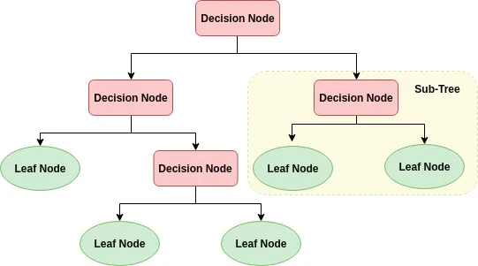
Fig : Generalized Decision Tree

Slide 5
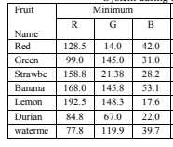
Pre processing the data
Extracting the mean RGB value , shape , area and perimeter

Slide 6


Slide 7
Procedure
Select fruit image
Find the Contours & Crop the fruit area
Compute mean for RGB components .
Compute shape by threshold segmentation (remove noises, morphological operations)
Compute geometrical properties (Area, perimeter)
Use Decision Tree Classifier and parameters in 3, 4, 5 to classify the image
Output Result

Slide 8
Thank you

