Slide 1
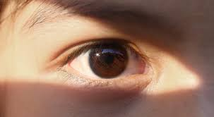

Diabetic Retinopathy Detection and classification

Slide 2
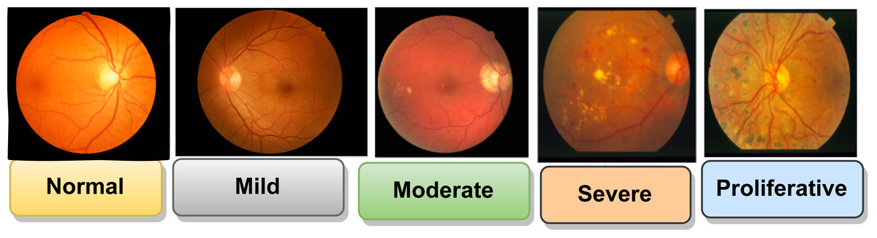
Concept & Objective
🔹 Diabetic Retinopathy (DR) is a complication of diabetes that damages blood vessels in the retina, the light-sensitive tissue at the back of the eye. High blood sugar levels cause these vessels to leak or become blocked, leading to vision problems and potential blindness. DR progresses gradually and often goes undetected in the early stages of DR
Class 0 – No DR
Healthy retina with no signs of diabetic damage.
Class 1 – Mild Non-Proliferative DR
Small areas of balloon-like swelling in the retinal blood vessels (microaneurysms).
Class 2 – Moderate Non-Proliferative DR
Blockage in some retinal blood vessels, leading to blurred vision.
Class 3 – Severe Non-Proliferative DR
More vessels are blocked, the retina is deprived of blood, and signals are sent for new vessel growth.
Class 4 – Proliferative DR
In the most advanced stage, new, fragile blood vessels grow and may bleed, causing permanent vision loss.

Slide 3
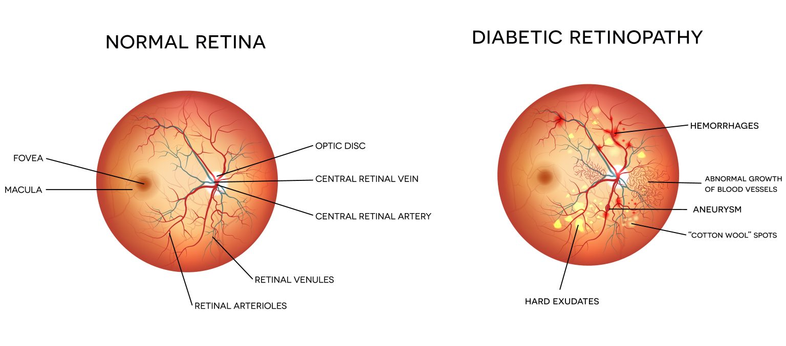
Diabetic Retinopathy (DR) is a leading cause of blindness in diabetic patients.
Early stages of DR are often asymptomatic, leading to late diagnosis.
Manual screening of retinal images is time-consuming and requires expert ophthalmologists.
There is a lack of affordable, accessible screening tools in rural and underserved regions.
AI-based screening systems can provide early, automated diagnosis.
Reduces the burden on healthcare professionals.
Helps in rapid triaging in remote areas using portable imaging devices.
Supports global efforts to prevent vision loss in diabetic populations.

Slide 4
Dataset Source:
APTOS 2019 Blindness Detection – Kaggle
Retinal fundus images labelled with 5 levels of diabetic retinopathy
Number of Classes:
5 Classes:
0: No DR
1: Mild
2: Moderate
3: Severe
4: Proliferative DR
Dataset Size:
Training Images: ~3662
Test/Validation Split: 80% train, 20% validation
Class | Label | No. of Images
0 | No DR | 1444
1 | Mild | 799
2 | Moderate | 279
3 | Severe | 236
4 | Proliferative | 154

Slide 5
Implementation
Dataset: APTOS 2019 Blindness Detection dataset from Kaggle (labelled fundus images in 5 DR severity classes).
Data Preprocessing:
Images resized to 180×180 pixels
Augmentation applied (rotation, zoom, flipping)
The dataset is balanced to reduce class bias
Model Training:
Four models trained: Custom CNN, InceptionResNetV2, Xception, and DenseNet201
Used TensorFlow & Keras with early stopping and learning rate scheduling
Training/validation split: 80/20
Performance Evaluation: Accuracy, F1-score, and confusion matrices are used to assess model results
Deployment: Model integrated with a FastAPI backend and an HTML frontend for image upload and result display

Slide 6
Preprocessing
Image Resizing
All images resized to 180 × 180 pixels
Ensures uniform input shape for all models
Data Augmentation (Training Set Only)
Introduced variability to avoid overfitting
Techniques used:
Random Flip (horizontal & vertical)
Random Rotation (20%)
Random Zoom (20%)
Improves generalization
Reduces overfitting
Simulates real-world image variations
Image Resizing
[0, 255] → [0, 1]
Done using: Helps speed up training and improves convergence
Helps speed up training and improves convergence

Slide 7
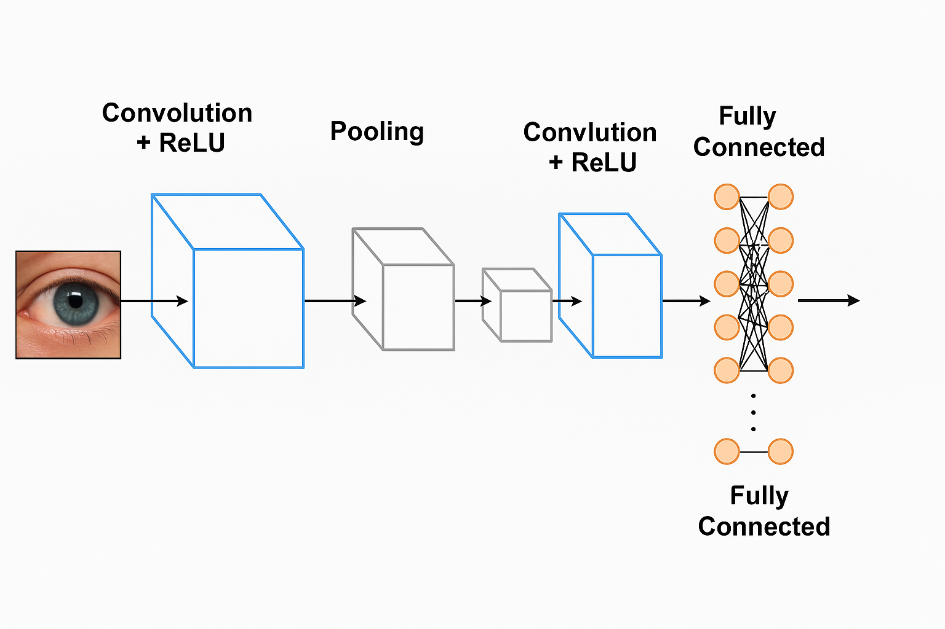
Technologies used
Custom Convolutional Neural Network (CNN): Built from scratch to understand deep learning models' baseline performance and architecture in image classification.
InceptionResNetV2: Combines the depth of Inception architecture with residual connections for efficient gradient flow and improved accuracy on medical image data.
Xception: Uses depth-wise separable convolutions to reduce computational cost while maintaining high accuracy in extracting retinal features.
DenseNet201: Connects each layer to every other layer in a feed-forward fashion, promoting feature reuse and strengthening gradient propagation.

Slide 8
Results and Evaluations
Model Comparison: Evaluated Custom CNN, InceptionResNetV2, Xception, and DenseNet201 on accuracy and classification metrics
Best Performance: DenseNet201 achieved the highest accuracy and F1-score, showing strong generalization across all DR classes
Confusion Matrices: Highlighted correct vs. misclassified predictions, especially for Mild and Moderate DR classes
Evaluation Metrics:
Accuracy: Overall model correctness
F1-Score: Balance between precision and recall
Precision & Recall: Assessed per class to analyze minority class prediction
Visual Insights: Plotted training vs. validation loss curves to detect overfitting Displayed metrics as bar charts for clearer model comparison

Slide 9
Model | Accuracy | Precision | Recall | F1-Score
Custom CNN | 0.8280 | 0.8266 | 0.8280 | 0.8265
InceptionResNetV2 | 0.8070 | 0.8068 | 0.8070 | 0.7960
Xception | 0.7450 | 0.7421 | 0.7450 | 0.7380
DenseNet201 | 0.8840 | 0.8879 | 0.8840 | 0.8796

Slide 10
Future work
Dataset Expansion: Integrate additional datasets like EyePACS or Messidor to improve model generalization and robustness.
Cloud-Based Deployment: Deploy the application on platforms like AWS or GCP for real-time, remote accessibility in clinical settings.
Mobile Integration: Build a lightweight version of the model to enable mobile-based eye screening in underserved areas.
Real-Time Video Analysis: Extend functionality to analyze fundus videos, offering more dynamic and robust diagnostic capability.
Explainable AI (XAI): Integrate Grad-CAM or SHAP to enhance interpretability and build trust with healthcare professionals.

