Slide 1
Bubble sort
Presentation-1
-BY Prudhvi

Slide 2
Bubble sort
Bubble sort, sometimes referred to as a process to sort out the unordered data into a ascending order, it is a simple sorting algorithm that repeatedly steps through the list, compares adjacent elements and swaps them if they are in the wrong order.

Slide 3
Algorithm to bubble sort
step1 : Look at the first number in the list, or array list, or neither in the array
step2 : Compare the current number with the next number which is receding to it.
Step3 :Is the next number smaller than the current number? If so, swap the two numbers around. If not, do not swap.
step4 : Move to the next number along in the list and make this the current number.
step5 : Repeat from step 2 until the last number in the list has been reached.
step6 : If any numbers were swapped, repeat again from step
Step7 :If the end of the list is reached without any swaps being made, then the list is ordered and the algorithm can stop.

Slide 4
example for bubble sort: 3, 2, 4, 1, 5
1st process | 2nd process | 3rd procee
3, 2, 4, 1, 5 | 2, 3, 1, 4, 5 | 2, 1, 3, 4, 5
2, 3, 4, 1, 5 | 2, 3, 1, 4, 5 | 1, 2, 3, 4, 5
2, 3, 4, 1, 5 | 2, 1, 3, 4, 5 | 1, 2, 3, 4, 5
2, 3, 1, 4, 5 | 2, 1, 3, 4, 5 | 1, 2, 3, 4, 5
2, 3, 1, 4, 5 | 2, 1, 3, 4, 5 | 1, 2, 3, 4, 5
The answer will be : 1,2,3,4,5

Slide 5
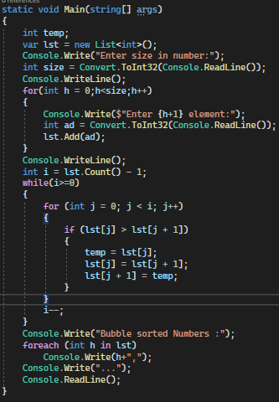
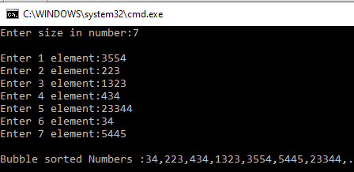
My code and output
Input | Output

Slide 6
Linear search
Presentation 2
-BY Prudhvi

Slide 7
Linear search
linear search is the simplest method of searching a data from given user input. Starting at the beginning of the data set, each item of data is examined until a match is made. Once the item is found, the search ends. If there is no match, then it will decide according to algorithm. In my else statement I kept as “out of range”.

Slide 8
Algorithm for linear search
step1 : First we should sort the data structure that we declared.
Step2: Then let’s take a variable size to mention the size of array, or list or neither array list and it should be subtracted with 1 for condition.
Step3 : to index initialize an other statement to zero to index from start of the data structure.
Step4: initialize a another variable to take the input and that variable checks with the condition. If it matches the condition should print the value of variable initialize to zero and break. If not the other condition should print value isout of range

Slide 9
Example for linear search
If we want to index no 25
25
13 18 25 46 58 77
0 1 2 3 4 5
25
13 18 25 46 58 77
0 1 2 3 4 5
25
13 18 25 46 58 77
0 1 2 3 4 5
So, the indexing value will be “2”

Slide 10
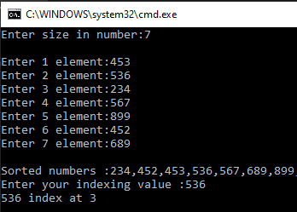
My code and output
CODE | OUTPUT
//linear search Console.WriteLine(); Console.Write("Enter your indexing value :"); int a = Convert.ToInt32(Console.ReadLine()); int q = 0, p=0; while (q < lst.Count()-1) { if (lst[q] == a) { p++; break; } q++; } if (p == 1) Console.WriteLine($"{a} index at {q}"); else Console.WriteLine("not in range"); Console.ReadLine();

Slide 11
Binary search
Presentation-3

Slide 12
Binary search
This Binary search method conquered by divide and rule method it is a search algorithm that finds the position of a target value within a sorted data structure. Binary search compares the target value to the middle element of the array If they are not equal, the half in which the target cannot lie is eliminated and the search continues on the remaining half, again taking the middle element to compare to the target value, and repeating this until the target value is found. If the search ends with the remaining half being empty, the target is not in the Data structure. The we can print the target is not living in the range.

Slide 13
Algorithm for binary search
Step1: Before getting into process we should make sure the list is sorted.
Step2 : Then we shall determine half of the array by using this formula low + high / 2. we use this mid value to index the list or array. If it matches the output index will be printed
step#3: if it does not match if the condition states that indexed value is more than input value, We change our low to mid + 1 and find the new mid value again. Else if index value is less than input value We change our high to mid - 1 and find the new mid value again. Once if low value reaches high value or high value reaches low value then we print out of range.

Slide 14
Example for binary search
If I want to Index 25
13 18 25 46 58 77
0 1 2 3 4 5
if (input > lst[(l+h)/2])
h = mid - 1
13 18 25 46 58 77
0 1 2 3 4 5
So by above iteration 25 Index at 2

Slide 15
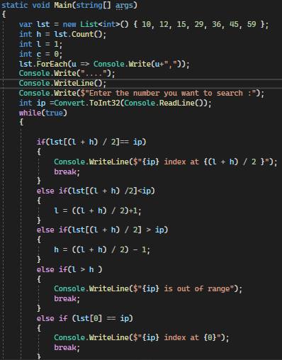
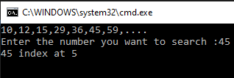
My code and out put
CODE
OUTPUT

Slide 16
-Thank you
Done by -N.Prudhvi
@Nations Benefits.

