Slide 1



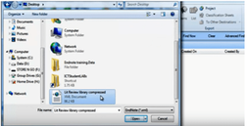
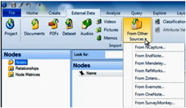
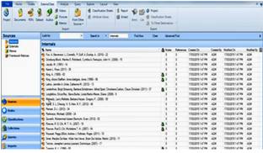
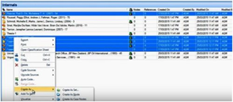
BUS7C4 SUPERVISION SESSION
LECTURE RESULTS/FINDINGS, ANALYSIS AND DISCUSSION
EXPLORING ORGANISATIONAL APPROACHES TO INTERNATIONAL MARKET ENTRY UNDER THE GLOBAL ECONOMY
STUDENT NAME: RAMA KOTESWARA RAO MANGINENI
STUDENT ID: S24013995
RESEARCH FOCUS
How do organisations approach international market entry in the global economy?
USE OF NVIVO FOR SECONDARY QUALITATIVE DATA ANALYSIS
Secondary qualitative data analysed through NVivo 15with inductive thematic coding
SECONDARY DATA SOURCES USED FOR DATA ANALYSIS
KEY FINDINGS (THEME)
OECD internationalisation reports
UNCTAD case studies
World Bank Trade and Investment Reports
Peer-reviewed journals studies (Causer et al., 2024)
Global economic conditions influence entry strategy selection
Organisational prefer low-risk entry modes under economic uncertainties (Zámborský et al., 2022)
Organisational capabilities and resources shapes market entry decisions
Regulatory and institutional environments affect strategy choices (Adesina et al., 2024)
ANALYSIS AND DISCUSSION
·Organisations adjust international market entry strategies in response to different level of global economic stability (Hasan et al., 2024)
·These are through prioritising risk mitigation throughout uncertain environments
·Strategic flexibility emerges as a critical capability with enabling firms to make investment commitments and modify entry modes
·These are in accordance to changing economic conditions and market conditions (Fujimori et al., 2022)
·Regulatory and institutional pressure within host countries encourage organisations in adopting collaborative entry approaches
·These involves strategic partnership and joint ventures in reducing legitimacy and operational risks (Akinsola et al., 2025)
·The findings reinforce established internationalisation theories (Uppsala internationalisation model)
·It emphasises gradual market commitments with experimental learning in foreign expansion decisions (Guercini and Milanesi, 2022)
REFERENCES
Adesina, A.A., Iyelolu, T.V. and Paul, P.O., (2024). Leveraging predictive analytics for strategic decision-making: Enhancing business performance through data-driven insights. World Journal of Advanced Research and Reviews, 22(3), pp.1927-1934. https://pdfs.semanticscholar.org/b76b/ff29715b465db49a3f2f8b30222f2bea02a8.pdf
Akinsola, O.K., Taofeek, A. and Kingsley Onu, D.Y.O., (2025). Legal Challenges and Best Practices for Structuring Corporate Partnerships, Joint Ventures, and Strategic Alliances. https://www.researchgate.net/profile/Bryan-Collins-4/publication/388653168_Legal_Challenges_and_Best_Practices_for_Structuring_Corporate_Partnerships_Joint_Ventures_and_Strategic_Alliances/links/67a1196596e7fb48b9b11d4b/Legal-Challenges-and-Best-Practices-for-Structuring-Corporate-Partnerships-Joint-Ventures-and-Strategic-Alliances.pdf
Causer, H., Spiers, J. and Riley, R., (2024). A method for synthesizing qualitative data sources in the co-production of postvention guidelines for the NHS: a worked example. International Journal of Qualitative Methods, 23, p.16094069241229985. https://journals.sagepub.com/doi/abs/10.1177/16094069241229985
Fujimori, S., Wu, W., Doelman, J., Frank, S., Hristov, J., Kyle, P., Sands, R., Van Zeist, W.J., Havlik, P., Domínguez, I.P. and Sahoo, A., (2022). Land-based climate change mitigation measures can affect agricultural markets and food security. Nature Food, 3(2), pp.110-121. https://www.nature.com/articles/s43016-022-00464-4
Guercini, S. and Milanesi, M., (2022). Foreign market entry decision-making and heuristics: a mapping of the literature and future avenues. Management Research Review, 45(9), pp.1229-1246. https://www.emerald.com/mrr/article/45/9/1229/305647
Hasan, M.M., Rayhan, Z., Mukta, R.T. and Faruq, O., (2024). Research on adapting marketing techniques to different culture economics and regulatory environment to entering new international markets. Информатика. Экономика. Управление/Informatics. Economics. Management, 3(4), pp.0257-0277. https://cyberleninka.ru/article/n/research-on-adapting-marketing-techniques-to-different-culture-economics-and-regulatory-environment-to-entering-new-international
Zámborský, P., Sullivan-Taylor, B., Tisch, D. and Branicki, L., (2022). Antecedents of risk and uncertainty management capabilities: Insights from multinational enterprises in New Zealand. Journal of Management & Organization, 28(3), pp.632-658. https://www.cambridge.org/core/journals/journal-of-management-and-organization/article/antecedents-of-risk-and-uncertainty-management-capabilities-insights-from-multinational-enterprises-in-new-zealand/3099A5E049024F0CECB20DDFA397B916

