Slide 1

BUS7C4 SUPERVISION SESSION
LECTURE RESULTS/FINDINGS, ANALYSIS AND DISCUSSION
EXPLORING ORGANISATIONAL APPROACHES TO INTERNATIONAL MARKET ENTRY UNDER THE GLOBAL ECONOMY
Student Name: Rama Koteswara Rao Mangineni
Student ID: S24013995
Notes:
I am Rama Koteswara Rao Mangineni, a student in the International Business Management programme, and currently presenting an overview of my results, findings, analysis and discussion section on the topic of "Exploring organisational approaches to international market entry under the global economy”.

Slide 2
AIM, OBJECTIVES AND RESEARCH QUESTION OF THE STUDY
Research Question
How do organisations approach international market entry in the context of the global economy?
Research Aim:
The study aims to “Explore how organisations undertake international market entry strategies within the global economy". These are through the assistance of evaluating existing qualitative evidence from reliable sources.
Research Objectives
The research objectives of this study are as follows,
To outline international market entry strategies discussed in existing qualitative studies
To examine the influence of global economic conditions on shaping organisational decisions in the context of international market entry strategies
To explore organisational factors that impacted the selection of international market entry approaches
To synthesise recurring themes and patterns regarding international market entry strategies with the help of Nvivo-based analysis
Notes:
In this slide, I have presented the aim, objectives and research question of the study to provide a clear direction of the research and help the reader in understanding the actual purpose of the study.

Slide 3

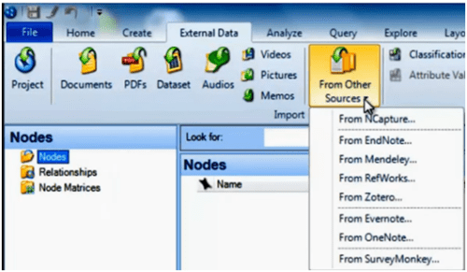
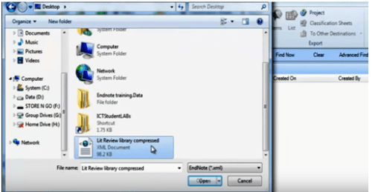
SECONDARY DATA SOURCES USED FOR ANALYSIS
OECD reports on internationalisation strategies (Organisational analysis and qualitative policy)
UNCTAD international market entry case documents (Qualitative case-based evidence)
World Bank Global Trade and Investment Reports (Strategic and institutional qualitative narratives)
Peer-reviewed journals and articles available on reliable databases (Emerald, Taylor & Francis, Google Scholar and others)
Notes:
The slide is focused on outlining publicly available sources or secondary qualitative data, which are selected to carry out an NVivo-based thematic analysis into practices.

Slide 4
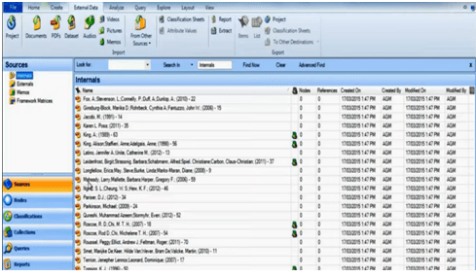
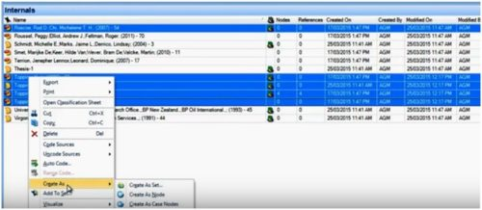
SECONDARY QUALITATIVE DATA ANALYSIS
Secondary qualitative data were systematically imported to NVivo version 15 for organisation and analysis process
Application of inductive coding in identifying key concepts and recurring patterns (Kraiwanit et al., 2023)
Nvivo facilitated efficient data management, theme development, and transparent coding
It enhances the credibility and academic rigour of the analysis process (Limna, 2023)
Notes:
The slide contributes towards explaining the procedure and effectiveness of analysing secondary qualitative data with the help of NVivo software

Slide 5
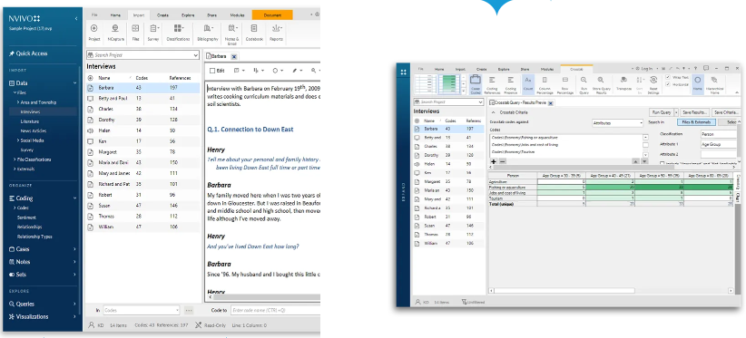
USE OF NVIVO IN SECONDARY QUALITATIVE DATA ANALYSIS
NVivo software utilised in coding, organising and managing large volumes of secondary qualitative data
Initial codes are formed and refined (Allsop et al., 2022)
These are to explore key patterns related to international market entry approaches
Use of NVivo software supports consistency and transparency in the analytical process (Niedbalski and Ślęzak, 2023)
These are essential in strengthening the validity of the study findings
Notes:
The slide presents how NVivo software is utilised in supporting thematic analysis and systematic coding of secondary qualitative data.

Slide 6
REFERENCES
Allsop, D.B., Chelladurai, J.M., Kimball, E.R., Marks, L.D. and Hendricks, J.J., (2022). Qualitative methods with Nvivo software: A practical guide for analysing qualitative data. Psych, 4(2), pp.142-159. https://doi.org/10.3390/psych4020013
Kraiwanit, T., Limna, P. and Siripipatthanakul, S., (2023). NVivo for social sciences and management studies: A systematic review. Advance Knowledge for Executives, 2(3), pp.1-11. https://d1wqtxts1xzle7.cloudfront.net/104584003/AKE_2_3_No._23-libre.pdf?1690550783=&response-content-disposition=inline%3B+filename%3DNVivo_for_Social_Sciences_and_Management.pdf&Expires=1769016357&Signature=BTM2VVXduHb1KiHfXJ9moJALqqc-kgSyKwgrqkb3K~Rwe43VpehRRczY9ZcsX2TBdfK5sfLTz1cgpGkkZneUlJCr8mq7IUb1h52STXbhDOip5ypx~xizQyLbGPu8jD-MheIivS-j--UtCHG6yYVRZGldsW6myoSjoWGS~XqVeZCJKNCpevAREsqDbL-icZqQHbP0dmgIWGi~bp~8K68hAKlkHA8AzF~LohAGTuVatCe0drvZpnJRIrugNZ51cFq6GlKZDqrMCHAZRJKAtR29H9QwsoIhO98TmRBoiWpSBtWPu1fjUTSEoZj68yPBVpsGQy9bSjIF50ZS1jUdtvfcvg__&Key-Pair-Id=APKAJLOHF5GGSLRBV4ZA
Limna, P. (2023). The impact of NVivo in qualitative research: Perspectives from graduate students. Journal of Applied Learning and Teaching, 6(2), 271-282. https://doi.org/10.37074/jalt.2023.6.2.17
Niedbalski, J. and Ślęzak, I., (2023), January. NVivo as a tool for supporting teamwork in the context of qualitative research conducted remotely: opportunities, limitations, and practical tips. In World Conference on qualitative research (pp. 38-59). Cham: Springer International Publishing. https://doi.org/10.1007/978-3-031-31346-2_3
Notes:
Allsop, D.B., Chelladurai, J.M., Kimball, E.R., Marks, L.D. and Hendricks, J.J., (2022). Qualitative methods with Nvivo software: A practical guide for analysing qualitative data. Psych, 4(2), pp.142-159. https://doi.org/10.3390/psych4020013
Kraiwanit, T., Limna, P. and Siripipatthanakul, S., (2023). NVivo for social sciences and management studies: A systematic review. Advance Knowledge for Executives, 2(3), pp.1-11. https://d1wqtxts1xzle7.cloudfront.net/104584003/AKE_2_3_No._23-libre.pdf?1690550783=&response-content-disposition=inline%3B+filename%3DNVivo_for_Social_Sciences_and_Management.pdf&Expires=1769016357&Signature=BTM2VVXduHb1KiHfXJ9moJALqqc-kgSyKwgrqkb3K~Rwe43VpehRRczY9ZcsX2TBdfK5sfLTz1cgpGkkZneUlJCr8mq7IUb1h52STXbhDOip5ypx~xizQyLbGPu8jD-MheIivS-j--UtCHG6yYVRZGldsW6myoSjoWGS~XqVeZCJKNCpevAREsqDbL-icZqQHbP0dmgIWGi~bp~8K68hAKlkHA8AzF~LohAGTuVatCe0drvZpnJRIrugNZ51cFq6GlKZDqrMCHAZRJKAtR29H9QwsoIhO98TmRBoiWpSBtWPu1fjUTSEoZj68yPBVpsGQy9bSjIF50ZS1jUdtvfcvg__&Key-Pair-Id=APKAJLOHF5GGSLRBV4ZA
Limna, P. (2023). The impact of NVivo in qualitative research: Perspectives from graduate students. Journal of Applied Learning and Teaching, 6(2), 271-282. https://doi.org/10.37074/jalt.2023.6.2.17
Niedbalski, J. and Ślęzak, I., (2023), January. NVivo as a tool for supporting teamwork in the context of qualitative research conducted remotely: opportunities, limitations, and practical tips. In World Conference on qualitative research (pp. 38-59). Cham: Springer International Publishing. https://doi.org/10.1007/978-3-031-31346-2_3

Slide 7
THANK YOU

