Slide 1
COB
Notes:
© 2006 Capgemini - All rights reserved
0

Slide 2
Objectives
Why do we require COB?
COB – Batch Stages
How to Initiate the COB process?
Services – Overview
COB Services
TSM
COB

Slide 3
Objectives
Delivery Services
PRINT.IN
PRINT.OUT
SWIFT.IN
SWIFT.OUT
TSA.SERVICE
TSA.WORKLOAD.PROFILE
TSA.PARAMETER
TSA.STATUS

Slide 4
Objectives
How to Monitor COB process?
COB.MONITOR
NON STOP
DATES
How to Troubleshoot COB Errors?
EB.EOD.ERROR
EB.EOD.ERROR.DETAIL
Where to check Errors in the COB stages?
COMO
Error Messages

Slide 5
Objectives
How to ADD a JOB to a BATCH ?
How to Remove a JOB from a BATCH?

Slide 6
Session wise Breakup
Session 1
Why do we require COB?
COB – Batch Stages
Session 2
How to Initiate the COB process?
Services – Overview
COB Services
Delivery Services

Slide 7
Session wise Breakup
Session 3
TSA.SERVICE
TSA.WORKLOAD.PROFILE
TSA.PARAMETER
TSA.STATUS
How to Monitor COB process?

Slide 8
Session wise Breakup
Session 4
How to Troubleshoot COB Errors?
Where to check Errors in the COB stages?
Error Messages
How to ADD a JOB to a BATCH ?
How to Remove a JOB from a BATCH?

Slide 9
Why do we require COB?
COB stands for Closure Of Business.
It marks the end for all the financial transactions of a day.
It supports 24 hours Non Stop processing if the Non Stop module installed.
COB process is a Batch process.
The important events in COB are
Generation of loan schedules
Accruals
Internal bank accounting and reports.

Slide 10
What is Batch Processing ?
The Batch control system which is invoked to display the list of processes to be run.
If a 'company mnemonic' has not been specified then the process of default company will be loaded.
Otherwise the process of specified company is loaded.
The Batch name should be a meaningful with respect to the
Application or
Function
of the process.
Notes:
This name is used when the batch control system is invoked to display the list of processes to be run. If a 'company mnemonic' has not been specified as part of the process name then the default company (for user OPERATOR) will be loaded and used, otherwise the specified company is loaded. The name should be made as meaningful as possible to reflect the application/function of the process.

Slide 11
Why do we require COB?
COB is used to process
Events
Calculating and posting interest
Change the bank date to next working date &
Generation of various reports.
The Close Of Business performs several activities based on
The scheduled date &
The condition specified.

Slide 12
COB – Batch Stages
The COB process have five stages.
Each stage is sorted and the COB process is performed by the system in the sorted order.
The sorted order of the COB stages is
Application
System Wide
Reporting
Start of Day &
Online

Slide 13
COB – Batch Stages
Application
Individual applications process takes place.

Slide 14
COB – Batch Stages
System Wide
System related process like
Interest & charges calculations
Rescheduling
Revaluation
are performed

Slide 15
COB – Batch Stages
Reporting
Important system reports namely
Trial balance
General ledger &
Transactions journal
generations are performed here.

Slide 16
COB – Batch Stages
Start of Day
The change in the COB dates takes place.
Standing orders, cash flow maintenance will be performed

Slide 17
COB – Batch Stages
Online
All non critical reports and processes which can be run after the system has returned to online mode.

Slide 18
Services - Overview
Services can be run in interactive mode for testing purposes.
The agents have to be manually started for every session.
This requires the Temenos Service Manager to run in debug mode and thus the subsequent agents have to be manually started.
It is advised that this method is used for testing purposes only.
After starting the TSM, the individual agents allotted to SERVICE should be manually started.

Slide 19
Temenos Service Manager (TSM)
Temenos Service Manager runs the COB service as a background service.
TSM invokes the appropriate agents as defined in the profile of COB service.
TSM will automatically start the required number of agents for the service provided the service has the field SERVICE.CONTROL set to AUTO
The agents replace the sessions which were used to run the job in a multi thread architecture to save the time and to maximise the use of system resources.

Slide 20
Delivery Services
The process of sending advices is achieved through a module in T24 called ‘DELIVERY’
Delivery System manages the flow of all messages from T24, such as confirmations, payments and advices.
Interface with various GLOBUS transaction or contract processing modules.
Control modules for all the different message carriers for both input and output messages
Messages may be either printed or sent via electronic carrier systems

Slide 21
Delivery Services
Delivery messages can be of two types namely
Inward
Received from External Sources
Outward.
Advices that go out of our delivery subsystem to other sources.
Most on-line transactions within T24 will send messages.
Messages are generated automatically as soon as contract is authorized.

Slide 22




Delivery Services
The different carriers used in Delivery Services are
SWIFT
PRINT
Record needs to be created in the TSA.SERVICE with the key as
SWIFT.IN
SWIFT.OUT
PRINT.IN &
PRINT.OUT

Slide 23
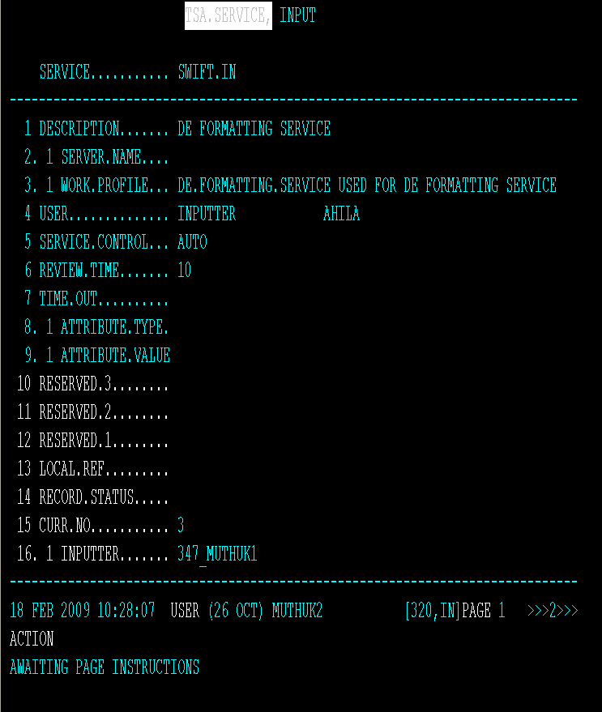
Delivery Services – SWIFT.IN

Slide 24
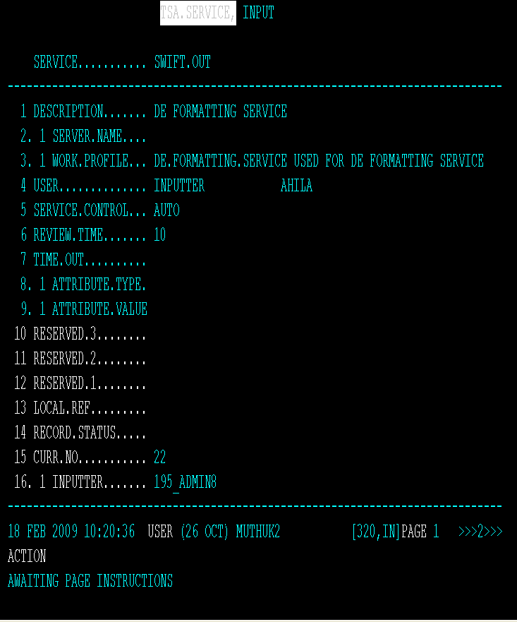
Delivery Services – SWIFT.OUT

Slide 25
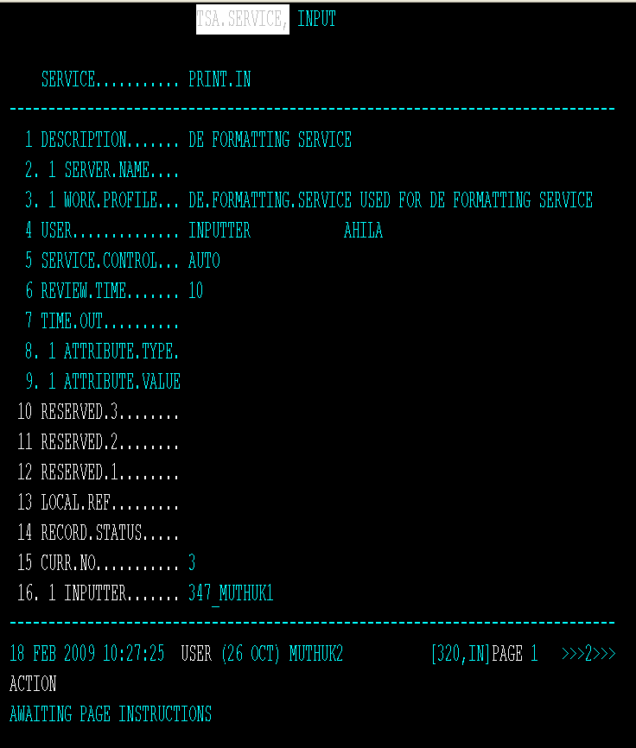
Delivery Services – PRINT.IN

Slide 26
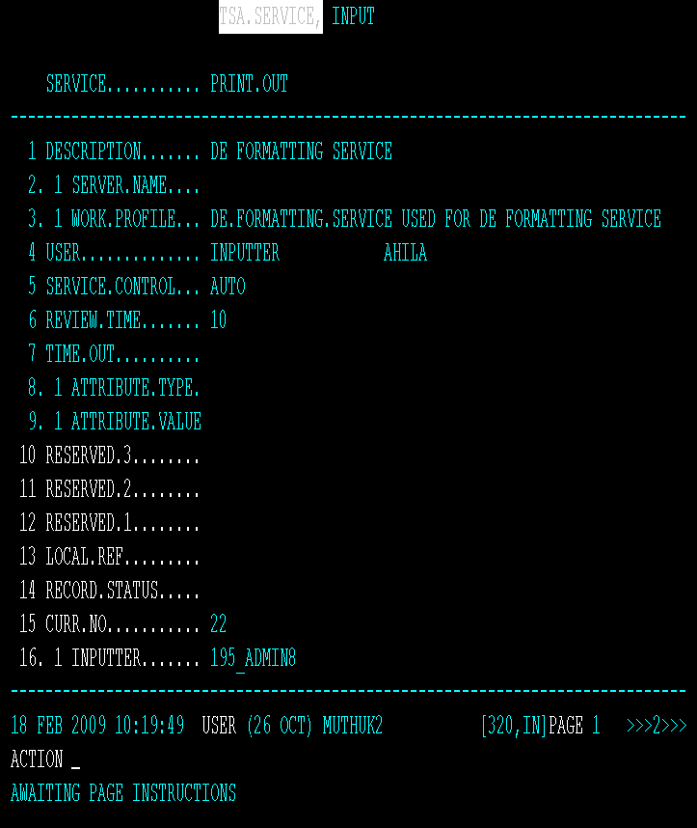
Delivery Services – PRINT.OUT

Slide 27
COB Services
T24 COB is run as a T24 Service.
Record needs to be created in the TSA.SERVICE with the key as COB
The key COB is hardcoded and shall remain the same for global close of business
This service has to be defined with
The appropriate profile
The server name
The OPERATOR/USER who will be running the Close Of Business

Slide 28
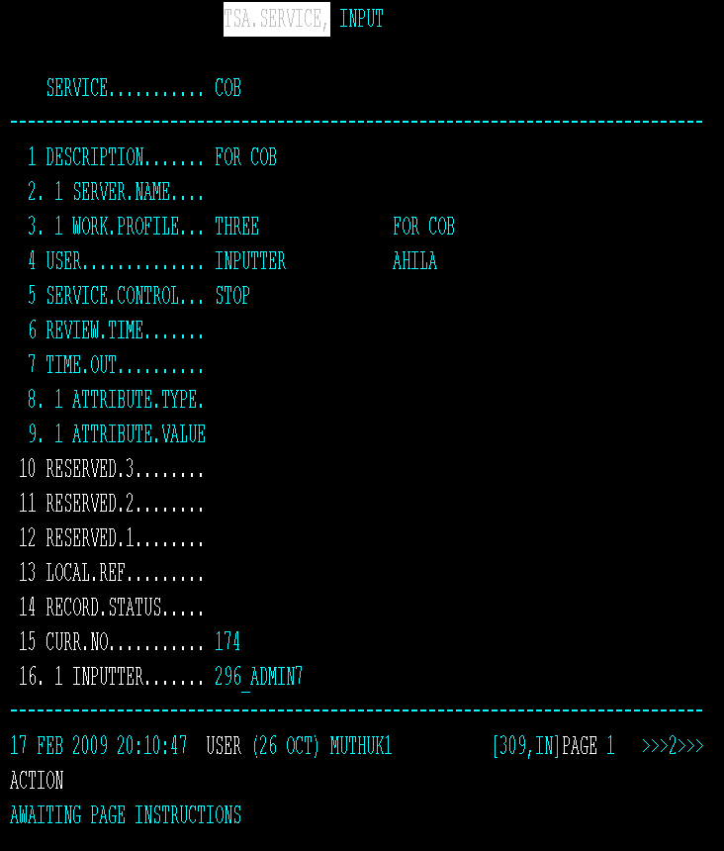
Services - Overview– COB Record

Slide 29
Services - Overview– TSA.WORKLOAD.PROFILE
The profile is defined in the TSA.WORKLOAD.PROFILE record.
The profile contains
The number of agents for the Close Of Business has to be invoked

Slide 30
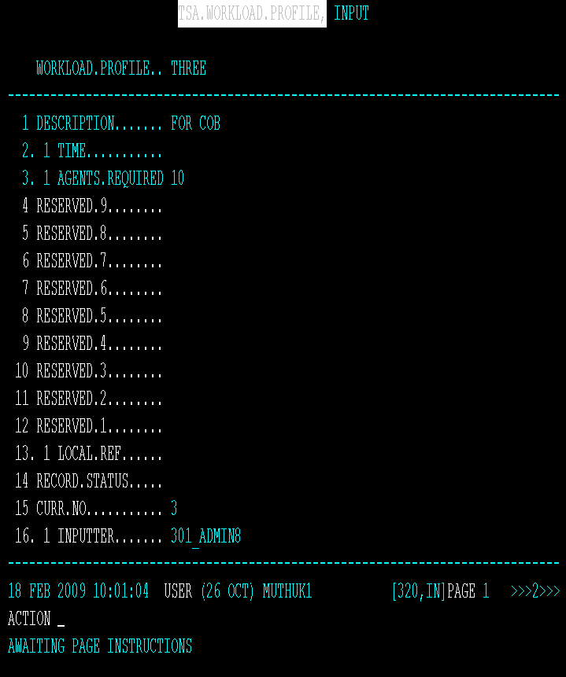
Services - Overview– TSA.WORKLOAD.PROFILE

Slide 31

Services - Overview– TSA.SERVICE
The details of the REVIEW.TIME and DEATH.WATCH have to be specified in the TSA.SERVICE record.

Slide 32
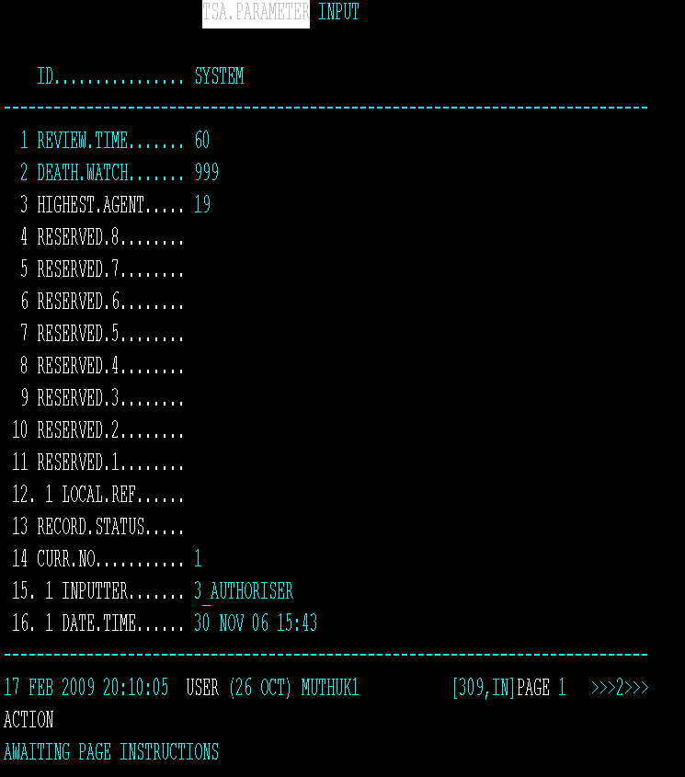
Services - Overview– TSA.PARAMETER
Otherwise the details will be defaulted from the TSA.PARAMETER record.
Notes:
DEATH.WATCH
This field holds the seconds for the death watch. The system if it does not find a contact with a particular agent for a time greater than the death watch will mark the particular agent as DEAD. The Service Manager will review the response from every agent and will act upon agents that don't respond for a given period of time.
REVIEW.TIME
This field holds the review time by the Service Manager of all the agents that are running currently. The system does a periodical review of all the agents running in the system. The delay time during every review can be specified in this field.

Slide 33
Initiate COB Service
To initiate the COB service
The record in TSA.SERVICE application called COB has to be marked for Starting.
If the TSM service is not started, then it needs to be started before the COB is initiated.

Slide 34
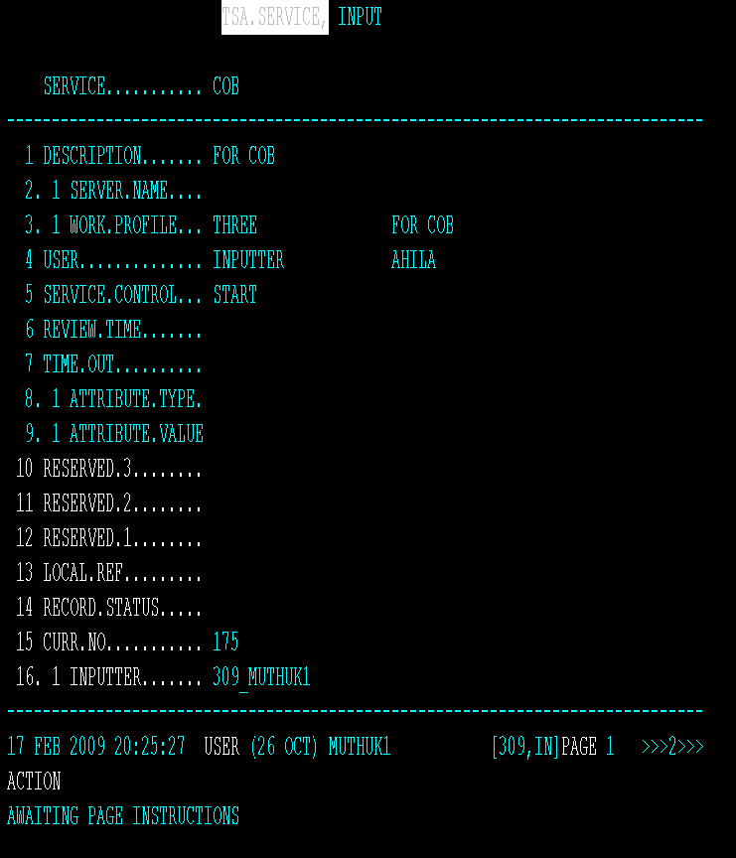
Initiate COB Service
The service control field for the COB record is set as “START”

Slide 35
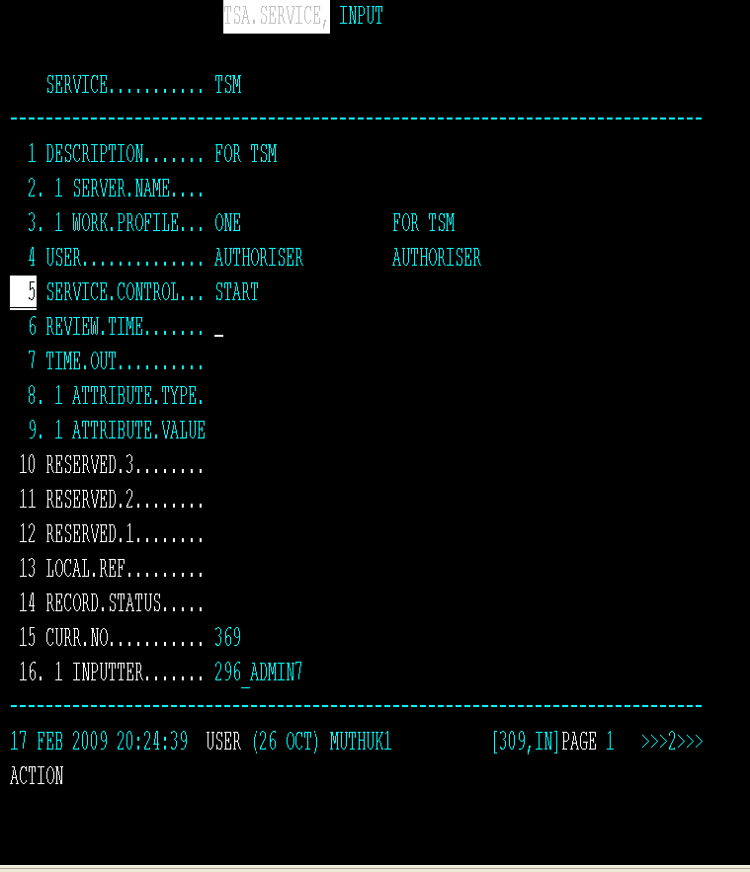
Initiate COB Service
The service control field for the TSM record is set as “START”

Slide 36

Initiate COB Service
Log out from T24 and return to jshell prompt
Start the TSM in interactive mode (with the –DEBUG option)

Slide 37
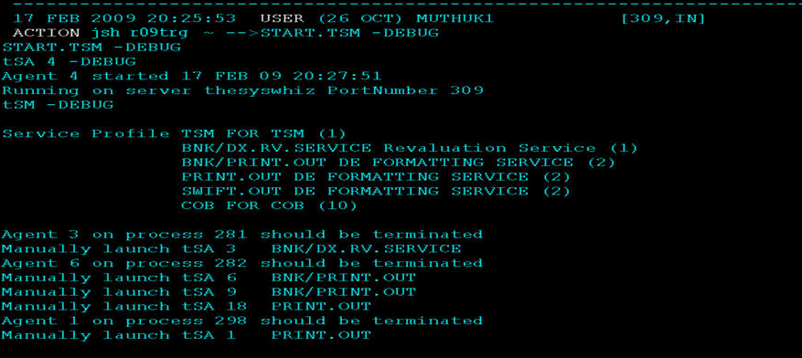
Initiate COB Service

Slide 38
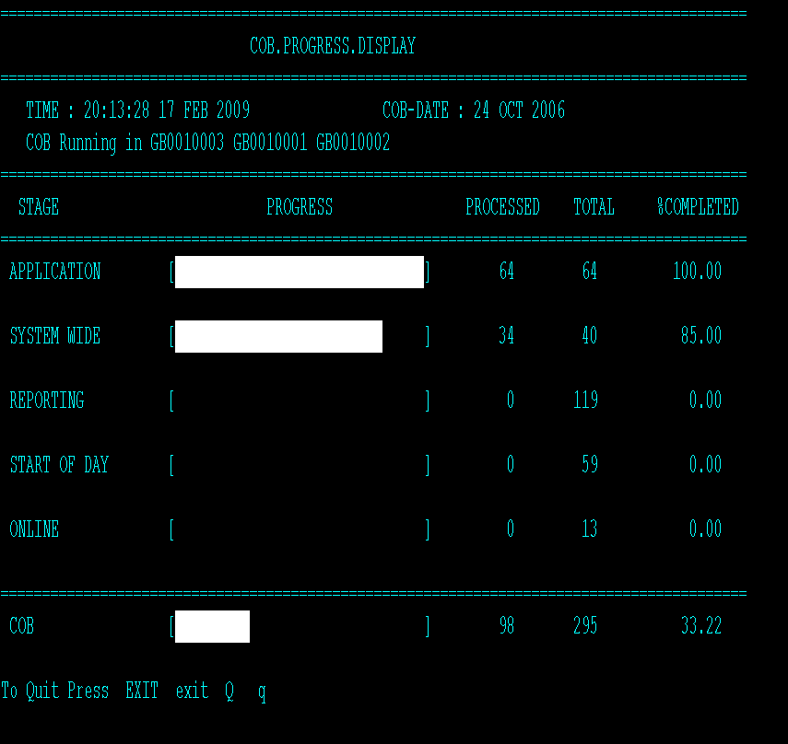
COB.MONITOR
A view of the COB.MONITOR during the COB process.

Slide 39
Monitoring COB - tEC
Enquiries to monitor the progress of COB are
COB.PROGRESS
JOB.PROGRESS
It shows the he records processed with the time taken.
They can be accessed via the Temenos Enterprise Console (tEC).
Enquiries to monitor the status of agents is
AGENT.STATUS

Slide 40
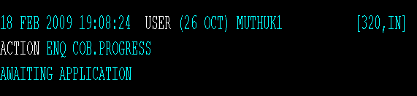
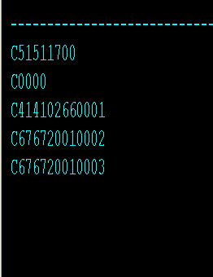
Monitoring COB - tEC
COB.PROGRESS
A listing of active companies and an indication (progress bar) of their time to completion

Slide 41
Monitoring COB - tEC
JOB.PROGRESS
This enquiry lists all active and completed jobs by descending start times (i.e. current on top).
It shows the start time, end time, elapsed time, contracts processed, total contracts to process, throughput (contracts/minute) and individual server rate.
The latter is the number of contracts processed in one minute by a server process
This will be compared historically to see if thee job is slowing down as time passes.

Slide 42
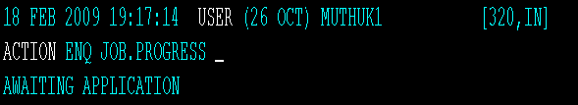
Monitoring COB - tEC
JOB.PROGRESS

Slide 43
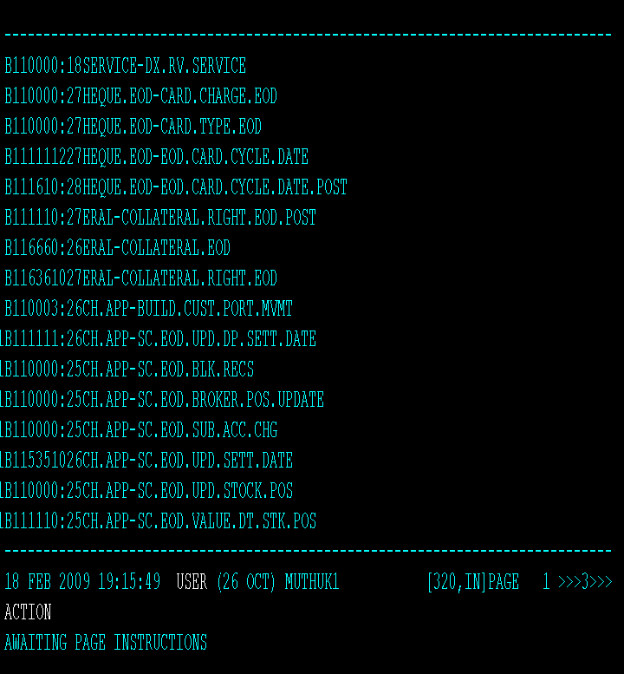
Monitoring COB – JOB.PROGRESS
The output of the Enquiry JOB.PROGRESS

Slide 44
Monitoring COB
AGENT.STATUS
This enquiry lists the CURRENT status of all the agents.
It shows the
Agent ID
Agent Number
Server Name
Name of the server where the agent is running.
Agent Status
Status of the agent

Slide 45
Monitoring COB
Process Id
Operating system level process ID for the agent process that is running
Current Service
The service the agent is performing at the moment.
Next Service
The service the agent is supposed to perform next.
Last Message
Message displayed by the agents which performs the jobs.
Notes:
Current Service - Here the Agent 1 is performing the TSM service and the other agents are performing the service COB
Next Service – While COB is running, if you wish to stop COB, set the field SERVICE.CONTROL to STOP for the record COB in the TSA.SERVICE file. Then, check the NEXT.SERVICE value for the agents running COB, it will be set to STOP denoting that the agents needs to stop once they complete the current transaction
RUNNING – Agent performing the job
STOPPED – Agent has stopped properly.
DEAD – Agent did not report within the time given and hence the tSM has marked the agent as DEAD
Last Message - The agent running tSM will not display any message as it is just monitoring agents.

Slide 46
Monitoring COB
Como Name
Name of the log file that holds the log information of the agent
Job Progress
Status of the jobs
Notes:
Job Progress - 1=Processing Contracts
2=Selecting Contracts
3=Managing Control List
4=Selecting list file
5=Managing Batch record
6=Waiting on list record
7=Processing Single threaded

Slide 47
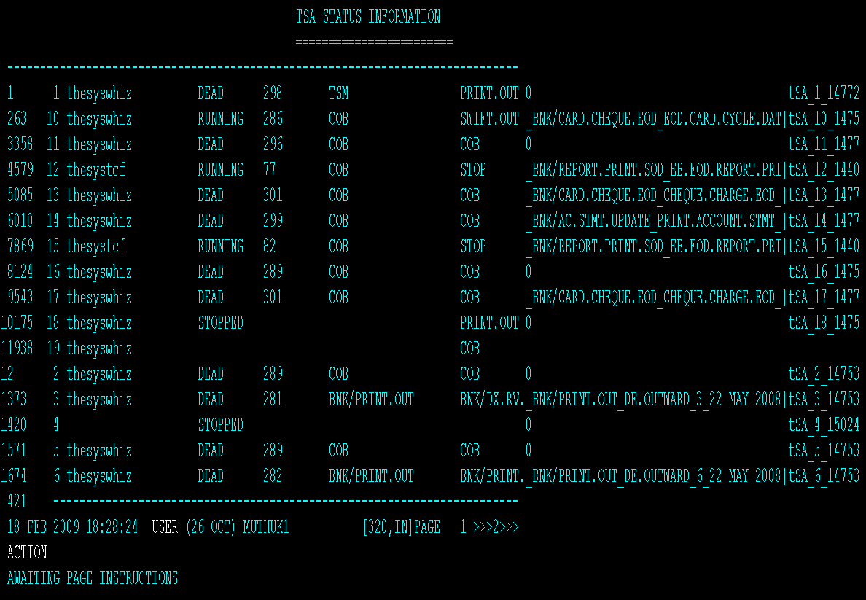
Monitoring COB – AGENT.STATUS
The status of the agents through the Enquiry AGENT.STATUS.
Notes:
Job Progress - 1=Processing Contracts
2=Selecting Contracts
3=Managing Control List
4=Selecting list file
5=Managing Batch record
6=Waiting on list record
7=Processing Single threaded

Slide 48
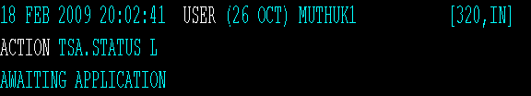
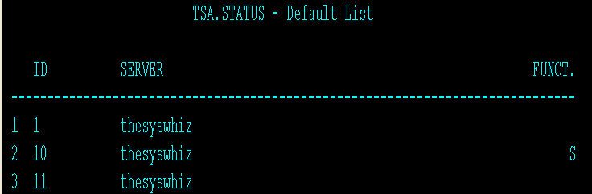
TSA.STATUS
Temenos Service Agents are invoked to run the Service and they run and update the file TSA.STATUS of their progress and status

Slide 49
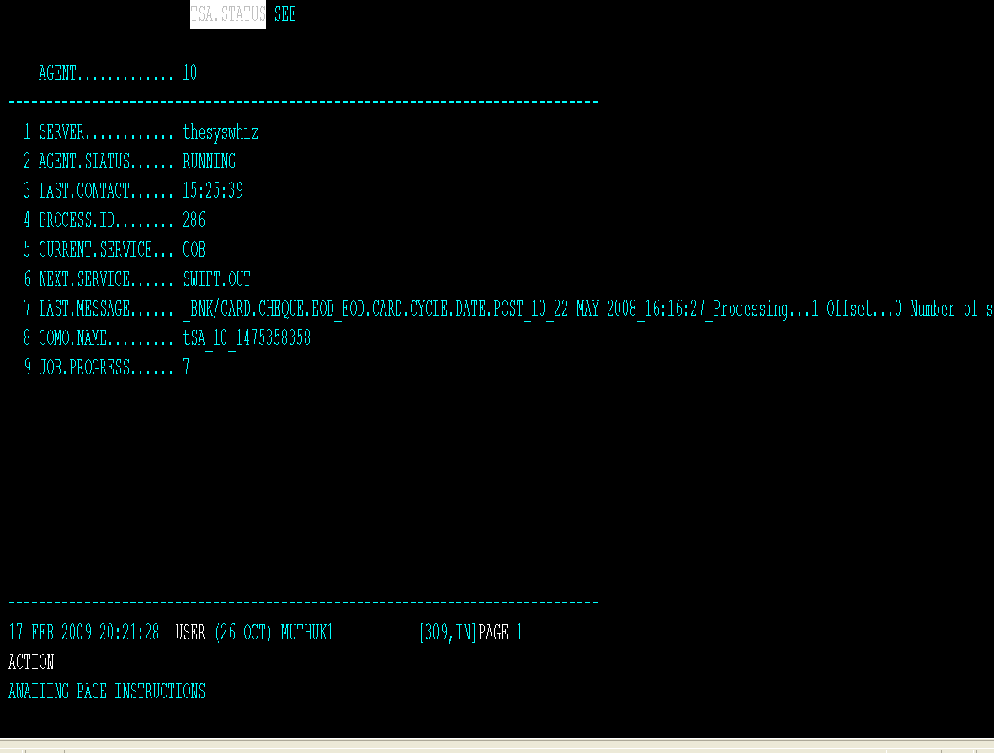
Monitoring COB – TSA.STATUS
The details view of the TSA.STATUS record.
Notes:
Job Progress - 1=Processing Contracts
2=Selecting Contracts
3=Managing Control List
4=Selecting list file
5=Managing Batch record
6=Waiting on list record
7=Processing Single threaded

Slide 50
Date Changes During COB
COB maintains two different records per company in the DATES application.
COB restores the old dates record with the key as the CO.CODE-COB
Ensures that all COB processing happens based on the -COB record in DATES
Online processing happens based on the CO.CODE record in DATES application.

Slide 51
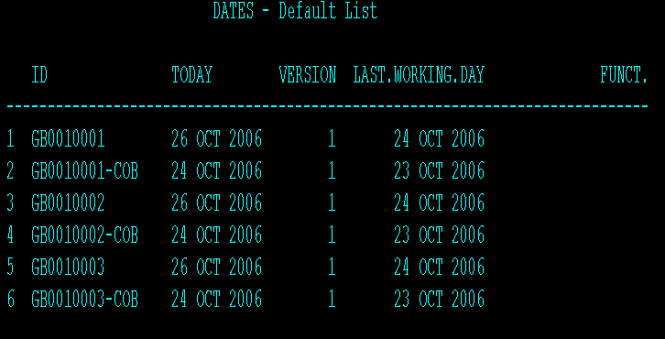
Date Changes During COB
Company Code
Today
Next Working Day
Last Working Day
US0010001
14th July 2004
15th July 2004
13th July 2004
US0010001-COB
13th July 2004
14th July 2004
12th July 2004

Slide 52
Non Stop Process @ COB
Non Stop Processing and Close Of Business complement each other.
Close Of Business disallow input and processing of records in all applications other than one supported by Non-Stop service.
The applications that are available in NS stop service will be available without any restrictions.
They will be using the next working date for processing.
T24 Non stop ensures the concurrent transactions are not picked up by the COB which is running parallel.

Slide 53
Applications That Support NS Processing (Function I And A)
ACCT.INTERIM.CAP
• TABLE.CAPITALISE.CORR
• PAYMENT.STOP
• GROUP.CREDIT.INT
• GROUP.DEBIT.INT
• ACCT.CAPITALISATION
• ACCOUNT.STATEMENT
• GROUP.CAPITALISATION
• ACCT.STATEMENT.CHARGE
• TURNOVER.DEBIT
• TURNOVER.CREDIT
• FUNDS.TRANSFER
• TELLER
• TELLER.ID
• CUSTOMER
• ACCOUNT
• SEC.ACC.MASTER
• SECURITY.MASTER
• CUSTOMER.SECURITY
• STANDING.ORDER
• DATA.CAPTURE
• SC.SETTLEMENT

Slide 54
Applications That Support NS Processing (Function I And A)
• INTEREST.STATEMENT
• ACCOUNT.CREDIT.INT
• ACCOUNT.DEBIT.INT
• ACCOUNT.CLOSURE
• ACCOUNT.DEBIT.LIMIT
• BALANCE.REQUIREMENT
• NOTICE.WITHDRAWAL
• AC.LOCKED.EVENTS
GENERAL.CHARGE
ENTITLEMENT
CURRENCY
FORWARD.RATES
PERIODIC.INTEREST
TRANSACTION.CHARGE
DEBIT.INT.ADDON
HIGHEST.DEBIT

Slide 55
Applications That Support NS Processing (Function I And A) – New Deals Only
• PD.CAPTURE
• PRE.SYNDICATION.FILE
• FACILITY
• SL.LOANS
• SL.CHARGE
• SL.BUY.SELL
• SL.ROLLOVER
• SL.REPAYMENT.SCHEDULES
• SL.FACI.RATES
• SL.RATES.PART
• SWAP
• FRA.DEAL
PD.PAYMENT.DUE
• MM.MONEY.MARKET
• FOREX
• SEC.OPEN.ORDER
• SC.EXE.SEC.ORDERS
• SEC.TRADE
• SECURITY.TRANSFER
• MG.MORTGAGE
• MG.PAYMENT
• LD.LOANS.AND.DEPOSITS
• LD.SCHEDULE.DEFINE
• FD.FID.ORDER
• FD.FIDUCIARY

Slide 56
Error Handling
A process can consist of any number of jobs
A Job can have a number of programs or operating system commands.
If an error occurs
The system may return immediately to the monitor screen and display the process and the job in error
In the case of less severe errors, update the record for the current batch and the current company on the EB.EOD.ERROR file and continue.

Slide 57
Error Handling
The details of these errors can be located in
EB.EOD.ERROR file and
EB.EOD.ERROR.DETAIL file.
In case of any crashes during COB the concerned transaction will be rolled back and the COB will continue.
This ensures that COB can continue after an error and partial updates are rolled back to keep the database in sync.

Slide 58
Error handling
Jobs can abort for a variety of reasons, both system and application orientated
Any system related crashes will be sensed by the TSM and the dead agent will be started again.
In case of no activity in a agent for a period of time as defined in the DEATH.WATCH field of TSA.SERVICE
Then, TSM restarts the agent ensuring that the COB Crashes are monitored and restarted by the Service Manager.

Slide 59
Error Handling
Any application related crashes will written to EB.EOD.ERROR with
The information on the job name
The record and the text of the crash.
The underlying record from the .LIST file will be removed
The updates done till then for the particular transaction will be rolled back.

Slide 60

COMO
Log files get stored under a directory &COMO&
LIST &COMO& to get a lot of log files
JED &COMO& <Log file Name> to view the contents of the log file
Log file ID : tSA_<Agent Number>_<Date and time>
If an agent is restarted, there will be 2 log files for that agent as the log file ID is based on date and time
Log files do not get cleared automatically

Slide 61
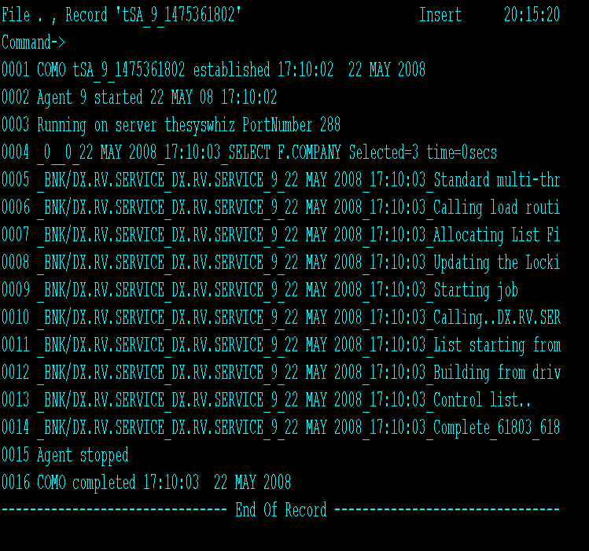
COMO - A View

Slide 62
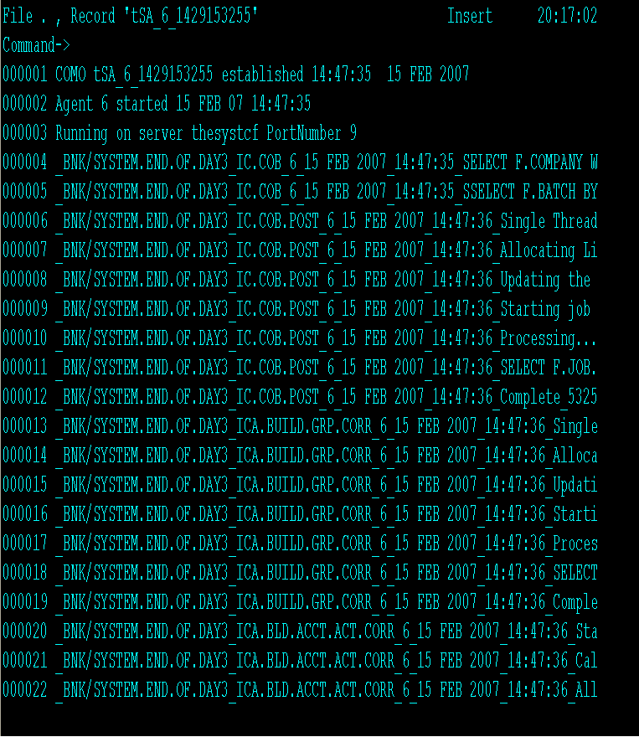
COMO – A View

Slide 63
Error Messages
Error Message | Cause
BATCH NOT COMPLETED YET | You cannot return to online mode until all batch process have been completed
EOD HAS BEEN INITIATED | EOD has already been set
ILLEGAL FREQ FORMAT | Invalid frequency code specified in process
ILLEGAL ORDER | The jobs in the process have been specified in an execution order that is illegal i.e job1 depends on the completion of job 2
INITIALISES ERROR | Job failed during initialization no need to restore the database to re run
INVALID ENTRY, TRY AGAIN | Unknown command at current action level
JOB ERROR | Job terminated with an error see process output
LINE.NO OUT OF RANGE | Row selection number does not have an associated process.
NO ENTRY IN PGM.FILE | Job not defined in PGM.FILE

Slide 64
Error Messages
Error Message | Cause
OPTION INVALID IN ON-LINE | Option from menu cannot be executed until the end of day has been initiated.
PROCESS JOB STATUS IS xxxxx | You cannot start this process when another has failed. Re-run the job in error first.
PROCESS NAME NOT RECOGNISED | Process name entered is not on the BATCH file
PROCESS NOT IN HOLD OR ERROR | Cannot select process to be restarted when the current status is not HOLD or ERROR
PROCESS NOT IN RUN STATE | Cannot select a process to be halted when the current status is RUNNING
PROCESS NOT PRESENT | Unknown process name entered from action line.
REC MISSING | Fatal error during process execution – see process output for more detail
RESTORE DB | Database must be restored to re-run this job
UNKNOWN JOB IN PGM.FILE | Job not defined in PGM.FILE

Slide 65
How to add a JOB to a Batch
Write a routine compile and catalog it
Create a PGM entry for the routine with “S” type.
Now edit the Batch in input mode and enter the routine name in the JOB.NAME field.
Commit and authorise the batch.
Next slide depicts a batch is opened in the Input mode for adding a new batch

Slide 66
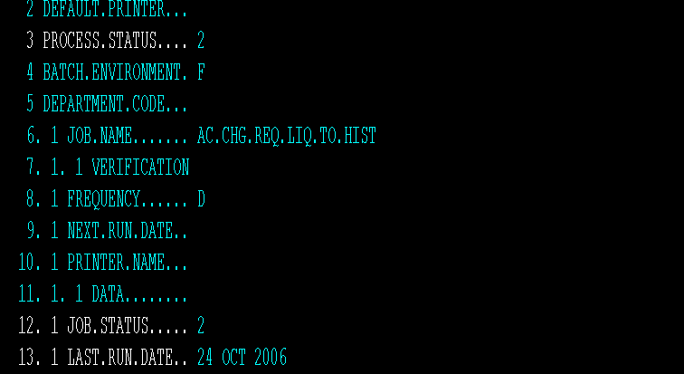
BATCH – Adding A JOB

Slide 67
How to add a JOB to a Batch
Next slide depicts the addition of the job BR.EOD.LIQ.TO.HIS in a existing batch.

Slide 68
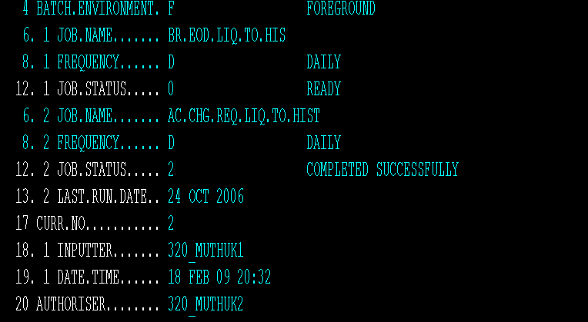
BATCH – Adding A JOB

Slide 69
How to remove a JOB from a Batch
Removing a job from a Batch can be done in 2 ways
By removing the Job (routine name) from the Batch by deleting the multivalue field JOB.NAME.
By making the particular job’s frequency as “Adhoc” by entering the frequency as “A”.

Slide 70
How to remove a JOB from a Batch – Method 1
Edit the Batch in Input mode and delete the multivalue field JOB.NAME of the particular job.
Commit and authorise and now the Batch will exclude the particular job.
Next slide shows the status of the batch with the job BR.EOD.LIQ.TO.HIS opened in the Input mode.

Slide 71
BATCH – Removing A JOB

Slide 72
How to remove a JOB from a Batch – Method 1
Next slide depicts that the job BR.EOD.LIQ.TO.HIS is removed from the batch.

Slide 73
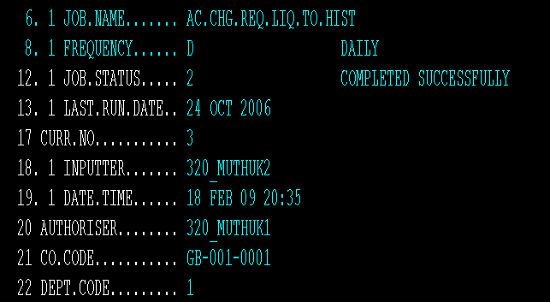
BATCH – Removing a JOB

Slide 74
How to remove a JOB from a Batch – Method 2
Edit the Batch in Input mode and make the particular job frequency as “A” (Adhoc)
Commit and authorise and now the Batch will exclude the particular job while the batch is called.
Next slide shows the status of the batch with the job BR.EOD.LIQ.TO.HIS opened in the Input mode.
The FREQUENCY field for the JOB.NAME field BR.EOD.LIQ.TO.HIS is set to “A” (Adhoc)

Slide 75
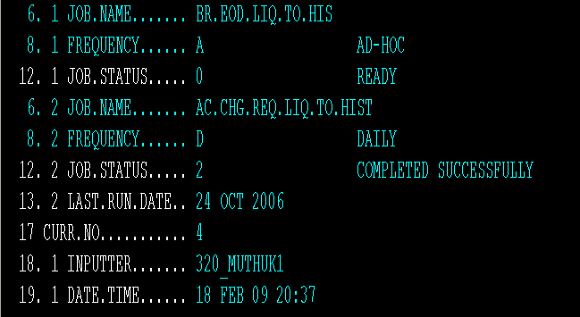
BATCH – Removing a JOB (by Ad Hoc)

Slide 76
Workshop 1
Create a COB record and run the COB with 5 agents
Check the Progress of the COB process
Check the dates change
Check the status of the Agents
Document and Analyse the process of all 5 agents
Troubleshoot and Document if any error occurs.
Notes:
Job Progress - 1=Processing Contracts
2=Selecting Contracts
3=Managing Control List
4=Selecting list file
5=Managing Batch record
6=Waiting on list record
7=Processing Single threaded

Slide 77


www.capgemini.com/financialservices

