Slide 1
ARRANGEMENT ARCHITECTURE Product Setup & Technical usage
Temenos-T24
By
Iyyappan Rajagopal
Dinesh Bogunuva Raja

Slide 2
Introduction
This document helps the user to understand about the functionality of Arrangement Architecture (AA) and flow of product setup and technical aspects in AA.

Slide 3
Components of AA
In AA, we have 5 major components are below,
Product Line – Defined by Temenos
Product Group – Provides a structure to the product
Product - Master table for designing any product
Property class – Building blocks
Property – Triggered and validated in arrangement

Slide 4
Flow of AA
From 5 major components, 3 are available under “Products” link and remaining 2 under “Product Conditions”.

Slide 5
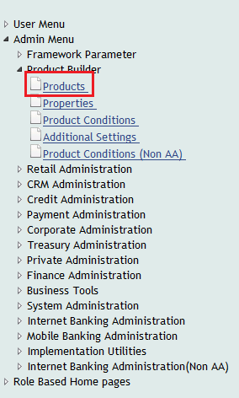
Products Menu

Slide 6
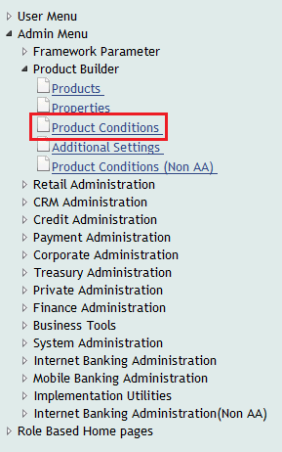
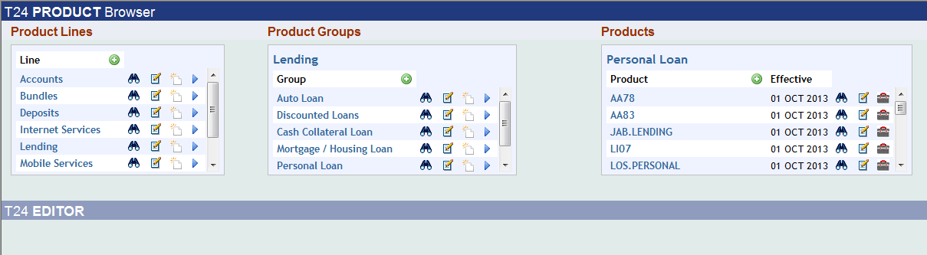
Product Conditions screen

Slide 7
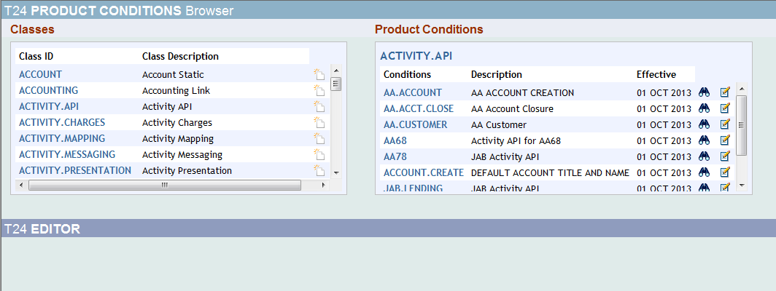
Product Line and Product Group
In the above components, Product Line and Product Group will be created only by Temenos. In other components, we will be able to define conditions.

Slide 8
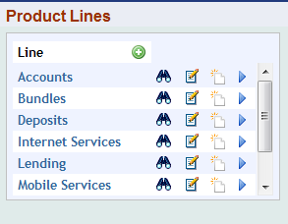
Product Line
Product Line is a high level definition of the business component.
It is where we select the purpose of what we are going to do. If we wish to get a loan, then we will go with “Lending” product line. If we wish to deposit, then we select “Deposits” product line.

Slide 9
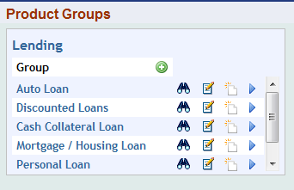
Product Group
Product group provides basic shape to the product. This is where we will select which loan we are going to take. For example: if we wish to take personal loan, we will select “Personal Loan” product group.

Slide 10
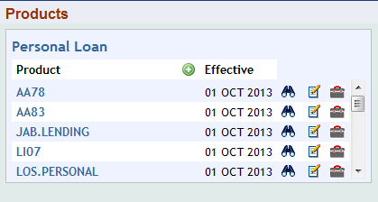
Product
This is where the user links the desired properties to appropriate conditions.
For the product group we selected, we will have different products to use. In this product, we will define the conditions about how the product should behave.

Slide 11
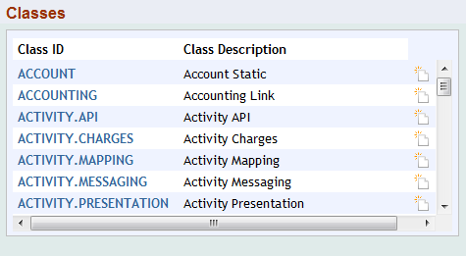
Product Class
Class is where will have set of activities to behave.
Some major used classes are ACTIVITY.API and ACTIVITY.PRESENTATION.

Slide 12
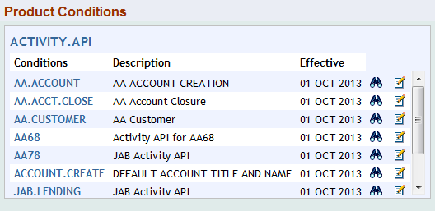
Product Conditions
Product Condition is where we will define the behavior.

Slide 13
Defining conditions
In the product condition, we will define conditions for classes. For the respective class, there will be some set of conditions to define the class.
For example: We are considering ACTIVITY.API, we have to create or modify to define conditions.
Some of the frequently used classes are given below:

Slide 14
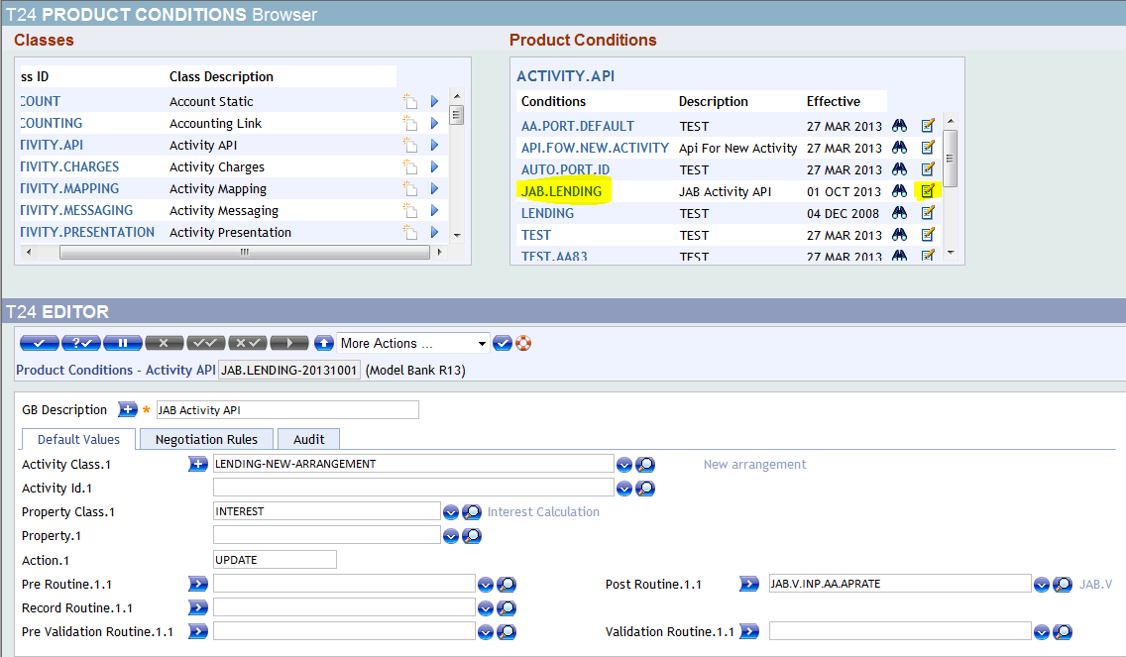
ACTIVITY.API
It is used to define properties which have more than one pre/post routines.
In this ACTIVITY.API we have to attach routines.
Here, user can define ACTIVITY, PROPERTY.CLASS and ACTION.

Slide 15
Define Routines
In order to define our local routines we have to provide valid Activity Class / Activity ID along with the Property class/ Property along with Action.
We can define routines under following sections.
Record routine – Triggered when record opens
Pre validation routine – Triggered before validating the record
Validation routine – Triggered during validation
Pre routine – Triggered before required action takes place
Post routine – Triggered after required action takes place
From the above screenshot our routine will get triggerred whenever the user updates the values in the Interest tab/section for a new a Lending contract.
The below screenshot product setup shows the Record , Validation and Post routine attached in the JAB.LENDING product.

Slide 16
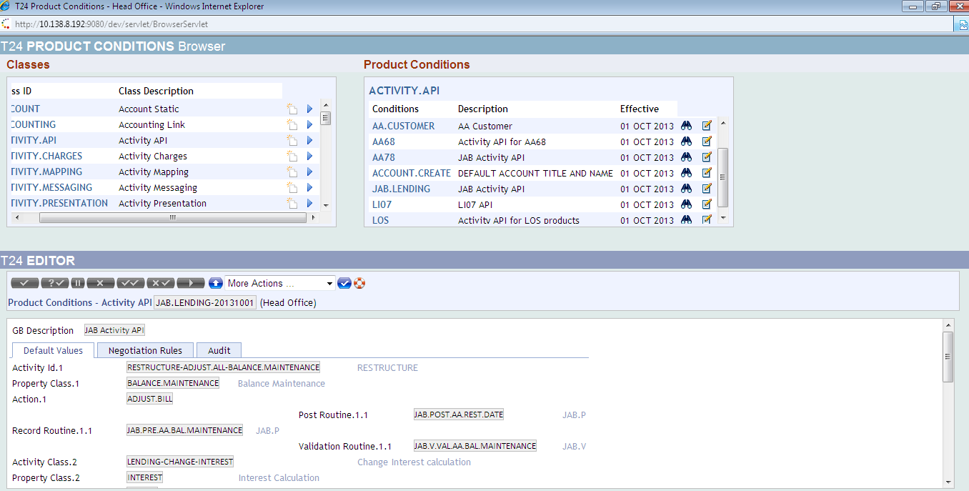
AA Product Conditions

Slide 17
Validation routine
From the above screenshot our routine will get triggered whenever the user adjust the bill then validate the record for a “RESTRUCTURE-ADJUST-ALL-BALANCE-MAINTAINTENANCE” activity and Action– “ADJUST-BILL”.

Slide 18
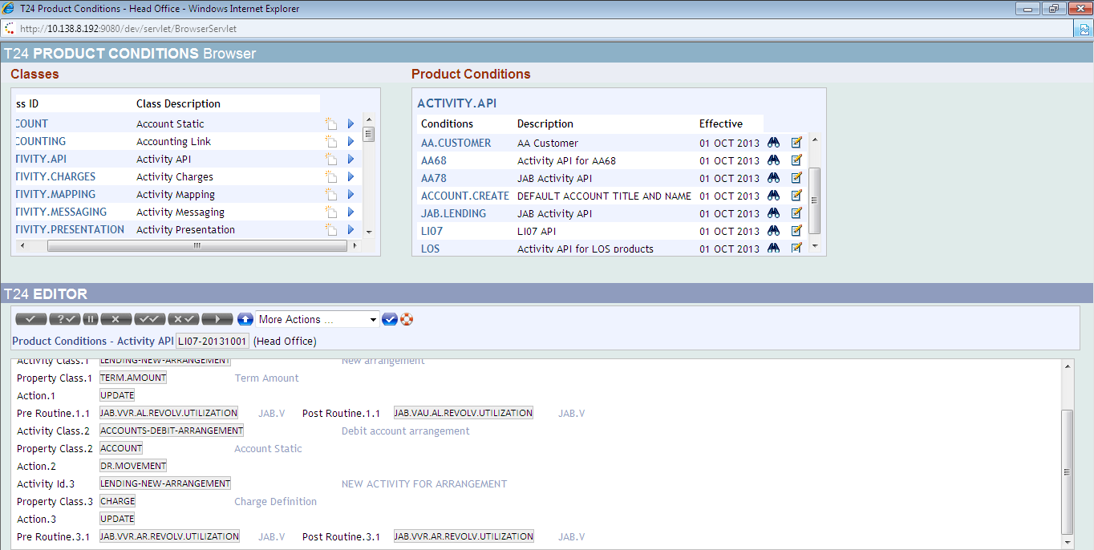
Pre Routine:
From the above screenshot our routine will get triggered whenever the user opens the record and updates in the Charge tab/section for a new a Lending contract.

Slide 19
Post Routine
Post routine is triggered both UNAUTH and AUTH status for a Lending New Arrangement .
Local routine to perform the required action is attached as Post routine in JAB.LENDING product.

Slide 20
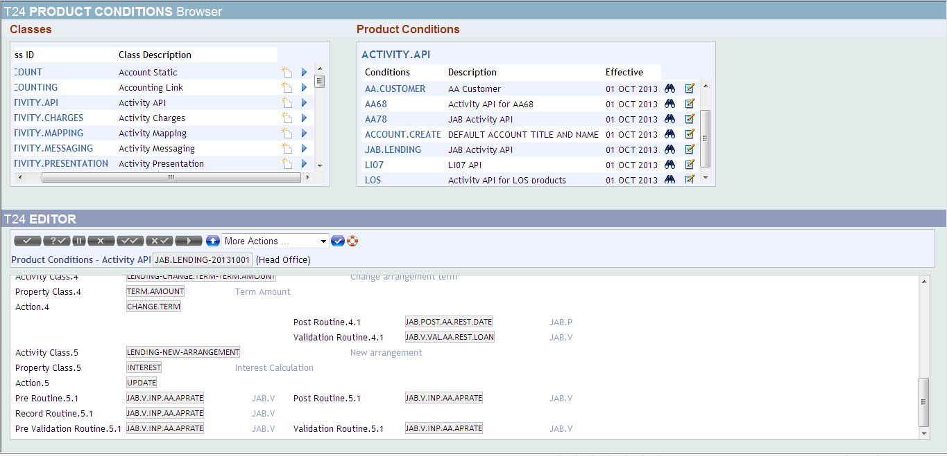
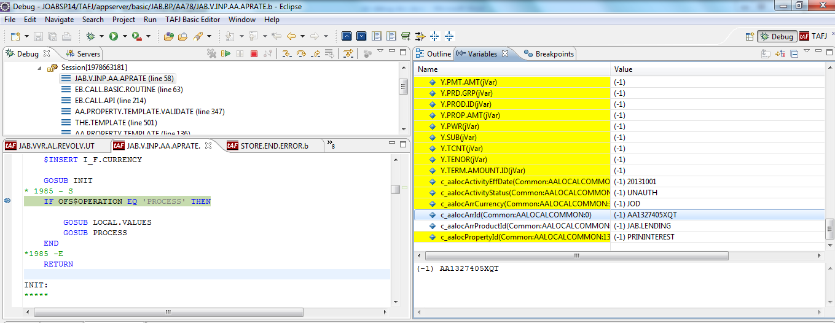
The below screenshot shows the post routine triggered with “UNAUTH” status,

Slide 21
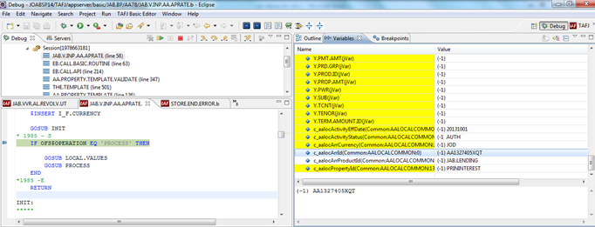
AUTH Status
The below screenshot shows the post routine triggered with “AUTH” status,

Slide 22
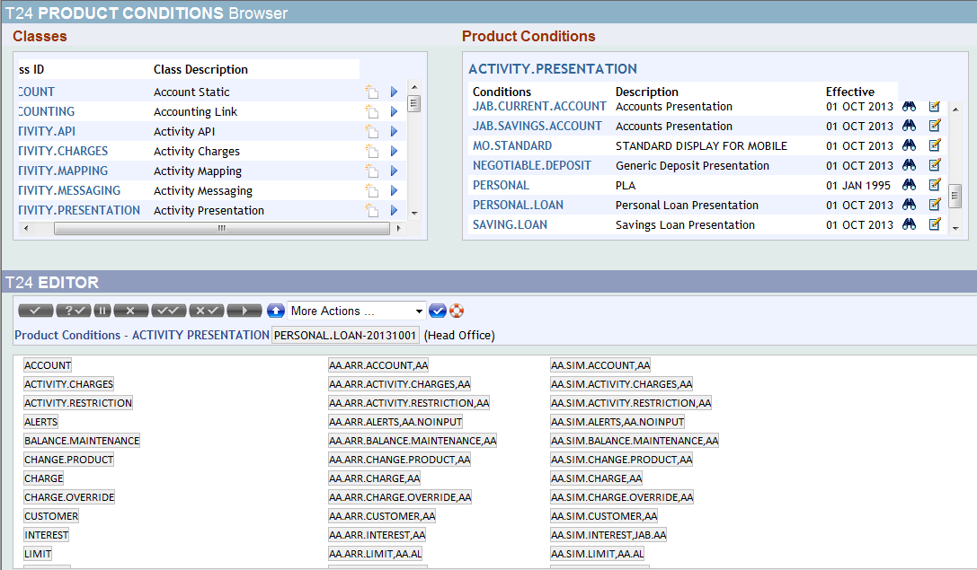
ACTIVITY.PRESENTATION
It is used for defining various versions in a single screen which will be used for different Property classes/Properties/Activities during an entry.
Here, we will attach VERSIONS

Slide 23
ACTIVITY.CHARGES
It defines the charge that needs to be applied when activity is triggered.
For example:
If we increase/decrease Term amount (LENDING-INCREASE-TERM.AMOUNT/LENDING-DECREASE-TERM.AMOUNT) in an arrangement, corresponding charge property will be called which was defined in Property conditions.

Slide 24
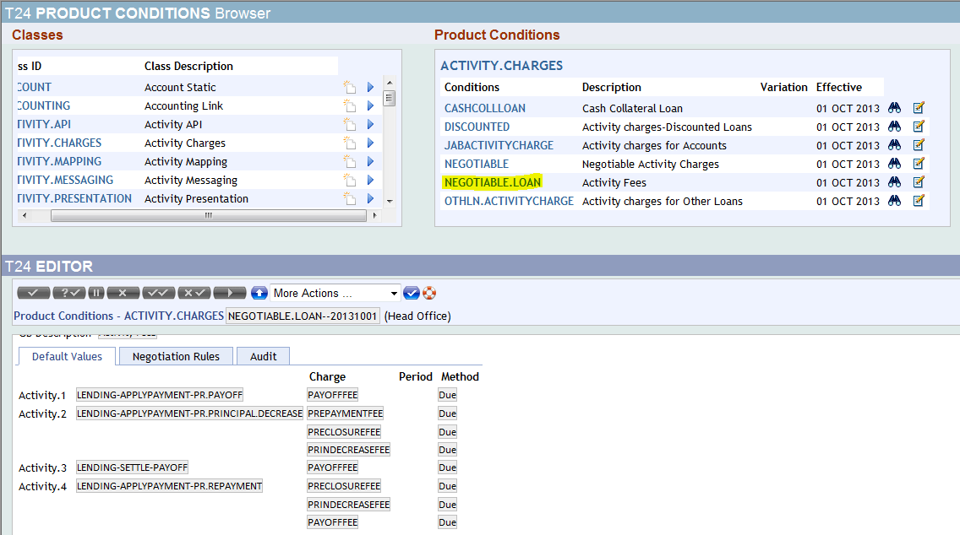
ACTIVITY CHARGES

Slide 25
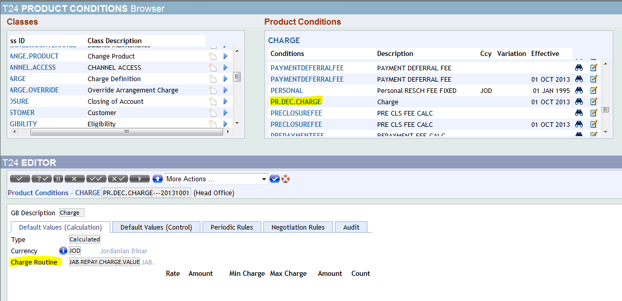
CHARGE
This property is used to define charges. This property class can be added to PAYMENT SCHEDULE property class for defining scheduled charges. To define charges related to an activity this class can be used in ACTIVITY CHARGE property class.
Charge routine field is used to define calculation as required by user. Usually, we will attach routine in this field to calculate charge.

Slide 26
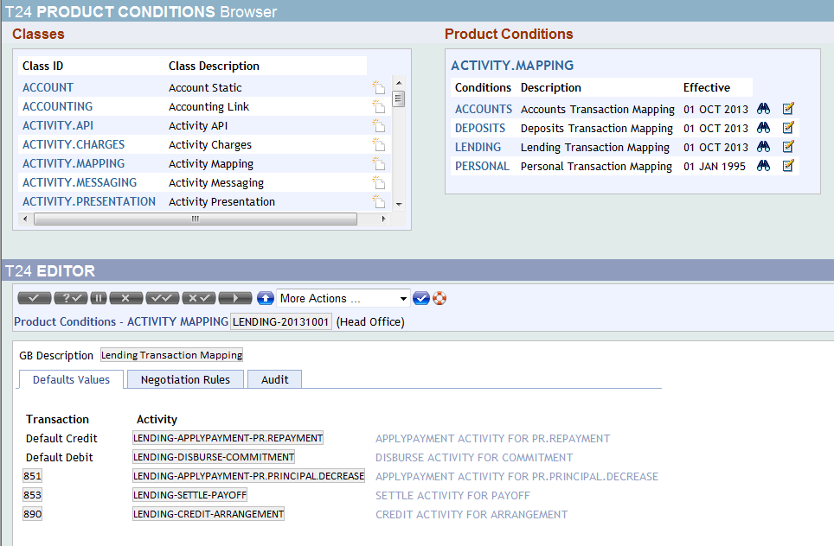
ACTIVITY.MAPPING
In this property class, we will define about which transaction code to be hit during respective activities.

Slide 27
Product setup flow of AA
While setting up the product, we have to consider Property classes and Property conditions in Product Group and Product respectively.
For example: Please see the below screenshots showing flow of attaching API to product.
Lending -> Personal Loan (View) -> Activity API -> API

Slide 28
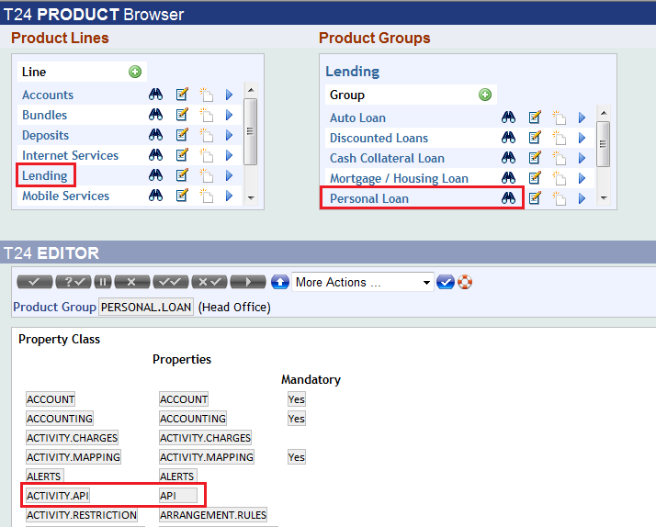
T24 Product
In the above screenshot, Property class is ACTIVITY.API and the id given for this property class is API. This should be given in the Property Condition.

Slide 29
New Arrangement Architecture
While creating a new Arrangement Architecture, it displays multiple Product groups and Product.
Every Product Groups contains different Products.
Please find below the product groups and products in the product catalog which is defined in the products and product conditions.

Slide 30
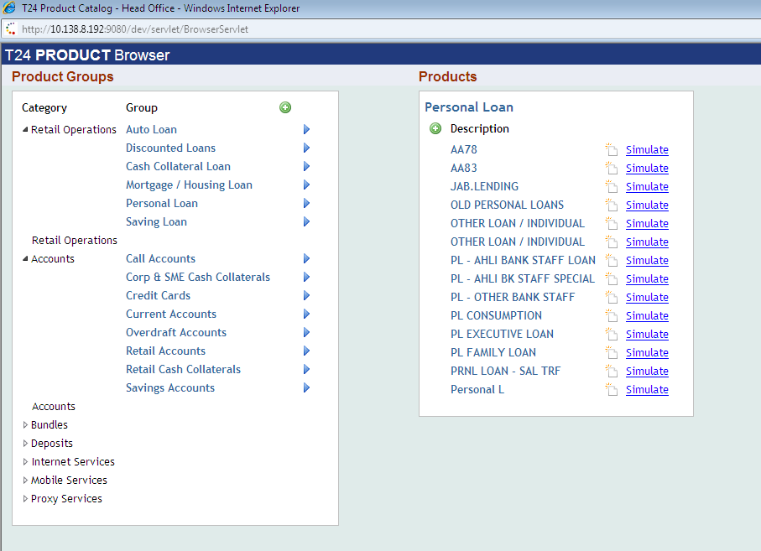
Product Groups & Products

Slide 31
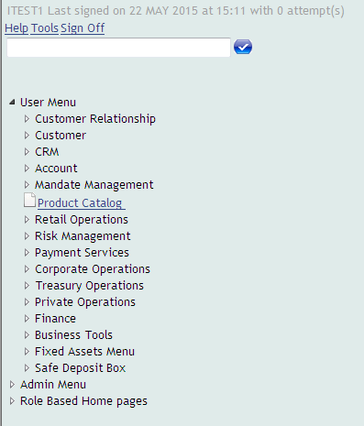
Create New Arrangement Architecture
To create New Arrangement Architecture via T24 browser, follow the below steps
Click on User Menu -> Product Catalog

Slide 32
Pop up window will be opened, Choose Product Group as Personal Loan & Product as Other Loan

Slide 33
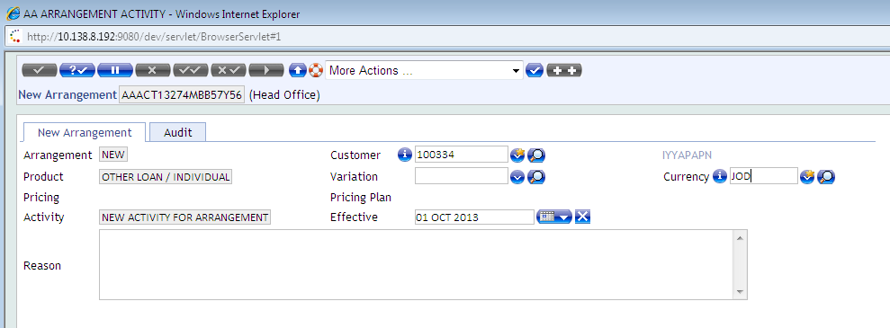
New Arrangement Screen
Enter your Customer id and Currency details in the above screen and validate the record, it will open up the arrangement screen to define values.

Slide 34
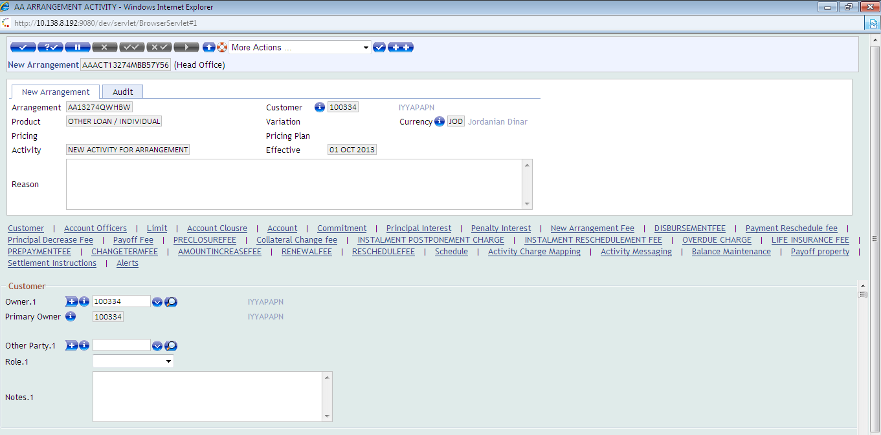
New Arrangement

Slide 35
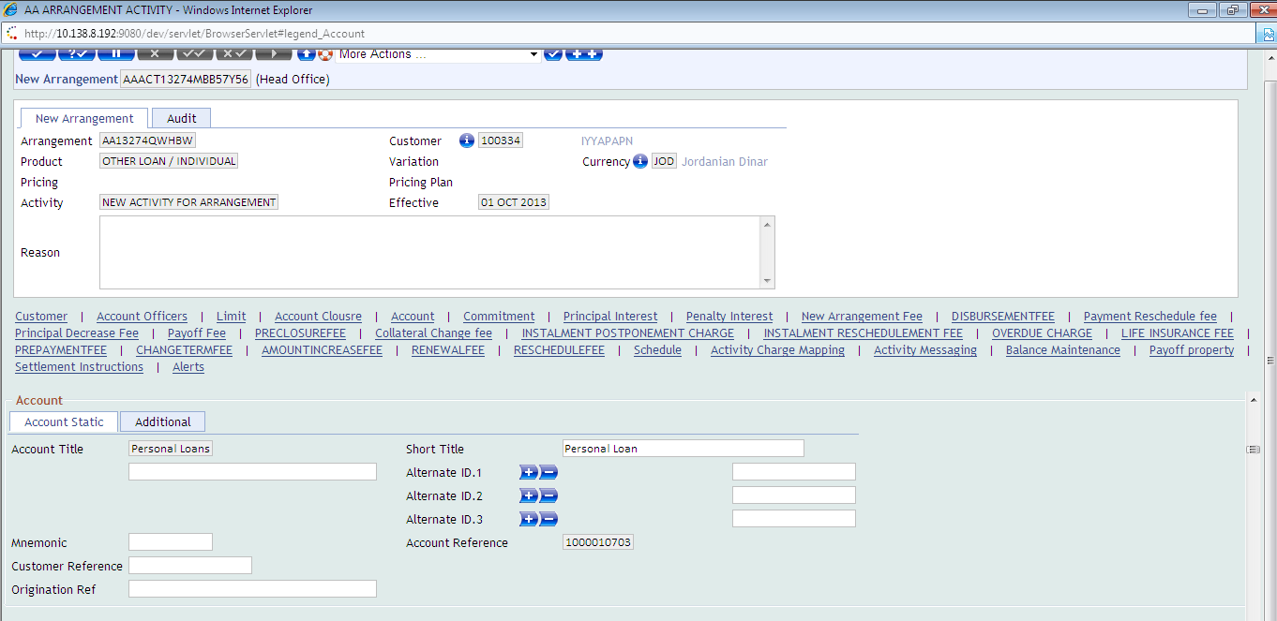
Account Tab
Mandatory input fields are -Term Amount and Penalty interest (Fixed rate)

Slide 36
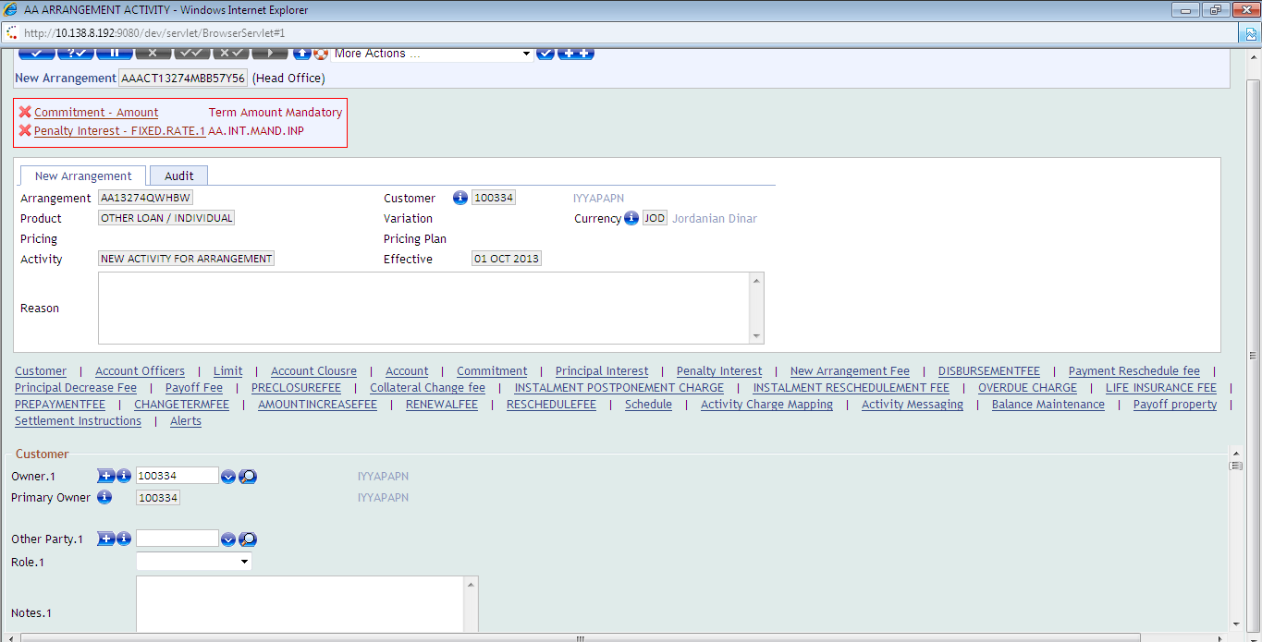
Mandatory Fields
The below errors are raised in product conditions which is defined in the product conditions,

Slide 37
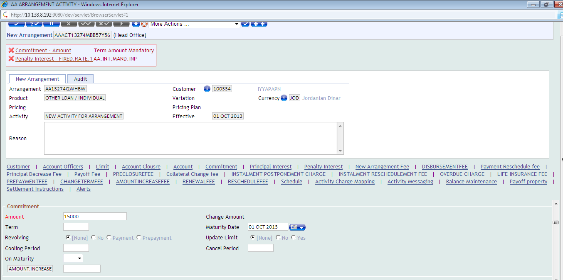
Commitment tab:
Input the term amount of the loan,

Slide 38
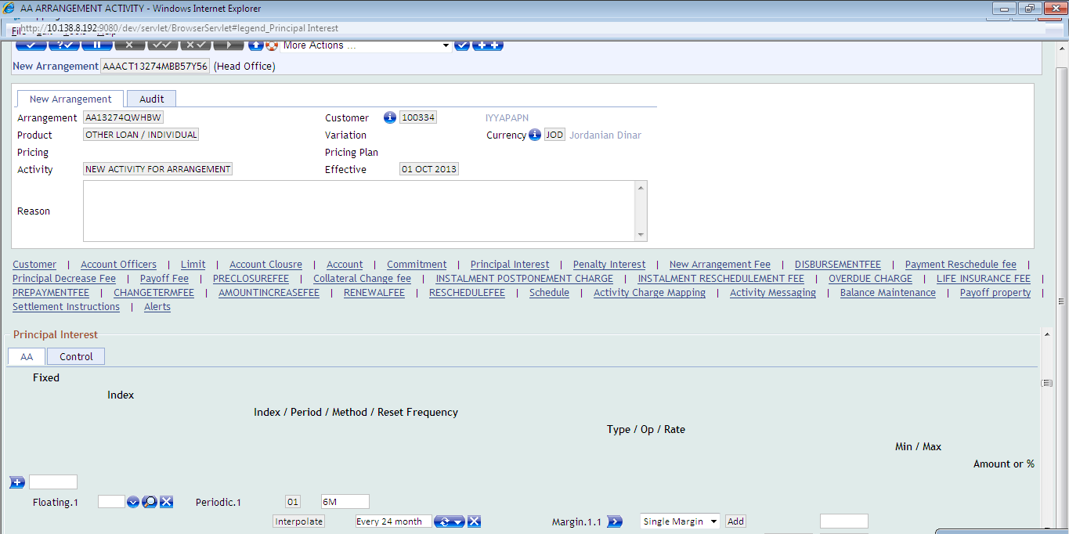
Principal Interest tab
Principal interest values are defaulted from product conditions,

Slide 39
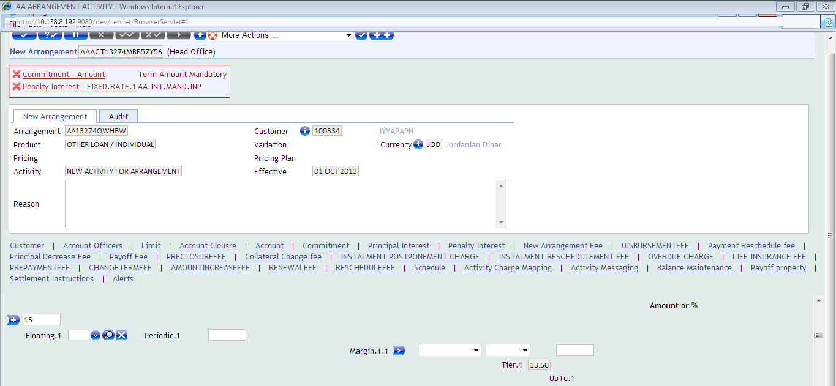
Penalty Interest tab:
Penalty interest values are defaulted from product conditions,

Slide 40
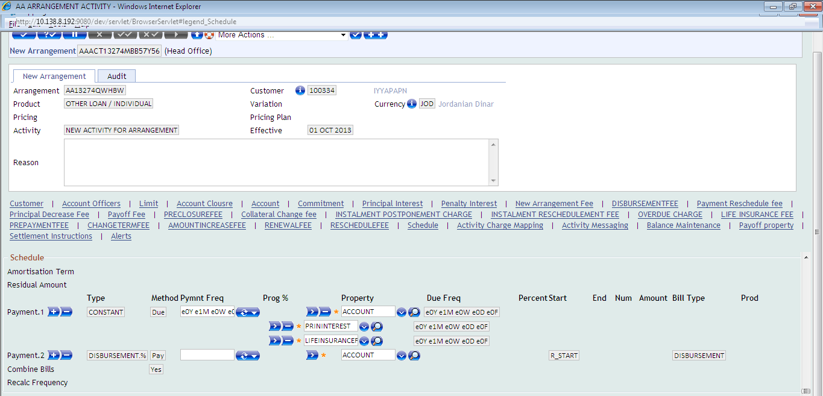
Schedule for the respective arrangement architecture
Here defined the Payment type, Method, Property & Frequency.

Slide 41
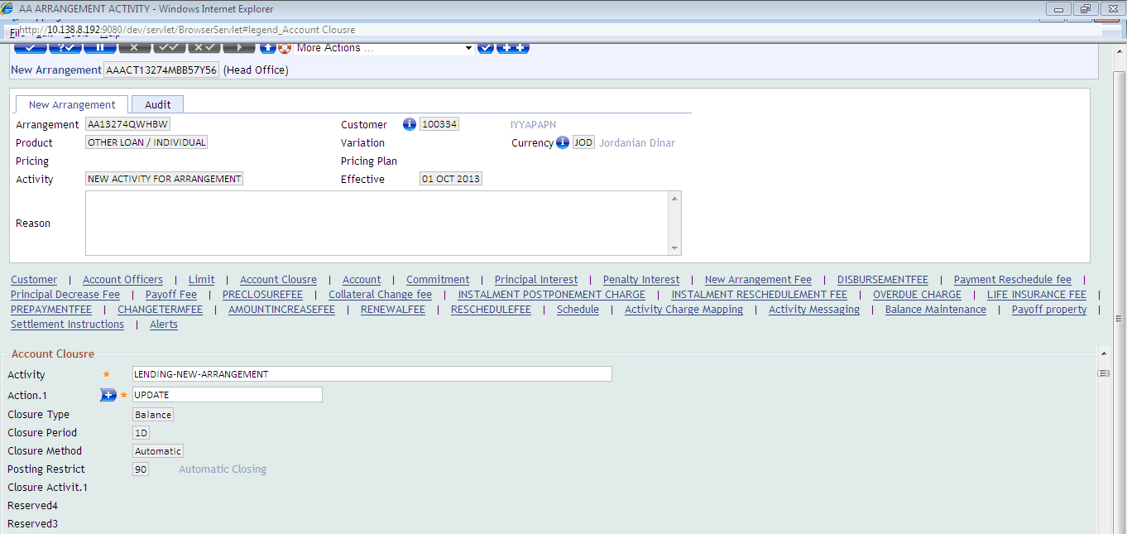
Account Closure
In account closure Activity and action fields are defaulted based on the Product & Product condition’s Setup.

Slide 42
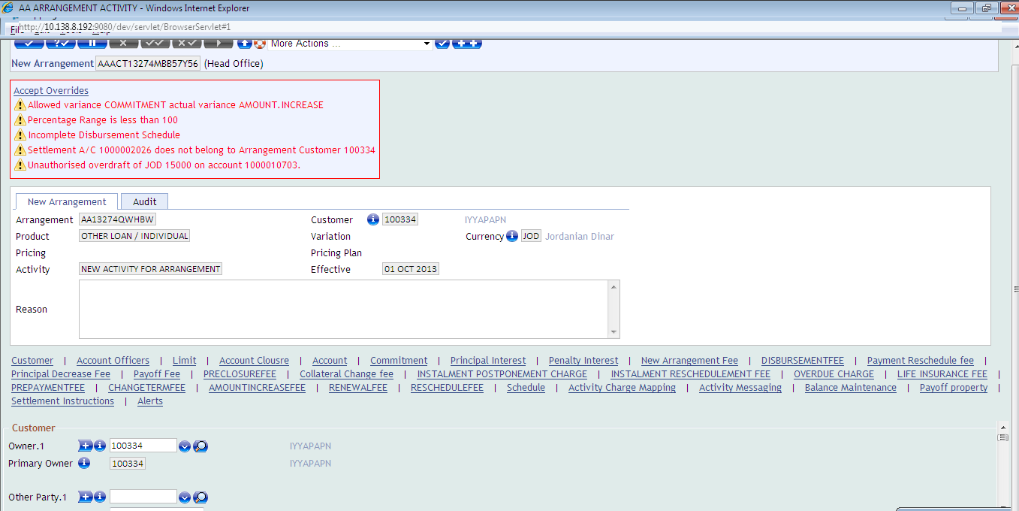
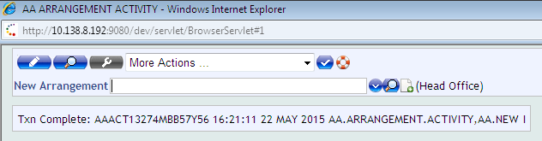
Commit AA record
After committing the record,

Slide 43
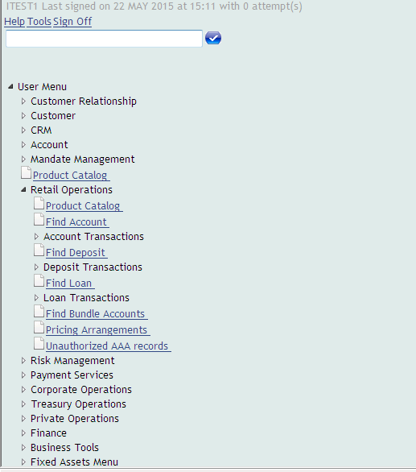
Find AA Loan / Authorize the AA Loan
Once Commit the AA record, then find the loan/ authorize the record.
Click user Menu - > Find Loan

Slide 44
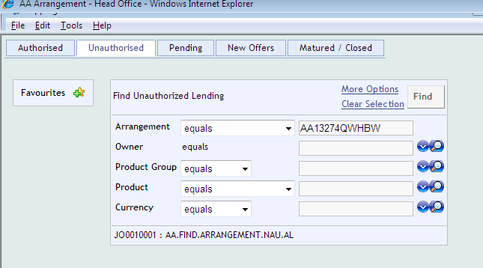
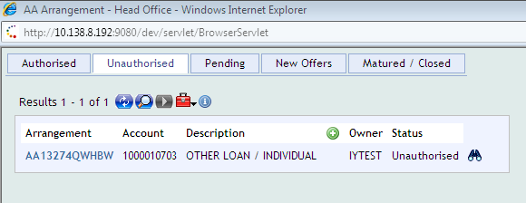
Find AA Loan Select Unauthorized AAA tab, For Ex : Input the Arrangement id - AA13274QWHBW

Slide 45
Arrangement Overview of the AA record
AA record displays below details are,
Arrangement ID - AA arrangement ID
Account - AA account
Arrangement conditions – Contains Product Group and Product details
Principal & Penalty Interest
Schedule - Contains the charges of Life insurance and interest
Account details – Commitment, start & maturity date details
Pending Activities – Unauth records are list down in the additional Details & Approve the AA record.
Activity Log – Listed the triggered activities in the Arrangement.

Slide 46
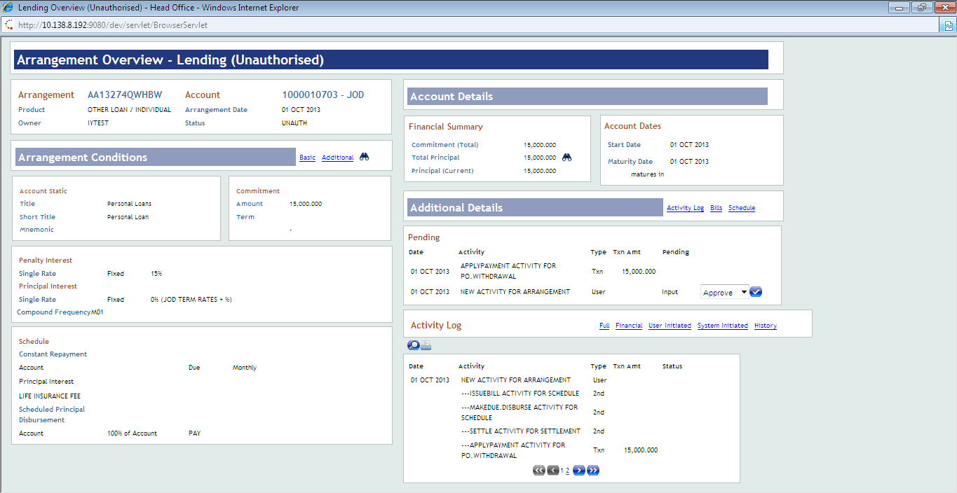
Arrangement overview screen

Slide 47
Authorise AA record
Authorize the AA record,
In the Additional Details tab, displays the pending activities,
Select the “Approve” option and commit, after Popup window will be opened,

Slide 48
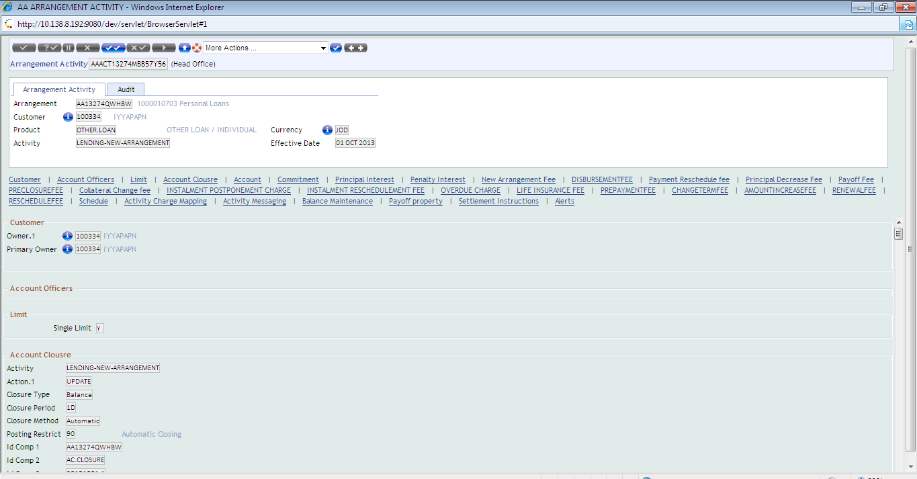
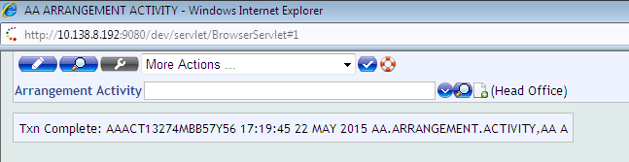
Authorisation Screen

Slide 49
Commonly used Insert file and common variables in AA
These insert files and common variable are used to find the AA record details.
Insert Files
$INSERT I_F.AA.INTEREST
$INSERT I_F.AA.TERM.AMOUNT
$INSERT I_F.AA.ACTIVITY.HISTORY
$INSERT I_F.AA.ARRANGEMENT.ACTIVITY
$INSERT I_AA.LOCAL.COMMON
$INSERT I_AA.APP.COMMON
$INSERT I_F.AA.PRODUCT
$INSERT I_AA.ACTION.CONTEXT
$INSERT I_F.AA.TERM.AMOUNT
$INSERT I_F.AA.LIMIT

Slide 50
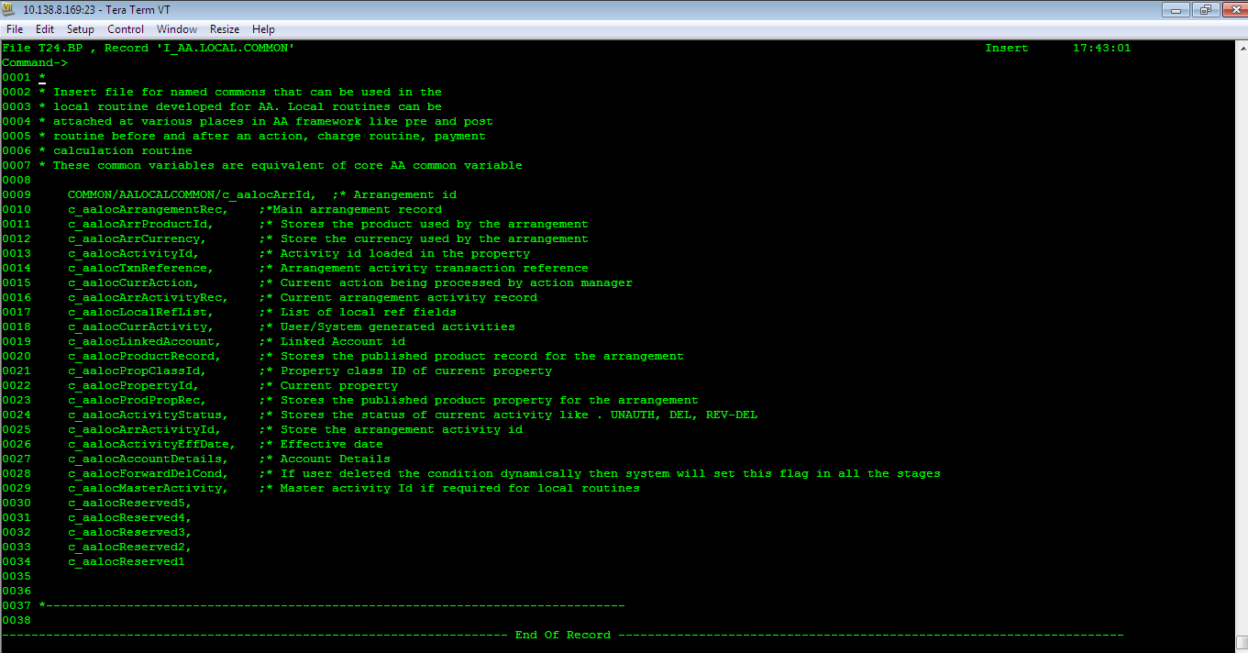
Common Variables
For Ex: Find below the common variables of I_F.AA.LOCAL.COMMON,

Slide 51
c_aalocArrProductId - The above contract shows product id is “OTHER LOAN/INDIVIDUAL”
c_aalocArrCurrency - Currency “JOD”
c_aalocActivityId – Activity ID “AAACT13274MBB57Y56”
c_aalocLinkedAccount – Linked acc no – “1000010703”
c_aalocArrId - Arrangement ID “AA13274QWHBW”
c_aalocActivityStatus – Like “UNAUTH” , “REVERSE” ,”DELETE”, “AUTH”
c_aalocPropertyId – Like “PRININTEREST”
c_aalocPropClassId – Like “TERM.AMOUNT”
Likewise, above mentioned AA Insert files are having many common variables.

Slide 52
Property Classes
For reading the AA record is different from the normal read command (CALL F.READ()),
Initially we need to get the Arrangement ID.
Mostly used property classes are,
CLOSURE
CUSTOMER
INTEREST
LIMIT
TERM.AMOUNT
OFFICERS
PERIODIC.CHARGES
SETTLEMENT
BALANCE.MAINTENANCE
CHARGE.OVERRIDE
CHARGE

Slide 53
AA Subroutine
Initially get the Arrangement Id to process the Property class find below details of the routine,
Reading the property class
Initially get the arrangement using common variable – “c_allocArrId” and read the AA.ACTIVITY.HISTORY table to get the Arrangement Activity id.
Used common variables are – “c_allocArrId”, “c_allocActivityEffDate”
The below routine used the Core API – AA.GET.ARRANGEMENT.CONDITIONS to read and write the AA record.
Total Arguments - 7
Passed Arguments are – Arrangement ID, Prop class, Property, R.Conditions and Err message.

Slide 54
RAISE Conditions:
RAISE(R.CONDITION) is used to get the values for the defined property class “TERM.AMOUNT”.
The below routine to get the Amount, tenor, and maturity date of the Term amount property class values.

Slide 55
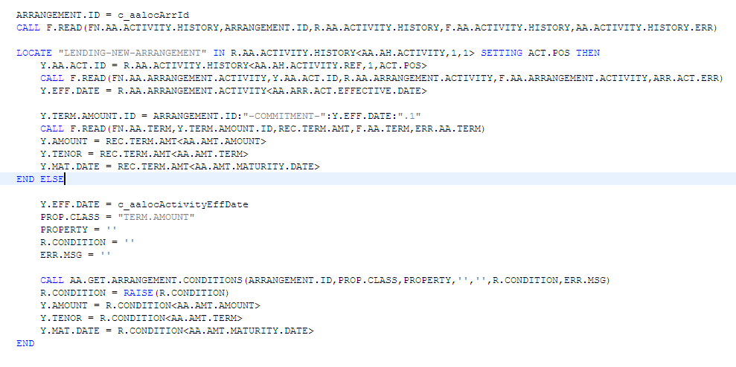
Routine Flow
Using this we can get the records for the tables or any property class

Slide 56
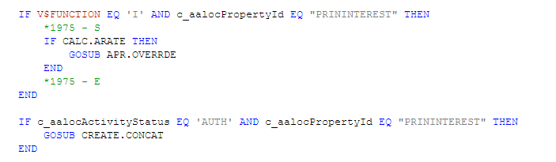
Common variables
Below Common variables are used to check the conditions,

Slide 57
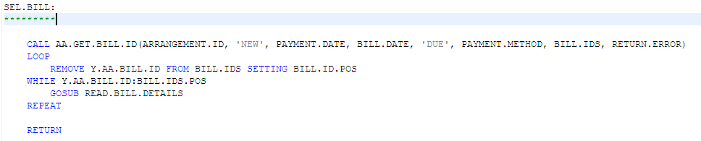
Select Command in the AA record:
The below example is used to select the AA Bill record by using the Core API – AA.GET.BILL.ID
Total Passed Arguments - 8

Slide 58
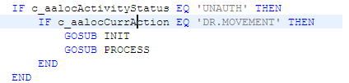
Reversal Logic in AA record
Common variable – “c_aalocCurrAction” to get the Current AA action in the AA record,

Slide 59
Updating fields in AA
Authorizing the record:
For updating fields, use below logic, instead of using F.WRITE api,
R.AA.ACC.RECORD<AA.AC.LOCAL.REF,Y.RESTRUCT.DATE.POS,Y.CNT+1> = TODAY R.AA.ACC.RECORD<AA.AC.LOCAL.REF,Y.END.DATE.POS,Y.CNT+1> = Y.DATE
The below condition is used to check the status of the record ,
REQD.PROCESS = c_arrActivityStatus["-",1,1]
REQD.PROCESS EQ 'UNAUTH' then
Below API “AA.ACTION.LIST.MANAGER” is used to “APPEND” the fields like OFS process.
CALL AA.ACTION.LIST.MANAGER("APPEND", "", "", "")

Slide 60
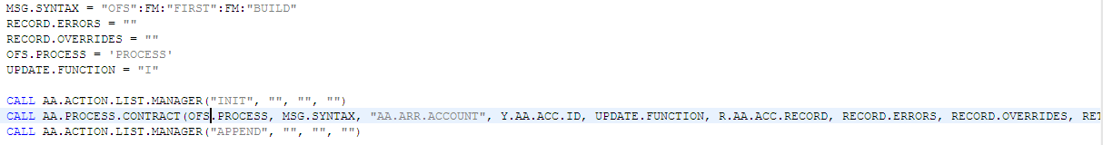
Updating existing record
The below logics are used to updating the existing records ,
REQD.PROCESS = c_arrActivityStatus["-",1,1]
REQD.PROCESS EQ 'AUTH' then
CALL AA.ACTION.LIST.MANAGER("INSERT", "", "", "")
Below API “AA.ACTION.LIST.MANAGER” is used to “INSERT” the fields like OFS process.

Slide 61
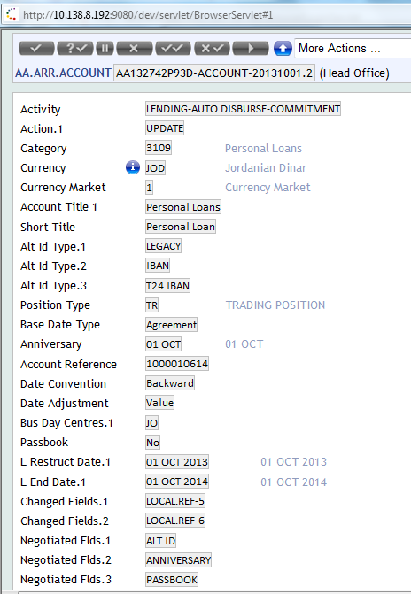
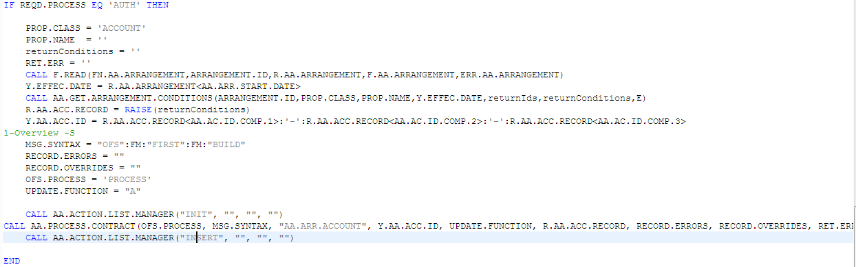
Updated Restructure date & End date below

Slide 62
T24 Browser Level debug in TAFJ for AA routine
Browser Listener
Initially start the browser.Listener in the Eclipse then input the contract in the T24 Browser.
If the routine is attached, then during the respective activity routine is triggered which is attached (like POST, PRE and Validation routine) in the products setup.

Slide 63
Variables Tab
Below the AA Routine triggered for the respective AA activity.
Already mentioned the AA common variable in the section- 7.2
AA Variables and Values:
In the variables tab, find the values of the AA common variables,
For Ex:
c_aalocActivityStatus - DELETE
c_aalocCurrAction - DR.MOVEMENT.
c_aalocArrCurrency - JOD
c_aalocPropertyId - PRININTEREST
c_aalocArrProductId - JAB.LENDING
While processing batch in COB/ONLINE, Activity Status is like UNAUTH or DELETE.

Slide 64
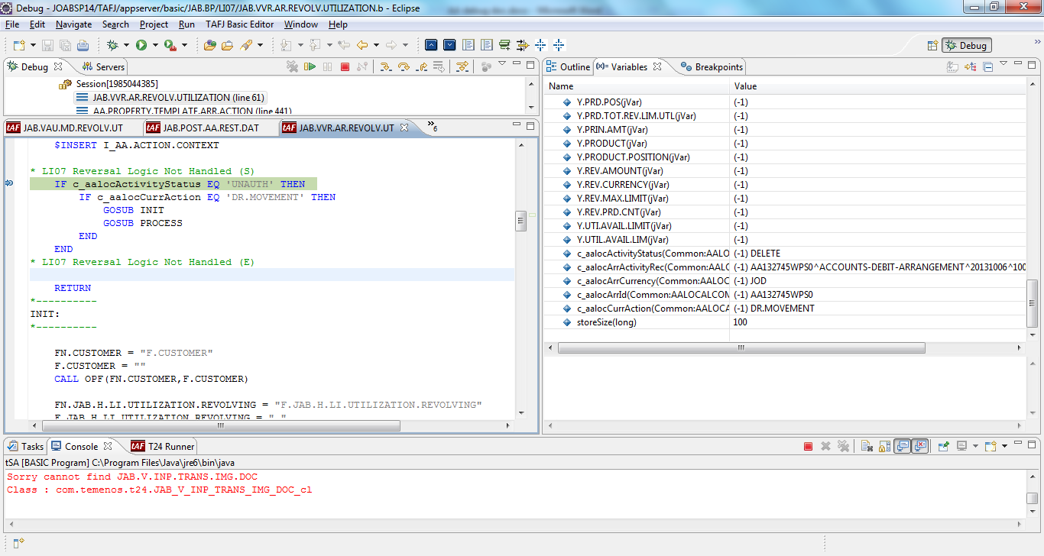
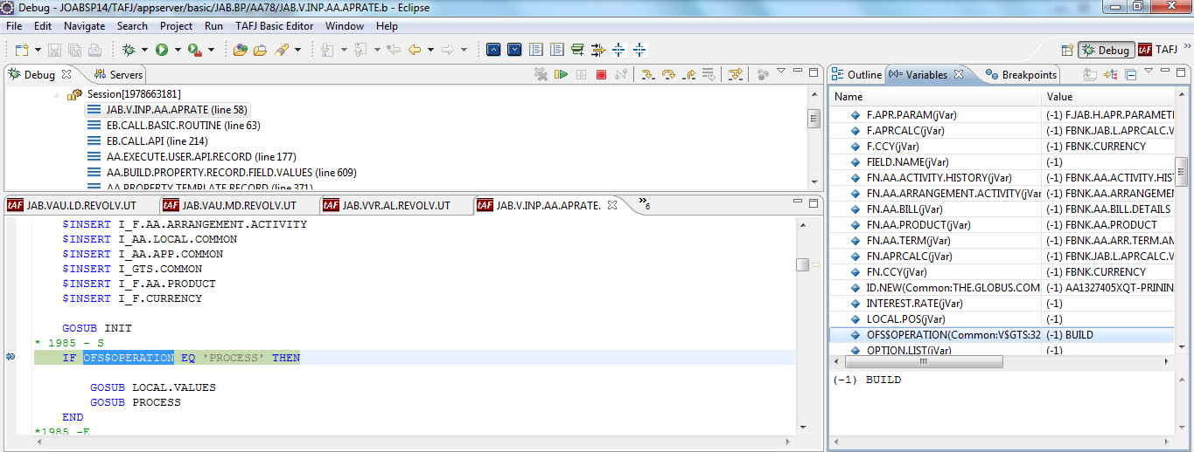
Debugging in AA routine

Slide 65
Common variables
Below screenshot shows the common variable values of Arrangement ID, Product ID, Property ID, Currency and Status of AA contract.

Slide 66
Thank You

