Slide 1
OFS – Open Financial Services

Slide 2
OBJECTIVES
To understand
Purpose and Functionality of Open Financial Services
Application design – Architecture
Related Applications involved
Message structure
Interface types and interface definition
Transaction updates and Enquiry
Acknowledgement process

Slide 3
INTRODUCTION
Interface to allow update and Interrogation in T24/Globus
Used for variety of external purposes.
  Internet Banking Applications
  ATM Transactions
  External System Feeds
Data available in external source can be processed
Message structure (OFS/XML)
Two components involved
  Open Financial Service (OF)
  Open Financial Service Online (OO)

Slide 4
FUNCTIONALITY
OFS provides the following functionality:
Batch mechanism to update T24 record
Online real-time updates of T24 records
Allow interrogation of the T24 database by returning information based on ENQUIRY
Customization of message processing using user defined routines.
Multi company processing.
Support for sub values.
Enhanced error message details.
Ability to run on platforms other than UNIX (i.e. NT).

Slide 5
ARCHITECTURE
EXTERNAL FEED
OFS
OFFLINE
QUEUE
ONLINE
MANAGER
OFS REQUEST
MANAGER
OFS QUEUE
MANAGER
OFS
DETAILS
GLOBUS
TRANSACTION
OFS ENQUIRY
MANAGER

Slide 6
TERMINOLOGIES
REQUEST TYPES
  Transaction Update
  Enquiry
INTERFACE TYPES
  Online/Telnet
  Batch
  Globus
  Session
STRUCTURE OF MESSAGE
  OFS
  XML
  GTS
Notes:
GTS.CONTROL:
Null (Reject errors / Approve overrides)
1 (Errors on HLD / Approve Overrides)
2 (Errors Rejected / Overrides in HLD)
3 (Errors in HLD / Overrides HLD)
4 (Hold Only)

Slide 7
RELATED APPLICATIONS AND FILES
OFS.SOURCE
EB.PHANTOM
OFS.REQUEST.DETAIL

Slide 8
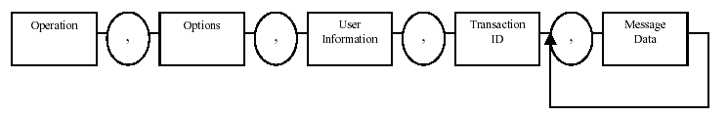
MESSAGE STRUCTURE - TRANSACTION
OFS Message consists 5 elements and each one is separated by ‘,’
Operation
Options
User Information
Transaction id
Message Data

Slide 9
OPERATION
Contains the valid GLOBUS application name which is going to be updated.
Example : SECTOR

Slide 10

OPTIONS
Element ‘OPTIONS’ contains 3 components and each one separated by ‘/’
  Version Name
  Function
  Operation
Function – if left blank is defaulted with ‘I’ – Input
Operation – Validate or Process
Example : TEST/I/PROCESS

Slide 11
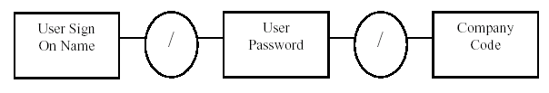
USER INFORMATION
Element ‘USER INFORMATION’ contains 3 components and each one separated by ‘/’
  Sign On Name
  Password
  Company Code
Example : INPUTT/123456/US0010001

Slide 12

TRANSACTION ID
Element ‘TRANSACTION ID’ contains 2 components and each one separated by ‘/’
  Transaction Id
  Message Id
Message id has to be given only if for Application FOREX
EXAMPLE: 1000/

Slide 13

MESASAGE DATA
Message data contains,
  Field Name
  Multi-value number
  Sub-value number
  Field Content
‘,’ is used to separate Next field
Example: DESCRIPTION::= Financial , SHORT.NAME::=Financial

Slide 14
MESSAGE STRUCURE - TRANSACTION
The Final message that is going to be passed to Globus through OFS for Transaction is,
SECTOR , TEST/I/PROCESS , INPUTT/I/ ,1000/ , DESCRIPTION::= Financial , SHORT.NAME::=Financial

Slide 15
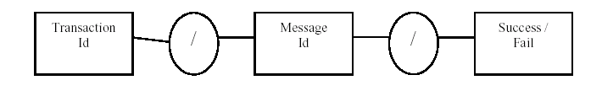
RETURN MESSAGE STRUCTURE - TRANSACTION
Return Message consists
  Transaction id
  Message id
  Success/Fail indicator
    1 for Success
    -1 for Failure
Apart from these, Transaction details also returned on successful updation and Error details displayed in failure.

Slide 16
SETTING UP INTERFACE DEFINITION
ONLINE/TELNET

Slide 17
INTERFACE DEFINITION - ONLINE
Necessary File to be set up for OFS processing for ONLINE/TELNET Updates is
  OFS.SOURCE

Slide 18
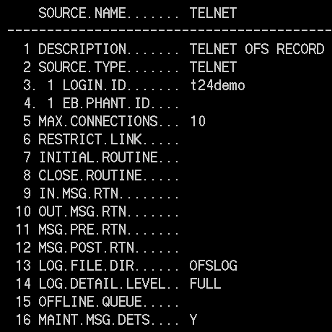
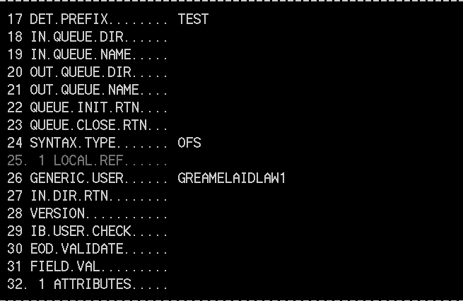
OFS.SOURCE - ONLINE

Slide 19

OFS.CONNECTION.MANAGER
After setting up ‘OFS.SOURCE’ for Online updates, Initiate ‘OFS.CONNECTION.MANAGER’ from jsh prompt.
Syntax : OFS.CONNECTION.MANAGER <source name>
System prompts to enter OFS message
Enter OFS messages to be processed.

Slide 20
RETURN MESSAGE
After processing message , system will return a message from which we can identify that updates are successful or not.
In the above message, Transaction is updated successfully and Transaction details also returned.

Slide 21
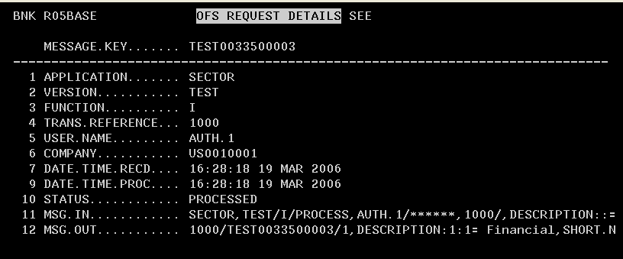
OFS REQUEST DETAILS

Slide 22
SETTING UP INTERFACE DEFINITION
BATCH

Slide 23
INTERFACE DEFINITION - BATCH
Necessary Files to be set up for OFS processing are for BATCH mechanism
  OFS.SOURCE
  EB.PHANTOM

Slide 24
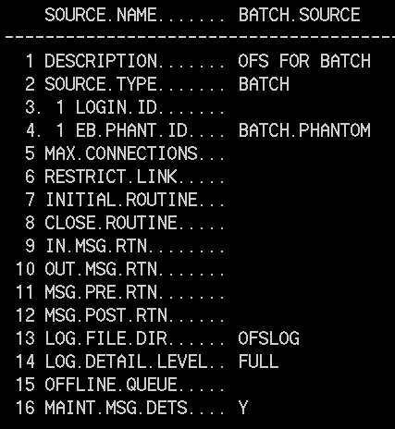
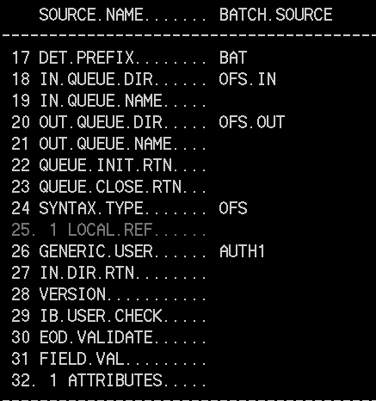
OFS.SOURCE - BATCH

Slide 25
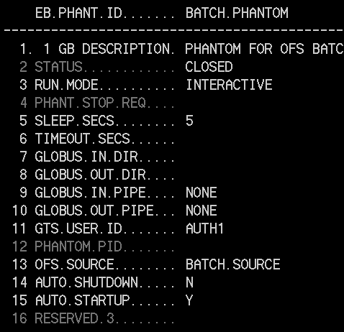
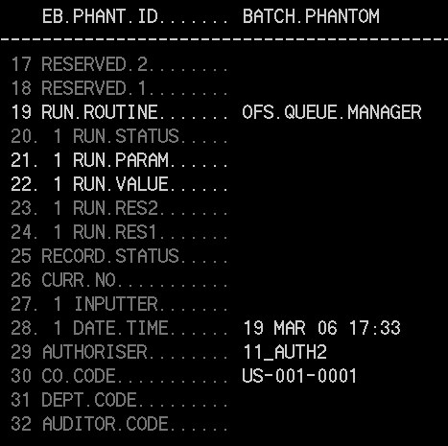
EB.PHANTOM

Slide 26
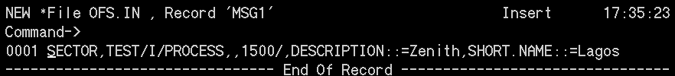
BATCH
After setting OFS.SOURCE and EB.PHANTOM for Batch then pass the OFS message to be processed through the In Queue Directory specified in your OFS.SOURCE record.
Here In Queue Dir is OFS.IN
From the jbase prompt : JED OFS.IN <record>
Save the Record.

Slide 27
BATCH
Enter INTO GLOBUS/T24
From the Globus Application using ‘COMMITT’ the created EB.PHANTOM record (BATCH.PHANTOM) with Function ‘V”
Example : EB.PHANTOM V BATCH.PHANTOM
Check the Out Queue Dir using JED OFS.OUT MSG1

Slide 28
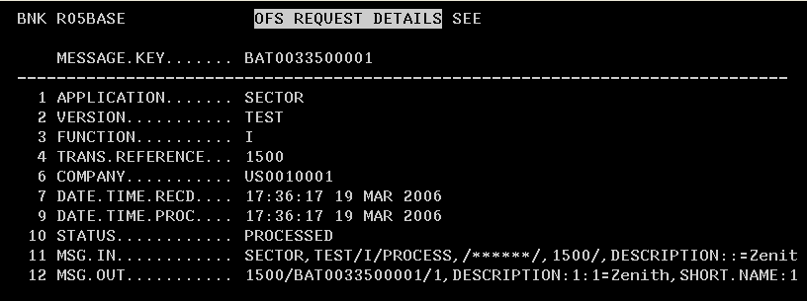
OFS.REQUEST.DETAIL

Slide 29
MESSAGE STRUCURE - ENQUIRY

Slide 30
MESSAGE STRUCTURE - ENQUIRY
OFS Message structure for Enquiry is the Same as in Transaction except that element ‘MESSAGE DATA’ differs.
For interrogations
Operation should be always ENQUIRY.SELECT
Transaction id should be name of Enquiry
Equivalent Message elements are
  Operation ENQUIRY.SELECT
  Options ‘’
  User name ‘’
  Transaction id <Name of Enquiry>

Slide 31

MESSAGE DATA FOR ENQUIRY
Message data for Enquiry contains
  Selection Field
  Operand
  Field Value
Example : CURRENCY:EQ=GBP,CUSTOMER:EQ=100053

Slide 32
MESSAGE FOR ENQUIRY
The Final message that is going to be passed to Globus through OFS for Enquiry is,
ENQUIRY.SELECT,,,TESTENQ,CUSTOMER:EQ=1000
This message can be passed either thro ONLINE or BATCH process .
Steps are the same as in Transaction

Slide 33

RETURN MESSAGE - ENQUIRY
Structure of return message for Enquiries on Failure
Header Caption details
Column details
Returned Data

Slide 34

RETURN MESSAGE STRUCTURE - ENQUIRY
Structure of return message for Enquiries on Failure
Eg:- CUSTOMER = “INVALID CUSTOMER”

Slide 35
USER - EXITS IN OFS
INITIAL.ROUTINE - When the communication process starts
CLOSE.ROUTINE - When the communication process ends
IN.MSG.RTN - Allows manipulation of each message immediately after receipt from the external system
OUT.MSG.RTN - Allows manipulation of each return messages from OFS.REQUEST.MANAGER
MSG.PRE.RTN - Allows manipulation of message, BEFORE processing within OFS.REQUEST.MANAGER
MSG.POST.RTN - Allows manipulation of message, AFTER processing within OFS.REQUEST.MANAGER

Slide 36
OFS Routines - Workshop
Write a Subroutine to count the number of characters received in the input string and return back a string “The length of Request message is:” followed by the actual count characters in the request message. If the request message is empty then a string “The length of Request message is: EMPTY” must be returned..

Slide 37

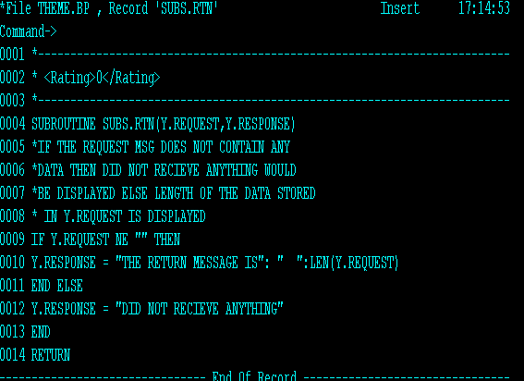
Solution – Step 1 : Write the Routine

Slide 38
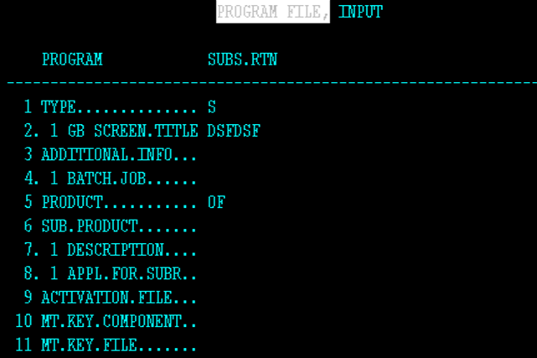
Solution – Step 2 : PGM.FILE

Slide 39
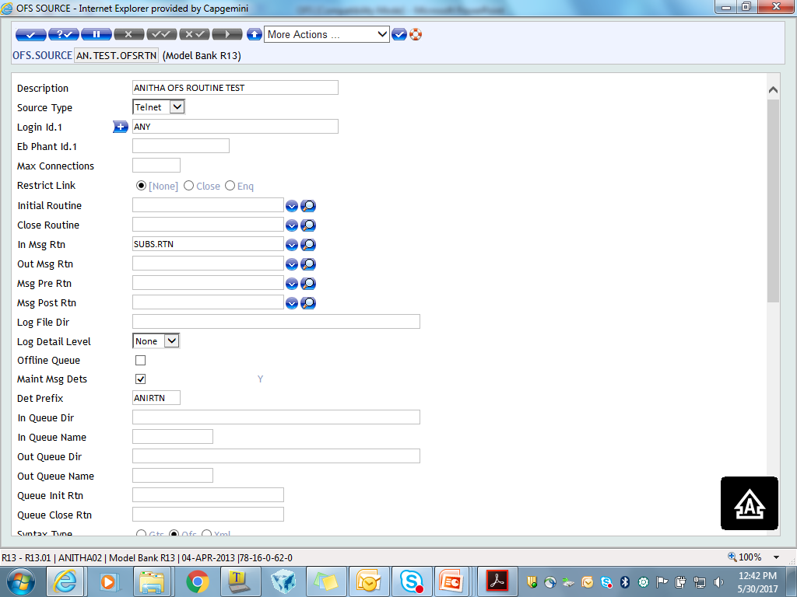
Solution – Step 2 : Attaching Routine in OFS.SOURCE

Slide 40
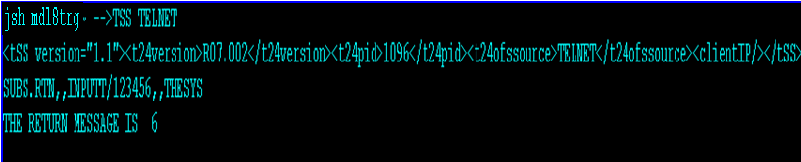
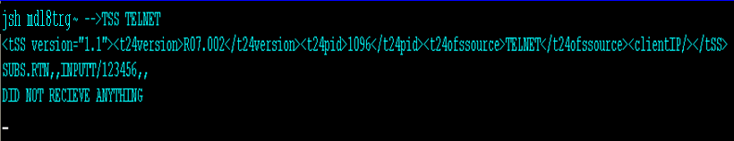
Solution – Step 3 : Output

Slide 41
I_GTS.COMMON – OFS Common variables
The I_GTS.COMMON contains the common variables of the OFS module
Inserting this in the programs makes them available for use during the OFS processing
A subroutine attached in MSG.PRE.RTN field of OFS.SOURCE can make use of the common variables of the OFS module by inserting the I_GTS.COMMON file
Notes:
MSG.PRE.RTN – Allows a user defined routine to be specified for a particular service. The routine specified here will be executed within the OFS processing prior to application update or execution of enquiry.
Arguments : OFS.MESSAGE

Slide 42
OFS Common variables
GTSACTIVE | Flag to indicate if OFS is used for the message being processed
OFS$SOURCE.ID | ID of the OFS.SOURCE record that is currently being used
OFS$SOURCE.REC | Dynamic array containing the OFS.SOURCE record that is currently being used
OFS$GLOBMAN.ACTIVE | Flag to indicate if OFS Globus mode (OFS.GLOBUS.MANAGER) is used for the message being processed

Slide 43
SUMMARY
OFS Architecture and Functionality
OFS message Structure
Interface Types, Request Types
Applications involved
Setting up interface definition and processing message

Slide 44


www.capgemini.com/financialservices
Notes:
© 2006 Capgemini - All rights reserved

