Slide 1
T24
WEB SERVICES
(TWS)
PREPARED BY
AMY
& KUMARAN

Slide 2
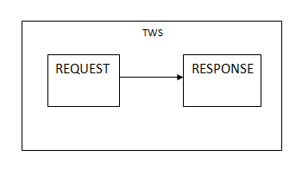
WEB SERVICES
A web service is a service that accepts a request and returns data or carries out a processing task. The return data is normally formatted in a machine readable format. Web services are known as XML Web services since the request or response or both must be in a XML format.
Services are what you connect together using Web Services. Web Services refers to the technologies that allow for making connections.

Slide 3
WEB SERVICES
Definition :
A software system designed to support interoperable machine to machine interaction Over a network by using XML
How a web service is called ?
-> it’s location = where the service is located, by its URL which is registered on the search engine
-> It’s interfaces = It’s method, signature & return values
->Transport Protocol = what protocol does the service understands, which means the request and response will be passed through HTTP or SMTP
-> The message Protocol = What format does the message follow

Slide 4
Architecture of WEB SERVICE
XML web service is a software service which is exposed on the web through SOAP described with a WSDL file registered in UDDI.
UDDI-> Provide a way to register a web service
WSDL -> Provide a way for a web service to describe itself
SOAP ->Defines a format for message to be sent and to invoke a message
XML -> Describe data types used in web service
HTTP -> Specifies the transport protocol to be used to connect the web service.
UDDI
WSDL
WSDL
SERVICE REQUESTOR
SOAP
SERVICE PROVIDER

Slide 5
TWS IN T24
How does TWS fit in T24
CERTIFICATE SERVER
EXTERNAL INTERFACE
5) Validates the SSL certification between the web server and application server
4) The output is picked by the External interfaces from web server
1) Communicate with the web server
WEB SERVER
T24 APPLICATION SERVER
2) Will request to the T24 Application server
3)Application server will send response to web server through OFS

Slide 6
Creating Web Services
You need the following software to try the examples shown in this unit ; To create web services and generate response following are the requirements :
a. Eclipse-jee-helios-SR2-win32 are suggested. This can be downloaded from http://www.eclipse.org
b. Jboss4.2.3 release
c. SOAP UI

Slide 7
APPLICATIONS USED
OFS.SOURCE :
OFS source is used for connecting the TWS, it should have a source type as TELNET, syntax type as OFS and Attribute value as TWS
PW.ACTIVITY :
ID should always start with WS. In order to bypass the PW.ACTIVITY ID validation.
The TARGET field holds the service like ENQUIRY/VERSION.
EB.SERVICE:
Create a record with @ID as per the requirement, the field ACTIVITY.ID = PW.ACTIVITY.ID

Slide 8
Steps To Create TWS Web Service
A user creates a project using TWS project template and communicates with T24 application server.
Once the connection is established, a list of Business Services and Operations is fetched.
The user selects the list of Business Operations from the Business Service to be published as Web API.
The newly created web service is published to the web server.

Slide 9
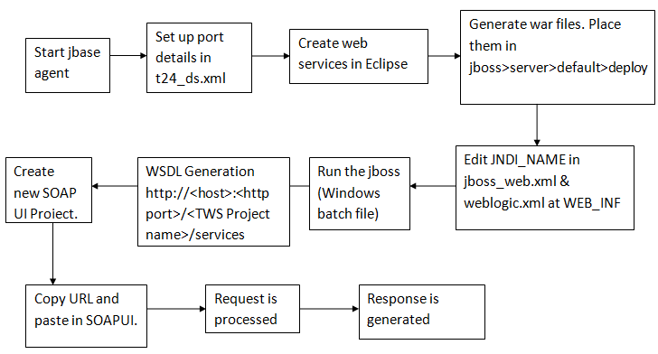
PROCESS FLOW

Slide 10
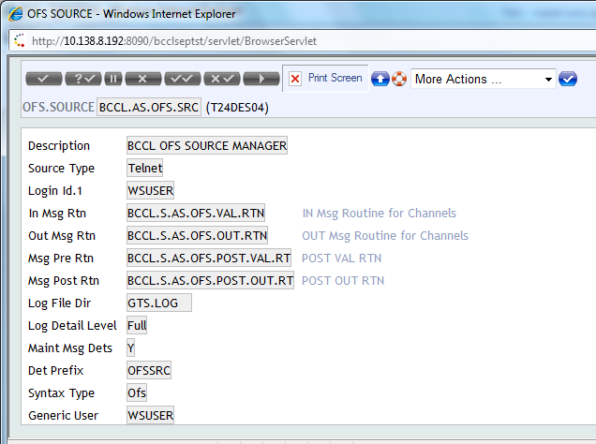
CONFIGURATION STEPS FOR WAR FILE: Make sure the OFS.SOURCE record with record ID as BCCL.AS.OFS.SRC is available in the area as shown below:

Slide 11
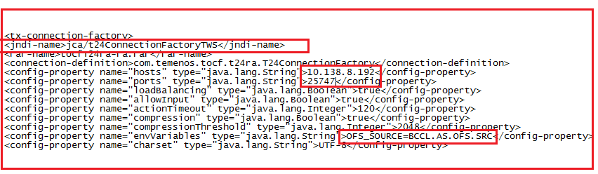
(Note: Ensure that t24.ds.xml file in JBOSS contains the connection factory as BCCL.AS.OFS.SRC)

Slide 12
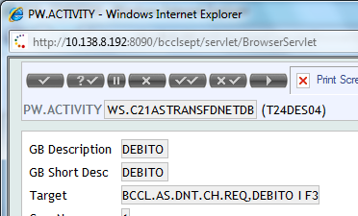
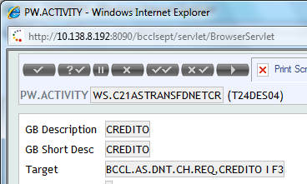
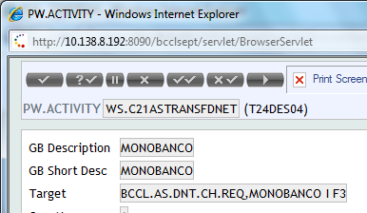
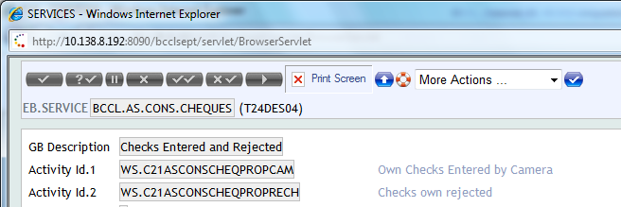
Installation steps: Install Eclipse and Copy the plug-in jar file “com.temenos.tws.plugin.jar” to the plugins directory of your eclipse install and restart it. Install SOAPUI software. Configure JBOSS with “BCCL.AS.OFS.SRC” as connection factory as mentioned in pre requisite. Note: Create the required ENQUIRY/VERSION, PW.ACTIVITY, and EB.SERVICES (@ID of EB.SERVICE & PW.ACTIVITY should begin with WS.) PW.ACTIVITY for Version

Slide 13
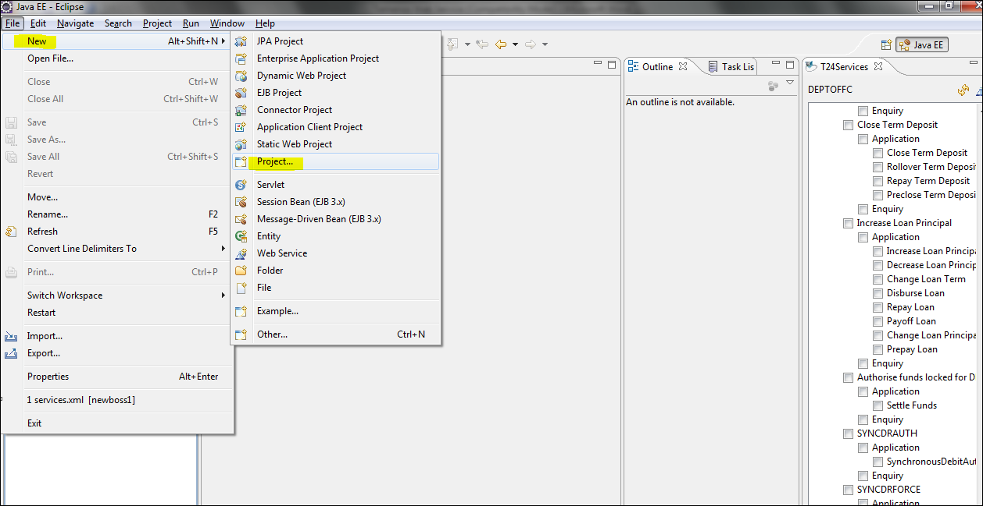
Follow below steps to create a new war file Launch the eclipse. Navigate to File -- > New -- > Project

Slide 14
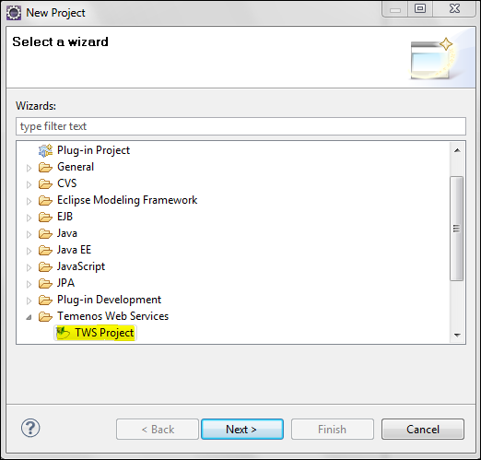
A selection wizard will be popped up Select TWS project Under Temenos Web service and click next

Slide 15
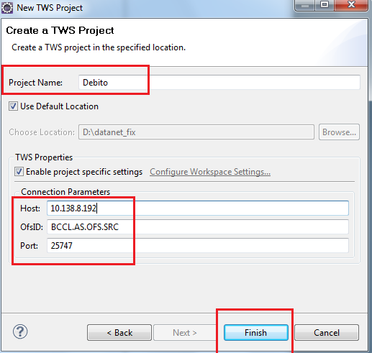
Enter the Project Name, Host , OfsID and Port as shown below and click finish button

Slide 16
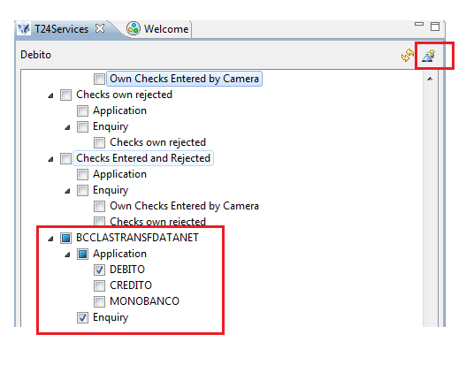
Note: Ensure that before click the “Finish” button agent (port) needs to be run on the mentioned Host In left side Tab a New project file will be created with the created project name Click the project file BCCL.AS.TRANSF.DATANET and the list of services will be listed in right side TAB under “T24 services”. Select the services that needs to be tested and click the “Create services” link as shown below:

Slide 17
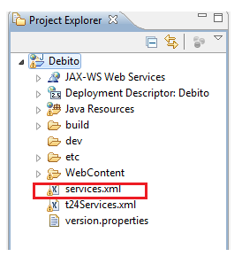
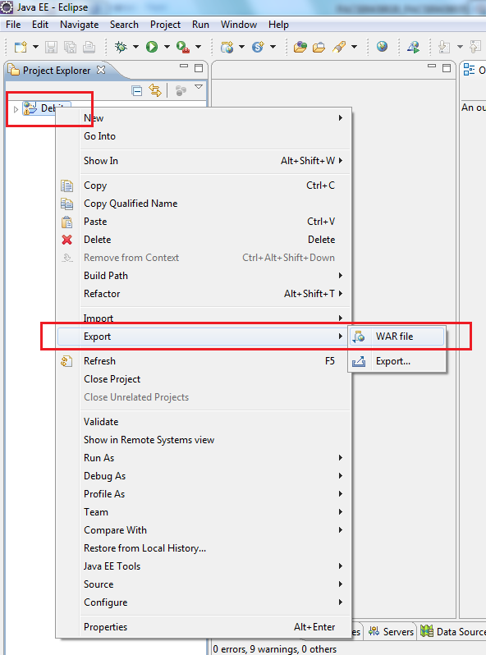
Once the above process is done a “services.xml” file will get generated under the respective project folder.
Export the war file by Right click the project file DEBITO

Slide 18
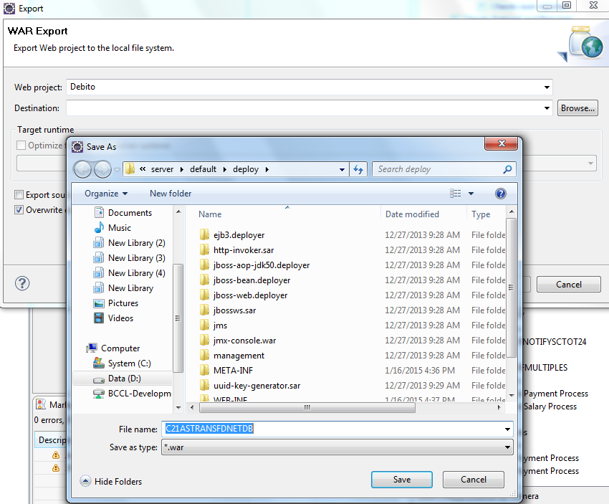
Choose the specific folder to export the war file and export it

Slide 19
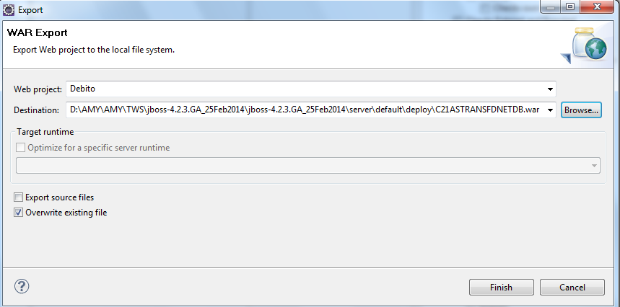
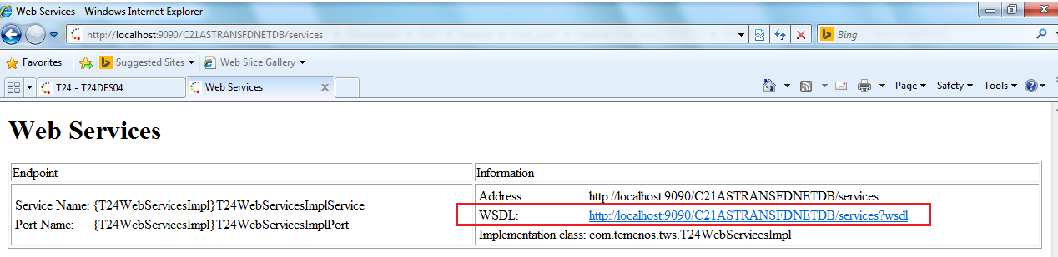
Enquiry Execution:
Deploy the war file in JBOSS under the path -→ JBOSS -- >server - - >default - - > deploy
WSDL link generation:
Test that the web services are successfully deployed by browsing to the following URL.
http://<host>:<http port>/<TWS Project name>/services

Slide 20
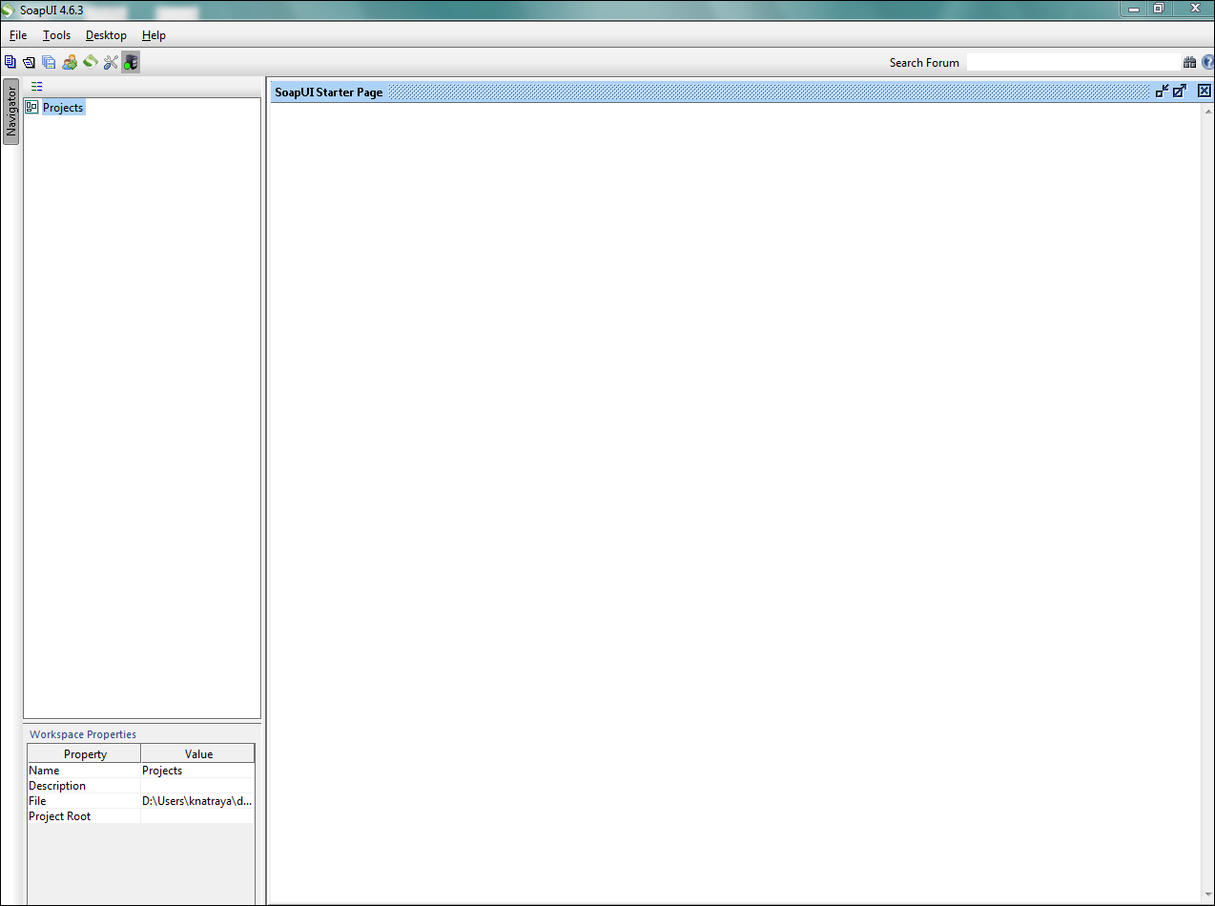
Copy the above highlighted WSDL link Launch SoapUI (soapUI.exe)

Slide 21
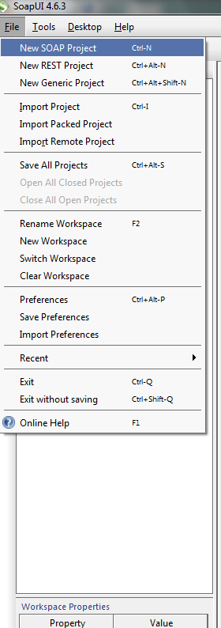
Navigate to File -- > New SOAP Project

Slide 22
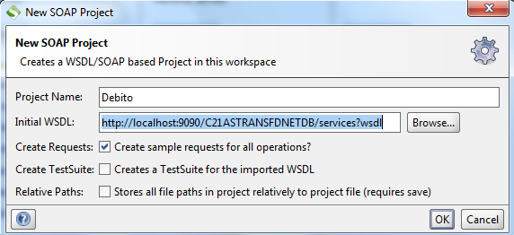
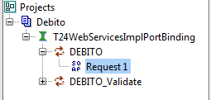
Paste the WSDL link copied from Browser
Project screen will get opened as shown below and click the Request1 link to generate the Selection criteria

Slide 23
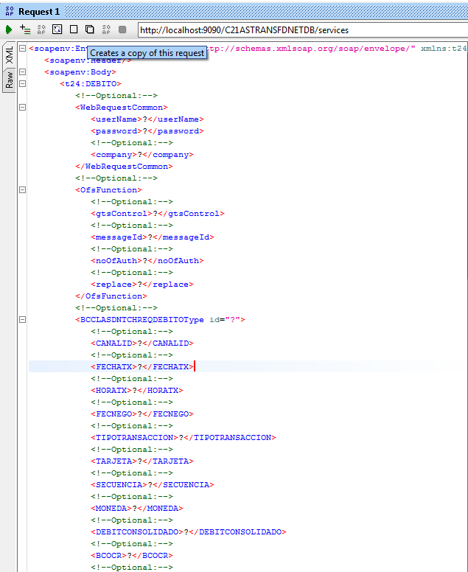
Pass the required selection criteria value and press the “submit request button” which is highlighted below: (Note: Before click the submit request button ensure that the tag value doesn’t contain the “?”. If the selection field value tag is null then the value “?” needs to be deleted and null value should be passed)

Slide 24
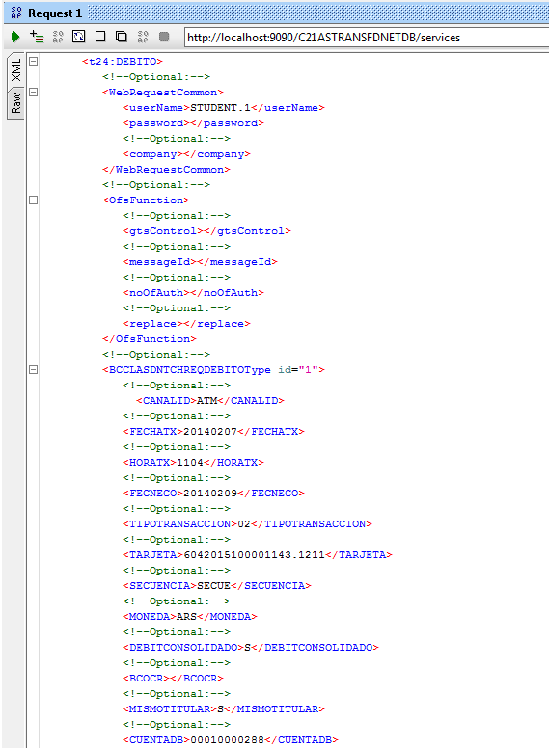

Slide 25
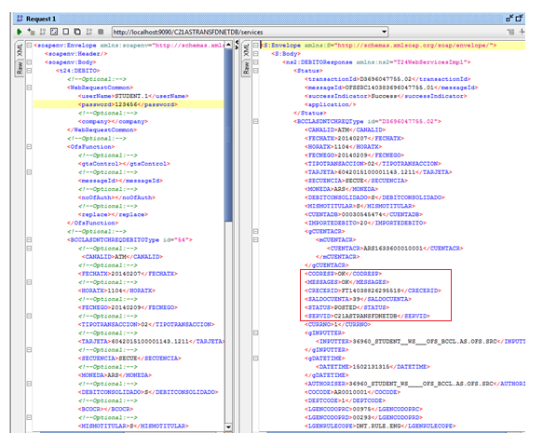
Once the above process done then an OFS message will be generated and hit the T24 and the response will be shown in right side tab
Follow the similar steps for Credito & Monobanco transactions.

Slide 26
Overrides in TWS
How the overrides are managed in TWS ?
Overrides are managed in the TWS based on the GTS Control Value
Value Status Of Response
Null Error – Reject the record & Return response
Override – Approve automatically and commit
1 Error - $NAU file with status hold
Override - Approve automatically and commit
2 Error - Reject the record & Return response
Override - $NAU file with status hold
3 Error - $NAU file with status hold
Override - $NAU file with status hold
4 All transactions are in to $NAU file with status as hold
GTS control value can be provided at 3 levels OFS.MESSAGE,VERSION&VERSION.CONTROL

Slide 27
TWS Features
TWS features are:
Compliant to industry standard tools and technology
Minimum dependent on T24 code and vendor specific components
Platform independent
Ease of deployment

Slide 28
THANK YOU

