Slide 1
JQL
May 2011
Notes:
© 2006 Capgemini - All rights reserved
0

Slide 2
Objectives
Why JQL?
Where do we use JQL?
How do we use JQL commands?
JQL commands
Notes:
Multivalued Files
JBASE uses a three-dimensional file structure called a non-first normal form data model to store
multiple values for a field in a single record known as multivalued fields. A multivalued field
holds data that would otherwise be scattered among several interrelated files. Two or more
multivalued fields can be associated with each other when defined in the file dictionary. Such
associations are useful in situations where a group of multivalued fields forms an array or are a
nested table within a file. You can define multivalued fields as belonging to associations in which
the first value in one multivalued field relates to the first value in each of the other multivalued
fields in the association, the second value relates to all the other second values. Each multivalue
field can be further divided into subvalues, again obeying any relationships between fields

Slide 3
Why JQL?
JQL allows retrieve data from the database.
Data are retrieved in a structured order.
To present the data in a flexible and easily understood format.
Notes:
The jQL Command would look like this:
LIST SALES WITH MONTH = “JANUARY” BY DATE
By using the jQL Command LIST with a file named SALES and your predefined data definition
records such as MONTH and DATE, you can construct complex ad-hoc reports directly from the
Command line interface (>). You can also choose how you want the information presented;
displayed directly to your printer or to your screen; listed in date order, or in descending or
ascending order. The choice is yours as jQL contains a rich range of commands for listing,
sorting, selecting and controlling the presentation of your details and is a safe language for end
users.

Slide 4
Where do we use JQL ?
jQL Commands could be entered from terminal.
jQL Commands could also be embedded in applications programs, procs and paragraphs
The language resemble everyday English language.
Notes:
With the exception of the “EDELETE” Command, jQL will not alter the contents of the source
data files.
All jQL Command sentences begin with a verb-like Command such as LIST or SELECT
followed by a file name such as SALES or PERSONNEL, and then a series of qualifiers and
modifiers with which you control elements such as eligible data, report formatting, any totals that
you want to appear and so on.

Slide 5
How do you enter a JQL command
A jQL Command sentence is entered at the shell
Each sentence must start with a jQL Verb and can be of any length.
If an invalid Command is entered, the system will reject it and displays an appropriate error message
Notes:
A jQL Command sentence is entered at the shell in response to a Command prompt (:) or a select
prompt (>). If a Command such as SELECT or GET-LIST creates an implicit list whilst in
jSHELL, it displays the select prompt. Each sentence must start with a jQL Command and can be
of any length. Press <ENTER> to submit the constructed sentence. If you enter an invalid
Command, the system will reject it and display an appropriate error message.
EXAMPLE
jsh ~ -->SORT jcustomers FIRSTNAME LASTNAME CITY STATE NUMUSERS
WITH FIRSTNAME = "TED" AND NUMUSERS > “10” BY CITY DBL-SPC HDRSUPP
(P
The verb in this case is SORT. The file specifier is jcustomers. The fields specified in the output
specification are FIRSTNAME, LASTNAME, CITY, STATE & NUMUSERS. The selection
criteria specify that only those records with a FIRSTNAME of TED and with more than 10 users
should be returned. The sort criterion says to order the results by the CITY field. The format
specifier sets the output to be double spaced with no header. The (P option sends all output to the
printer rather than the screen.

Slide 6
Sentence construction
General Syntax for an JQL statement
jQL-verb {DICT} file-specifier {field-list} {record-list} {selection-criteria} {FROM #}{sortcriteria}
{USING file- specifier} {macro-call}{output-specification} {format-specification}
{output-limiter}{(options}
Notes:
SYNTAX ELEMENTS:
Verb --- One of the verbs like Commands detailed later. Most Commands will
accept any or all of the optional clauses
file modifier
file modifiers --- DICT, ONLY=, WITHIN and TAPE modify the use
of the file, and how it is accessed
file specifier --- Identifies the main data file to be processed. Usually the data section of
a file, but could be a dictionary or a secondary data area
record-list--- Defines which records will be eligible for processing. Comprises an
explicit list of record keys or record selection clauses. An explicit list
comprises one or more record keys enclosed in single or double quotes.
A selection clause uses value strings enclosed in single or double quotes
and has at least one relational operator. If no record list is supplied, all
records in the file will be eligible for processing unless an “implicit” record list is provided by preceding the Command with a selection Command such as GET-LIST or SELECT
FROM list#--- A number from 0 through 10 of an active select list that contains record
IDs. The query operates on records whose IDs are in the select list.
Selection-criteria-- Qualify the records to be processed. Comprises a selection connective
(WITH or IF) followed by a field name. Field names can be followed by
relational operators and value strings enclosed in double quotes. Logical
Connectives AND/OR ca also be used. Expressions can be
parenthesized to specify precedence.
sort-criteria -- Specify the order in which the data is returned. Comprises a sort
modifier, such as BY or BY-DSND, followed by a field name. Used
also to “explode” a report by sorting lines corresponding to multivalued
fields by value, and to limit the output of values (see output
specification).

Slide 7
Why Item lists?
An item list specifies the items within the file to be further processed.
If no list is given, all items in the file are implied.

Slide 8
Types of Item List
An explicit item-id list
An implicit item-id list
An item-id selection clause
Notes:
You can combine Item-id selection with implicit but not with explicit item-id lists. You can
combine every type of list with selection criteria based on attribute values.

Slide 9
Explicit item-id list
An explicit item-id lists lists items for processing, which encloses each item-id in double quotes.
Spaces between item-ids are optional. An item-id list cannot include a relational operator and ignores any included logical connectives
Notes:
JQL treats the values you place between quotes as item-ids, not as value strings. This treats the
left ignore, right ignore and wild card as ordinary characters and not as special characters.

Slide 10
Implicit Item-id list
To provide an implicit item-id list execute a verb such as SELECT or GET-LIST immediately before executing a jQL command.
Notes:
If you also specify item-id selection, the jQL processor
effectively ANDs its result with the implicit item-id list to limit further the items selected.
If you specify an explicit item-id list, the processor ignores any implicit list.

Slide 11
Item-id Selection clause
An item-id selection clause expresses limits on the value of item-ids, for selection for processing.
It has at least one value string that defines an item-id or part of an item-id
An explicit relational operator must precede at least one value string.
The relational operator is what makes jQL treat item-id selection differently from an explicit item list.
Notes:
You can use logical connectives
to combine relational operations. If you do not use an explicit logical connective, jQL defaults to
the OR connective. JQL searches the file for each item-id that matches the value strings in the
criteria. If an implicit item-id list has been specified, the processor checks only those item-ids
present in the list.

Slide 12
Value Strings
Value strings are character strings enclosed in delimiters (usually single quotes)
Used to compare against character strings in the file.
String can also include the following special characters:
Left ignore ([) at the beginning of the string to indicate that the item-id may start with any characters (for example,’[son’)
Right ignore (]) at the end to indicate that the item-id may end with any characters (for example,Johan]’)
Wild cards(^) anywhere within the string, each wild card matching one character of any value (for example, ‘Joh^ns^n).
Notes:
The value string cannot contain the character by which it is
delimited. For example: if the value string is enclosed in single quotes, it may contain double
quotes, but not single quotes. Otherwise, the value string can contain any printable character,
excluding RETURN, LINE FEED, and system delimiters. The simplest value string is a character
string that has precisely those characters for testing (for example. ‘Johansen’) however a value

Slide 13
Between Connective
The connective BETWEEN followed by two value strings is a shorthand way of saying ‘all values greater than the first value string and less than the second’.
The value of the second value string must be greater than the value of the first to select items.
Value strings including special characters ^, [ and ] are not valid.

Slide 14
Relational Operators
These express a relationship between an item-id (or attribute value in the case of selection criteria) and the value string.
At least one relational operator is required in an item-id selection clause.
Value strings within the clause not preceded by a relational operator are treated as if preceded by the equal operator.
The operator test for relationships Equal(=), less than or equal (<=) etc., the result of a relational operation is a truth-value: true or false.
Notes:
You can enter relational operators as special characters
symbols or as their mnemonic equivalents

Slide 15
Logical Connectives
The logical connective AND or OR joins two relational expressions.
The default connective is OR.
If giving two relational expressions without a logical operator between them, items satisfying either expression are selected (as if the OR connective had been used).
The connective AND yields a truth-value of true if all the truth values it is combining are true.
Notes:
If
any truth-value is false, the result of the AND connective is false. The OR connective yields a
truth value of true if at least one of the truth values it is combining is true.

Slide 16
COUNT
Reports the total number of records found in a file, which matches the specified selection criteria.
Syntax
COUNT file-specifier {record-list} {selection-criteria} {USING file- specifier} {(options}
Options:
B Supress Initial line feed
C{n} Display running counters of the number of records
selected and records processed
Notes:
C{n} -- Display running counters of the number of records selected and records
processed. Unless modified by n, the counter increments after every 500 records
processed or the total number of records if less than 500. The n specifies a number
other than 500 by which to increment. For Example, (C25) increments the
13 counter after every 25 records processed.

Slide 17
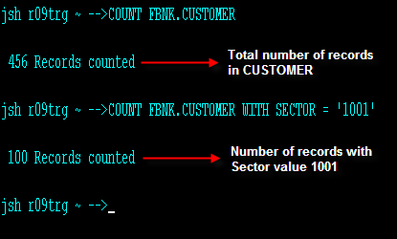
Example

Slide 18
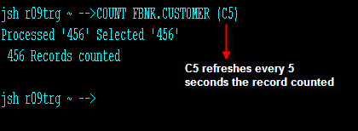
Example

Slide 19
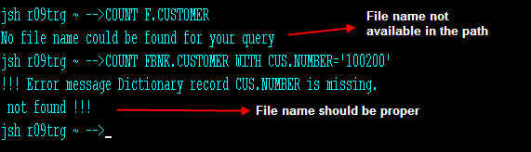
Error Handling

Slide 20
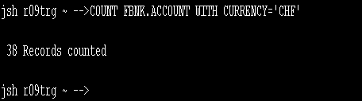
Workshop 1
Count the number of accounts with the currency as ‘CHF’
Solution

Slide 21
EDELETE
Deletes selected records from a file according to record list or selection criteria clauses.
Syntax
EDELETE file-specifier [record-list | selection-criteria]
Notes:
Comments: EDELETE requires an implicit or explicit record list, or selection criteria. Preceding
the Command with a SELECT, GET-LIST or other list-providing Command can provide an
implicit list. EDELETE will immediately delete the specified records. To clear all the records in a
file, use the CLEAR-FILE Command.

Slide 22
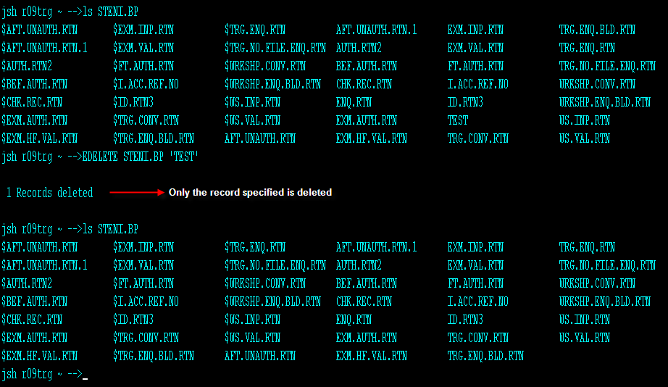
Example

Slide 23
ESEARCH
Generates an implicit list of records in a file if they contain (or do not contain) one or more occurrences of specified character strings.
Syntax
ESEARCH file-specifier {record-list} {selection-criteria} {sort-criteria} {USING file-specifier} {(options}

Slide 24
ESEARCH
Options
A : ANDs prompted strings together. Records must contain all specified strings
I : Displays the keys of selected records.
L : Saves the field numbers in which it found the specified strings.
N : Selects only those records that do not contain the specified string(s).
S :Suppresses the list but displays the record keys that would have been selected.
Notes:
Prompt: At the prompt supply one or more search strings:
String: Enter the required character string and press <ENTER>. This prompt is repeated until
only <ENTER> is pressed. You can enter unlimited characters.
Do not enter double quotes unless they are part of the string to search.
Comments: When the Command terminates (unless the “S” option is used), it displays the total
number of entries in the generated list. The list is then available as if generated by a SELECT,
GET-LIST or other list-providing Command. If you do not specify a sort criteria clause, the
record list will be unsorted.

Slide 25
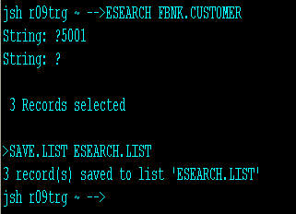
Example

Slide 26
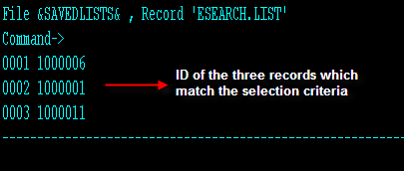
Example

Slide 27
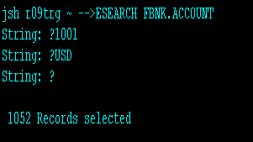
Workshop 2
Create a savedlists called my.save.list which has the data of the accounts whose category is 1001 or currency ‘usd’
Solution

Slide 28
LIST
Generates a formatted report of records and fields from a specified file.
Syntax
LIST file-specifier {record-list} {selection-criteria} {sort-criteria} {USING file-specifier} {output-specification} {format-specification} {(options}
Notes:
Comments: If providing no output specification clause the system searches for default data
definition records (named 1, 2 and so on) in the file dictionary and then in the file specified in the
JEDIFILENAME_MD environment variable. If no default data definition records are found, it
lists only the record keys. You must specify a sort criteria clause to sort the records

Slide 29
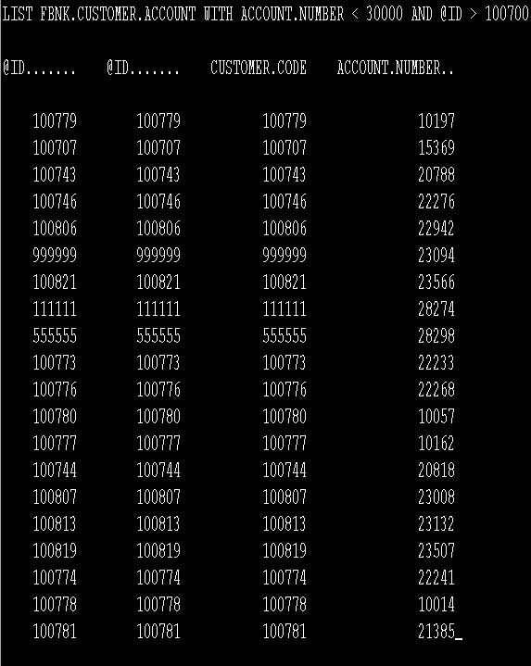
Example

Slide 30
Workshop 3
Display the list of account with negative working balance
Solution
LIST FBNK.ACCOUNT WITH WORKING.BALANCE < 0

Slide 31
SELECT
Generates an implicit list of record keys or specified fields based on the specified selection criteria
Syntax
SELECT file-specifier {record-list} {selection-criteria} {sort-criteria} {output-criteria} {USING file-specifier} {(options}
Notes:
The options are:
C{n}Display running counters of the number of records selected and records processed. Unless
modified by n, the counter increments after every 500 records processed or the total number of
records if less than 500.
n n Specifies a number other than 500 by which to increment. For Example, C25 increments the
counter after every 25 records processed.
Comments: You must specify a sort criteria clause to sort records.
See also the SSELECT Command.
If you specify an output-criteria clause, the generated list will comprise the data (field) values
defined by the clause, rather than the selected record keys.
If you are in jSHELL when the Command terminates, it displays the total number of entries in the
generated list and the list is made available to the next Command, as indicated by the > prompt.
If you use the BY-EXP or BY-EXP-DSND connectives on a multivalued field, the list will have
the format:
record-key]multivalue#
where multivalue# is the position of the multivalue within the field specified by BY-EXP or BYEXP-
DSND. multivalue# can be accessed by a READNEXT Var,n statement in a jBC program.

Slide 32
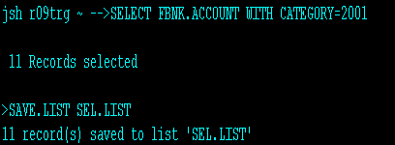
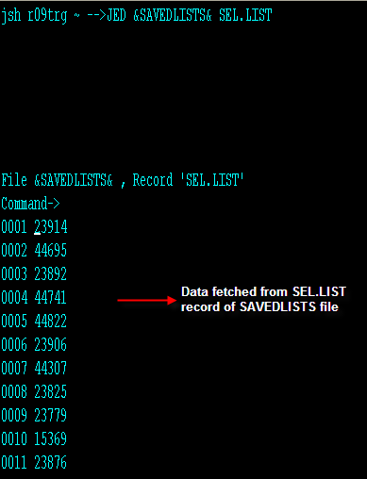
Example

Slide 33
Workshop 4
Select the account details with working balance between 0 and 1000 and display them
Solution
SELECT FBNK.ACCOUNT WITH WORKING.BALANCE < 1000 AND WORKING.BALANCE > 0
LIST FBNK.ACCOUNT

Slide 34
BSELECT
Retrieves selected records and generates a list composed of data fields
Each subvalue within a field becomes a separate entry within the list.
Syntax
BSELECT file-specifier {record-list} {selection-criteria} {sort-criteria} {USING filespecifier}{output-specification} {(options}
Notes:
When the Command terminates, it displays the total number of entries in the
generated list and makes the list available as if generated by a SELECT, GET-LIST or other listproviding
Command.
If you do not specify a sort-criteria clause, the record list will be unsorted.
If you do not specify an output-specification, it uses the default data definitions “1”, “2” etc. .

Slide 35
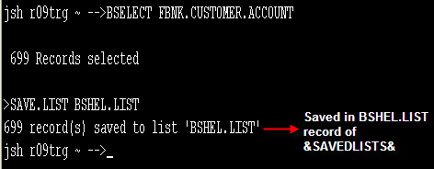
Example

Slide 36


www.capgemini.com/financialservices

