Slide 1
Travel Experts
Website Development project
By
the design super group
Notes:
Adam

Slide 2

Agenda
Executive Summary
Who we are
Goals and Objectives
Website Live Drive
Financial Summary
Q&A
Notes:
Adam

Slide 3

Executive Summary
Travel Experts
Top travel agency in Calgary, Alberta
Divers and growing client base
Website to support growth strategy
The Design Super Group
Team of in-house developers and designers
Experienced in customer-specific web solutions
Drive solutions through technology
Notes:
Adam

Slide 4








Who We are
Boutique software development firm based in Calgary, Alberta specializing in full-stack website design and development
Provide custom solutions for projects of all sizes
Focus on relationships to understand client needs
Technology:
Website – HTML, JavaScript, Bootstrap, Cascading Style Sheet
Database/Server – Mongoose, MongoDB, Node.js, MS Azure
Notes:
Adam

Slide 5

Our Team
Edwin Gono Santosa
Senior Developer
Chikaodili Ikechukwu
Senior Developer
Adam Zukowski
Project Manager / Designer
Oyakhire Airende
Chief Technology Officer / Writer
Chinenye Okpalanze
Chief Executive Officer
Notes:
Adam

Slide 6

Goals and Objectives
Create a solution which enables digital growth
Website and Server
Engaging customer experience
Attractive product showcase
High functionality
Database
Front-end back-end seamless integration
Easy to understand
Secure and safe
Notes:
Adam

Slide 7
Solution overview
Client
HTML,JS, CSS
Application Server
Node.js
Database Server
Mongo.DB
Cloud Platform
MS Azure
Internet
Notes:
Oyaks

Slide 8

Website Requirements
Clear and easy to navigate
Attractive and with a consistent look
Main page – welcoming and provides links & menus
Contact Us page – contact information for the agency
Vacation Package page – list of available packages
Customer Registration page – customer account set up
Notes:
Oyaks

Slide 9

Database Requirements
Easy to navigate categories
Easy updates to existing data and categories
Packages page - data dynamically generated
Registration page – data storage
Notes:
Oyaks

Slide 10
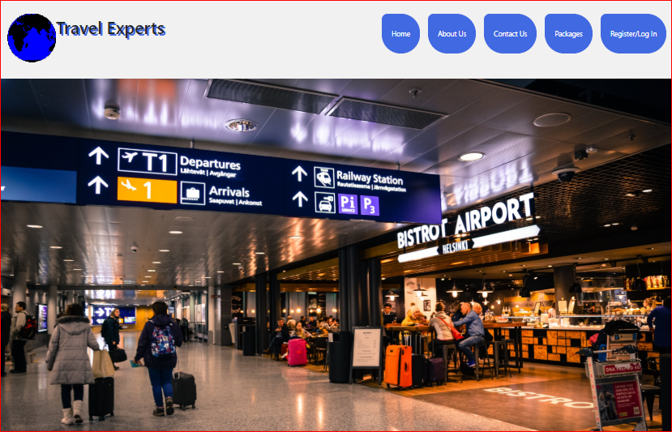
Website – Live Drive
Travel Experts Experience
Home
About Us
Contact Us
Packages
Registration/Log In
https://ajala.azurewebsites.net/
Notes:
Main page – welcoming and provides links & menus – Edwin
About us – Edwin
Contact Us page – contact information for the agency – Edwin
Agents table
Contact us form database update
Vacation Package page – list of available packages – Chika
Package table
Customer order form
Oder database update
Customer Registration page – allows customer to set up account – Chinenye
New user
Existing user
MS Azure hosting – Chika

Slide 11
Website Requirements
Clear and easy to navigate
Attractive and with a consistent look
Main page – welcoming and provides links & menus
Contact Us page – contact information for the agency
Vacation Package page – list of available packages
Customer Registration page – allows customer to set up account
Notes:
Oyaks

Slide 12
Database Requirements
Easy to navigate categories
Easy updates to existing data and categories
Vacation Packages page - data for packages dynamically generated
Registration page – data storage
Notes:
Oyaks

Slide 13

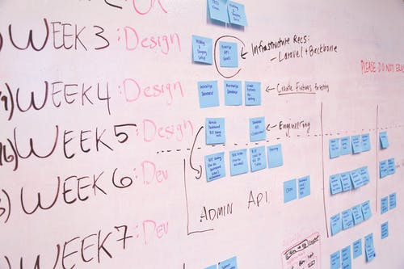
Financials Summary
Budget
Total = $55,249
Spent = $53,750
Balance = $1,499
Schedule
Start - July 20, 2020
End - August 7, 2020
- Total hours – 395 hours
Project Delivered
→ Under Budget
→ On Schedule
Notes:
Oyaks

Slide 14

Thank you
The Design Super Group
Calgary, Alberta
www.designsuper.com
Notes:
Oyaks

