Slide 1
Introduction to a Computer
Computer Programming I
Edited August 2011

Slide 2
Evolution of Computers
Computer Programming I

Slide 3
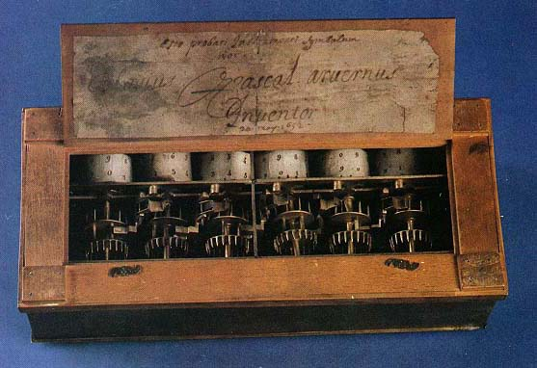
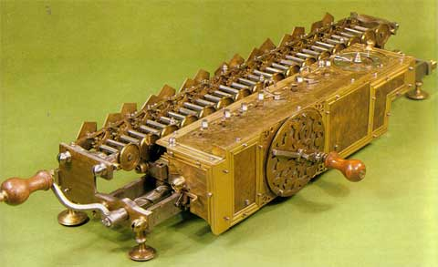
Mechanical Devices
Pascaline (1642)
Set of gears, similar to clock
Only performed addition
Stepped Reckoner
Gottfried Leibniz
Cylindrical wheel with movable carriage
Add, subtract, multiply, divide, square roots
Jammed/malfunctioned

Slide 4
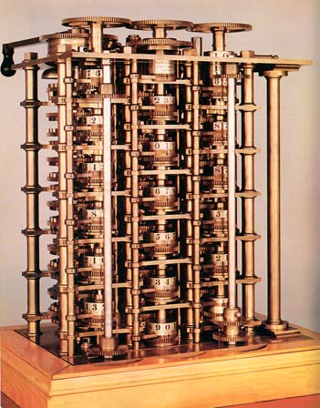
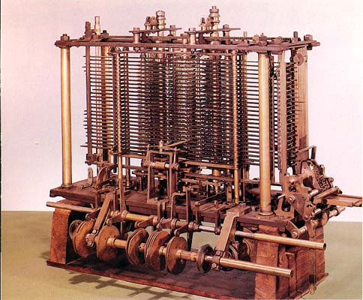
Mechanical Devices
Difference Machine (1822)
Charles Babbage
Produce table of numbers used by ships’ navigators.
Never built
Analytical Machine (1833)
Perform variety of calculations by following a set of instructions (or program) on punched cards
Never built
Used as a model for modern computer

Slide 5
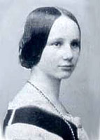
Mechanical Devices
Babbage’s chief collaborator on the Analytical Machine was Ada Byron.
Ada Byron
Sponsor of Analytical Machine
One of first people to realize its power and significance
Often called the first programmer because she wrote a program based on the design of the Analytical Machine.

Slide 6
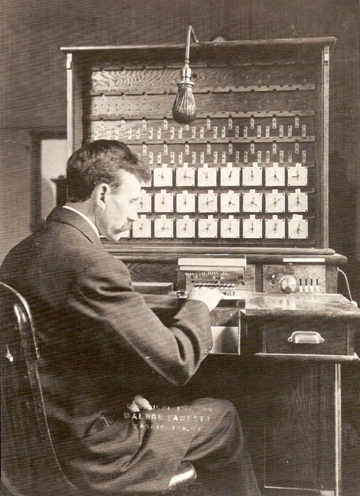
Electro-Mechanical Devices
Hollerith’s Tabulating Machine
Herman Hollerith – used electricity
For US Census
Holes representing information to be tabulated were punched in cards
Successful
Mark I (1944)
IBM & Harvard
Mechanical telephone replay switches to store information and accepted data on punch cards.
Highly sophisticated calculator - unreliable

Slide 7
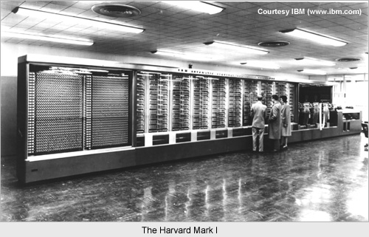
The Mark 1

Slide 8
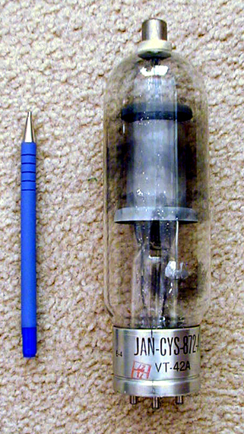
First Generation Computers
Atanasoff-Berry Computer (ABC)
Built b/w 1939-1942
Used binary number system
Vacuum tubes
Stored info by electronically burning holes in sheets of paper.
ENIAC
Electronic Numerical Integration and Calculator
1943, 30 tons, 1500 sq ft., 17,000+ vacuum tubes
Secret military project during WWII to calculate trajectory of artillery shells.
Solve a problem in 20 min that would have take a team of mathematicians three days to solve.

Slide 9
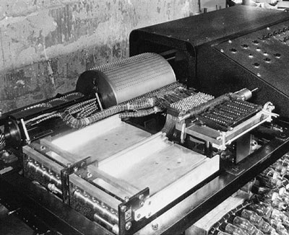
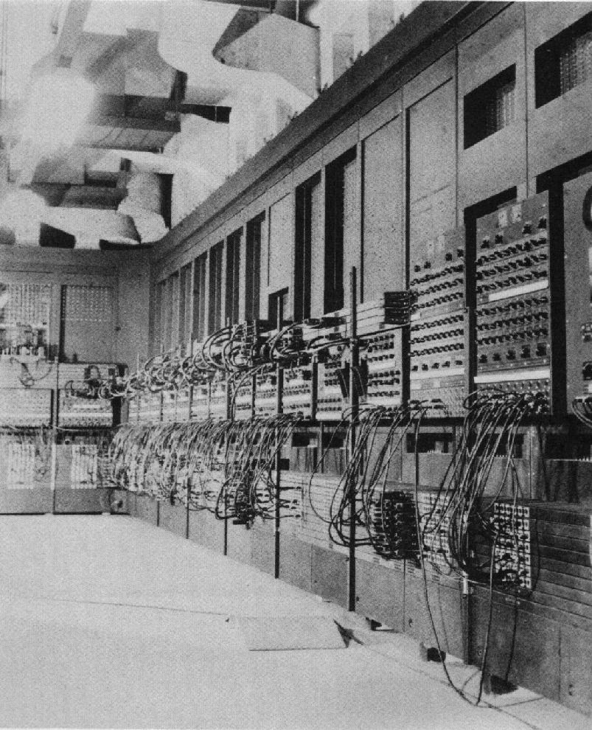
What is a Computer?
An electronic machine that accepts data, processes it according to instructions, and provides the results as new data.

Slide 10
The Stored Program Computer
Alan Turing & John von Neumann
Mathematicians with the idea of stored programs
Turing
Developed idea of “universal machine”
Perform many different tasks by changing a program (list of instructions)
Von Neumann
Presented idea of stored program concept
The stored program computer would store computer instructions in a CPU.

Slide 11
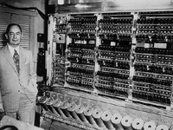
The Stored Program Computer
Von Neumann, Mauchly and Eckert designed & built the EDVAC (Electronic Discrete Variable Automatic Computer) and the EDSAC (Electronic Delay Storage Automatic Computer)
Designed to solve many problems by simply entering new instructions stored on paper tape.
Machine language (1’s & 0’s)

Slide 12
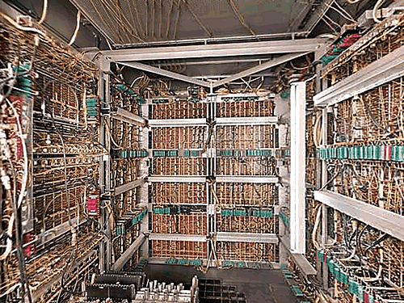
The Stored Program Computer
Mauchly & Eckert built 3rd computer (UNIVAC - UNIVersal Automatic Computer)
1st computer language – C-10 (developed by Betty Holberton)
Holberton also developed first keyboard and numeric keypad
First UNIVAC sold to US Census Bureau in 1951

Slide 13
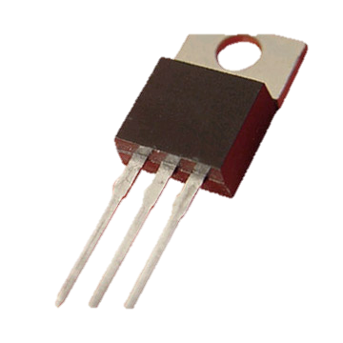
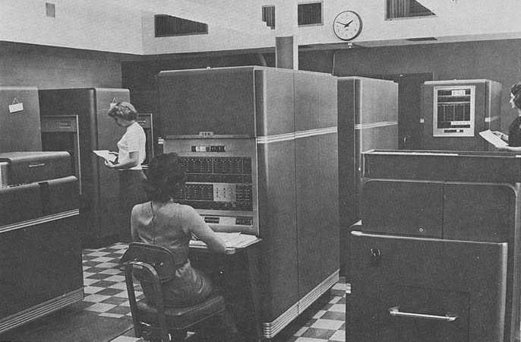
Second Generation Computers
1947, Bell Lab (Shockley, Bardeen, Brittain)
Invented the transistor
Replaced many vacuum tubes
Less expensive, increased calculating speeds
Model 650 (early 1960s)
IBM introduced first medium-sized computer (Model 650)
Still expensive

Slide 14
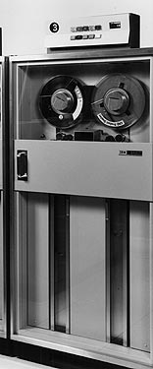
Second Generation Computers
Change in way data was stored
Magnetic tape and high speed reel-to-reel tape machines replaced punched cards
Magnetic tape gave computers ability to read (access) and write (store) data quickly and reliably

Slide 15
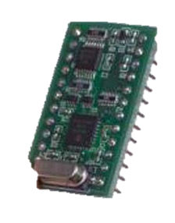
Third Generation Computers
Integrated circuits (ICs) – replaced transistors
Kilby and Noyce – working independently developed the IC (chip)
ICs
Silicon wafers with intricate circuits etched in their surfaces and then coated with a metallic oxide that fills in the etched circuit patterns
IBM System 360 (1964)
One of first computers to use IC

Slide 16
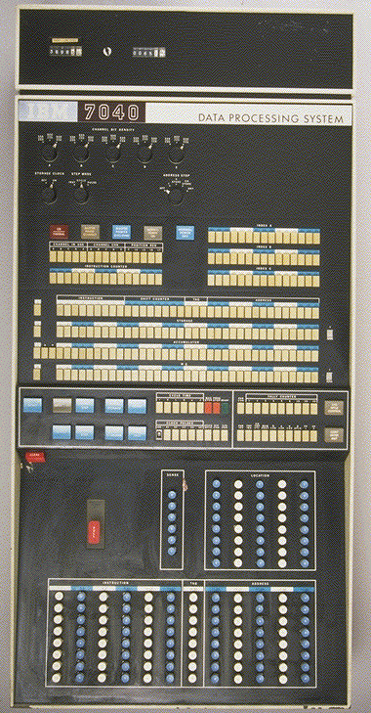
Mainframes
A large computer that is usually used for multi-user applications
IBM System 360 one of first mainframes
Used terminals to communicate with mainframe

Slide 17
Fourth Generation Computer
Microprocessor (1970)
Hoff at Intel Corp, invented microprocessor
Entire CPU on a chip
Makes possible to build the microcomputer (or PC)
Altair – one of first PCs 1975
Wozniak and Jobs designed and build first Apple Computer in 1976
IBM introduced IBM-PC in 1981

Slide 18
Components of a Computer
Computer programming 1

Slide 19
Components of the Computer
CPU/Processor
Memory (RAM)
Storage
Input Devices
Output Devices

Slide 20
The Personal Computer
Hardware
Physical components
Input devices
Keyboard, mouse, cd/dvd, diskette drive, light pen
Peripheral devices
Scanner, printer
Output device
Monitor, printer

Slide 21
Desktop and Mobile Computing
Desktop computers
are single-user systems designed with microprocessor technology where an entire CPU is contained on a single chip.
Designed to fit on or under a desk.

Slide 22
Desktop and Mobile Computing
Mobile computing devices
Long-lasting batteries to allow them to be portable
Notebook computers
Portable, light-weight computers comparable to a desktop in capability
Tablet PCs
Similar to pad/pencil
Write on screen with stylus (pen)
Handwriting recognition software

Slide 23
Desktop and Mobile Computing
Mobile computing devices
Handheld computers
PDAs
Palm-sized
Contains applications for storing contact information, schedules, lists and games.
Use stylus for input
Smart phones
Cellular phones that are able to read and receive email and access the Internet
Some have cameras, video, mp3 players

Slide 24
Desktop and Mobile Computing
Mobile computing devices
Wearable computer
Designed to be worn
In clothing
Wristband
MP3 players, hands-free cell phones
Monitor health problems

Slide 25
The Personal Computer
Base Unit
Contains many storage devices such as a diskette drive, a cd/dvd drive, and a hard disk drive.
Contains the motherboard which contains
CPU (Central Processing Unit)
Processes data and controls the flow of data between the computer’s other units.
ALU (Arithmetic Logic Unit)
Performs logic and arithmetic operations
Makes comparisons
So fast that the time need to carry out a single addition is measured in nanoseconds (billionths of a second)

Slide 26
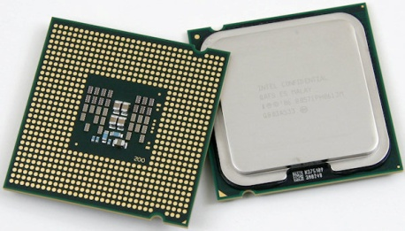
CPU/Processor
A computer’s processor is the “brain” of the computer. All calculations and operations function because of the CPU.
Speed is measured in Hz usually gigahertz (GHz) today. A hertz is a measure of a cycle.
Current CPUs range from 1.8 to 3.2GHz.
Quad Core CPU in the LGA (Land Grid Array) 775 package

Slide 27
CPU
Current CPUs are dual, tri, quad, or oct core.
CPUs now have up to 8 “brains”. They can for the first time perform more than one operation at the same time!
Before dual core CPUs, CPUs could only perform one operation at any given second. The operation could change very rapidly, but it always only actually performing one operation. This is no longer the case with dual/tri/quad core CPUs.

Slide 28
Data Flow through the CPU
Input
Memory
Output
CPU
The “Brain” of the Computer

Slide 29
CPU
CPUs contains the following:
L1 cache
L2 cache
Processing Unit
Memory Controller
Cache is high speed memory that stores frequently accessed instructions. Cache makes your computer faster. Current CPUs have 128KB of L1 cache and up to 32MB of L2 cache.

Slide 30
What is Cache?
Cache (pronounced cash) is high speed memory. L(Level) 1 cache is within the CPU itself. This cache is very high speed and stores instructions executed over and over.
Example: If you are playing a card game, the L1 cache might store the instruction to flip over a new card.
L2 cache is a slower and larger version of L1 cache.

Slide 31
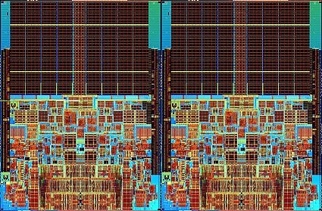
Cache
Level 2 cache is at the top of each die. You are looking at a quad core CPU (2 dual cores glued together. L1 cache is located at the bottom middle. This is an actual image of a CPU. Intel Q6600 to be exact.
L2 cache
L1 cache

Slide 32
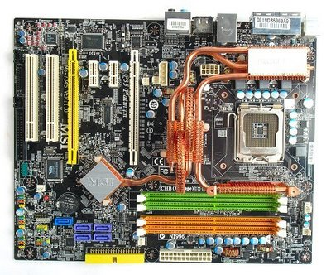
CPU
CPUs plug into a mother(main)board. This board is where all components of your computer are plugged into.

Slide 33
The Motherboard
Contains
Expansion boards
Circuit boards that connect to the motherboard to add functionality. (sound and video) **2005
Clock rate
Determines the speed at which a CPU can execute instructions
Megahertz (million of cycles per second) MHz
Gigahertz (billion of cycles per second)GHz
Memory
Stores data electronically
ROM – Read Only Memory
Contains most basic operating instructions for computer
Cannot be changed – permanent
RAM – Random Access Memory
Memory where data and instructions are stored temporarily
Data stored in RAM can be written to any type of storage media (diskette, cd, jump drive)

Slide 34
The Motherboard
Contains
SRAM – Static Random Access Memory
High-speed memory referred to as cache
Used to store frequently used data for quick retrieval
Bus
Set of circuits that connect the CPU to other components
Data Bus/Address Bus
Transfers data between the CPU, memory and other hardware addresses that indicate where the data is located and where it should go
Control Bus
Carries control signals

Slide 35
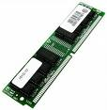
Random Access Memory (RAM)
Without RAM your computer will not operate. It will just beep loudly for the next 216 years or until you turn it off.
RAM is plugged into the motherboard into the long slots with tabs on the end.
Current PCs have between 512MB and 4GB of RAM installed.
A stick of RAM →

Slide 36
RAM
RAM holds data for all applications that are currently running on your computer, but only while the power is on.
Your computer has RAM because it is up to 1000 times faster than your hard drive where the data is stored.

Slide 37
Types of RAM
Current computers use DDR2 or DDR3 RAM.
Notebooks/Laptops use SO-DIMMs which is DDR3 RAM but smaller.
DDR= Double Data Rate which means the computer reads data from the RAM at least two times per cycle.

Slide 38
RAM Speed
Speeds are measured in MHz or throughput rate. DDR2-800 and PC2-6400 are the same thing.
When measured in megahertz the speed will be prefixed with DDR, when measured by throughput the speed will be prefixed by PC.
Throughput is measured in MB/sec so 6400=6400MB/sec or 6.4GB/sec.
PC2- DDR2 PC3- DDR3

Slide 39
Bytes
The unit used to measure memory and storage on a computer is a byte. Bytes can be broken down into bits (binary digit ). A bit is a single 0 or 1 in binary. 1 byte is a character like an A.
Some languages (mainly Asian) require 2 bytes to display one character.
Remember your metric prefixes from math or science? They apply to computers too!

Slide 40
Bytes
Kilo- Thousand (1000 bytes)
Mega- Million (1000 KB, 1,000,000 bytes)
Giga- Billion (1000 MB, 1,000,000 KB)
Tera- Trillion (1000 GB, 1,000,000 MB)
Peta- Quadrillion
Exa- Quintillion
Add byte to the prefix. Kilobyte, Megabyte etc. All can be abbreviated using the first letter of the prefix and B. (KB, MB, GB).

Slide 41
Wrong Numbers?
The numbers you just saw are all in fact wrong- at least when it comes to a computer.
Why is this?

Slide 42
Wrong Numbers?
The numbers you just saw are all in fact wrong- at least when it comes to a computer.
Why is this? You will learn the answer soon!
The numbers are approximations of the actual values which are powers of two.
1 MB is actually 1,024KB. 1024 is the closest a power of 2 can come to 1000.

Slide 43
Storage
Data can be permanently stored on various devices.
Examples:
Hard Drive
Optical disc (CD/DVD)
Flash Drive (USB drive/jump drive)
Floppy Disk
Unlike RAM- data is not lost when power is turned off to these devices.

Slide 44
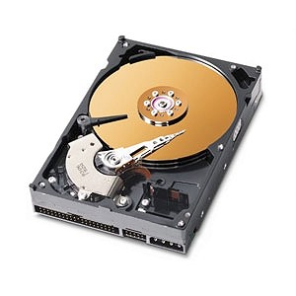
Hard Drive
Works much like a record player. Has platters and an arm(called read/write head) that comes very close (but never touches) the platter and records data using magnetic impulses.
Hard drive with cover off showing a platter and the read/write arm.

Slide 45
Optical Drives
Optical drives use magnetic media like CDs or DVDs to store data. The data is read using a laser.
The laser burns “pits” into the disc to store data. CDs hold around 700MB of data, DVDs hold up to 15.9GB of data.

Slide 46
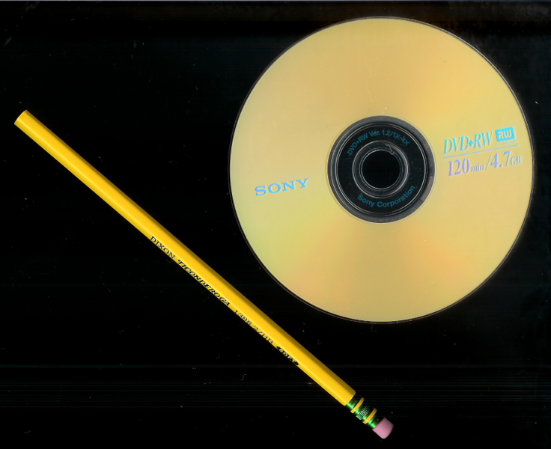
More Optical
CDs and DVDs can be different types-
Audio
Video
Data
Picture
The only difference is what format the data is stored in. All drives read the discs the same way.

Slide 47
Flash Drives
Flash drives are USB drives are sold in capacities of 128MB to 128GB.
Flash drives use a special type of memory called flash memory based on EEPROM or Electrically Erasable Programmable Read-Only Memory)
Flash drives are small, and can store data for up to ten years.

Slide 48
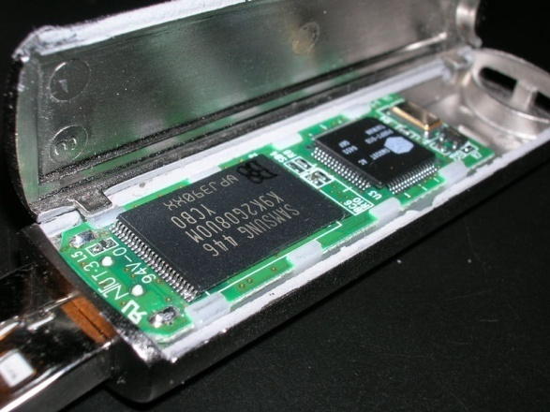
More Flash
Unlike other storage- flash drives can be dropped and not lose data.
iPod Nano/iPod Touch/iPhone/iPad also use the same flash memory as a flash drive to store music.
Flash drive opened up showing the memory chips

Slide 49
Programming Languages
Computer Programming I

Slide 50
Types of Languages
Programming Languages are classified into various categories:
High Level
Very High Level
Low Level
The higher the level the more abstraction from the hardware.

Slide 51
Low Level
Low level languages have almost no abstraction from the hardware.
This code is written to specific hardware, and will only operate on the hardware it was written for.
Notes:
It would be helpful to define abstraction for the students here.

Slide 52
More Low Level
Two types:
Machine Code (1GL)
Assembly Language (2GL)

Slide 53
Machine Code
Machine code is understood directly by the CPU. An example is below:
8B542408 83FA0077 06B80000 0000C383 FA027706 B8010000 00C353BB 01000000 B9010000 008D0419 83FA0376 078BD98B C84AEBF1 5BC3
Obviously, it takes specialized knowledge to program in machine code.
What numbering system is this?

Slide 54
Machine Code
8B542408 83FA0077 06B80000 0000C383 FA027706 B8010000 00C353BB 01000000 B9010000 008D0419 83FA0376 078BD98B C84AEBF1 5BC3
If you said Hex, you are right! Machine code is written in hex. The groups of numbers reference memory addresses in RAM.

Slide 55
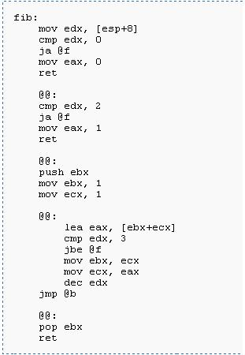
Assembly Language
One level of abstraction from machine code is assembly language.
The same program from the last slide is given in MASM an assembly language.

Slide 56
High Level Language
In contrast a high level language provides strong abstraction from the hardware.
This allows a program to be written in a language that can run on multiple types of computers (running the same operating system).

Slide 57
More High Level
We will code in Visual Basic 2010
Basic is an old language that has been updated over the years and adapted by Microsoft for use for writing Microsoft Windows and Web applications.

Slide 58
Evolution of Basic
Basic first appeared in 1964 and was designed by John George Kemeny and Thomas Eugene Kurtz at Dartmouth University.
The current version of Visual Basic is the 9th version from Microsoft. (Visual Basic 2010)
Microsoft first released VB in 1991. This moved the BASIC language to an event driven and object-oriented programming (OOP) language.

Slide 59
Other High Level Languages
C#
C++
J#
F#
Java
D
E
And the list goes on and on…
Notes:
http://en.wikipedia.org/wiki/Categorical_list_of_programming_languages

Slide 60
A History Lesson
When was the first computer program written and who wrote it?

Slide 61
A History Lesson
When was the first computer program written and who wrote it?
A: Ada Lovelace- in 1842-43.
Modern programming is said to of started in the 1940s.
The first “modern” language was Plankalkül which was described in 1943, but not implemented until 1998. It was designed by Konrad Zuse.
Notes:
Plankalkül is German for Plan Calculus

Slide 62
Languages Used Today
The 1950s and 1960s brought about languages still used today:
FORTRAN- John Backus et al. (1955)
LISP- John McCarthy et al.(1958)
COBOL- Grace Hopper et al. (1959)
RPG- IBM (1959)
BASIC- 1964 (as noted previously)
Notes:
FORTRAN- "FORmula TRANslator“ LISP- the "LISt Processor“ and COBOL- COmmon Business Oriented Language

Slide 63
Late 1960s and 1970s
This was the period when most of the languages used today were invented or are derived from one of the languages invented in this time period.
1969- B (forerunner to C)
1970- Pascal (Java borrows from Pascal)
1972- C (C++, Java, C#, and many others are based on C)
1973- ML (F# is based on ML, C++ borrows from ML too)
1978- SQL (databases)

Slide 64
The Internet Age 1990s
During the early/mid 1990s many Internet languages were developed:
1991-Python
1995- Java
1995- Javascript (not related to Java)
1995- PHP
1995- Delphi (Object Pascal)

Slide 65
So what has changed?
The past few slides contained a list of all these languages, but how have they evolved?
The biggest change is more abstraction as described previously.
For example a program written in Java on a Windows system an run on a Mac, Windows, Linux, etc. as long a the proper software (a Java complier) is installed.
Early programs were bound to specific hardware- current programs are not.

Slide 66
OOP (Object Oriented Programming)
The next major evolution is the move to object oriented programming or OOP.
As defined by Wikipedia: Object-oriented programming (OOP) is a programming paradigm using "objects" – data structures consisting of data fields and methods together with their interactions – to design applications and computer programs.
Notes:
OOP is not the end all be all in fact many people particularly in academia widely criticize it.

Slide 67
Wrapping it Up
In this lesson we took a look at how a computer works and the evolution of computers and programming languages..

