Slide 1
Understand Problem Solving Tools to Design Programming Solutions
Computer Programming I

Slide 2
Objective/Essential Standard
Essential Standard: 2.00 Understand the Solution Development Process
Indicator: 2.02 Understand Problem Solving Tools to Design Programming Solutions. (3%)

Slide 3
Problem Solving Tools
Programs are created to solve problems.
A solution must be designed prior to coding.
One method of designing a solution to a problem is to create an algorithm.

Slide 4
Algorithms
An algorithm is a list of steps to solve a problem written in plain English.
Steps to solve a problem are written out and numbered in the order in which they should be executed.
They should be as extensive as necessary to outline the solution.
Your algorithm is not only going to tell your program what to do but how to do it.

Slide 5
Algorithm Example – Going Home
The Walk Algorithm
Leave classroom
Turn right out of school building
Walk 1.2 miles
Turn right on street
Go to 4th house
The Bus Algorithm
Go to the bus area
Get in right bus
Go to house

Slide 6
Algorithms
Both algorithms, and others that accomplish the same task (of getting you home).
There are advantages and disadvantages associated with each option.
You have to consider each option and its advantages/disadvantages before you choose the algorithm you want to continue developing into your program.

Slide 7
Programming Algorithm Example
Simple steps representing a process for dealing with a guessing game in which the computer generates a random number and the player guesses.
Generate a secret random number between 1 and 100.
Get a number from the player.
Compare the player’s guess to the secret number.
Compare the numbers. If the numbers are identical, go to step 5. Otherwise, tell the player the number was either too high and return to step 2.
Display a message stating the secret number was guessed.

Slide 8
Pseudocode
Pseudocode is a mix of English language and code that represents what you want your program to do.
It helps you determine how you want the program to work as well as what variables and methods/functions you will want to include.
Developing pseudocode will help you work through your logic, reducing the number of errors and potential re-writes you will have to do.

Slide 9
Pseudocode Example
Represents the same process for dealing with a guessing game in which the computer generates a random number and the player guesses the number
Sub btnCheckGuess_Click()
randomNumber = 37
Get playerGuess from text box
If playerGuess = randomNumber Then
Display “Correct”
ElseIf playerGuess < randomNumber Then
Display “Guess too Low”
Else
Display “Guess too High”
End Sub

Slide 10
Flowchart
A third tool in programming is through the use of a flowchart.
Flowcharts use symbols and text to give a visual representation of a solution to a problem.
The direction of the arrows indicates the flow of the logic.
Notes:
Multiline comments are not supported in VB. Each line of the comment must begin with a ' .

Slide 11
Flowchart
Flowcharts help the programmer begin to plan the programming project.
They provide a visual representation of the algorithm or process.
They describe the inputs, processes and outputs of the program that are needed to successfully complete the project.

Slide 12
Flowchart Symbols
There are many flowchart programs, however you can also use Microsoft Word to create a flowchart – or just a piece of paper and a pencil.
To create the flowchart, there are different symbols that represent the various parts. We will only use a few of these symbols.
Use lines with arrows to indicate flow of control.
The text in your flowchart symbols is your pseudocode.

Slide 13
Flowchart Symbols
Ovals : Start should always be the first shape, with a End at the end of the flow chart or a process.
Start/End
Parallelogram: This shape is used to show raw materials used for ‘ingredients’ and to show the finished product. Input/Output – Get/Display
Input/Output
Processes
Rectangles should be used to show processes/commands, eg. ‘Bake Cake’. These are activities.
Decisions
Diamonds: Hold questions that resolve into True or False. Used for decisions that divide into two options and to control loops.

Slide 14
Oval
Used for Start & Stop
Start
Parallelogram: Used for inputs – raw materials
Examples:
Get Cake Ingredients
Plastic, metal
Sequence Logic Structure
Commands one after another
Input
Process A
Input
Rectangle :
Used for all processes
Examples:
Bake cake, Review music
choices or Build wheels
Process B
Parallelogram:
Used for outputs
– finished product
Examples:
Finished cake
Car door
Output
Stop

Slide 15
Structured Programming
A technique that has proven to be very effective in solving programs as well as in modifying solutions.
The principles of structured programming are fundamental to procedure-oriented programming.
They are also relevant to object-oriented programming.

Slide 16
Structured Programming
Structured programming is the ability to express a problem solution using only three basic patterns of logic. These patterns are referred to as control structures.
The patterns are based on the computer’s ability to execute instructions in a step-by-step, sequential manner; its ability to make decisions; and its ability to repeat instructions.
“Structure theorem” (paper by C. Bohm and G. Jacopini in 1965) – accepted as a proof of the claim that the three structures are sufficient for programming.

Slide 17
Basic Control Structures
Three patterns:
Simple Sequence control structure
Conditional control structure
Decision
Iteration control structure
Loops

Slide 18
SIMPLE SEQUENCE Control Structure
Represents the computer’s ability to execute instructions in a step-by-step, sequential manner.
Example: directions to get to the school – steps must be followed sequentially

Slide 19
SIMPLE SEQUENCE Control Structure
Proceed down Main Street for two miles
Turn left on Ocean Drive,
Proceed on Ocean Drive for three blocks, to the fork.
At the fork, take Swan Street to the left.
Proceed two blocks.
House is second on the left. (246 Swan Street.)

Slide 20
Conditional Control Structure
Represents the computer’s ability to make a decision
Example: provide alternate directions if there is a blocked intersection.

Slide 21
Conditional (Decision)
Logic Structure
One time through – one way or the other only
Start
Input -optional
If Question- answered true or false
True (yes)
False (no)
Process A
Process B
End Decision
Output -optional
Stop

Slide 22
Start
Conditional (Decision)
Logic Structure
Used for Start & Stop
Input
Used for inputs – raw materials
Examples:
Cake Ingredients
Plastic, metal
True (yes)
If Process
A
False (no)
Used for decision making
- Questions
Process A
Used for all processes
Examples:
Bake cake
Review music choices
Build wheels
Process B
End Decision
Used for outputs – finished product
Examples:
Finished cake
Car door
Output
Stop

Slide 23
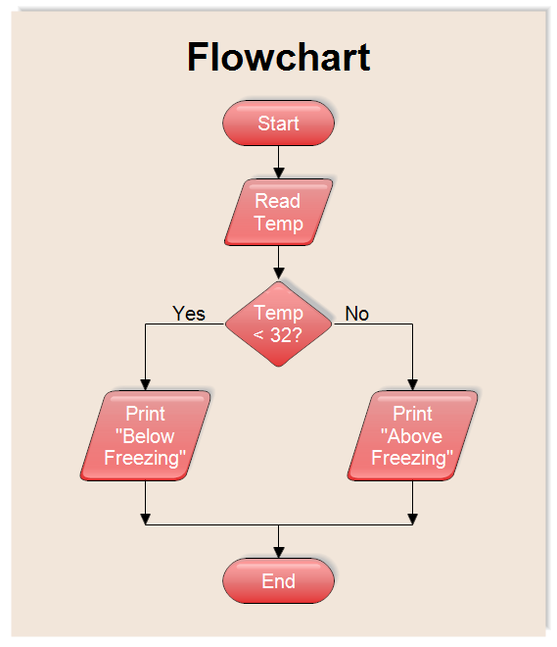
Conditional (Decision)
Logic Structure
One time through – one way or the other only

Slide 24
Decision - Pseudocode and Flowchart
Start
Proceed down hall
Proceed down hall
Turn left at first intersecting hallway
IF hungry THEN
Turn right into the cafeteria
ELSE
Continue to classroom
ENDIf
Turn left at first intersecting hallway
Hungry?
F
T
Continue to Classroom
Turn right into cafeteria
End Decision
Stop

Slide 25
Iteration Control Structure
Represents the computer’s ability to repeat a series of instructions
Loop – a series of repeated instructions
Infinite loop – instructions that would continue without a way out.
Every loop must include a statement that defines how many times to execute the loop steps or under what condition to continue or stop the looping process.

Slide 26
Iteration Control Structure
DOWHILE hair is not clean
Wash hair
Rinse hair
ENDDO

Slide 27
Loop - Pseudocode and Flowchart
Start
Proceed down hall
Proceed down hall
Get food in cafeteria
DOWHILE hungry
Eat
END DO
Get food in cafteteria
Hungry?
F
T
Eat Food
End Decision
Stop

Slide 28
Used for Start & Stop
Start
Iteration (Loop) Structure Logic
Used for inputs – raw materials
Examples:
Cake Ingredients
Plastic, metal
Input
DOWHILE Question
(T or F)
False (no)
Used for decision making
- Questions
NO PROCESSES ALLOWED HERE!!!!
Exit only
True (yes)
Process A
Process B
ENDDO
Used to show where loop stops – required.
Stop

Slide 29
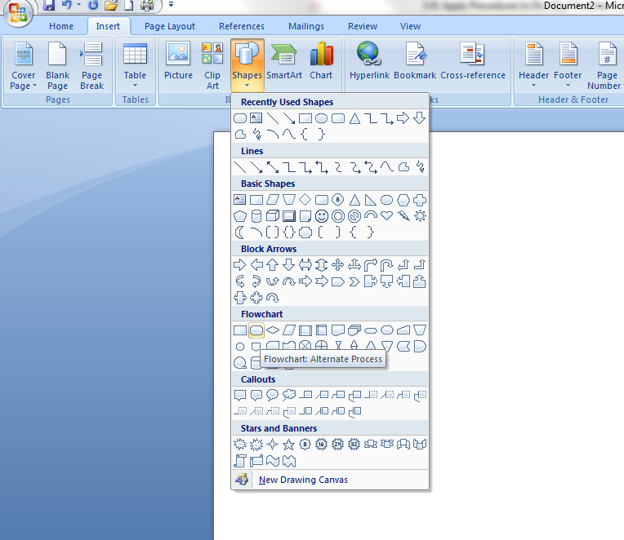
Using Microsoft Word to Create a Flowchart
Open Microsoft Word.
Under Insert choose Shapes
Look down the list until you see Flowchart.
Hoover your mouse over a shape, you will see a popup telling you what that shape is used for.

Slide 30
Using Microsoft Word to Create a Flowchart
Select and draw the shapes needed for your program logic.
Once you draw a shape you can right click and select Add Text to enter information into your symbol.
Join your symbols using arrows indicating program data flow.

Slide 31
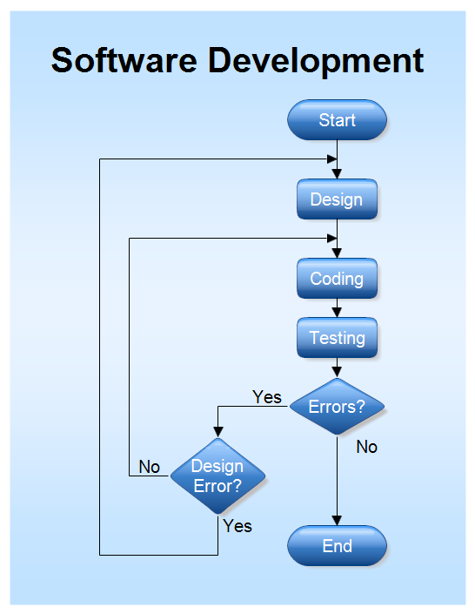
Iteration (Loop) Structure Logic

Slide 32
Expectations
Some general rules:
If you do not understand the problem, you probably will not be able to create a solution.
Remember to start with the solution in mind.
Your program solution should not necessarily look like that of another programmer.
Use your tools to help you determine your solution.

