Slide 1
Essential Standard 5.02 Understand Breakpoint, Watch Window, and Try And Catch to Find Errors
Computer Programming I

Slide 2
Essential Standard and Objectives
Essential Standard 5.00 Apply Programming Logic
Indicator 5.02 Understand Breakpoint, Watch Window, and Try And Catch to Find Errors.

Slide 3
Debugging
So your program is all written- but it does not work!
What’s next?
This process is called debugging.
There are two types of debugging- programmer debugging (fixing errors) or program debugging (allowing for unexpected input from a user)

Slide 4
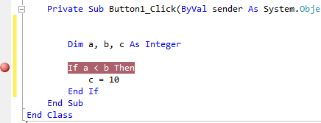
Break Point
A break point is a tool used by a programmer to isolate a section of code and watch how the complier steps through it.
This is often used with a IF statement or loop code.
Break Point example.
Notes:
Ifs and Loops are covered in Standard 7. This works in VB or C# as it is a feature of Visual Studio and not a specific language.

Slide 5
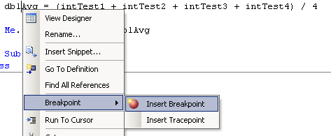
Adding a BreakPoint
There are two ways to add a breakpoint
Right-click on the line of code > BreakPoint > Insert BreakPoint
Click in the grey vertical bar to the left of your code window.

Slide 6
Adding a BreakPoint
A red dot will appear in the grey bar and the text will be highlighted in red.
The breakpoint will be “active” when you execute and the compiler reaches that line of code.
A yellow arrow will appear in the red dot.
The line of code will be highlighted in yellow.

Slide 7

Using a Break Point
In the example below the program has reached the breakpoint.
The program will stop (break) and wait on the coder.
The program is now controlled by the debugging controls.

Slide 8
Debugging Controls
There are 6 tools here.
Green arrow (play): execute the rest of the program without stopping
Pause- stop here
Blue Square-stop the program and return to the IDE
Step Into- move to the next line of code in the programming block
Step Over- skip the current programming block
Step Out- exit the current programming block
Notes:
A programming block is group of code- like a sub, an IF statement, or a loop.

Slide 9
The Watch Window
Another tool is the watch window.
This works only with the debugger is in break mode (at a breakpoint).
The watch window allows the coder to track the value of variables as the program is being executed.
This is useful way to catch logic errors that might otherwise be missed.

Slide 10
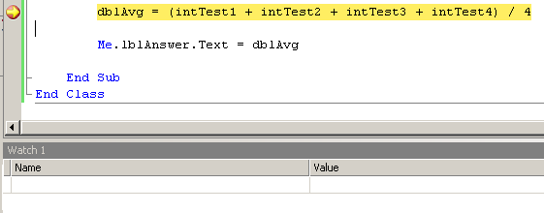
Watch Window
Once in Break Mode, the Watch Window will be displayed.
If it does not open, you can open it.
Debug→Windows→Watch→Watch 1 (up to 4 can be open)

Slide 11
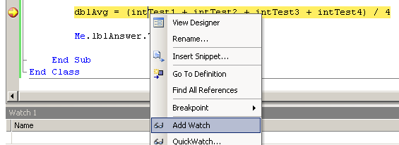
Watch Window
You can hover your cursor over variables in your editor window to see a popup window of the value.
To add variables to the Watch Window
Right Click on the variables you want to “watch”.
Select Add Watch.
The variable is added to the Watch Window.

Slide 12
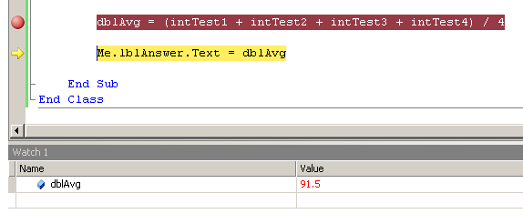
Watch Window
You can now step through your program and see how the values of your variables change.
Note how the line currently executing is highlighted and the values in the Watch window are red.

Slide 13
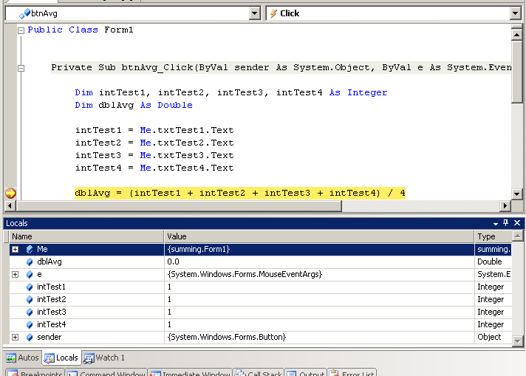
Locals Watch Window
There is an automatic Watch Window called Locals.
Access it by clicking on the tab at the bottom of your IDE. Or Debug > Windows > Locals

Slide 14
Debugging User Input
Good programmers make sure their programs can handle all exceptions.
One of the most common exceptions is bad/incorrect user input
For example: a field that asks for numbers (like an age) but the user enters the string “apple.”
The program will fail or produce unexpected results unless this error is handled.

Slide 15
Try..Catch
Try..Catch is a function to check for incorrect user input.
Basic format
Try
Line(s) of code to check for exceptions
Catch ex As Exception
What to do if an exception is found. Generally use a message box to alert the user
Finally (optional)
Run this code if an exception is found or not
End Try //End of the Statement
Notes:
Try..Catch can be used for other things too, but this is a main use. An exception is an error the program cannot handle on its own.

Slide 16
Example of Try..Catch
A user needs to input their age into a text box. Ensure that only numbers are typed into this box.
Try
intAge = Convert.ToInt32(txtAge.Text)
MessageBox.Show("Your age is: " & intAge)
Catch ex as exception
MessageBox.Show("Enter your age in digits!");
End Try
Notes:
Convert is a function that changes the data type of a variable from one type to another. This is NOT required in Visual Basic by default, but is good programming practice and is required here for the Try to find an exception if a string is entered. Variables (intAge) are covered in Standard 5.

Slide 17
Message Boxes
Alerting the user of an error is often done using message boxes as shown in the previous example.
Basic format: MessageBox.Show(“Message”)
There is no limit to the number of message boxes that can be used in a program.
Notes:
To use a combo of variables and text use the Concatenation operator (& in VB or + C#) which is covered in Standard 5.01.

Slide 18
Alternative Way
In VB there is an alternative way to check for proper input if the value is supposed to be a number.
IsNumeric is a function used with an IF statement.
It returns True if it finds a number, otherwise False.
Example
If IsNumeric(intAge) Then
Perform some code
Else
MessageBox.Show(“Enter Numbers!”)
End If
Notes:
This function does not exist in C#. Skip this slide if you are teaching C#. IF statements are covered in detail in Standard 7.02.

Slide 19
Wrapping it Up
In this lesson you learned how breakpoints, watch window, and try..catch work and can be used for debugging.

