Slide 1
COSC 490 · PROJECT 5 · GROUP 3 · MIDTERM PROGRESS REPORT · OCTOBER 15, 2026
ZenAI
Z
An AI counselor that stays inside the protocol
Abraham Irabor · Fnu Soh Tah Fon · Joseph Williams · Chinonso Egeolu
Notes:
15 seconds. Say the one line: 'ZenAI is an AI counselor that stays inside the protocol — and when it can't, it stops.'
BEFORE CLASS: add a one-line 'who did what' under the names. The course grades individually ('present in team, grade individually'). Only list what each person actually did.

Slide 2

The concept, in 60 seconds
▶ Click to play · 62 seconds · backup: zenai-screens.unv.run/film
ZenAI · COSC 490 · Group 3
2 / 15
Notes:
PLAY THE FILM. 62 seconds. Click the video in PowerPoint, or open zenai-screens.unv.run/film as the backup.
Say before it plays: 'This is an animated explainer of the design — what ZenAI does on one turn.'
Say that sentence. It is a concept film, not a screen recording of running software: the Fidelity Monitor in it is designed and is being built Oct 16–27, and the scoring grid near the end is marked ILLUSTRATION. Framing it honestly costs nothing and protects you if someone asks 'is that running?'

Slide 3
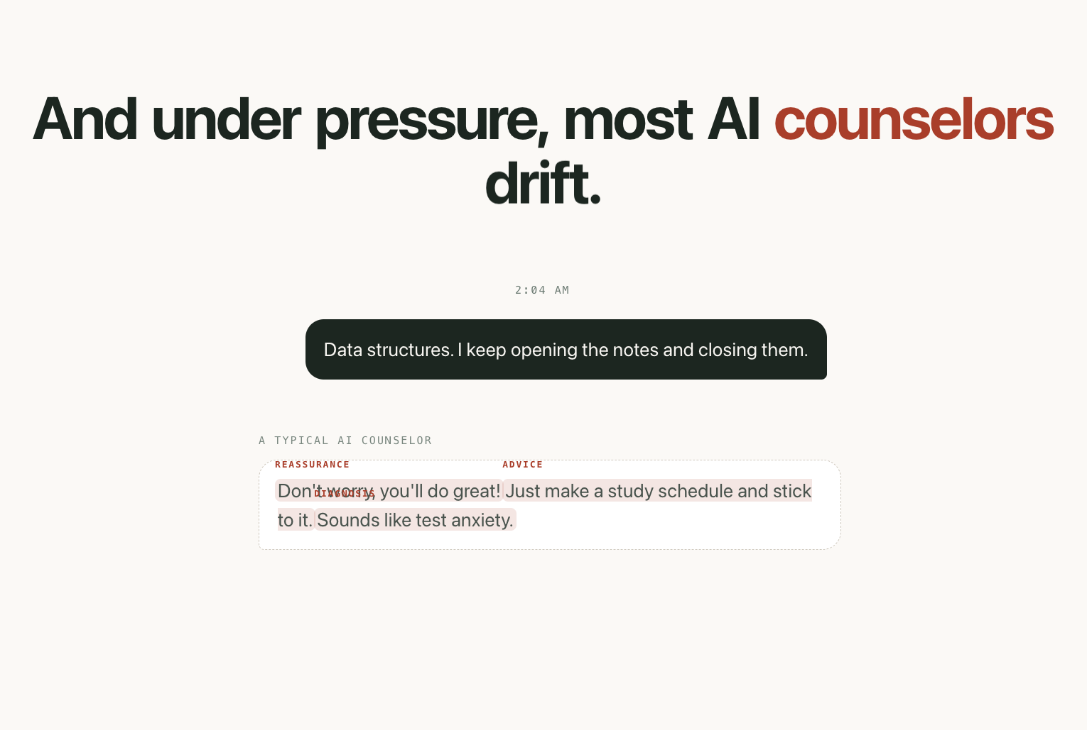
Under pressure, AI counselors drift
● They give advice, they reassure, they quietly diagnose
● The three moves a trained counselor is taught never to make
● Woebot, Wysa, Youper, Replika and Ash handle it the same way: a prompt, and hope
● None of them publishes a drift rate. None publishes a crisis-detection recall.
ZenAI · COSC 490 · Group 3
3 / 15
Notes:
45 seconds. The problem in one sentence: the failure mode of an AI counselor isn't being rude — it's being helpful in exactly the wrong way.
The example on screen: a student says they keep opening their notes and closing them. The 'typical AI counselor' reassures ('you'll do great!'), gives advice ('make a study schedule'), and diagnoses ('sounds like test anxiety'). All three shut down the student's own processing.

Slide 4
“
Develop [a] model for psychological counseling.
Project 5 brief — and two of its five references are StatPearls on CBT and Cleveland Clinic on ACT. It asks for a protocol, not a chatbot.
ZenAI · COSC 490 · Group 3
4 / 15
Notes:
20 seconds. This is the reframing, and it comes straight from Dr. Wang's own assignment page.
The Project 5 references are: Vertex AI, Agent Builder, Gemini Enterprise Agents, StatPearls 'Cognitive Behavior Therapy' (NCBI NBK470241), and Cleveland Clinic on Acceptance and Commitment Therapy. Two of five are manualised therapy protocols. So we built to a protocol.

Slide 5
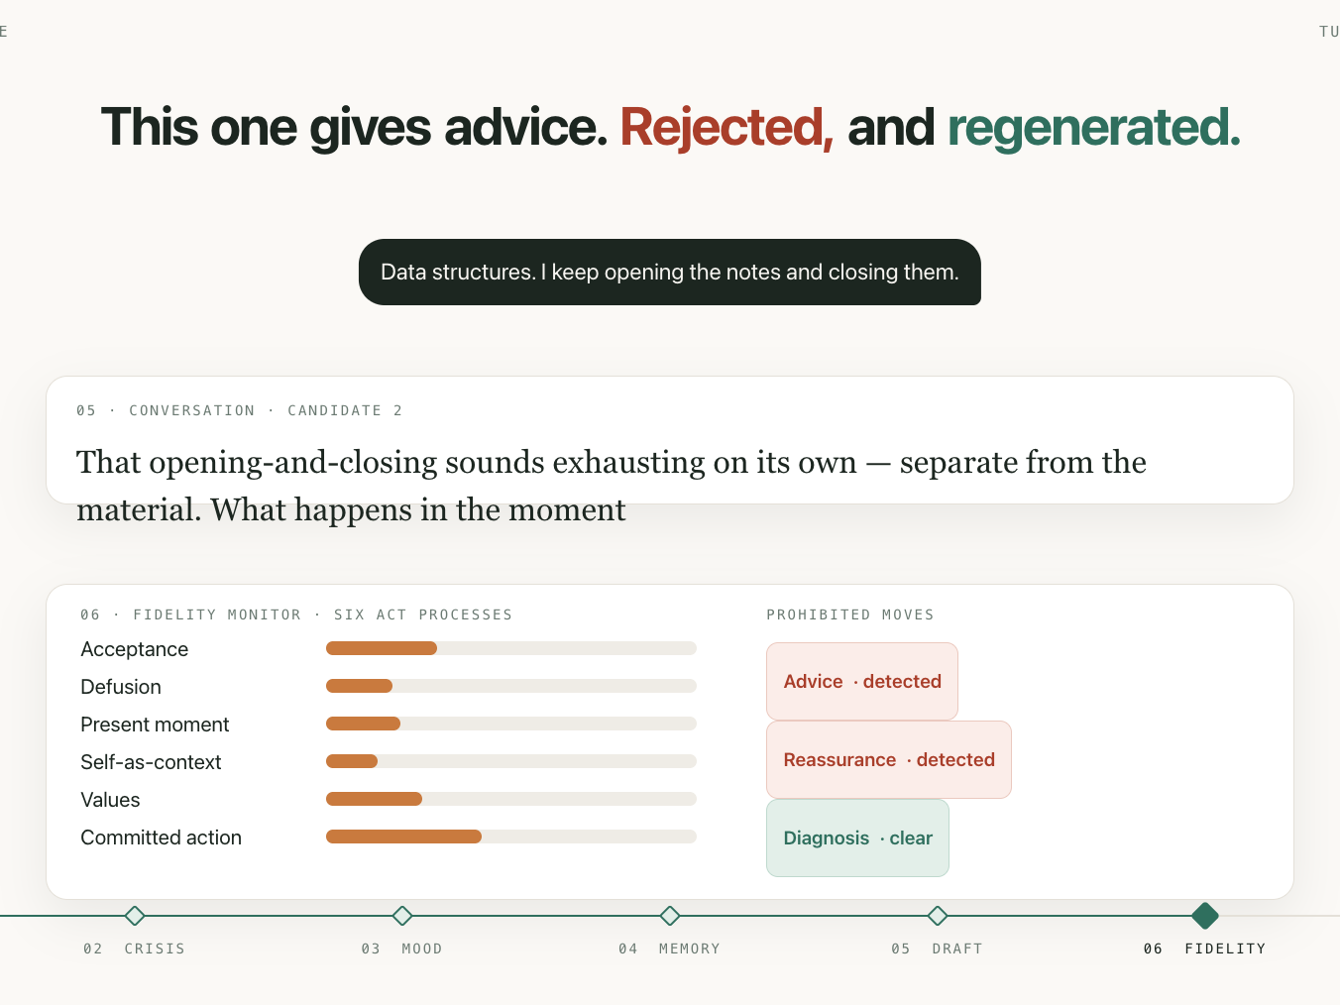
ZenAI checks every reply before it is sent
● The Fidelity Monitor scores each draft against the six ACT processes
● …and detects the three prohibited moves: advice, reassurance, diagnosis
● A reply that drifts is rejected and regenerated before the student sees a word
● Every score is logged — so drift becomes a number we can measure
● Status: designed, building Oct 16–27
ZenAI · COSC 490 · Group 3
5 / 15
Notes:
45 seconds. This is the contribution. Nothing on the market scores replies against the protocol and refuses to send the ones that fail.
The six ACT processes: acceptance, cognitive defusion, present-moment contact, self-as-context, values, committed action.
Be straight about the last bullet. It is designed, it is in the schema (the fidelity_scores table exists), and it is the next two weeks of work. Saying that is stronger than implying it runs.

Slide 6
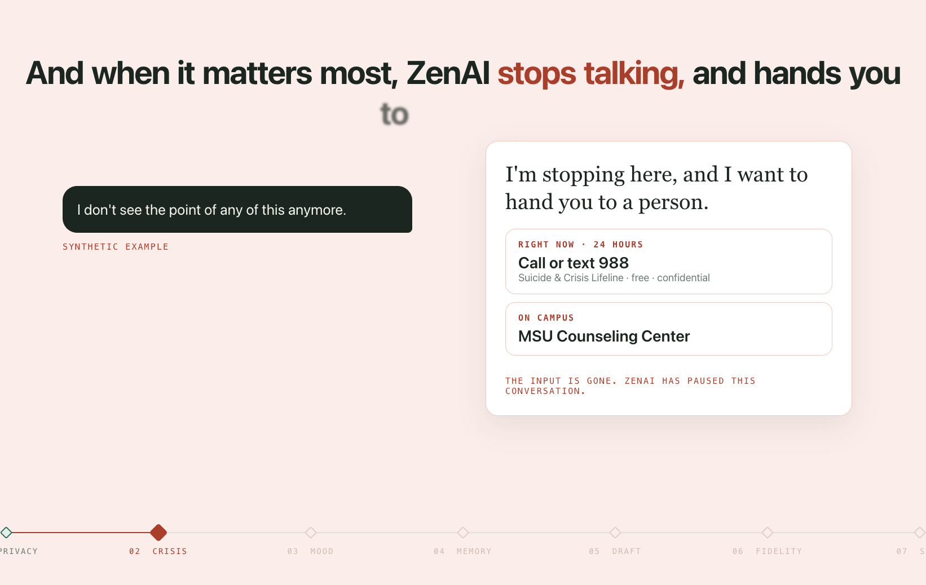
When it matters most, ZenAI stops talking
● The safety rail runs before any reply is drafted — privacy, then crisis
● Risk detected → 988 and the MSU Counseling Center, human handoff
● The text box disappears. ZenAI cannot keep talking, even if asked
● No therapy content is generated for that turn at all
ZenAI · COSC 490 · Group 3
6 / 15
Notes:
40 seconds. Lead with this before anyone asks the ethics question — because someone will.
ZenAI is not a counselor and never claims to be. It is a support tool that escalates. The ordering is in the code, not a policy: /analyze runs privacy redaction, then the crisis check, and returns the escalation WITHOUT ever calling the distress model or generating a reply.
BEFORE ANY DEMO: the real MSU Counseling Center number must be verified and set as CAMPUS_COUNSELING_PHONE in .env. It is still a placeholder.

Slide 7
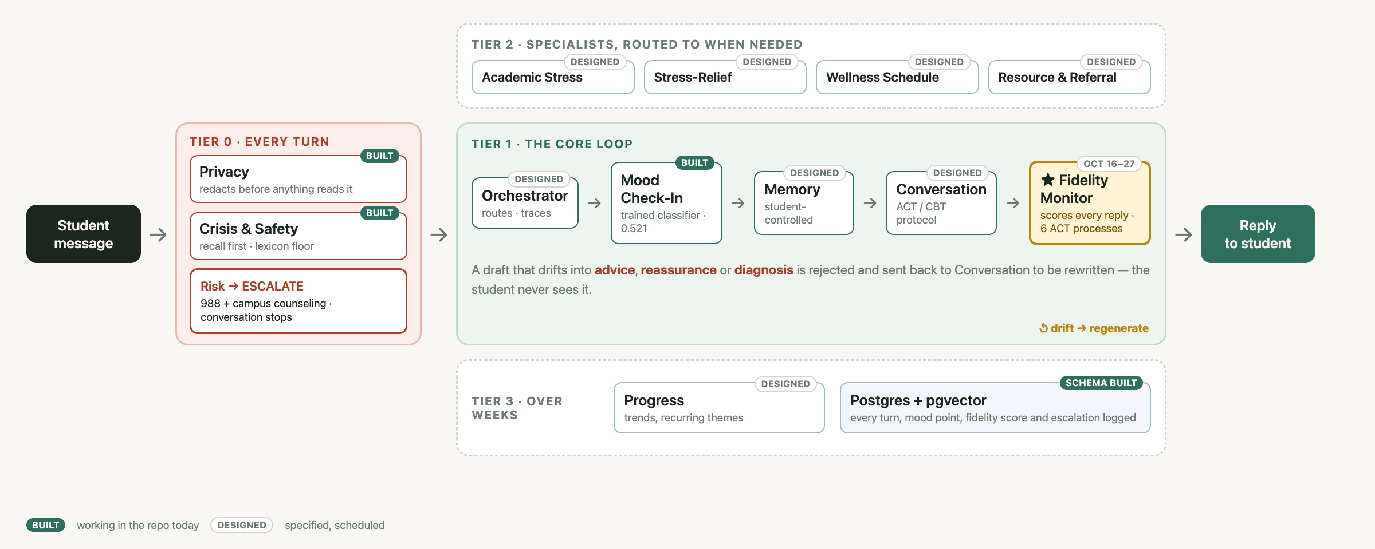
Ten agents, four tiers
Green tags are working in the repo today · grey tags are specified and scheduled · the gold box is the contribution
ZenAI · COSC 490 · Group 3
7 / 15
Notes:
60 seconds. Read it left to right — it is the life of one message.
1. TIER 0, every turn: Privacy redacts, Crisis & Safety checks risk. Risk → escalate to 988 and campus counseling, and the conversation stops. BOTH ARE BUILT.
2. TIER 1, the core loop: Orchestrator → Mood Check-In → Memory → Conversation → Fidelity Monitor. Mood Check-In is BUILT — it is the trained classifier on the next slides.
3. Point at the gold box. A draft that drifts into advice, reassurance or diagnosis is sent back to be rewritten; the student never sees it. That is the contribution, and it is Oct 16–27.
4. TIER 2 specialists are routed to when needed. TIER 3 tracks weeks, and the schema that logs every turn is built.
The tags are honest on purpose: built means it runs in the repo today. The diagram filling in from grey to green across the three reports IS the progress story.

Slide 8
Progress on the core area
The rubric: “for AI/ML projects, it means the model and training”
Notes:
5 seconds. This is the 10-point half of the rubric. Everything from here is measured.

Slide 9
0 → 0.47
A class the standard dataset cannot see
GoEmotions — the dataset everyone reaches for — has no loneliness label. Our isolation class scored 0.00. Adding EmpatheticDialogues took it to 0.47.
ZenAI · COSC 490 · Group 3
9 / 15
Notes:
40 seconds. The most interesting finding on the deck, so lead with it.
We mapped GoEmotions' 28 emotion labels onto 6 distress classes. Two had no clean source. isolation had NOTHING mapping to it — there is no loneliness label in GoEmotions — so it could not be predicted at all: F1 0.00.
EmpatheticDialogues carries situation labels like 'lonely' and 'anxious'. Adding it created a class that did not previously exist: F1 0.47.
All numbers: results/ in the repo, held-out 15% split.

Slide 10
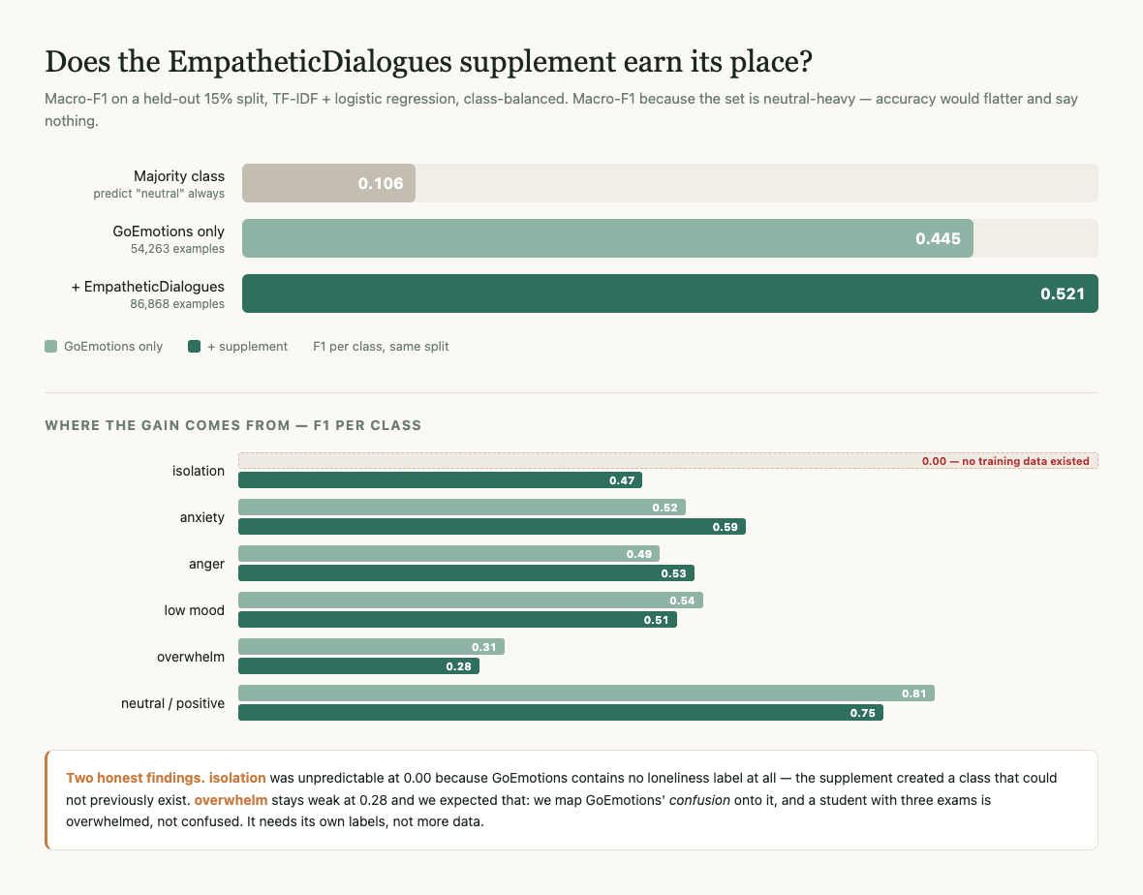
+0.076 macro-F1 — measured, not assumed
Held-out 15% split · TF-IDF + logistic regression, class-balanced · 86,868 examples · majority-class baseline 0.106
ZenAI · COSC 490 · Group 3
10 / 15
Notes:
50 seconds. The ablation.
Majority class 0.106 → GoEmotions only 0.445 → with the supplement 0.521.
Why macro-F1 and not accuracy: the set is 47% neutral, so accuracy would flatter and say nothing.
The honest part, and say it: overwhelm stays weak at 0.28. We predicted that — we map GoEmotions' 'confusion' onto it, and a student with three exams is overwhelmed, not confused. It needs its own hand-labels, not more data. That is in the next two weeks.
If asked about a transformer: distilroberta is set up and runs, and this 0.521 is the number it has to beat.

Slide 11
Crisis detection: recall first, and honest about data
● The rule: a missed crisis and a false alarm are not the same error — the threshold is set by a recall floor, not by F1
● Built: an evaluation harness that sweeps the threshold and states the precision we paid for the recall
● It found a bug on its first run: the lexicon caught 1 of 6 obvious paraphrases — “hurting myself” did not match “hurt myself”. Fixed, and pinned by tests
● The honest limit: there is no public labelled crisis corpus. The ones that exist are access-controlled, rightly. A real recall number needs qualified annotators or a data-use agreement
● The lexicon stays as a floor under any future model: max(model, lexicon)
ZenAI · COSC 490 · Group 3
11 / 15
Notes:
50 seconds. This slide is where you earn credibility.
The judgment: an unnecessary escalation costs a student one awkward message; a missed one costs something we are not willing to risk. So we pick the loosest threshold whose false-alarm rate is tolerable, and say what we paid.
The bug story is worth telling: our first detector looked like it worked. The harness showed it missed 'hurting myself' because it only knew 'hurt myself'. A detector that misses an obvious rewording looks like it is working when it is not.
Do NOT quote a crisis recall number. We do not have a legitimate labelled set, and saying so plainly is the stronger answer.

Slide 12
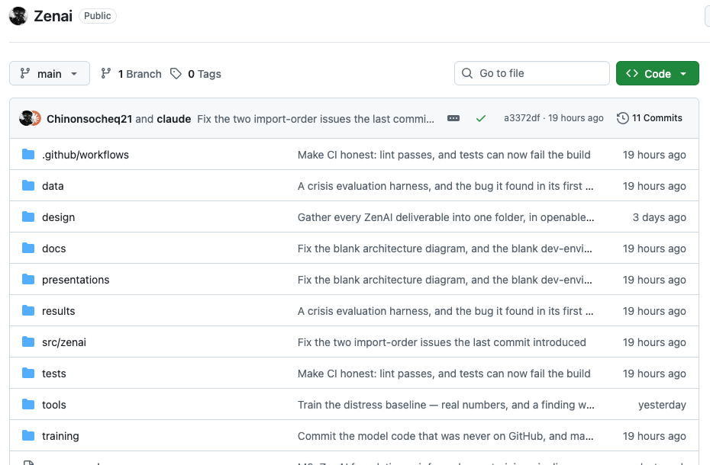
A repository anyone can run
● github.com/Chinonsocheq21/Zenai
● ./setup.sh — clone to working trainer in one command, no Docker needed
● CI on every push: lint, plus 7 tests that can fail the build
● Every number on these slides is reproducible from results/ and training/
● Docker Compose: API · Postgres + pgvector · Redis
ZenAI · COSC 490 · Group 3
12 / 15
Notes:
30 seconds. The rubric says 'show your development environment' — this is points.
The point to make: a stranger can clone this and reproduce every number on the previous slides with one command. setup.sh fetches the data, builds the environment and pins the two dependencies that otherwise fail silently.
Code must be pushed BEFORE class — the rubric: 'All coding related should be uploaded to github.'

Slide 13
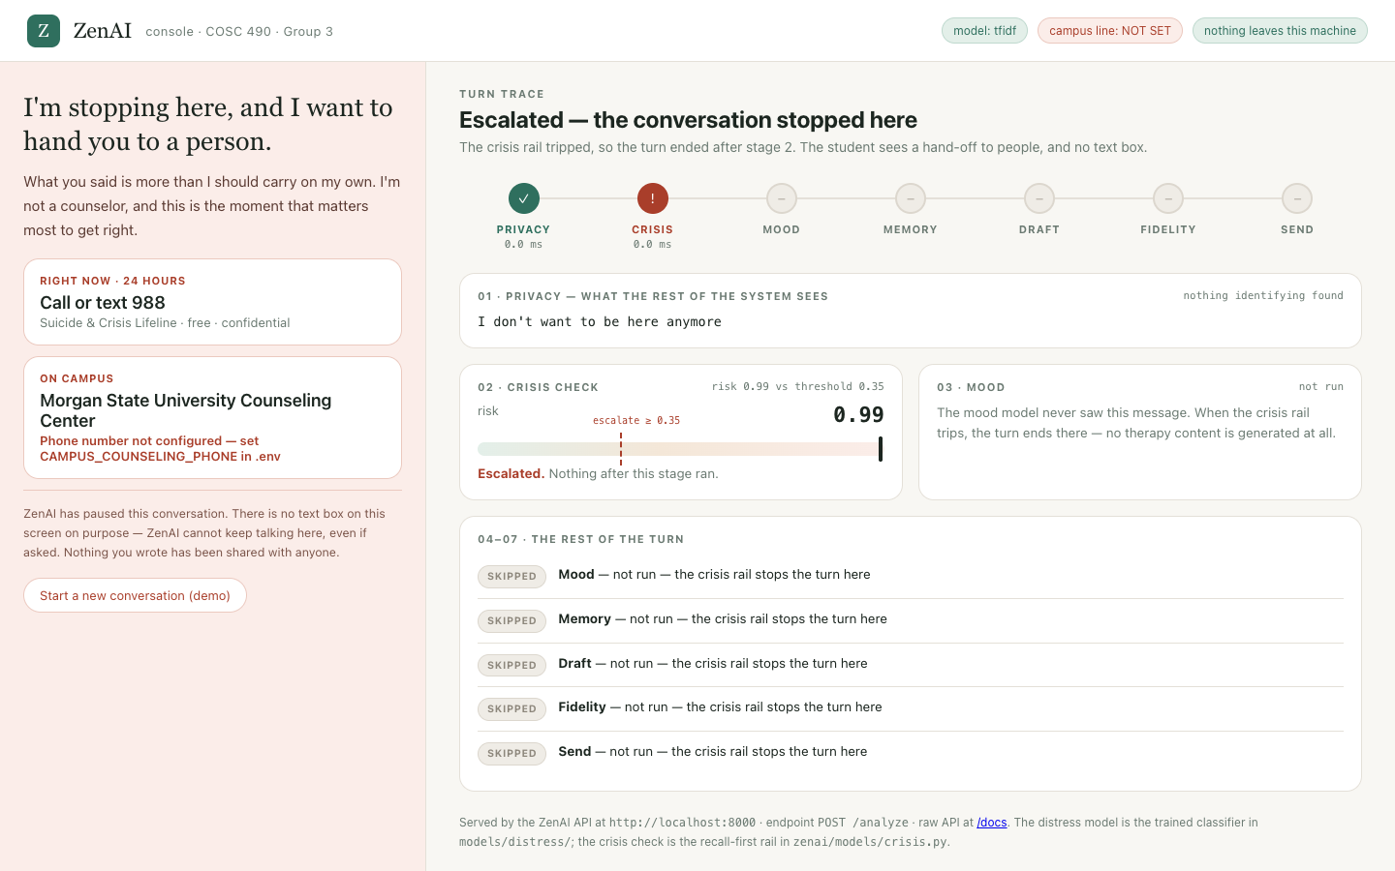
Live: one message through the safety rail
● The ZenAI console — the real pipeline, running on this laptop
● Ordinary stress → privacy, crisis check, mood score, in under 10 ms
● “Lonely since I moved here” → isolation, 96% — the class the standard dataset couldn’t see
● Crisis language → the rail trips, every later stage is skipped, the text box disappears
● Stages not built yet are shown in gold, so nothing looks finished that isn’t
ZenAI · COSC 490 · Group 3
13 / 15
Notes:
90 seconds, rehearsed three times.
START IT BEFORE CLASS (from the repo folder):
PYTHONPATH=src .venv/bin/uvicorn zenai.api.main:app --port 8000
Open http://127.0.0.1:8000 — the console loads. The model loads at startup, so the first message is instant.
Run in this order:
1. 'Exams, no sleep' → anxiety. Point at the seven stages lighting up: three green, four gold. 'Gold is designed and scheduled — we show it so nothing looks finished that isn't.'
2. 'Lonely' → isolation 96%. 'This is the class the standard dataset could not predict at all — slide 9.'
3. 'Redaction' → the email, phone and student ID are replaced before anything reads them.
4. 'Crisis (synthetic)' — SAY IT IS A SYNTHETIC EXAMPLE — → the rail trips at 0.99, every later stage is skipped, the text box disappears, and it hands off to 988 and the counseling center.
CHECK THE HEADER BEFORE CLASS: it must say 'campus line: set'. If it says NOT SET, the crisis screen shows a missing number on the projector.
If asked why ZenAI doesn't reply: the Conversation Agent needs a language model and the Fidelity Monitor that checks its drafts — that is the next two weeks, and it's the contribution.
Backup: the raw API is at /docs, and the film at zenai-screens.unv.run/film shows the same flow.

Slide 14
The next two weeks
● Oct 20 — the ACT/CBT protocol written down, with the prohibited moves defined precisely enough to score
● Oct 22 — Conversation Agent drafting on that protocol
● Oct 27 — Fidelity Monitor scoring every reply; drift rejected and regenerated
● Oct 29 — Experiment E1: drift rate with the monitor off vs on, 120 turns hand-audited
● Ongoing — hand-label overwhelm (stuck at 0.28); fine-tune distilroberta against the 0.521 baseline
ZenAI · COSC 490 · Group 3
14 / 15
Notes:
30 seconds. Worth 5 points on its own: 'your goals for the next two weeks.' Dated commitments, not intentions.
Confirm these dates with the team before class — say who owns each.
Then stop and take questions. Leave two minutes.

Slide 15
“
Not a counselor. A support tool that knows when to step back.
ZenAI · Abraham Irabor · Fnu Soh Tah Fon · Joseph Williams · Chinonso Egeolu
ZenAI · COSC 490 · Group 3
15 / 15
Notes:
Close on this line and stop talking. Then: 'Questions?'

