Slide 1

DevOps Intro
jaysonmc

Slide 2

Devops != CD/CI
From: https://aws.amazon.com/devops/what-is-devops/
DevOps is the combination of cultural philosophies, practices, and tools that increases an organization’s ability to deliver applications and services at high velocity: evolving and improving products at a faster pace than organizations using traditional software development and infrastructure management processes. This speed enables organizations to better serve their customers and compete more effectively in the market.
From: https://www.atlassian.com/devops
DevOps is a set of practices that automates the processes between software development and IT teams, in order that they can build, test, and release software faster and more reliably. The concept of DevOps is founded on building a culture of collaboration between teams that historically functioned in relative siloes
From: https://azure.microsoft.com/en-ca/overview/what-is-devops/
DevOps is the union of people, process, and technology to enable continuous delivery of value to customers. DevOps, a compound of dev (development) and ops (operations), is a software development practice that unifies development and IT operations. The meaning signifies coordination and collaboration among formerly siloed disciplines.
DevOps is …
Cultural
A philosophy
Set of practices
Tools
People
Processes
Technologies

Slide 3

Theory
Systems Thinking
Consider performance of the entire system
Feedback loops
IEEE - On an average 9 out of 10 start-ups fail
IAG - success in 68 percent of technology projects is "improbable”
Experimentation

Slide 4

Application
Systems Thinking
Push Quality Left
Unit testing
SECDEVOPS
SEC-QA-BA-DESign-Dev-Ops
Feedback (Aka kick the tires)
CI/CD
Experimentation
Improvement Kata

Slide 5

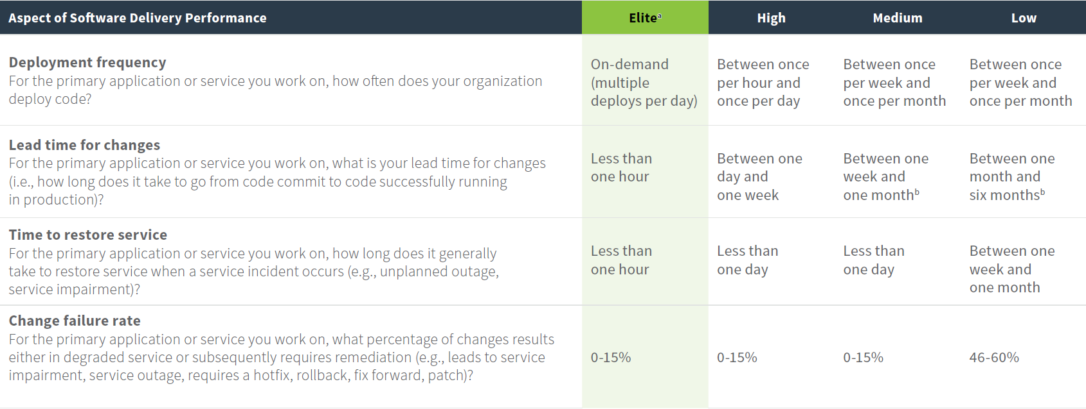
Why should I care?
Waterfall, Lean, Agile, whatever …
https://cloudplatformonline.com/rs/248-TPC-286/images/DORA-State%20of%20DevOps.pdf

Slide 6
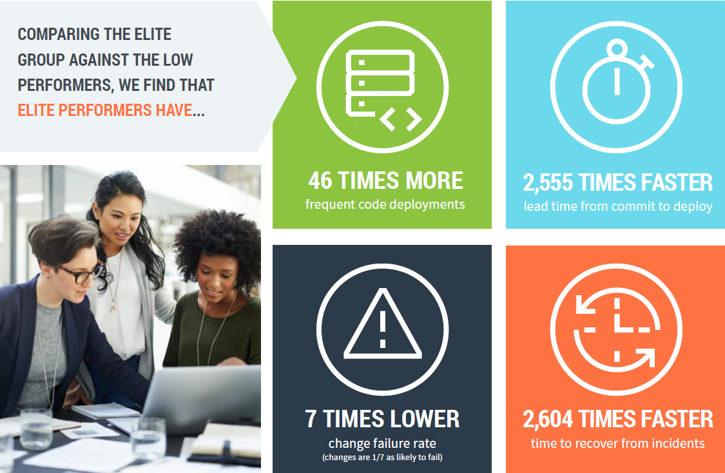
Why be a high performer?
Your mandate / Departmental Plan
Delivering better services
Digital Operations Strategic Plan
Availability
Increased reliability on IT
https://cloudplatformonline.com/rs/248-TPC-286/images/DORA-State%20of%20DevOps.pdf

Slide 7
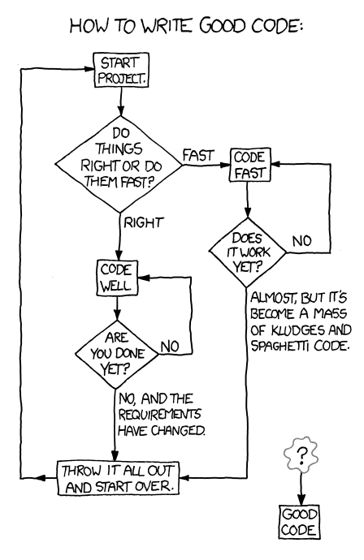

How?
Everyone
Feedback Loops
REDUCE WIP (Work in progress)
Set Max Number of items
Reduce context switching
Managers
Shift Left
TEAMS From start to finish
Option 2 for Big Orgs
Non-management
Forgiveness > Permission
Feedback Loops
Stop starting, start finishing

Slide 8

What’s next?
REPORTS
DORA - State of DevOps
Puppet – State of DEVOPS
BOOKS
The DevOps Handbook
The Phoenix Project
Courses
DevOps Culture and Mindset
… MORE
Follow
@devops_research
@puppetize

