Slide 1


Deep2Neuron Tech Academy
Internship 2023
Convolutional Neural Networks
A. CHINRAJ
July 1, 2023

Slide 2
Contents
Neural Networks
Convolutional Neural Networks
Convolutional Layer
Activation Layer
Pooling Layer
Flattening
Fully Connected Layer
Backpropagation
Pretrained Model
CNN Models
Applications
RNN vs LSTM
References

Slide 3
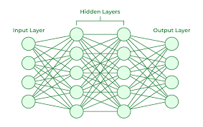


Neural Networks
Artificial systems inspired by biological neural networks
Recognize underlying relationships in a dataset
Deep Learning
Layers: Input layer, Hidden layers, Output layer

Slide 4
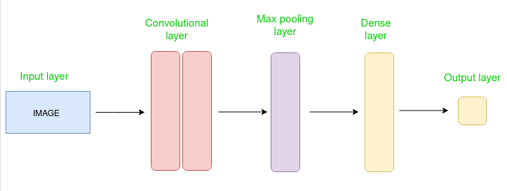
Convolutional Neural Networks
Deep learning algorithm
Designed for analyzing visual data
Capture local pattern and spatial dependencies within data
Building blocks : Convolutional layers – extract features

Slide 5
Convolutional Layer
Extract features from the dataset
Applies set of learnable filters – kernels
Filters – usually smaller matrices of 2x2, 3x3, or 5x5 shape
Slide over input layer
Dot product between kernel weight and corresponding input image patch
Output – Feature maps
Let convolutional layer have 12 filters then,
Output volume dimension : 32x32x12

Slide 6
Activation Layer
Activation function
Add non-linearity to the network
Common - ReLU: max(0,x)
Tanh
Leaky ReLU
Allow network to learn complex representations
Volume remains unchanged

Slide 7
Pooling Layer
Periodically inserted in the covnets
Main function : Reduce volume size
Make computation fast, prevent overfitting
Common types
Max Pooling
Average Pooling
Let max pool with 2x2 filters and stride 2,
Resultant volume dimension: 16x16x2

Slide 8
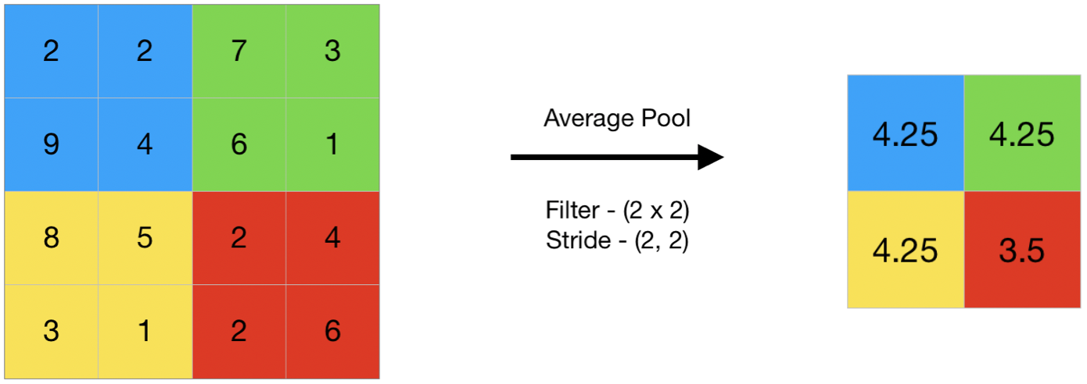
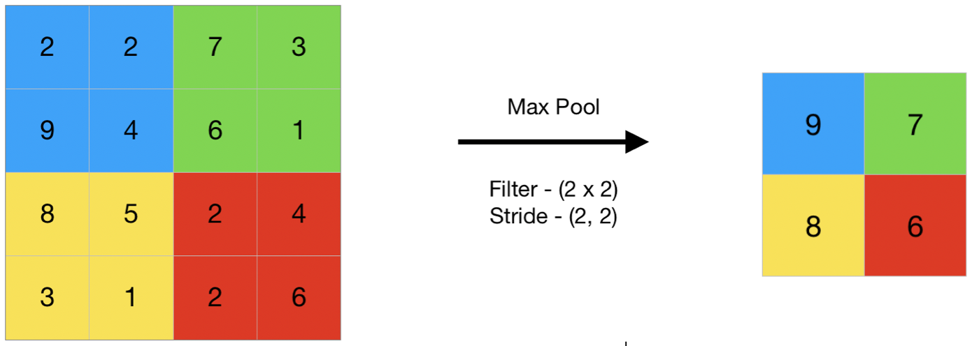

Slide 9
Flattening
Resulting feature maps are flattened
One-dimensional vector after convolution and pooling
As it can be passed to completely linked layer
For categorization or regression

Slide 10
Fully Connected Layer
Connect every neuron of one layer to
Every neuron in the next layer
Used for classification and regression tasks
Providing high-level reasoning,
Based on the extracted features

Slide 11



Input
Convolution

Slide 12
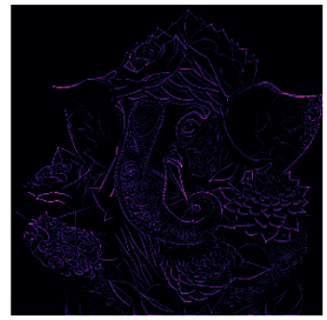
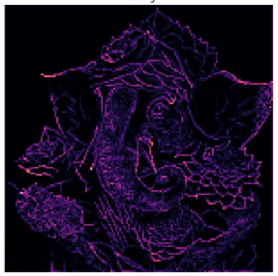
Activation
Pooling

Slide 13
Backpropagation
Used for training CNN
Adjusting weights of network,
based on the computed error or loss
Gradient of loss function is calculated,
w.r.t. network parameters
Weight updated using optimization algorithm
like SGD or its variants

Slide 14
Pretrained Models
Widely available and trained on large scale datasets,
such as ImageNet
Learned rich feature representations
Used as starting point for various computer tasks
Common technique – Transfer Learning
where pretrained model are fine-turned on
specific tasks with smaller labeled dataset

Slide 15
CNN Models
VGG
Xception
ResNet
DenseNet
InceptionV3
InceptionResnet
MobileNet
NasNet
EfficientNet
ConvNeXt

Slide 16
Applications
Image Classification
Object Detection
Sematic Segmentation
Image Generation
Video Analysis

Slide 17
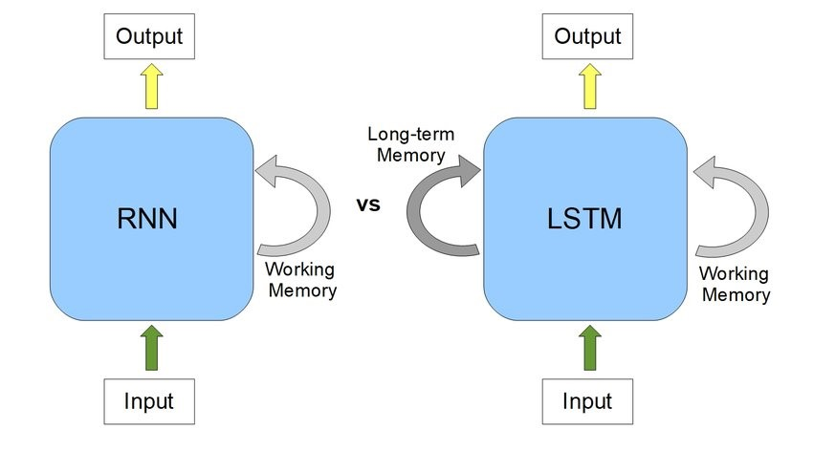
RNN vs LSTM

Slide 18

RNN vs LSTM
Recurrent Neural Network | Long Short-Term Memory
Basic RNN consists of single recurrent layer. | Recurrent layer with additional memory cells and gates.
Difficult to capture long term dependencies. | Memory cell allow the network to capture dependencies over longer time horizons.
Effective in processing short-term or immediate dependencies in linear data. | Effective for modeling and predicting sequences with long-range dependencies.
Training RNNs is relatively simpler than training LSTMs. | LSTMs are more complex than basic RNNs due to their additional components.
Suffer from vanishing gradient problem. | Overcome the vanishing gradient problem.

Slide 19
References
https://www.ibm.com/topics/neural-networks
https://news.mit.edu/2017/explained-neural-networks-deep-learning-0414
https://www.ibm.com/topics/convolutional-neural-networks
https://www.geeksforgeeks.org/introduction-convolution-neural-network/
https://www.techopedia.com/definition/22541/text-processing
https://www.datarobot.com/blog/text-processing-what-why-and-how/
https://www.geeksforgeeks.org/introduction-to-recurrent-neural-network/
https//machinelearningmastery.com/an-introduction-to-recurrent-neural-networks-and-the-math-that-powers-them/

Slide 20
Thank you

