Slide 1
B.TECH PROJECT-II
By
Chinta Krishna Mourya
Roll No. 17NA10011
Under the guidance of
Prof. Mohammed Rabius Sunny
Department of Aerospace Engineering
Indian Institute of Technology Kharagpur

Slide 2
Crack depth prediction of Abaqus model by Machine Learning tools

Slide 3
Introduction
In this work, I have developed a machine learning computational framework to determine and identify crack depth of an Abaqus model based on the results of the strain when crack was formed.
I’ve created single crack and multiple cracks at a time and collected the strain values.
The presentation tells about data acquisition and learning processes.

Slide 4
FlowChart
Preprocessed Data from Abaqus Analysis
Post Processed data with required features
Random Forest Regression &
Linear Regression
Resuts

Slide 5
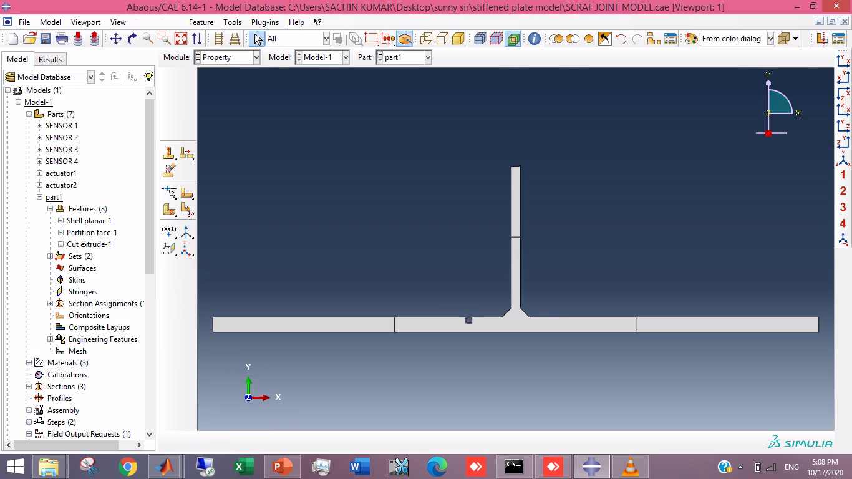
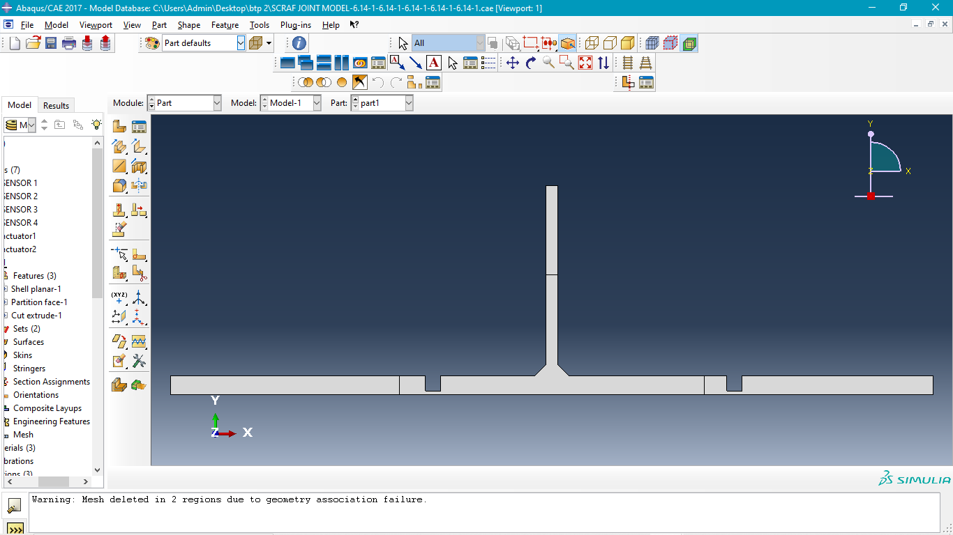
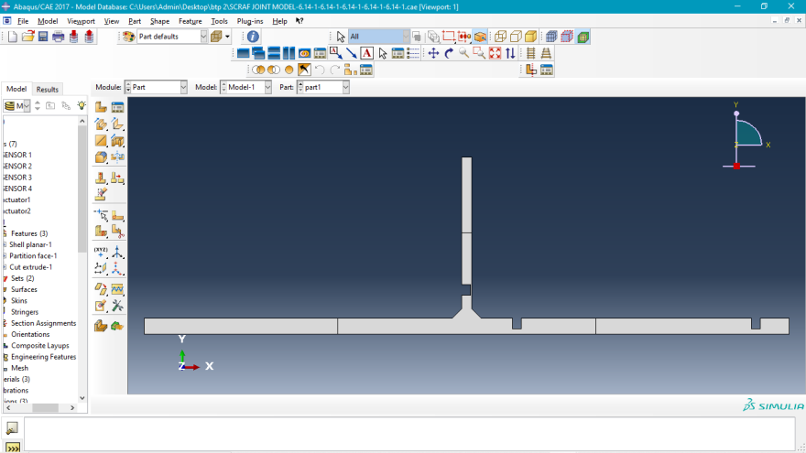
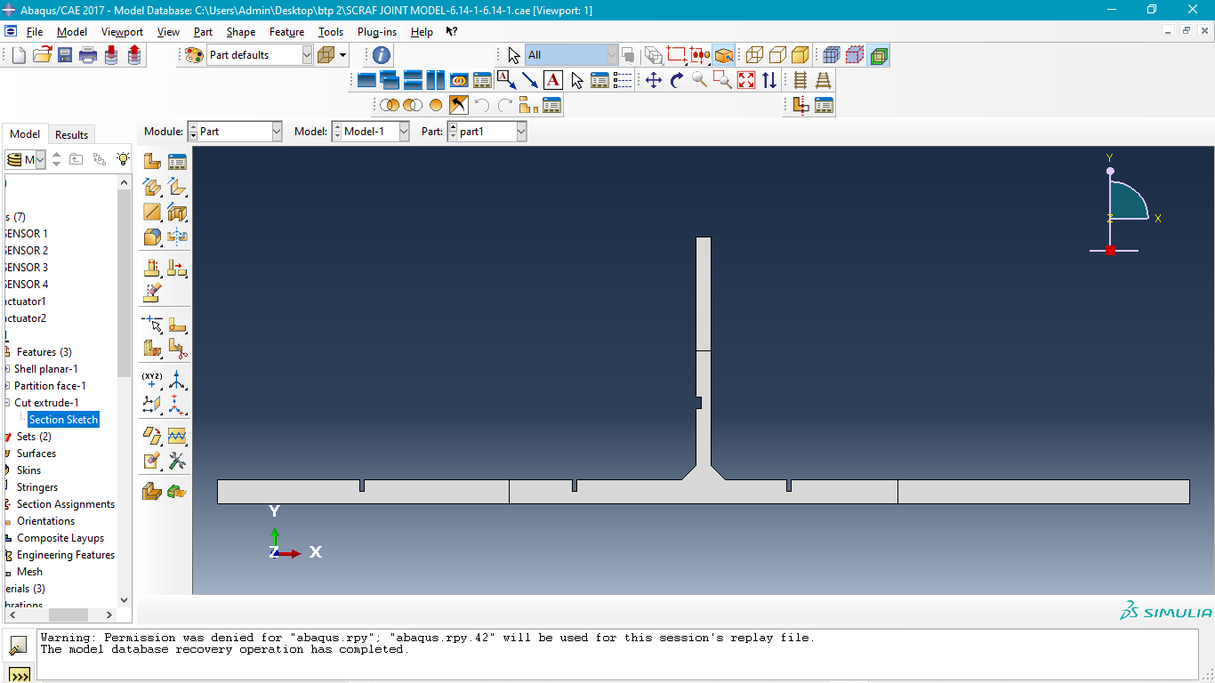
Crack
The dataset collected from abaqus analysis gives the strain of the model as electric potential values and simulation time for a particular depth.
This output from abaqus is input for training the machine learning model to predict the crack depth.

Slide 6
Random Forest Regression:
Regression analysis consists of a set of machine learning methods that allow us to predict a continuous outcome variable (y) based on the value of one or multiple predictor variables (x).
Random Forest?
Random forest is a way of averaging multiple deep decision trees, trained on different parts of the same training set, with the goal of overcoming over-fitting problem of individual decision tree. In other words, random forests are an ensemble learning method for classification and regression that operate by constructing a lot of decision trees at training time and outputting the class that is the mode of the classes output by individual trees.

Slide 7
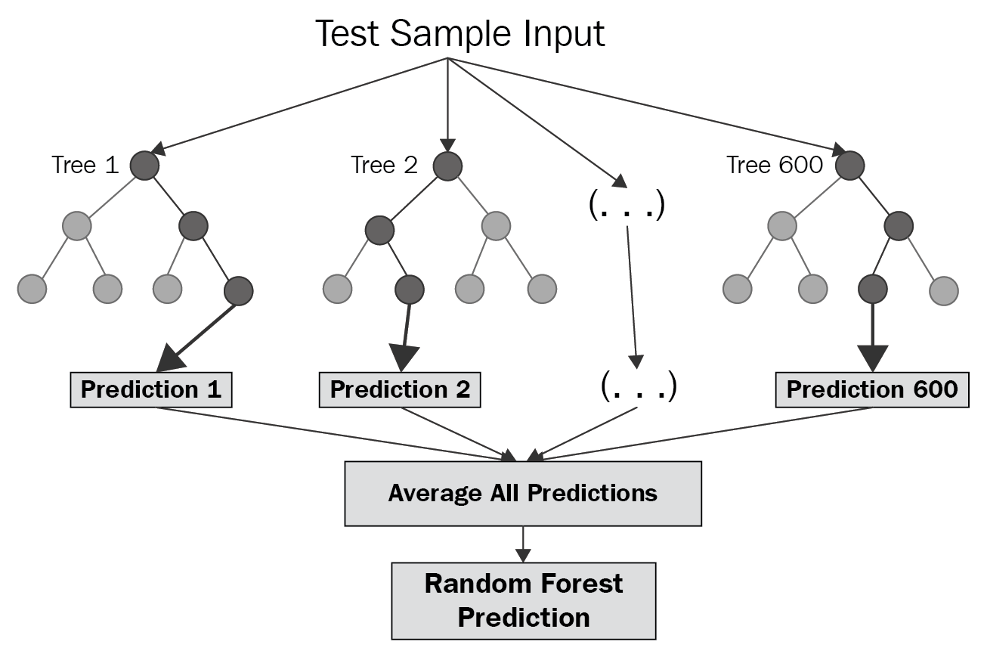
'Random' refers to mainly two process - 1. random observations to grow each tree and 2. random variables selected for splitting at each node
RANDOM FOREST SIMPLIFIED

Slide 8
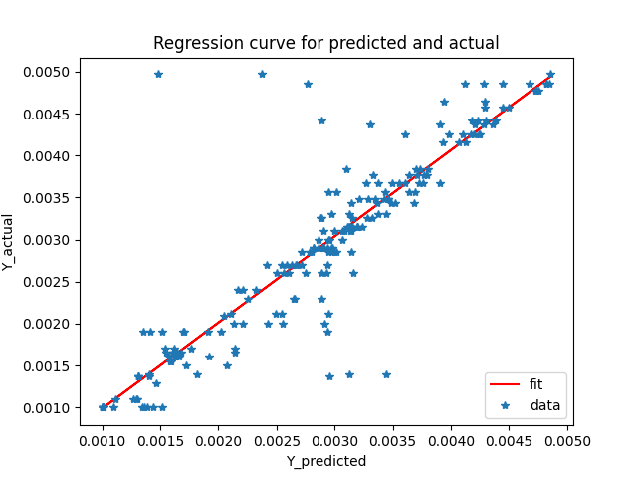
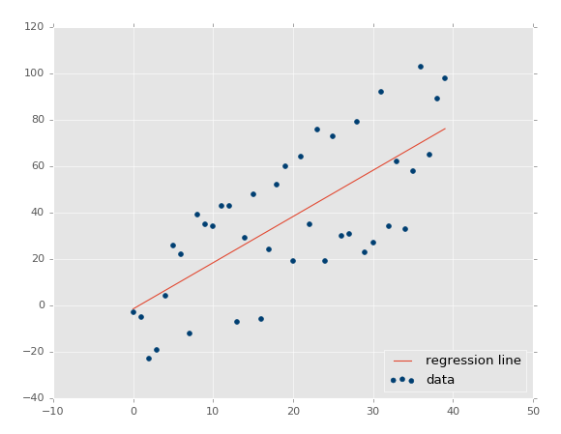
Linear Regression :
Linear regression performs the task to predict a dependent variable value (y) based on a given independent variable (x). So, this regression technique finds out a linear relationship between x (input) and y(output). Hence, the name is Linear Regression. If we plot the independent variable (x) on the x-axis and dependent variable (y) on the y-axis, linear regression gives us a straight line that best fits the data points, as shown in the figure below.

Slide 9
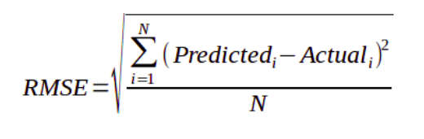
Model Prediction Error: RMSE(Root Mean Squared Error)
popular metrics for comparing regression models : A good measure of how accurately the model predicts the response
measures the model prediction error.
RMSE is an absolute measure of fit.
Lower values of RMSE indicate better fit.
For a wide set of values RMSE is defined as follows:

Slide 10
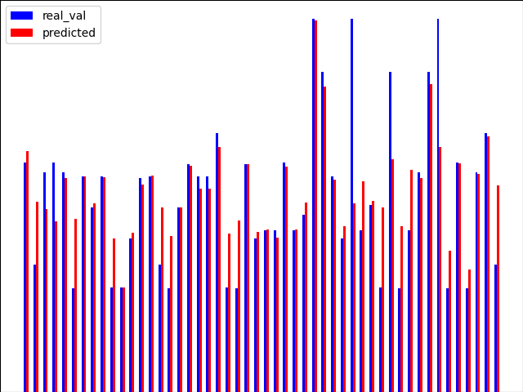
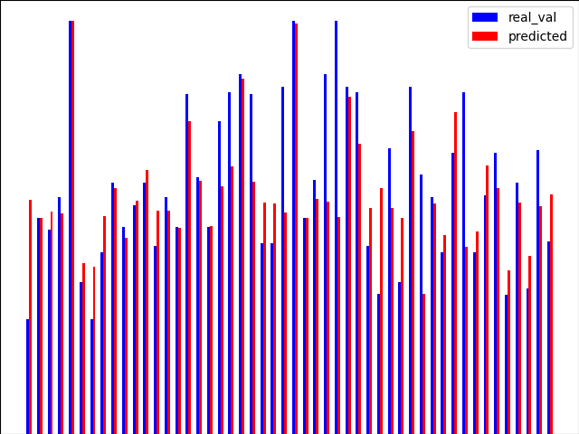
Results
The Graphs shows comparison between Real depths (blue) and
predicted depths(red) of testing set (various datasets) in training the
model by the RANDOM FOREST and RMS errors as follows
Datasets = 25 &
RMS error= 0.0007631
Datasets 49 &
RMSE = 0.0007195

Slide 11
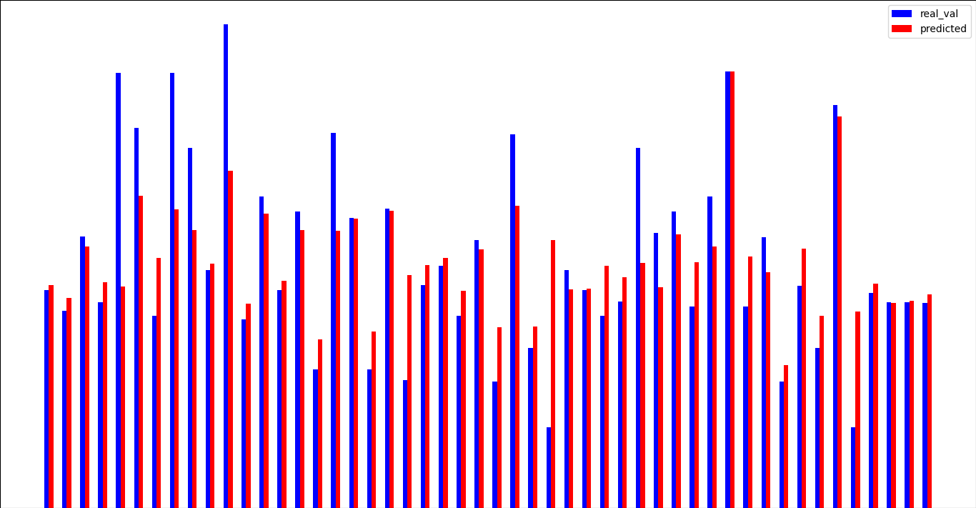
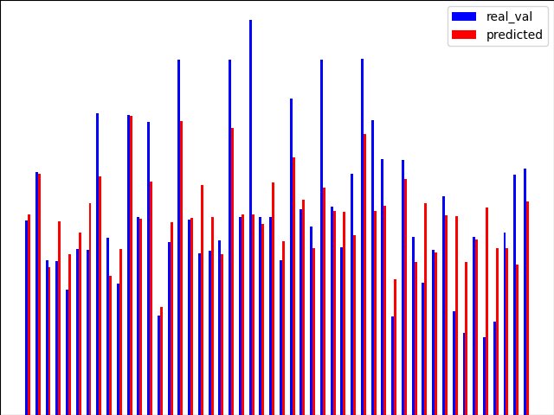
Datasets 73 &
RMSE = 0.0007543
Datasets 97 &
RMSE = 0.0007535

Slide 12
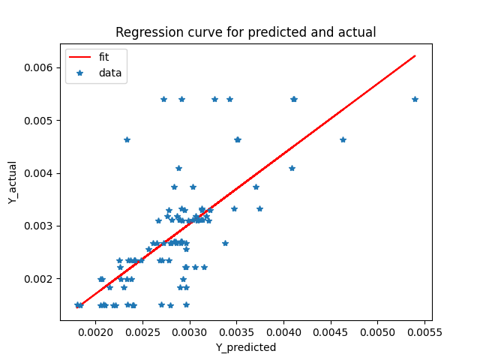
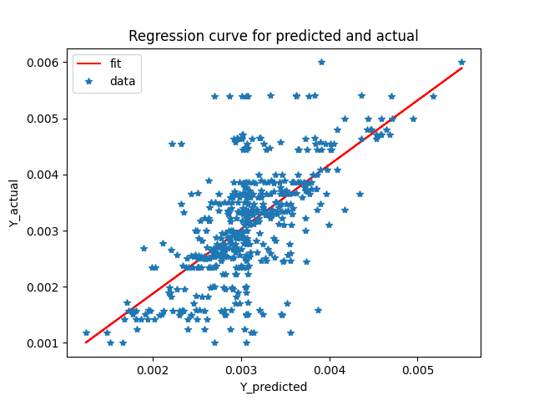
The plots are drawn Linear Regression algorithm :
Accuracy when trained with 25 datasets
Accuracy when trained with 97 datasets

Slide 13
Conclusion
In this study, we applied machine learning techniques to solve an inverse engineering problem of identification of the depth strain distributions.
The prediction on the depth of the crack is not necessarily from the training data, after studying the training data, the machine learning algorithm can automatically use interpolation to find the applied load location that is not in the train data. This is to say that we only need to train algorithm with a limited number of loading sets.
We can see in the plots clearly that increase in the datasets, increase in the accuracy.To obtain more accuracy, more data should be collected. The higher the density of the training data, the higher the predicted accuracy.

Slide 14
Thank You

